Slide 1
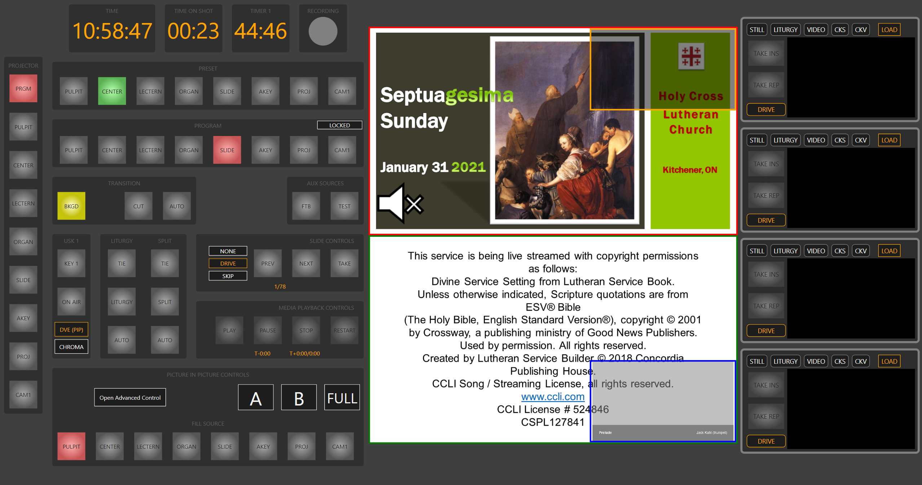
‘X’ Show/ Hide
‘F5’ - Start
‘F6’ - Stop
‘Z’ +
‘O’ Show/Hide
‘~’
‘1’
‘2’
‘3’
‘4’
‘5’
‘6’
‘7’
‘8’
‘1’
‘LShift’ +
‘LShift’
‘1’
‘2’
‘3’
‘4’
‘5’
‘6’
‘7’
‘8’
‘2’
‘3’
NP ‘0’
‘B’
‘C’
‘Space’
‘M’
‘Enter’
‘4’
NP ‘.’
NP ‘8’
NP ‘9’
‘Left’
‘T’
‘5’
‘R Ctrl’
‘Right’
‘R Shift’
‘6’
NP ‘4’
NP ‘5’
NP ‘6’
NP ‘1’
NP ‘2’
NP ‘3’
‘7’
‘8’
‘P’ Show/Hide
NP ‘/’
NP ‘*’
NP ‘-’
‘L’
‘LCtrl’ +
‘1’
‘2’
‘3’
‘4’
‘5’
‘6’
‘7’
‘8’

