Slide 1

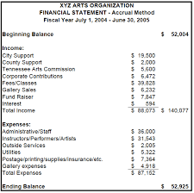


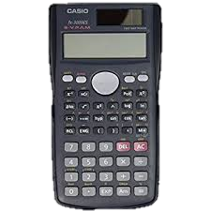
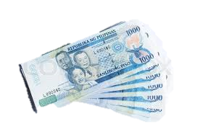
ACCOUNTANCY AND BUSINESS MANAGEMENT
A
B
M

Slide 2
WHAT IS ABM?

Slide 3
A
B
M
ASPIRE
BIG
MOMENTS

Slide 4
The ABM strand is designed to TRAIN students with managerial, numeracy and literacy skills necessary to meet the competencies and demands of globally competitive entrepreneurship.

Slide 5

WHY SHOULD YOU CHOOSE THIS STRAND?

Slide 6

5 reasons WHY ABM STRAND ROCKS!

Slide 7

1. A ticket to the corporate world.
Applied Economics, Business Ethics, Accountancy, Business Math and Principles of Accounting

Slide 8




2. ENHANCES SKILLS!

Slide 9

3. FAREWELL TO THIS SUBJECT!
LESS MATH!
HOORAY!

Slide 10
4. IT’S NOT ABOUT THE MONEY.

Slide 11
5. YOU DON’T HAVE TO BE JIMMY NEUTRON.

Slide 12
Bachelor of Science in Accountancy
Bachelor of Science in Accounting Technology
Bachelor of Science in Business Administration
Bachelor of Science in Accounting Informations System
Bachelor of Science in Office Administration
Bachelor of Science in Office Management
Bachelor of Science in Office System Management
Bachelor of Science in Business Management
Bachelor of Science in Customs Administration
Bachelor of Science in Business Economics
Bachelor of Science in Finance
Bachelor of Science in Financial Management
Bachelor of Science in Entrepreneurship
Bachelor of Science in Legal Management
Bachelor of science in Internal auditing
Bachelor of Science in Commerce
Bachelor of Science in Tourism Management
Bachelor of Science in Tourism
Bachelor of Science in Travel Management
Bachelor of Science in Culinary Management
Bachelor of Science in Hotel and Restaurant Management

Slide 13
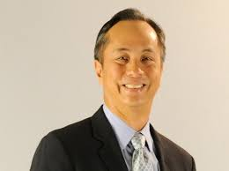
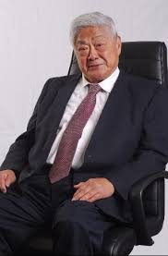
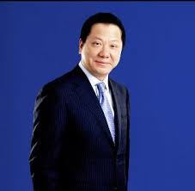
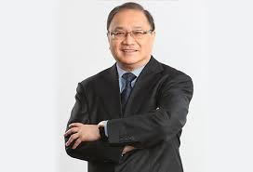
ABM PRODIGY!
EUGENIO LOPEZ III
JOHN GOKONGWEI
ANDREW TAN
MANUEL V. PANGILINAN
Owner of ABS- CBN Corporation
Studied Masters of Business Administration in Harvard Business School
Owner of Cebu Pacific, and Robinsons Land Corporation
Studied Masters degree in Business Administration in De La Salle University
Owner of the franchise of McDonalds in the Philippines
Studied Accounting in the University of the East
Owner of PLDT, TV5, and MERALCO
Studied Bachelor of Arts in Economics in Ateneo de Manila University

Slide 14

TAKE THE RISK
BE A LEADER
BE AN ABM LEARNER!

