Slide 1
BlackJack mini Console game
Python mini project

Slide 2
Libraries/Packages/module Used
Pytest – pytest is a unittesting framework
time – time is a python module, used it for sleeping/delaying the program
random – this is a python module as well, used it for shuffling the deck of cards

Slide 3
How the game is played?
In Blackjack, players bet against the dealer, trying to get a hand total as close to 21 as possible without going over
Card values are face value for numbered cards, 10 for face cards (J, Q, K), and 1 or 11 for an Ace.
Players receive two cards and decide to "hit" (take another card) or "stand" (keep their current hand).

Slide 4
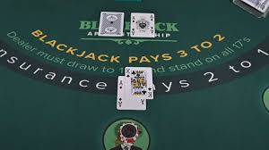
Initial cards

Slide 5
How wins are determined?
There are 3 possible ways to end the game:
Player keeps on hitting until they bust (Computer/Dealer wins!)
Computer keeps hitting until they bust(Player wins!)
Computer keeps hitting until it goes over the players total sum but less than 21 (Computer wins!)

Slide 6
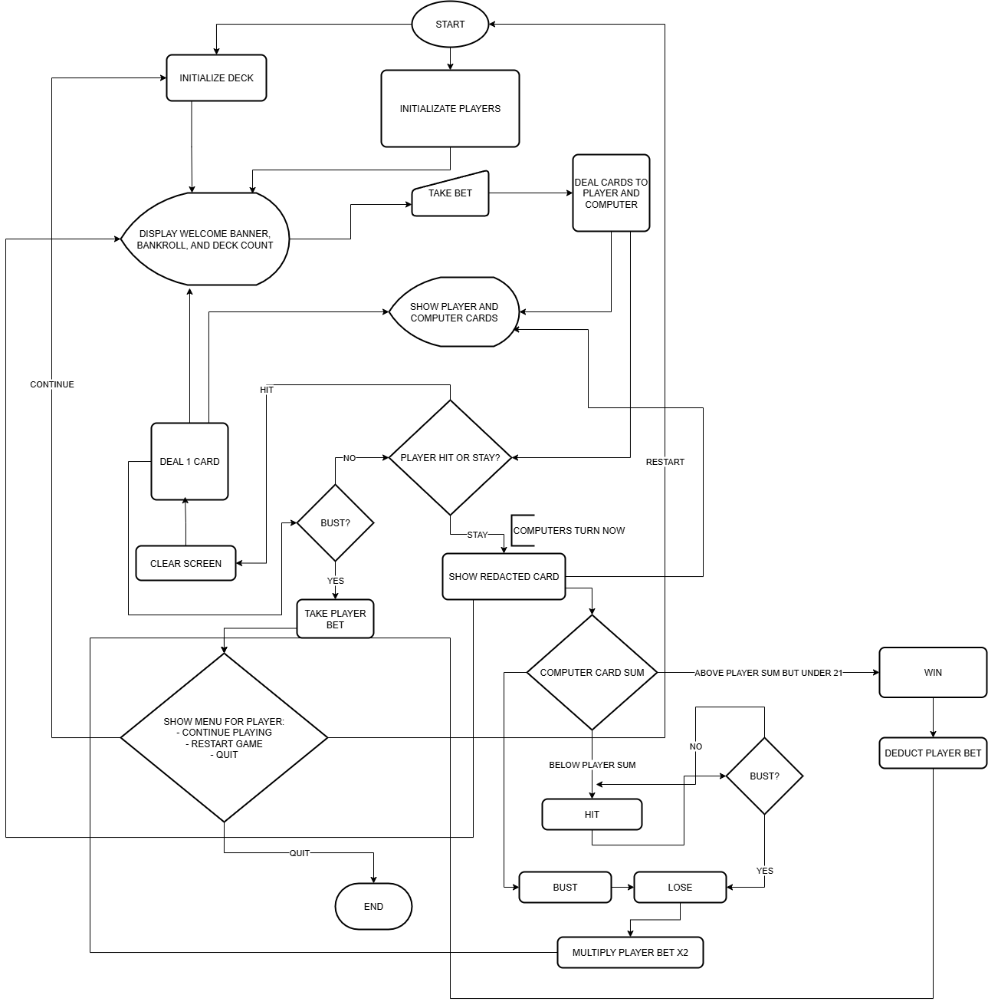

Slide 7
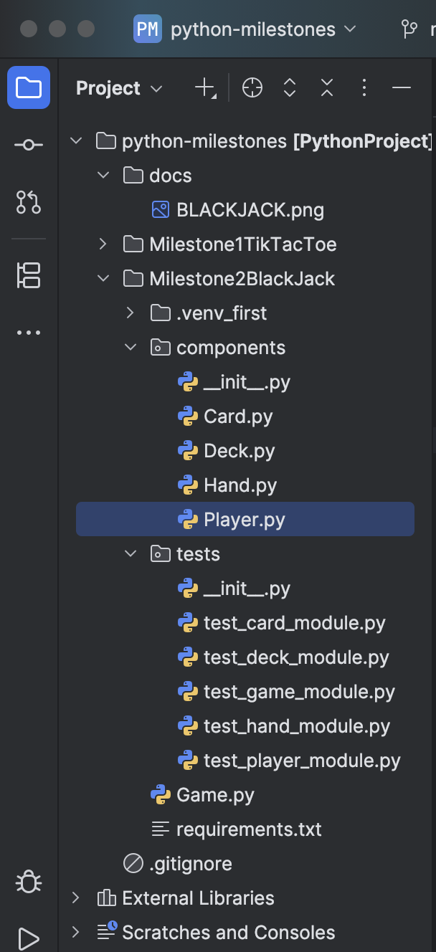
Project files

Slide 8
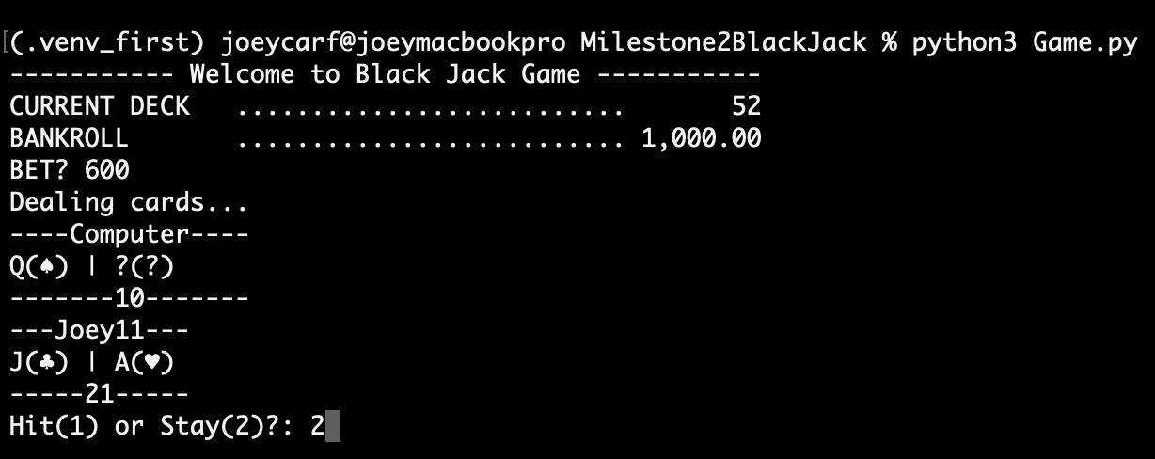
Computer busts

Slide 9
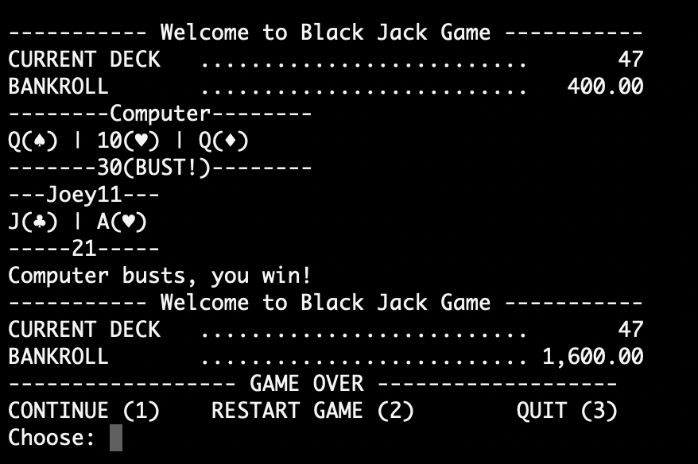
Computer will hit automatically after the 2nd card was shown since it’s only a total of 20 but the 3rd card is queen so computer busts

Slide 10
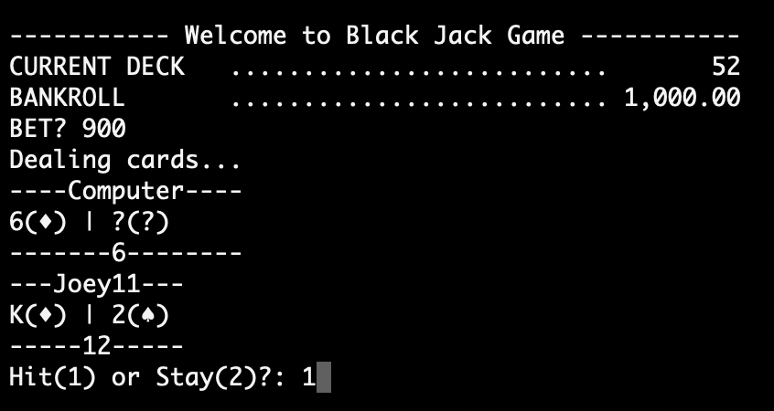
Player keeps hitting

Slide 11
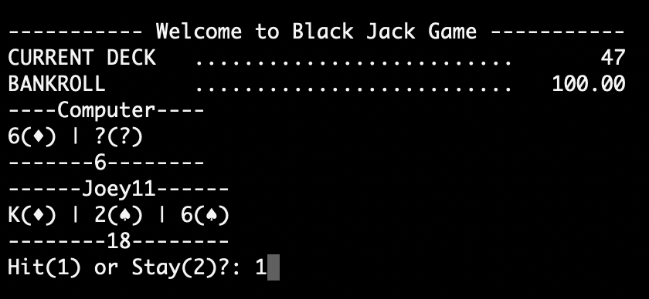
Player given 1 more card

Slide 12
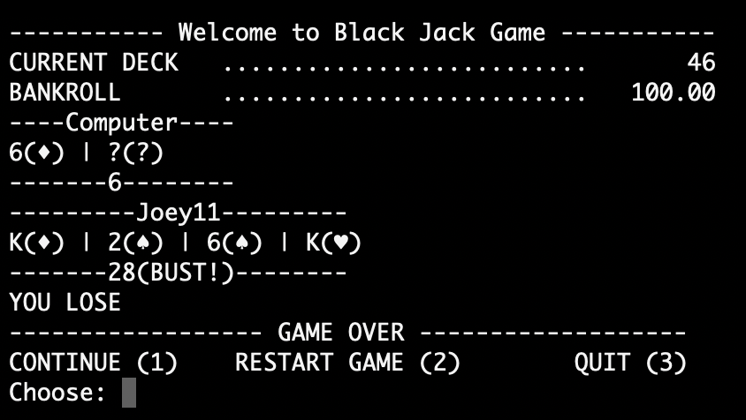
Eventually player exceeds 21 and busts

Slide 13
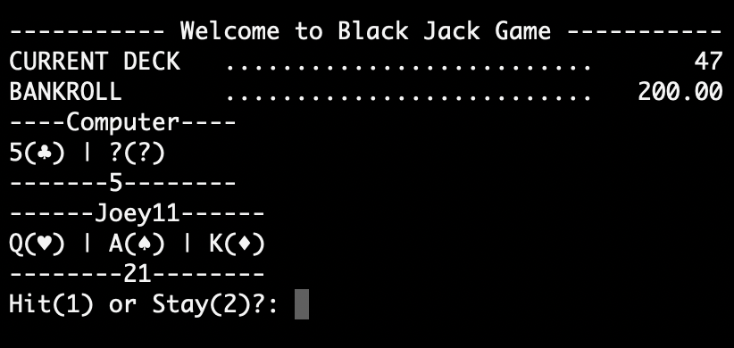
Ace value adjusts depending on which ever is favorable to player

Slide 14
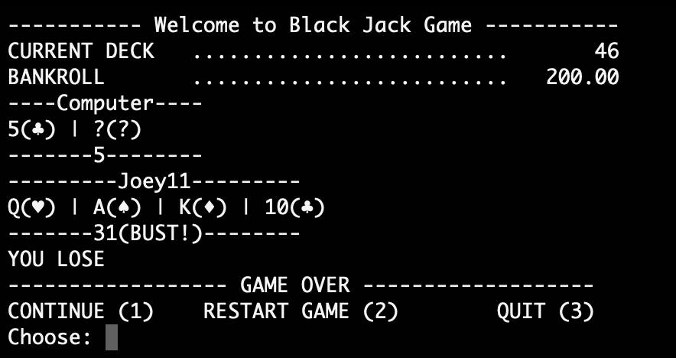
Decided to hit still and finally busts

Slide 15
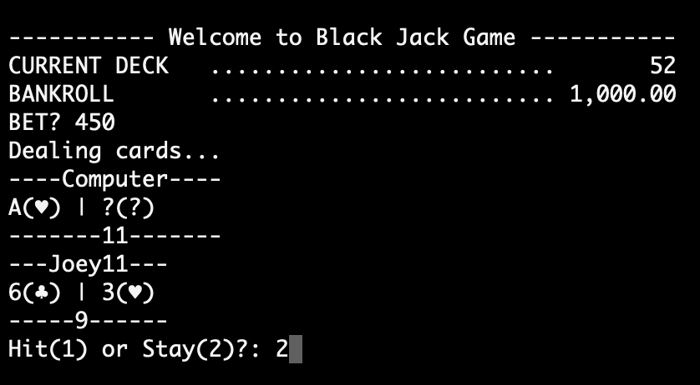
Computer beats the player’s sum but still less than 21

Slide 16
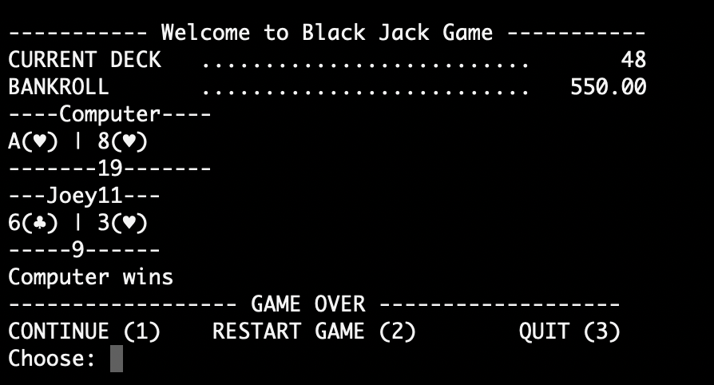
Computer’s 2nd card opens and total is higher than player’s and less than 21 so that constitutes a win!

Slide 17
Start of DEMO
End of presentation

