Slide 1
Decision Log Monitor Review
By Carl Gardiner

Slide 2
Decision Logs
As part of the Software Development Life Cycle (SDLC) at our organisation, we periodically make strategic decisions that significantly influence the behaviour, infrastructure, maintenance, development, and security of our software systems.
Due to changing requirements and contexts, reasons that previous decisions were made are often out of date or no longer aligned with the organisation’s broader strategy and goals.

Slide 3
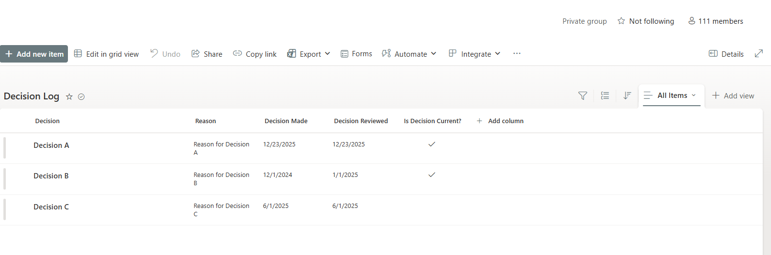
SharePoint List of Decision Logs
Notes:
Here is a mock up of how we store our decision logs at our organisation: With the decision, the reason for the decision, when it was initially made, when it was reviewed and if it is currently in effect.

Slide 4
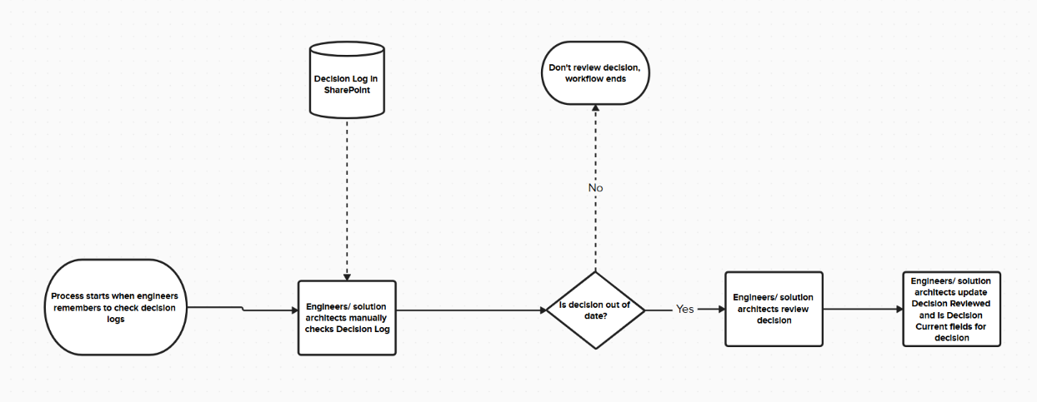
Initial Activity Flow Diagram

Slide 5
The Problem
Decisions are often not reviewed regularly due to other work taking up the time of engineers or solution architects
Decision reviews require the engineers or solution architects to manually check the decision logs to see which decisions are out of date, and there is no agreed upon timeframe for what is considered ‘out-of-date’

Slide 6
Requirements Gathering - Chief Technical Officer
“We want to ensure that our technical decisions line up with our goals directly. We also want to be an organisation that is looking towards the future and need to be attentive to what larger tech companies are doing so we do not get left behind technically.”

Slide 7
Requirements Gathering - Senior Engineer
“Decisions made by previous engineers or solution architects often leave me baffled and lead to technical debt. Knowing when to review decisions and reviewing them periodically could help prevent this.”

Slide 8
Requirements Gathering - Engineer
“I want to work with modern technology and more elegant solutions. Sometimes decisions made previously can lead to new features being really hard to implement, whereas if decisions were reviewed simpler solutions could be found.”

Slide 9
Requirements Gathering - Solution Architect
“Because of how often the cloud computing space (especially Azure, in our case) changes, it would be good if we could review decisions made previously. Often, new Azure products have better performance, features or security, and using these new products instead of continuing with old ones could reduce technical debt.”

Slide 10
Requirements Gathering - Solution Engagement Manager
“Sometimes I have to tell customers that a specific feature cannot be implemented for technical reasons. I’m told this is because of legacy software in most of these cases. I would like to be able to tell customers that a feature CAN be implemented, instead of frustrating them.”

Slide 11
Requirements Gathered for more consistent Reviewing Of Decision Logs
Keeping up with industry trends
Use of more advanced technologies in development and production
Preventing startups overtaking us by using more advanced technologies
Removing technical debt from longstanding, badly understood decisions
Providing more features for customers as a result of removing unnecessary technical debt

Slide 12
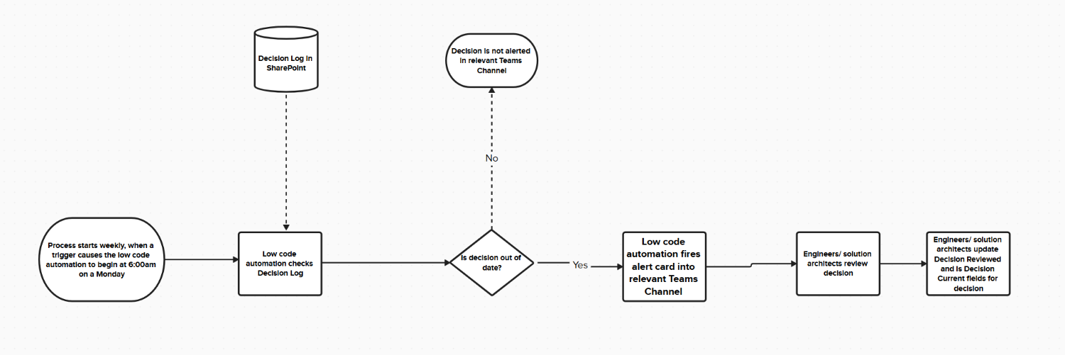
Proposed Activity Flow Diagram

Slide 13
Functionality
The system must be able to access Microsoft Teams for the organisation and interact with it in order to post alerts
The system should send alerts to the relevant Teams Channel if a decision has not been reviewed in 180 days (due to small team sizes and to prevent overload) or more and the decision is still in effect
The system must be able to read all the SharePoint Lists for decision logs so that each decision can be evaluated
This alerting should happen once a week, on a Monday morning
Unreviewed decisions should alert repeatedly, week-by-week, to ensure they are eventually reviewed

Slide 14
Usability
The alert should follow the WCAG (Web Content Accessibility Guidelines) 2 standard as closely as possible, with the text being well contrasted (Guideline 1.4.1, 1.4.3), links being understandable from their text (Guideline 2.4.4), with a large enough font size (Guideline 1.4.4)
The alert should show the information about the particular decision that is out of date
A clickable link should be on the alert, to send the user to the particular SharePoint List the decision is in, so the user can review it in depth and edit once the review has been carried out
Does not need to work on mobile screens
Intuitive UI, with the clickable link to the SharePoint List being obviously a link

Slide 15
Reliability
The alerting should fire off every Monday morning, without fail. In the event of a failure (such as credentials going out of date), the alert should instead explain that there was a failure of the system so an engineer can fix it
Only authorised personnel should be able to access the SharePoint Lists containing decision logs and change information about the decisions

Slide 16
Performance
Most employees start work at 9:00 AM, so even if the system needs to access multiple SharePoint lists, process all decisions, and post cards and messages to Teams channels, it only needs to complete within 3 hours (between 6:00 and 9:00 AM)
During testing on a single SharePoint List, the alert must be posted within 15 seconds of starting the test, to ensure scalability

Slide 17
Supportability
The alerting should be able to be expanded to more SharePoint Lists using parameterisation of SharePoint List links and iteration on these lists
Almost impossible for decision log lists to ever reach the maximum amount of records in a SharePoint List, which is currently 30 million
Version control should allow for rollback of versions of the service

Slide 18
Platform for Development
The platform chosen for development of the Decision Log Review Monitor is Microsoft Power Platform
Power Automate specifically will be the technology driving the automation solution

Slide 19
Functionality Reasons for Using Power Platform
Microsoft Power Automate has native connectors for both Microsoft Teams and SharePoint Lists, allowing for ease of development
My organisation already has access to Power Automate for everyone in the company through Microsoft 365 for Enterprise accounts, with a ‘Personal Productivity’ environment set up for developing this sort of application, and other environments set up for production use
Easy ‘drag-and-drop’ interface, with the ability to code the date time checks quite easily and modify alerts using variables

Slide 20
Security Reasons for Using Power Platform
Role-Based Access Control is already set up for each environment, preventing malicious actors from getting access to workflows
Microsoft Entra ID is used to ensure SharePoint permissions on connectors are role-based, and Teams connections are done via Entra ID Groups, preventing unauthorised actions in the workflow
Ease of use of credentials for connectors based on the above
Although not Power Platform itself, Role-Based Access Control is used when viewing the Teams Channel or SharePoint List, adding another layer of security

Slide 21
Cost Reasons for Using Power Platform
Microsoft 365 user accounts are already being used at my organisation, therefore any other platform would be financial overhead above and beyond this
Most other platforms, such as KNIME Analytics Platform or Mendix do not directly quote prices for enterprise, but can be assumed to be £1000 a head per year based on lower prices
In an organisation of over 500 developers, this would be estimated at £500,000 per year, a significant price to pay

Slide 22
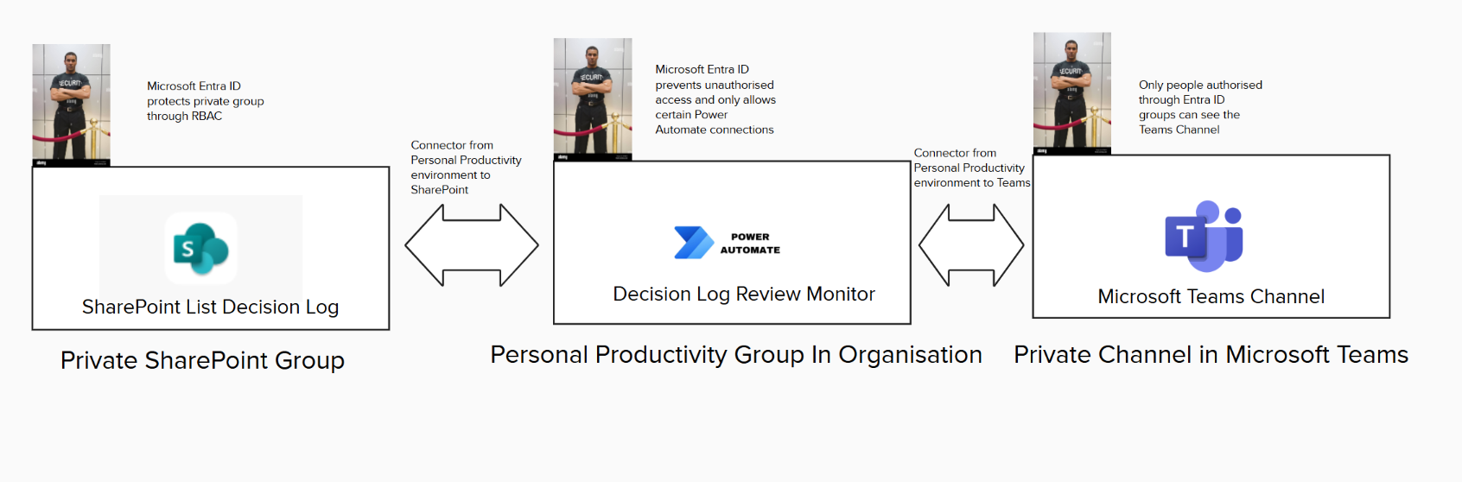
Diagram of Connections

Slide 23
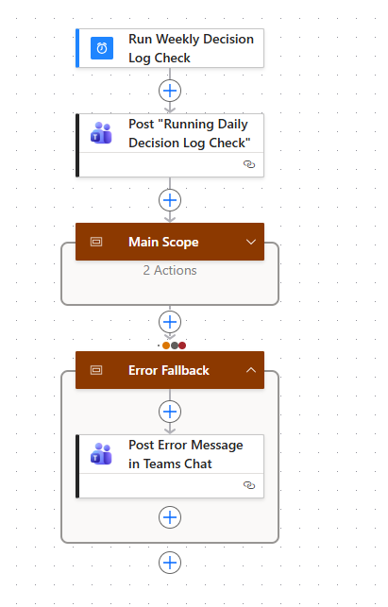

Slide 24
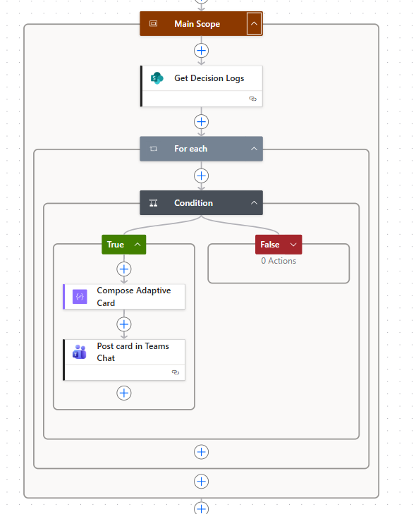

Slide 25
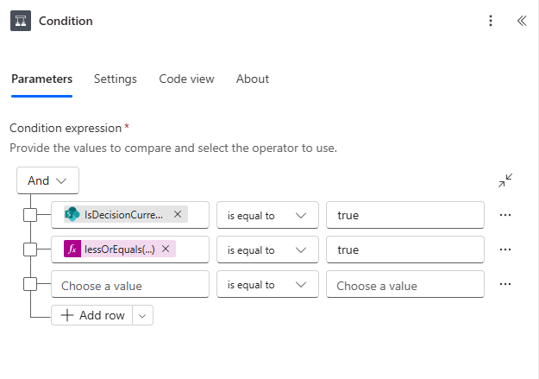


Slide 26
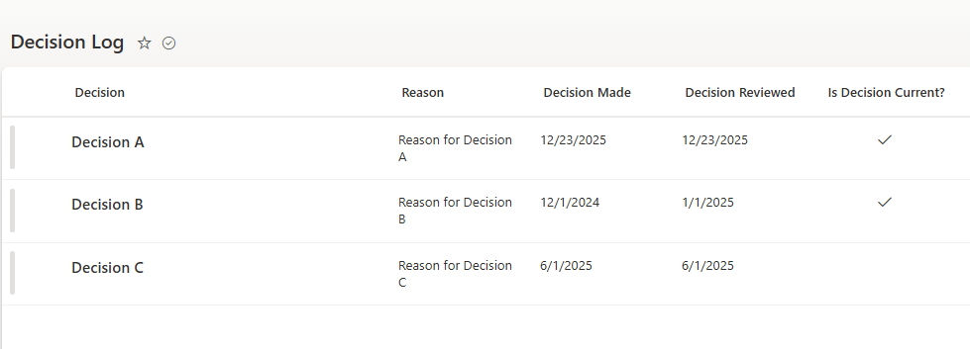
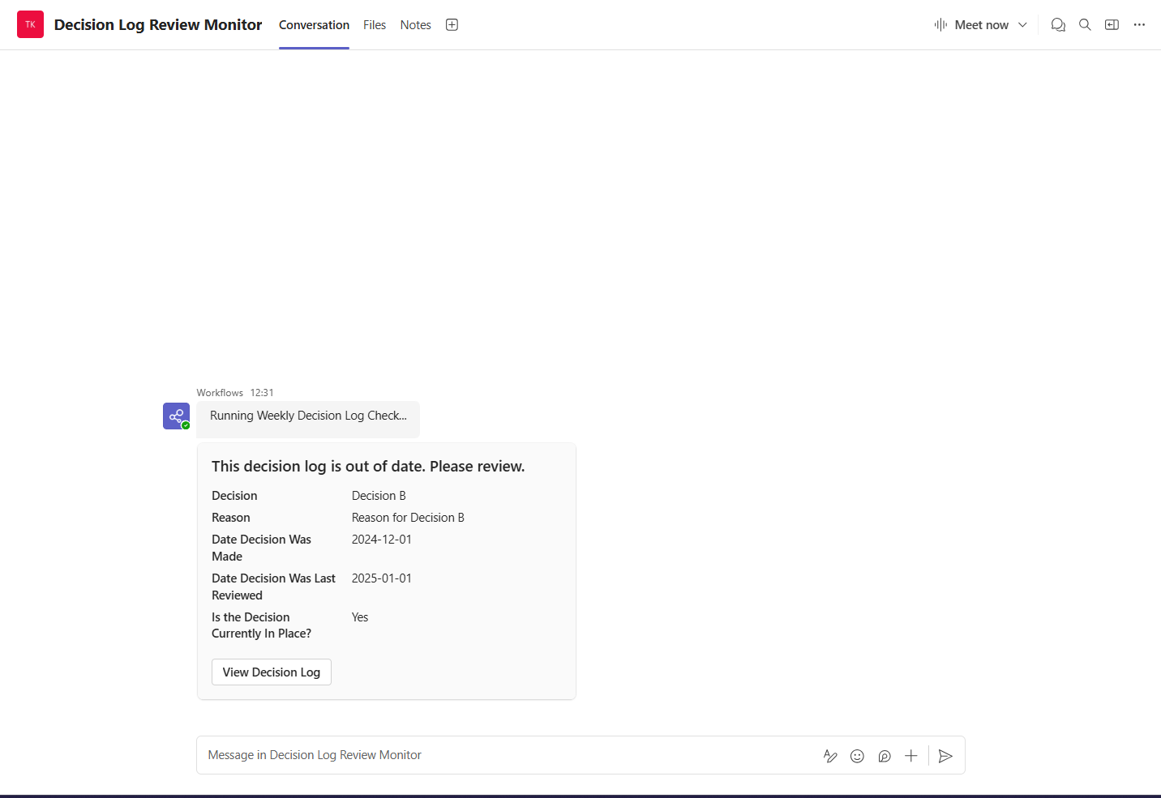
Show Functionality Proof
Notes:
This was based on a test run, hence the 12:31 timing. Only the out of date and current decision was alerted, the others were ignored

Slide 27
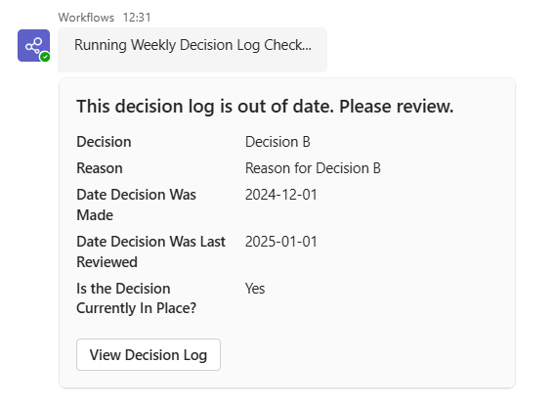
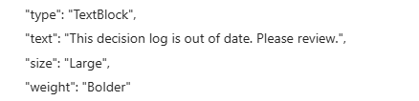
Show Usability Proof
High contrast black text on light grey background to conform to
WCAG 2 guideline 1.4.1 and 1.4.3
Large text to make it easier to see and conform to WCAG 2 1.4.4
‘View Decision Log’ shows what the link does. It also changes the cursor to a pointer and turns the button light grey when hovered over, conforming to WCAG 2 guideline 2.4.4 and making it intuitive for users

Slide 28
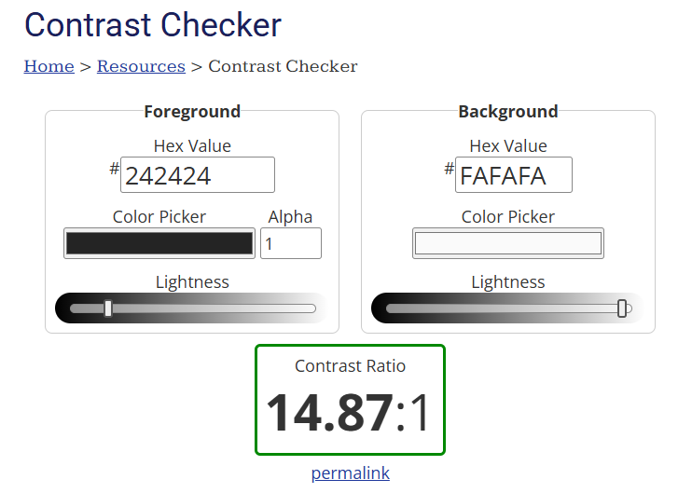
Notes:
Difference between the background and foreground colours used on the Microsoft Teams Card. Anything above 4.5:1 for normal text is compliant with WCAG

Slide 29
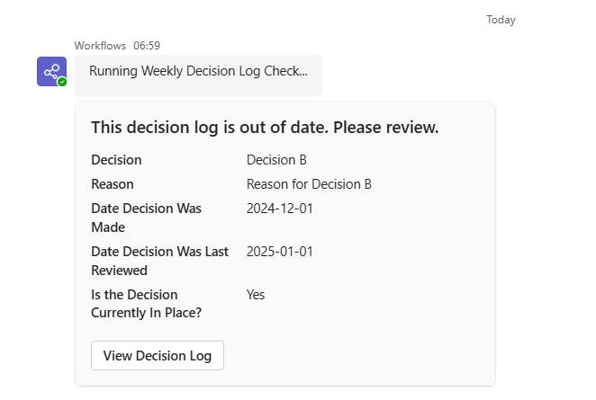
Show Reliability proof
Made on Monday. The reason for the 06:59 was due to backlog of other updates, and that there is no guarantee it will run immediately, unless using Premium Connectors
Still, as the runtime was very short, the given space of from 6:00am till 9:00am still works
Notes:
Made on Monday. The reason for the 06:59 was due to backlog of other updates, and that there is no guarantee it will run immediately, unless using Premium Connectors. Still, as the runtime was very short, the given space of from 6 till 9 still works.

Slide 30
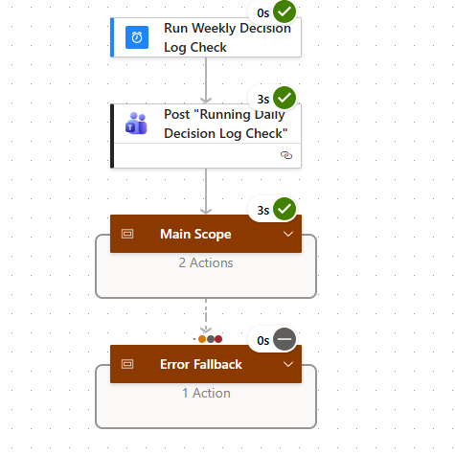
Show Performance proof
The performance criteria of running for a single list of 3 items in under 15 seconds is hit. This is shown using Power Automate’s Test flows.
The 3s time for both posting a message and running through the SharePoint List and posting a card to Teams indicates that the Main Scope’s largest slow downs are probably network related.
Therefore, in terms of scaling this is fine as it is unlikely there will be computational slowdown as there will never be millions of decisions to go through, and the 3-hour Monday morning window between 6am-9am could handle it anyway.

Slide 31
Show supportability proof
Credential refresh could be a problem, but hopefully the Error Fallback scope would help engineers identify the problem. Otherwise, Azure key vault or managed identities with auto refreshes can be used to refresh credentials, but this requires more setup/ cost
Easily supportable by having adding a ‘foreach’ loop to the outside of all the scopes, and parameterising for each particular SharePoint list decision log for each team

Slide 32
How this addresses the problem
This will address the problem of having to review decisions made over 180 days ago by automatically alerting into Teams Channels, and continuing to do so unless reviewed
Automated alerts will keep the amount of work to review decisions under control, instead of letting them pile up
Reduces the amount of manual work in checking, which has become a chore

Slide 33
How this Addresses Long Term Problems
Prevents our organisation being overtaken by other organisations using more modern technology, using more modern delivery methods or providing more features
Modern delivery: Blockbuster -> Netflix
Modern technology: MySpace -> Facebook
Modern features: Kodak -> Canon and Nikon
Notes:
Blockbuster was ousted as the delivery method became redundant in the age of streaming. MySpace failed to adapt to smartphones and mobile technology, so lost the largest social media from Netflix. Kodak refused to embrace digital photography, so lost out to Canon and Nikon.

Slide 34
Future Implementation
Currently only implemented on a test Teams Channel and a test SharePoint List
Using iteration in Power Automate, with a list of SharePoint Lists and Teams Channel combinations, the automation solution should be able to be used by multiple teams
The automation solution will need to be run in a production environment, instead of the Personal Productivity environment
Managed identities or key vaults in Azure will probably need to be used for credential refresh

