Slide 1
Job Description Comparison
Carl Gardiner

Slide 2
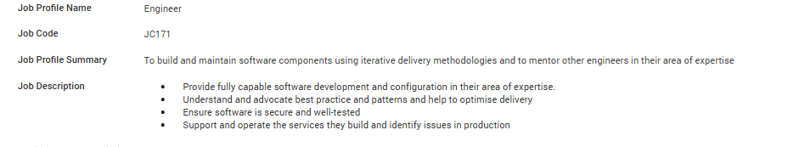
Current Job Description at Ordnance Survey

Slide 3
Other Aspects/ More Specific Aspects of My Job
Build and create deployment pipelines for cloud infrastructure
Manage cloud networking and permissions/ RBAC systems for cloud security
Use agile delivery methods to understand requirements for software systems in use in Ordnance Survey
Architect software systems in Azure, using best practice
Be comfortable using version control (Git)
Use frontend frameworks and technologies such as React and TypeScript
Be comfortable using .NET based APIs such as ASP.Net Core

Slide 4
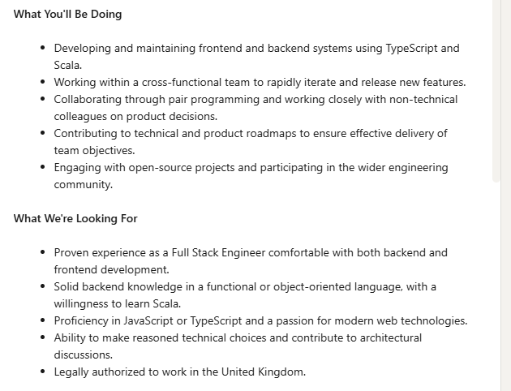
Similar Job Profiles on LinkedIn – Job 1

Slide 5
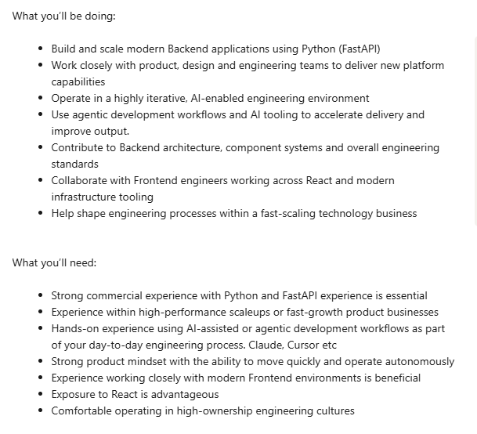
Job 2

Slide 6
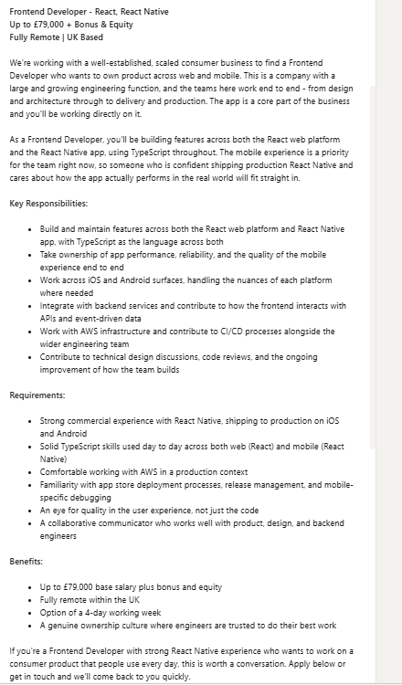
Job 3

Slide 7
Comparison
Company | Agile | Frontend | Backend | Infrastructure | Culture
Ordnance Survey | Agile workplace | React and TypeScript | C# | Azure | Fast-paced
Job 1 | Not mentioned | JavaScript/ TypeScript/ React | Scala | Not mentioned | Open-source friendly
Job 2 | Strongly hinted at with collaboration with product and design teams | React | Python/ FastAPI | Not mentioned | Fast-scaling
Job 3 | Strongly hinted at (same as Job 2) | TypeScript/ React Native | TypeScript | AWS | Genuine ownership culture

