Slide 1
Database Seeding Script for Development Environment Deployments
By Carl Gardiner

Slide 2
Organisation Background
Ordnance Survey operates in Azure
Push towards flexibility, repeatability and consistency
Save on costs, reduce development time, improve disaster recovery metrics and improve developer experience
Need multiple development or testing environments at one time

Slide 3
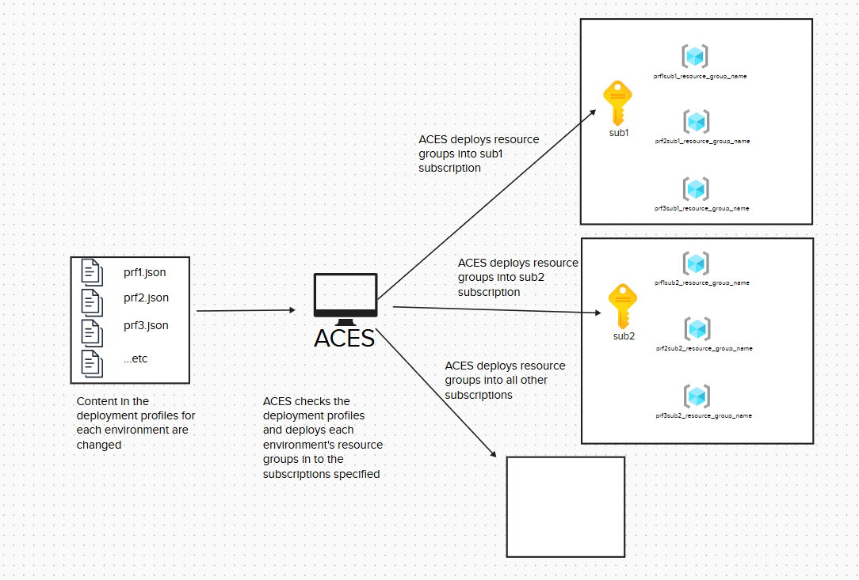
ACES and the Problem
Notes:
Currently, Ordnance Survey manages subscriptions and resource groups in Azure through their own bespoke deployment system: ACES. This system operates by referencing a collection of JSON files internally known as deployment profiles. Each system code (essentially a way of tracking cost per team or service) has its own deployment profile and resource groups are deployed into the subscriptions a deployment profile specifies (see Figure 1 below). This means that subscriptions have resource groups from multiple different teams and services across Ordnance Survey, as multiple different deployment profiles can declare that their resource groups should be in the same subscriptions as other deployment profiles. This is not the intended purpose of subscriptions, as subscriptions are intended to be used as financial containers for resources, as “Billing for Azure resources is done on a per-subscription basis. An Azure subscription defines a set of Azure resources that are invoiced together” (Microsoft Learn, 2026a). Having multiple teams and services running in the same subscriptions is in clear violation of this intention from Microsoft.
An example of this violation causing problems for Ordnance Survey is that their current use of subscriptions and resource groups often leads to the limit of 980 resource groups in a subscription being hit (Microsoft Learn, 2026b). This leads to stalled operations across the business as new subscriptions need to be created to accommodate more resource groups.
The biggest problem with ACES, though, is that it does not allow for the easy deployment and teardown of environments that developers need to work effectively. This is because it checks every deployment profile and then deploys or removes resource groups based on these deployment profiles. Some deployment profiles for certain system codes have gotten too large and can run for up to 4 hours before deploying a new resource group. As one of the benefits to cloud computing is the ability to “quickly spin up and tear down test environments, making more efficient use of resources” (Andersson, 2023), this slowness to deploy resource groups is unacceptable as the benefits of quicker development are lost. The other side to this is that unneeded resource groups would be slow to teardown, leading to unnecessary resource groups being left up (affecting the cap on resource groups in a subscription spoken of previously). Leaving these resources running in the cloud also increases Ordnance Survey’s cloud costs, as idle systems can generate significant charges over time; identifying and removing them can therefore reduce overall expenditure (Piper, 2025).
ACES does not by itself create resources in the resource groups, merely the resource groups themselves along with some networking components. Thus, even after ACES has run, other deployment pipelines would still need to run to provision concrete resources, thus extending the deployment of an environment further.

Slide 4
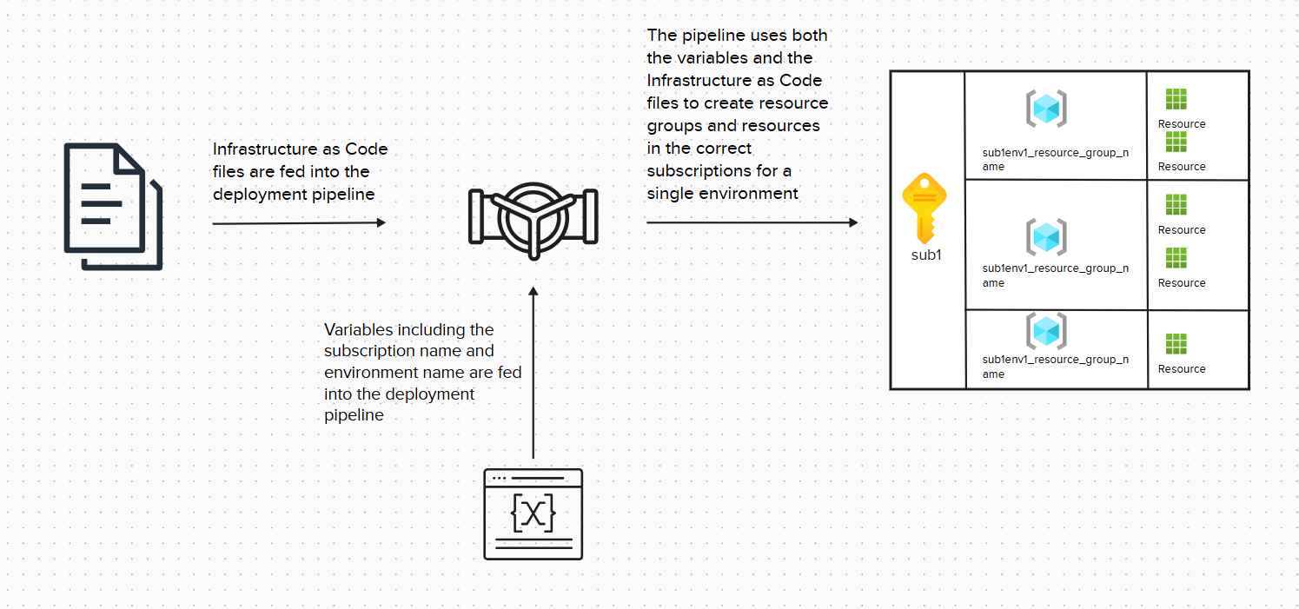
New Approach to Azure
Notes:
To combat this, new subscriptions outside the ACES system have been set up for some new services. Each subscription is named after the service it contains (acting as a billing bucket) and the type of environments it has in it. For example, one subscription may be for the production environment of Service A, whereas another subscription would be for the development and testing environments of Service A.

Slide 5
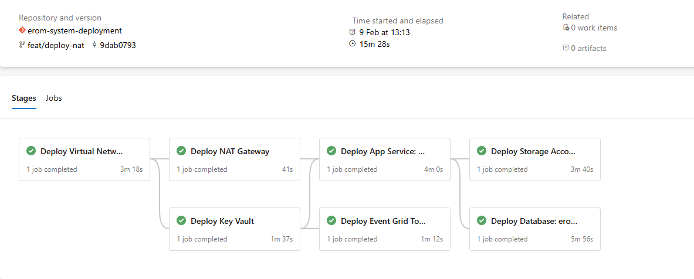
Work Already Completed
Notes:
Currently, new deployment pipelines have been created in Azure DevOps that can create development and testing resource groups in one of Ordnance Survey’s development and testing subscriptions for a service called Errors and Omissions, which is the service around which this project will be based. This service is being created anew and consists of two parts: a customer-facing frontend from which they inform Ordnance Survey of errors or omissions in mapping data, and an internal-facing frontend where reported errors can be investigated. These two services share backend systems, such as databases and storage accounts in Azure. So far, most of the infrastructure of the new service has been created, with key vaults, databases, backend APIs, event grids and network rules being deployed into their own resource groups. Currently, these pipelines run for about 15-16 minutes on average for a full deployment (see Figure 3 below) making deployment significantly faster than ACES.

Slide 6
Project Outline and Justification
Outline: Create test data and place in data stores
Outline: For test and development environments
Justification: Allow for automated testing on the data
Justification: Easily disposable, useful environments
Justification: Helps Disaster Recovery
Justification: ISO27001 Certification
Notes:
Because of the fact the system is currently not useful for development and testing, the business requirements for Ordnance Survey are that for the Errors and Omissions service, test data is created and placed into the relevant data stores during the deployment of development or testing environments. This would allow for easy visual identification of whether the Errors and Omissions service is working correctly upon deployment by viewing the internal-facing frontend locally to see if the data is displayed there. It would also allow for automated testing on the data in the future, allowing for further assurance that a system is working correctly and would allow for breaking changes to be identified in development and testing environments before reaching production environments, thus safeguarding production environments.
Adding test data to the relevant data stores would also allow for an easier developer experience and ties back into the idea of creating easily disposable, ephemeral environments. This, in turn, ties back into the overall maturity of Ordnance Survey’s cloud maturity in Azure, helping to prevent disaster, improve disaster recovery and help to retain ISO27001 certification.

Slide 7
Functional Requirements
A script which deploys data to the SQL DATABASE
A SCRIPT which deploys image blobs into azure related to a record in the sql database
Retrieve these through a local frontend instance
Notes:
- A script, running in the pipeline which deploys development and testing environments for the internal-facing Errors and Omissions service deploys records into the SQL database.
- A script, running in the pipeline which deploys development and testing environments for the Errors and Omissions service deploys blobs into the Azure blob storage. These blobs are related to a specific record in the SQL database, so that they can be retrieved by a frontend service through an API.
- The records in the SQL database and Azure blob storage should be possible to retrieve through an instance of a local frontend environment by going through an API in the development or testing environment.

Slide 8
Non-Functional Requirements
The data seeding script does not run for a significantly long time in relation to the deployment pipeline.
ENVIRONMENTS KEPT TO A MINIMUM
THE DATA SEEDING SCRIPT IS FLEXIBLE AND ADAPTABLE ENOUGH TO BE EXTENDED
Notes:
- The data seeding script does not run for a significantly long time in relation to the deployment pipeline.
- During this work, a single development or testing environment is deployed above what is currently being worked on by other developers and testers. This is to ensure that Azure costs are kept to a minimum during this. If possible, this environment should be torn down when it is unnecessary to leave it up, but this may not be practical for most of the duration of this work.
- The data seeding script is flexible and adaptable enough to potentially be reused in the future to allow development and testing environments to be hosted in containers. This ability to host environments in containers would extend to both local development and the cloud.

Slide 9
Security Requirements
USE KEY VAULTS INSTEAD OF HARDCODED CREDENTIALS
DATA SEEDING SCRIPT SHOULD USE LOWEST PERMISSION RBAC
ACCESS TO DEVOPS REPO RESTRICTED TO AUTHORISED PERSONNEL
ALL PR RECOMMENDATIONS ARE DEALT WITH SATISFACTORILY
Notes:
- The data seeding script should use connection strings which are stored in Azure Key Vaults instead of hardcoded values in the script. This will prevent breaches of Azure DevOps revealing secret connection strings and improves security by allowing for rotation of connection strings, preventing previous ones from working even if acquired by malicious actors.
The data seeding script should use an identity with least-privilege Role Based Access Control to access the Azure blob storage (or the most reasonably low-privilege based on current configurations). This will prevent the event where a modification of the script, either intentional or accidental, could affect things other than the specific blob store for the Errors and Omissions service.
Access must be restricted to authorised personnel for the Azure DevOps repository and pipelines in which the code for the data seeding script is stored or run. This is to prevent malicious actors modifying the script and running it in the pipelines. It also prevents malicious actors from inferring the database schema from code.
All valid recommendations made by reviewers for Pull Requests in our Azure DevOps organisation will be dealt with satisfactorily before the code for the data seeding script is merged.

Slide 10
Constraints
Human
Technological
Financial
Time and Scope

Slide 11
Human Constraints
- Carried out by team overseeing Errors and Omissions service
- Consists of one Senior Software Engineer, two Engineers and one Test Engineer
- Work 9 to 5 Monday to Friday
- Work done by single Software Engineer (me)
Notes:
In terms of human resources, the distribution of work will be being carried out by the team that oversees the Errors and Omissions service. The team consists of three software engineers (one of whom is the senior engineer) and a single test engineer. All the members of the team work from 9 to 5 Monday to Friday. It has already been decided by the product owner that oversees the team that the work to deploy the data with the development or testing environments will be mainly done by a single software engineer. However, this software engineer can call upon the other team members when expertise is required during the working hours of the team if necessary and provided the other members of the team are not engaged in time-critical work.

Slide 12
Technological Constraints
Azure
Azure DevOps
New Azure Subscriptions and Resource Groups
Spring Boot API
Azure SQL Database
Azure Blob Storage
React Frontend
Notes:
Given that the deployment pipelines are already running and using the new subscription models (as shown previously in Figure 2 and mentioned in Section 1.1.3), any method of placing data must conform to the implementation of these pipelines.
As such, here are the technological and infrastructure constraints of the project:
Azure – Ordnance Survey uses Azure as its cloud provider. It has invested significant resources and time into setting up the governance and security in Azure and as such any solution must integrate with Azure as the cloud platform.
Azure DevOps – The code that runs the deployment pipelines is stored in a repository in Azure DevOps. Again, this is Ordnance Survey’s choice for handling the Software Development Lifecycle (SDLC) for software projects, and significant resources have been used to make it secure and to link secure service connections to Azure. As such, any solution will likely use Azure DevOps and Azure DevOps Pipelines.
New Azure Subscription Models and Resource Groups – The new model for subscriptions at Ordnance Survey has been chosen by the product owner as the way forward for future projects. As such, any solution should not use ACES, but the new subscription model as shown in Figure 2 and Section 1.1.2.
Spring Boot API – The current API for Errors and Omissions is written in Java using Spring Boot. This is significant as although the data does not have to be created through this API for the purposes of the solution, it is a potential path forward for how to add the data into the data stores.
Azure SQL Database – Any relational records for the Errors and Omissions service are stored in an Azure SQL Database. As such, any data created during the deployment pipeline will have to be able to be placed in tables preconfigured in the deployment pipeline.
Azure Blob Storage – Blob storage is used for image data, occasionally used in some Errors and Omissions records. This is non-relational Binary Large Object data. As such, if image data is created during the deployment of development or testing environments, it will have to be stored here.
React Frontend – A local React Frontend, which is not currently part of the deployment, will be used to test the solution manually, to ensure data is being correctly displayed for the internal-facing front end.

Slide 13
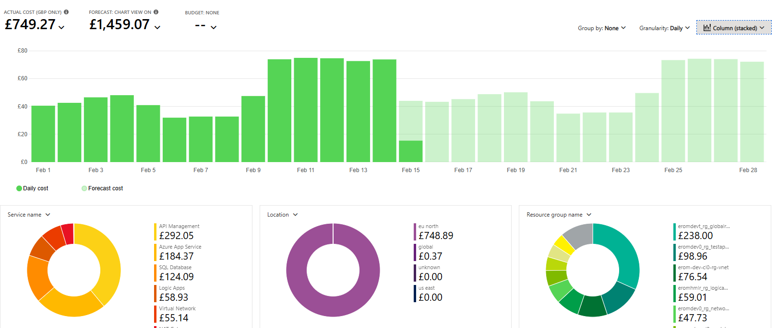
Financial Constraints – Part 1
Notes:
Currently, before implementation of any data seeding, the cost of a single development or testing environment for the Errors and Omissions service is expected to cost around £1459.07 per month. Figure 20 in Appendix B shows this and is taken from a former ACES resource group. Although the development environment created from the new deployment environment is different (being spread across multiple resource groups under the new subscription model) it should not exceed this amount for a month of work. Depending on the length of the work, the cost of provisioning such an environment may vary significantly. For example, if the work takes 3 weeks, the environment may cost roughly £1100 based on Figure 20 in Appendix B, whereas a six-week project would double that amount before the development environment is torn down again. Although tearing down the environments out-of-hours could reduce spend, it may impact developer productivity whilst working on this solution, so it arguably may end up costing more.

Slide 14
Financial Constraints – Part 2
Notes:
Currently, before implementation of any data seeding, the cost of a single development or testing environment for the Errors and Omissions service is expected to cost around £1459.07 per month. Figure 20 in Appendix B shows this and is taken from a former ACES resource group. Although the development environment created from the new deployment environment is different (being spread across multiple resource groups under the new subscription model) it should not exceed this amount for a month of work. Depending on the length of the work, the cost of provisioning such an environment may vary significantly. For example, if the work takes 3 weeks, the environment may cost roughly £1100 based on Figure 20 in Appendix B, whereas a six-week project would double that amount before the development environment is torn down again. Although tearing down the environments out-of-hours could reduce spend, it may impact developer productivity whilst working on this solution, so it arguably may end up costing more.

Slide 15
Time and Scope Constraints
Current deployment time is 15-16 minutes
Multiple basic records
Single attachment record
MVP
Notes:
Figure 3 indicates that the current deployment pipeline executes in approximately 15–16 minutes. The integration of data‑seeding tasks must therefore be designed to minimise any additional runtime. Although the precise tolerance for delay is difficult to quantify, an increase of roughly 50% would constitute a significant degradation in performance.
Records within the Errors and Omissions service can take a wide variety of forms. Over time, additional nullable fields and supplementary tables have been introduced into the database, to allow for a greater variety of records. As a result, a single record displayed on the frontend may draw from multiple related tables, and two Errors and Omissions records may differ significantly in structure and content.
Because of this, the initial focus will be on generating several minimal‑viable records—those containing only the mandatory, non‑nullable fields. This is intended to reduce scope creep, as it can prolong projects and leave team members uncertain about their next assignment (Kerzner, 2022). It is also because the most basic records being seeded give the greatest return on value, as they prove that the data seeding works and that multiple components of the system work together. In addition to these basic records, it is important to produce at least one record that includes an attachment, as this scenario requires integration with Azure Blob Storage, and would demonstrate that another component of the system integrates correctly. Attachment handling represents the most complex element of the data seeding process and could otherwise hinder future progress if not addressed early.
Although creating every possible permutation of an Errors and Omissions record would be ideal, the time available for this project necessitates keeping the number of record variations deliberately small. This approach ensures that the MVP remains achievable within the project constraints while still providing meaningful, representative test data. This MVP will in effect act as an integration test for the Errors and Omissions service. This will be useful as often “individual system elements that seem to work fine in isolation fail to work together properly due to functional, timing or other interface problems or just naturally interfere in the smooth operation of one another” (Engel, 2010).

Slide 16
Solution
Stage will be added to deployment pipeline for dev and test environments
This will seed data into SQL and blob storage in Azure for Errors and Omissions
Done through PowerShell scripts in the pipeline
Records need to be valid
Desire to not extend the pipeline runtime too much
Notes:
To meet the requirements and conform to the constraints mentioned in Sections 1.2 and 1.3, the following solution has been proposed:
A stage will be added to the existing deployment pipeline for development and testing environments. This stage will seed data into the SQL database and blob storage for Errors and Omissions. This will allow for development and testing work in these environments upon their creation.
To do this, PowerShell and Azure CLI scripts will be created which will interact with the database, seeding valid records into the database initially, and then placing attachments in the blob storage. The reason for using PowerShell and Azure CLI scripts is because of their native integration with Azure, and using prebuilt service connections with these scripts will allow for development to proceed smoothly. The blob storage is where images (known as attachments) that are referenced by a record in the SQL database are stored. As such, they need to be seeded after the initial database records are seeded.
These seeded records need to be valid and reflect real-world production records, as they may be used for future unit and manual testing in the pipeline and “High-quality, realistic data lays the essential groundwork for understanding how the system will truly behave once deployed in a live production environment. This is crucial for enabling developers to make informed design decisions and foresee potential pitfalls or issues early in the development life cycle” (Cowell & Malmqvist, 2024). As mentioned in Section 1.3 regarding constraints, the minimum-viable records will be created, along with one record which links with an attachment in blob storage. Multiple minimum-viable records will be created, because this will demonstrate the ability to create multiple records at one time in any script created.
Whilst it would be possible to seed the data by replicating what exists in a production database, this is problematic. A direct replication of production data would introduce a significant risk of GDPR non‑compliance, as any personal data stored in a development or testing database could be exposed in the event of a breach. Such incidents can “result in a heavy fine of up to £8.7 million or 2 per cent of your global turnover” (Information Commissioner's Office (ICO), 2026). One way to mitigate this risk would be to maintain a separate database containing only anonymised or synthetic test data; however, this approach would incur ongoing costs associated with provisioning and maintaining an additional database.
Because of the time constraint mentioned in Section 1.3.4, the goal for seeding this data is to not allow for the seeding script to overly extend the time taken to deploy the development or testing environment. So, the time taken for the script to run should not make the overall run of the pipeline take much longer than the roughly 15-16 minutes that it currently takes. Another reason for this is because one of the goals of the move away from ACES towards the new subscription model was to decrease the amount of time it takes to provision development and testing environments. Adding a long-running script would nullify this.
This project will not involve the deployment to production, as there are significant safeguards that need to be implemented there, and currently there is no production environment for the Errors and Omissions service in its current form. However, the data seeding pipeline stage must still add checks on whether or not an environment is production, in order to safeguard against accidentally running data seeding in production in the future.

Slide 17
Metrics and Success Criteria
4 records to be added to the database
1 record added afterwards that contains an attached image (DB and blob storage)
Data seeding pipeline is not extended by 10% over previous deployment time (15min 28sec)
All code merged is reviewed and approved during PR
Documentation about data seeding script / local frontend is produced
Notes:
- 4 records have been added to the SQL database in the development environment through the data seeding script. This is confirmed either by using a local frontend connected to the database through an API or through viewing the records themselves in the database.
1 record has been added to the SQL database that has a corresponding attachment blob stored in the Azure blob storage, both being created through the data seeding script. This is confirmed either by using a local frontend connected to the database through an API or through viewing the records themselves in the database and the Azure blob storage.
The data seeding script is added to the pipeline for deploying the development or testing environment. Confirmation of this being achieved is when the pipeline runs through entirely without fault in Azure DevOps pipelines.
The pipeline run will not be significantly extended by the addition of the data seeding script. This is confirmed once the pipeline run is complete without error but will require nuance in judging whether it has ‘significantly’ impacted the run of the pipeline. A good metric would be that it does not extend the pipeline run by more than 10% of the average time before the addition.
The code has been merged into the main or development branch of the code repository in Azure DevOps via Pull Request after having been reviewed by other Engineers. This will be confirmed by the PR being completed.
After the pipeline run has been fully completed, a local frontend should be able to connect to the deployed development environment and should be able to view the records as intended. This success criteria will be confirmed when this is achieved.
Documentation about the data seeding script has been produced and is included in a Wiki or README.md
Documentation has been produced that can inform people how to get the local frontend running to prove data has been correctly placed in the environment

Slide 18
Project Management Approach – Part 1
Agile methodology
Single Sprint (3 weeks)
Use of Azure DevOps Sprint Board
Git as source control
Enables changes and opportunities for improved practice
Notes:
The project is to be carried out using an agile methodology, coinciding with a single sprint for the team responsible for the Errors and Omissions service. In this, an overarching User Story will be created on the team’s Azure DevOps Sprint Board and individual Tasks will be created after reviewing the initial Work Breakdown Structure and Gantt Chart. Some of the individual tasks in the Work Breakdown Structure will be amalgamated into a single Task on the Sprint Board (such as those that involve the creation and testing of a single feature). Research activities will not be assigned as discrete tasks on the board, as they do not produce a specific deliverable; instead, time will be allocated to them in order to support a more informed solution design.
Git is the source control technology that will be used to handle any code-related Tasks, and each of these Tasks will have to be reviewed by other engineers or the senior engineer on the team during a Pull Request process to ensure that the code is to a high standard.
Adopting an agile methodology alongside this Pull Request process will enable changes and opportunities for improved practice to be identified throughout development and acted upon promptly through continuous feedback, thereby increasing predictability, reducing risk and minimising unnecessary cost (Rajesh, 2021).

Slide 19
Project Management Approach – Part 2
Phase 1: Research and Analysis
1
Phase 2: Design
2
Phase 3: Implementation
3
Phase 4: Testing
4
Phase 5: Documentation
5
Notes:
The project is to be carried out using an agile methodology, coinciding with a single sprint for the team responsible for the Errors and Omissions service. In this, an overarching User Story will be created on the team’s Azure DevOps Sprint Board and individual Tasks will be created after reviewing the initial Work Breakdown Structure and Gantt Chart. Some of the individual tasks in the Work Breakdown Structure will be amalgamated into a single Task on the Sprint Board (such as those that involve the creation and testing of a single feature). Research activities will not be assigned as discrete tasks on the board, as they do not produce a specific deliverable; instead, time will be allocated to them in order to support a more informed solution design.
Git is the source control technology that will be used to handle any code-related Tasks, and each of these Tasks will have to be reviewed by other engineers or the senior engineer on the team during a Pull Request process to ensure that the code is to a high standard.
Adopting an agile methodology alongside this Pull Request process will enable changes and opportunities for improved practice to be identified throughout development and acted upon promptly through continuous feedback, thereby increasing predictability, reducing risk and minimising unnecessary cost (Rajesh, 2021).

Slide 20
Project Management Approach – Part 3
4–6 Mar.
9–13 Mar.
16–20 Mar.
23–25 Mar.
Notes:
Where there is a need for testing following implementation of a feature, the two tasks on the WBS are linked by a dotted line.
A Gantt Chart has been subsequently created from the WBS (see Appendix A Figure 12) to provide estimated timelines to each of the tasks.
The project is scheduled to be carried out over four ‘weeks’ worth of work (the first and second week are only three days long, to fit into the team’s sprint). These weeks are broken up thusly:

Slide 21
Initial Risk Assessment
ID | Risk | Current Mitigating Actions
1 | Hardcoded or insecure connections strings are used to access the SQL database, thus exposing the database to malicious actors who acquire them. | Reviewers should pick up hardcoded connection strings in code during Pull Requests.
2 | The data seeding script may use an identity that has greater permissions than required, and this may lead to any malicious actor who manages to run the pipeline potentially having access to an identity that can do more than intended or be used in unintended ways. | The service connection identity used for the pipeline has the least privileges necessary to deploy either a development or testing environment. Whilst this may allow for some malicious actions if the pipelines were changed due to some privileges it has, on balance the privileges are contained to a particular subscription and any actions taken would be logged and could be audited.
3 | Malicious actors could gain access to the Azure DevOps repository and modify the seeding script to add malware to the database or blob storage. Malicious actors could also infer database schemas from the code in the repository. | The Azure DevOps project has Role-Based Access Control to ensure unauthorised personnel cannot access the project or have restricted actions inside the project. Modification of the script requires the ability to branch the code, which is permission-based, and attempts to merge such as modification into the main branch would be subject to review of a Pull Request.
4 | Pull Requests created whilst creating the data seeding script could introduce security vulnerabilities. | Pull Request require approval by a senior engineer or an engineer. Recommendations about security made by these reviewers will be considered and implemented if reasonable to do so before merging any Pull Requests.
5 | The creation of multiple development and testing environments may drive up the cloud costs in Azure significantly during the development of this data seeding script. | Only a single environment should be created for this work. If development work pauses for a significant amount of time, the environment should be pulled down as to prevent incurring further costs for no reason until development starts back up again.

Slide 22
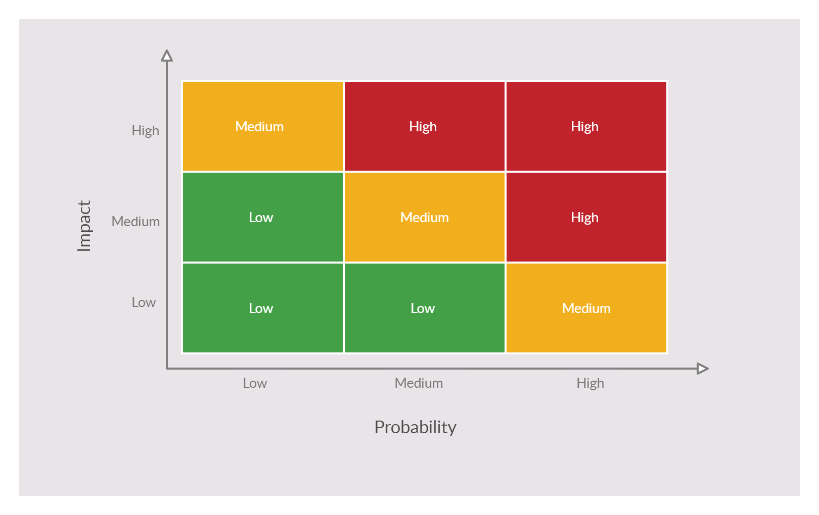
Risk Matrix

Slide 23
Risk Register
Risk ID | Probability | Impact | Risk Score
1 | Medium – the possibility of hardcoding connection strings in the code repository or outputting them to a terminal during a deployment pipeline run is very possible if due care is not taken. Hardcoded connection strings could also be left in development git branches, meaning malicious actors may eventually get access to them, even if the hardcoded connection string code never gets merged into the main branch. | Low – Because of the ephemerality of the development environments, and the fact that these hardcoded strings are not going to be used for production environments in this project, the impact should only affect development environments, which can be quickly shut down and put up with new connection strings. | Low
2 | Medium – The possibility of giving the pipeline agent’s identity additional roles in Azure’s backend is very possible. Caution will have to be taken when assigning roles, to make sure they are not over and above the necessary requirements for the project. | High – Accidentally giving the pipeline agent’s identity powerful privileges could lead to accidental or malicious sabotage of Ordnance Survey’s cloud estate on Azure. This could interrupt production services and in the worst-case scenario lead to a ransomware attack. This could financially cripple Ordnance Survey. | High
3 | Low – Because of Azure DevOps Role Based Access Control already implemented for Ordnance Survey’s estate, this is unlikely. The modification of any scripts for the database seeding would also require extensive effort and knowledge outside of the Azure DevOps estate. Inferring database schemas is the most probable result were Role Based Access Controls to be bypassed. Pipelines are unlikely to run on branches created by anyone who bypassed the Role Based Access Control and modified the code on new branches. | High – If someone were to modify the code in the repository and someone ran a pipeline using it, Ordnance Survey’s cloud estate in Azure could come under threat, potentially leading to a ransomware attack. Otherwise, the inference of a database schema would be a very small, probably negligible, threat. | Medium
4 | Low – Because of Pull Requests requiring approval by another engineer or senior engineer on the team and security vulnerabilities being notified by Azure DevOps Pipelines when a particular PowerShell cmdlet is deprecated (Microsoft Learn, 2026c), it is very unlikely critical vulnerabilities will make it through the Pull Request process. | High– Although many security vulnerabilities are low-impact, because of the variable nature and breadth of security vulnerabilities it is entirely possible that a critical vulnerability could be exploited, damaging Ordnance Survey’s Azure DevOps or Azure estate. | Medium
5 | Low – It is unlikely that multiple environments would be created, except by mistake. The nature of the pipelines is such that the creation of resources must be explicitly confirmed, and when it becomes apparent that a new environment is being created, the pipeline can be stopped and the new resources shut down. | Low – Each development environment is estimated to cost about £1500 for each month (see Appendix B Figure 20). As any development environment accidentally created is unlikely to be up for more than a few hours before being shut down, the cost should be negligible. | Low

Slide 24
Risk Mitigation Proposals
Use Key Vaults instead of hardcoded connection strings
Remove any additional permissions granted to a pipeline’s identity before the end of the pipeline run
Any accidental environments created should be shut down as soon as possible
Any development environments should be shut down as soon as possible
Notes:
The connection strings connecting to the database should not be hardcoded anywhere in the code repository, as access to this by unauthorised or incorrectly authorised parties could lead to malicious actors using them. Instead, secrets should be stored in Azure Key Vaults and retrieved using managed identities or service connection identities with appropriate access permissions. Connection strings should never be logged to the console in pipeline runs, to prevent the same problem of exposure.
Any additional permissions given to a pipeline agent’s identity should be removed before the end of a deployment pipeline run, any failure to remove this should be clearly identified, as this could lead to serious security problems if left unchecked.
None, the current mitigations should be sufficient without causing disruption for developers.
None, the current Pull Request approval should be sufficient. For this project, any problems found should be corrected unless found to be unreasonable.
Any accidental environments created should be shut down as soon as possible, and the environment for development and testing should be shut down when no longer necessary.

Slide 25
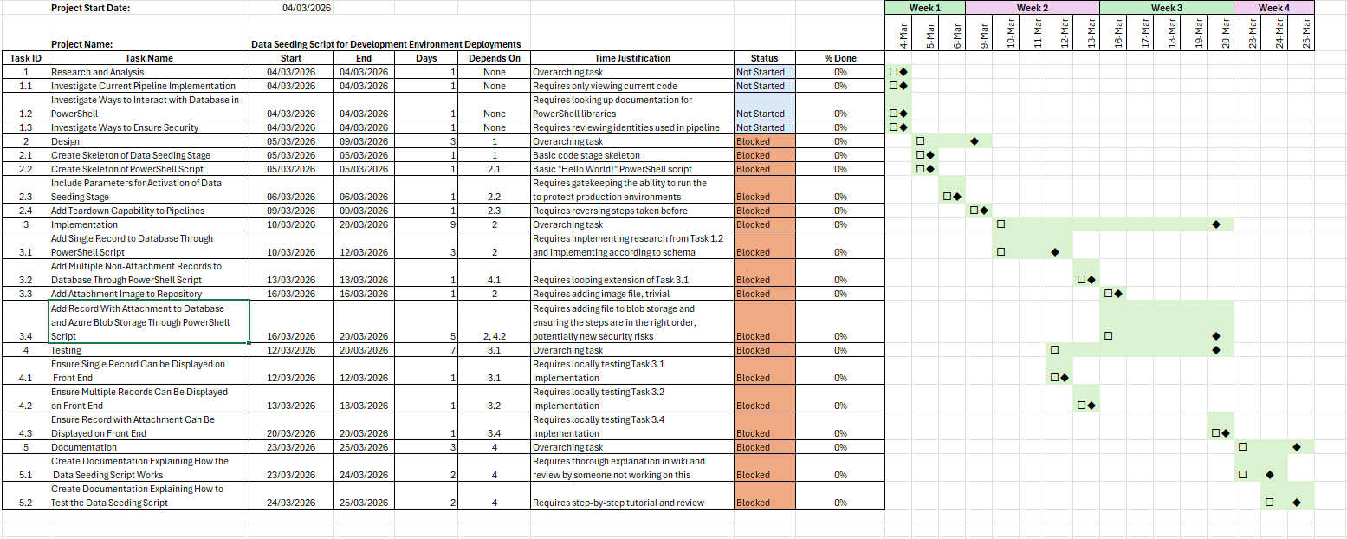
Initial Gantt Chart

Slide 26
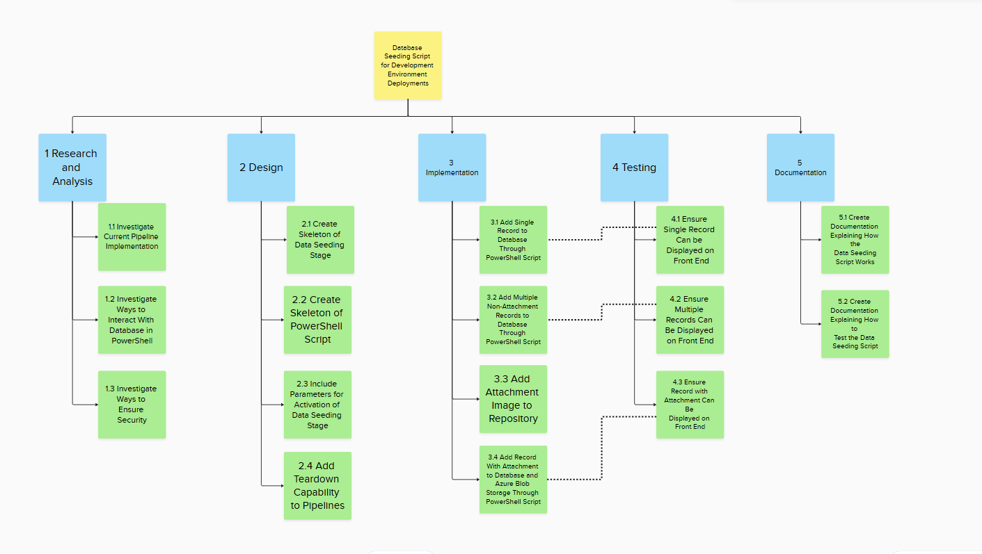
Initial Work Breakdown Structure

Slide 27
Solution Development and Testing – 4th-6th March
Completed Research and Analysis and Design Phases
Coded abstract pipeline code, no implementation details
Created Teardown Pipeline
During Pull Request, another Engineer suggested instead creating idempotent records
Leading to a reworking of the Gantt Chart and WBS
Notes:
During the first week of the project running from 4-6th March, the Research and Analysis and Design phases of the project were completed, as can be seen in Appendix A Figure 13. The use of Azure CLI and PowerShell functions inside any potential scripts were investigated to find out how secure credentials gathering and database access between an Azure DevOps pipeline agent and databases and storage accounts could be done. The current pipeline implementation was reviewed, and it was decided that an Azure DevOps pipeline stage would be created to handle access and the seeding of records into the Errors and Omissions service, and that this would be added to the end of the pipeline when other resources had been provisioned.
In terms of coding, abstract code for the data seeding stage was created, and parameters were placed around this stage, to ensure that the stage did not run if a production environment was used. To prove this, a “Hello World!” script was run when the abstract stage was triggered in the pipeline.
A teardown pipeline for the seeding of the data records was initially created during this week, but during the Pull Request another engineer suggested that instead of having a teardown pipeline for the data, the data seeding script should be made idempotent, so that no additional records would be created on reruns of the pipeline. This was also to make sure that any teardown pipeline could not accidentally run on a production environment, which would be disastrous. As can be seen from the Gantt Chart (Appendix A Figure 13) and the revised WBS (Appendix A Figure 11), new tasks were added to make sure that during the implementation work, idempotency would be achieved for the seeding of data.

Slide 28
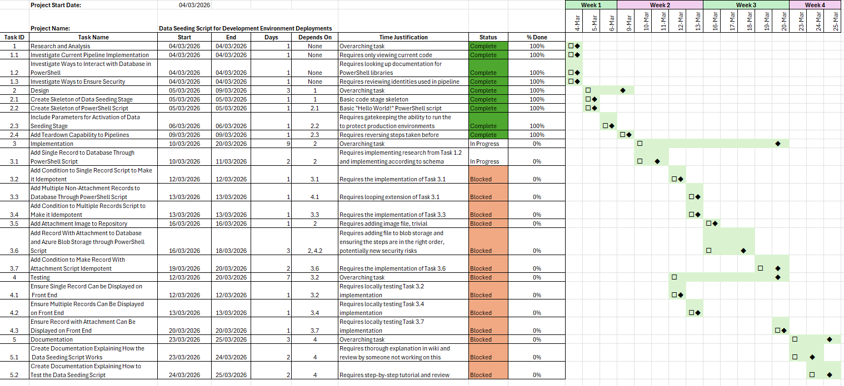
Gantt Chart (Second Week with Revisions)

Slide 29
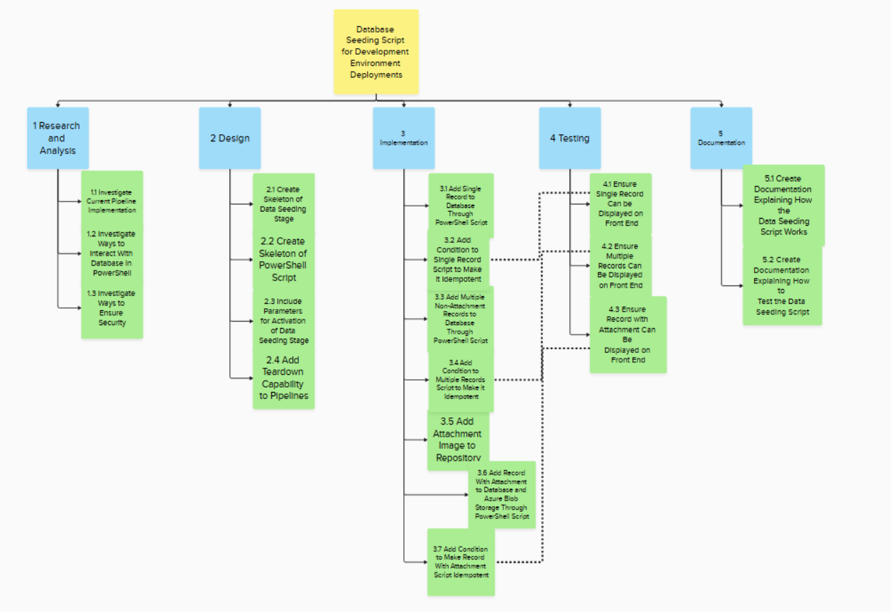
Final Work Breakdown Structure

Slide 30
Solution Development and Testing – 9th – 13th March
Completed some tasks on the Implementation and Testing Phases
Added multiple records through pipeline script
Script was idempotent
Adding and removing firewall rules for the Pipeline Agent was difficult until I found the ipify API
Notes:
During the second week of the project running from 9-13th March, some of the tasks in the Implementation and Testing phases were completed, as can be seen in Appendix A Figure 14. The ability to add a single Errors and Omissions record to the database through a script was achieved (see Figure 5 for visual evidence on the frontend), as well as testing this by viewing it on the frontend which was run on a local machine. This capability was made to be idempotent, so this single record would be uploaded if it didn’t exist in the database and wouldn’t be if it did. Subsequently, the script was amended to create multiple records in the database, and this was also tested on the local frontend and made idempotent.
The adding and removing of firewall rules on the database by referencing the current Azure DevOps pipeline agent’s IP proved to be difficult at first, as it became clear there was no internal identifier for the agent’s IP, and Microsoft only release ranges for their hosted agents on a weekly basis (Microsoft, 2026a), and do not give exact IPs. Opening an entire range of IPs in the databases firewall rules would not be secure, as it would potentially allow malicious actors to access the database. To address this issue, a workaround was implemented using the secure external API ipify to determine the pipeline agent’s IP address, which was then used to temporarily relax the database restrictions.

Slide 31
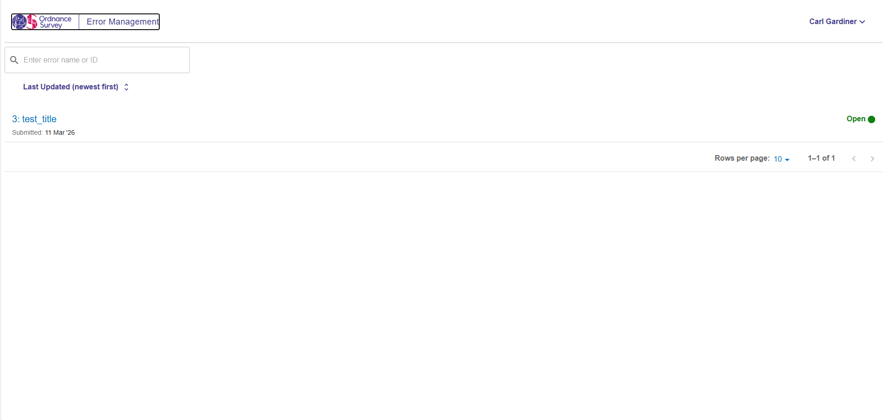
Evidence

Slide 32
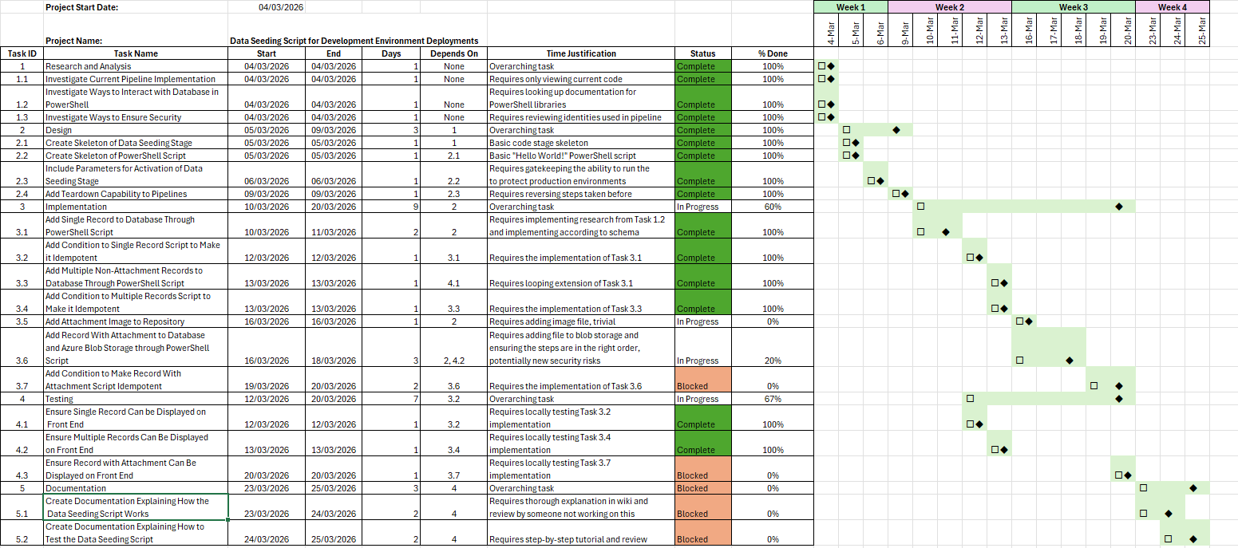
Gantt Chart (Third Week)

Slide 33
Solution Development and Testing – 16th – 20th March
All remaining Implementation and Testing Phase tasks were completed
Adding images to the storage account was more complex than bypassing database firewalls
Variable times led to having to add a waiting step for propagation
This led to Success Criteria around timings to fail, but was necessary
Notes:
During the third week of the project running from 16th-20th March, all the remaining tasks on the Implementation and Testing phases were completed, as can be seen in Appendix A Figure 15. This included adding a test image to the code repository and then subsequently adding a new record to the database linked to an uploaded image in Azure Blob storage. The PowerShell script for this was made idempotent, only uploading either the image or the record in the event they do not currently exist. This was then tested on the front end and was found to work correctly (see Figures 6 and 7 for evidence of this).
This was perhaps the most difficult week of the project, as many unforeseen and difficult to solve issues arose. Firstly, whilst adding and removing database access rules in the deployment pipeline was a solved problem in previous weeks, the inclusion of images and adding them to Azure Blob Storage proved to be a similar but far more complex problem. To allow the pipeline agent to upload an image to the Azure Blob Storage, the Azure role of Storage Blob Data Contributor role had to be added and removed from it in the pipeline. The access rules for the Azure Blob Storage also had to be added and removed in the pipeline run, adding another layer of complexity.
Perhaps the most difficult to solve problem was that the roles and access rules took variable amounts of time to propagate through Azure’s backend. This caused many failures when uploading images, despite the roles and access rules saying they were in the correct configuration. Due to this, a step was added in the pipeline to wait for one minute for the rules to propagate, and retry logic was added throughout the pipeline elsewhere. This was not an ideal solution, as it affected Success Criteria 4 (see Table 5), but one that was unavoidable, as Azure’s backend is a walled-off environment for security reasons.

Slide 34
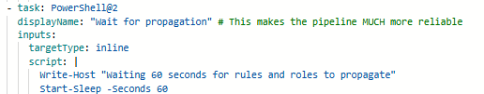
Evidence
Notes:
Evidence of propagation causing issues in the code

Slide 35
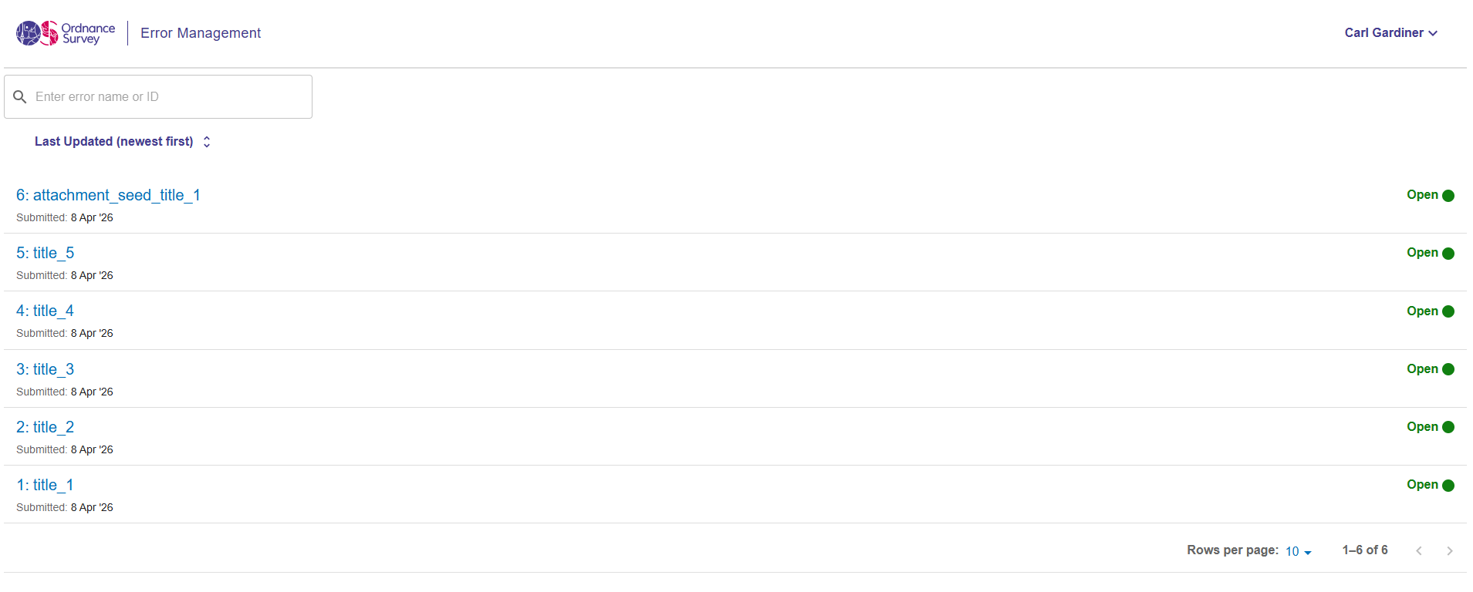
Evidence

Slide 36
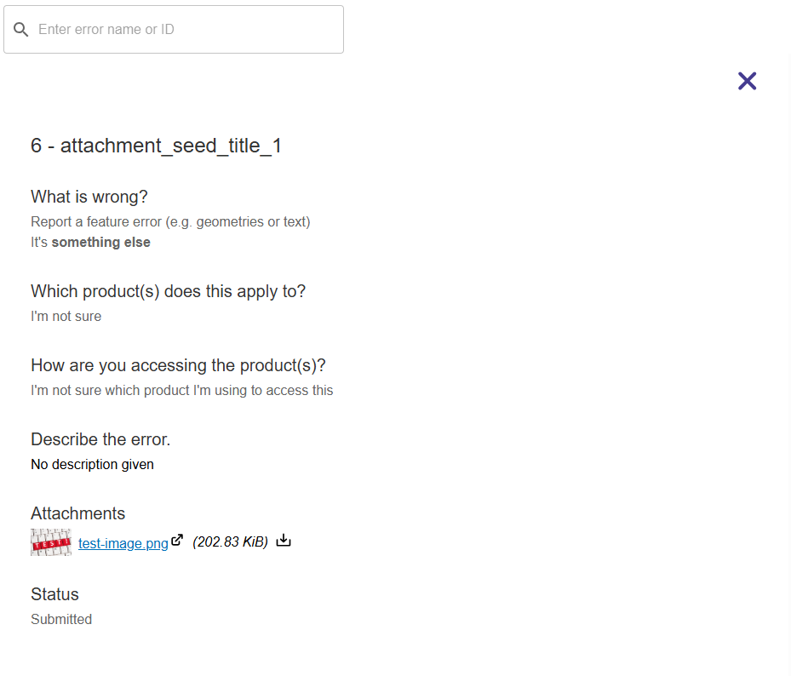
Evidence

Slide 37
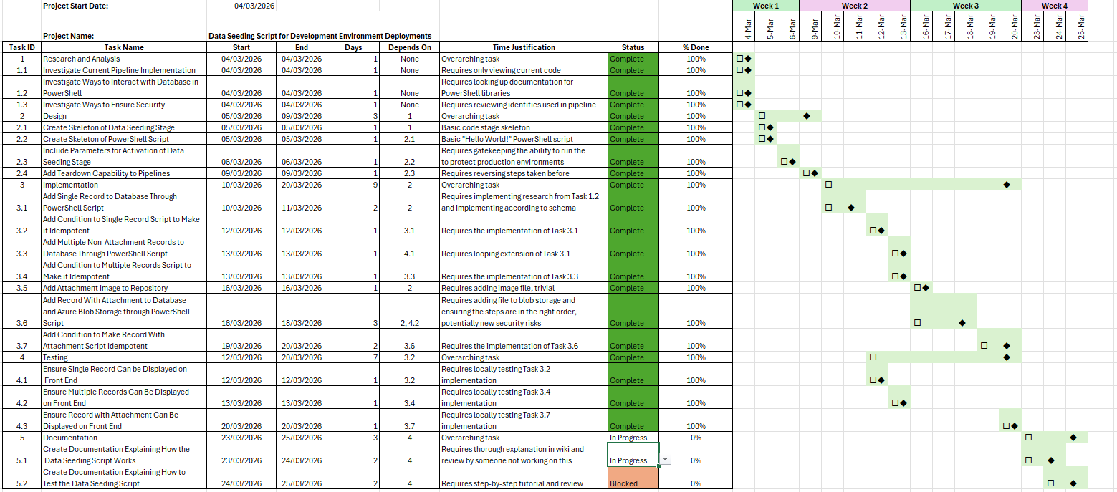
Gantt Chart (Fourth Week)

Slide 38
Solution Development and Testing – 23rd – 25th March
Completed Documentation Phase
This included adding to a README.md file in the code repository
Comments were made by the senior engineer in a Pull Request
Discussion about using JSON files in the future
Notes:
During the final week of the project, running from 23rd-25th March, all the Documentation tasks were completed, as can be seen in Appendix A Figure 16. This was included as a README in the project code repository and was subject to Pull Request review by other members of the team, to make sure it made sense. This README included information on how the data seeding script worked and how to test it on the frontend.
The only issues and adjustments raised here were the comments on the Pull Request, as can be seen in Figure 8 below. The main issues were other engineers on the team wanting file names and locations for where data creation happens. This led to a discussion about the possibility of using JSON files to hold the data separately from PowerShell scripts but was considered outside the immediate scope of this project.

Slide 39
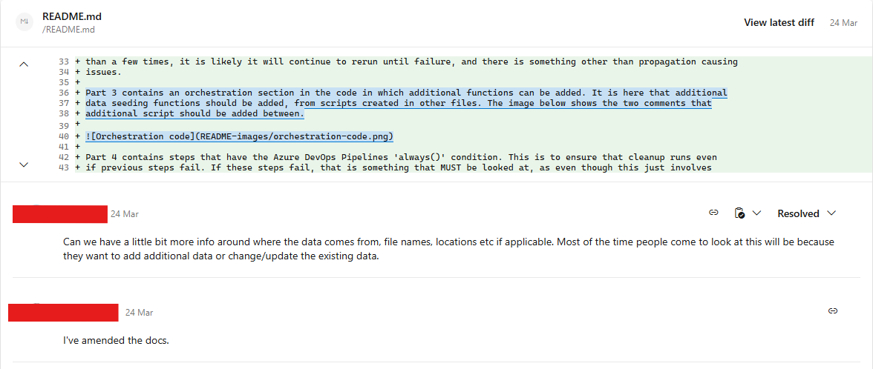
Pull Request Advice

Slide 40
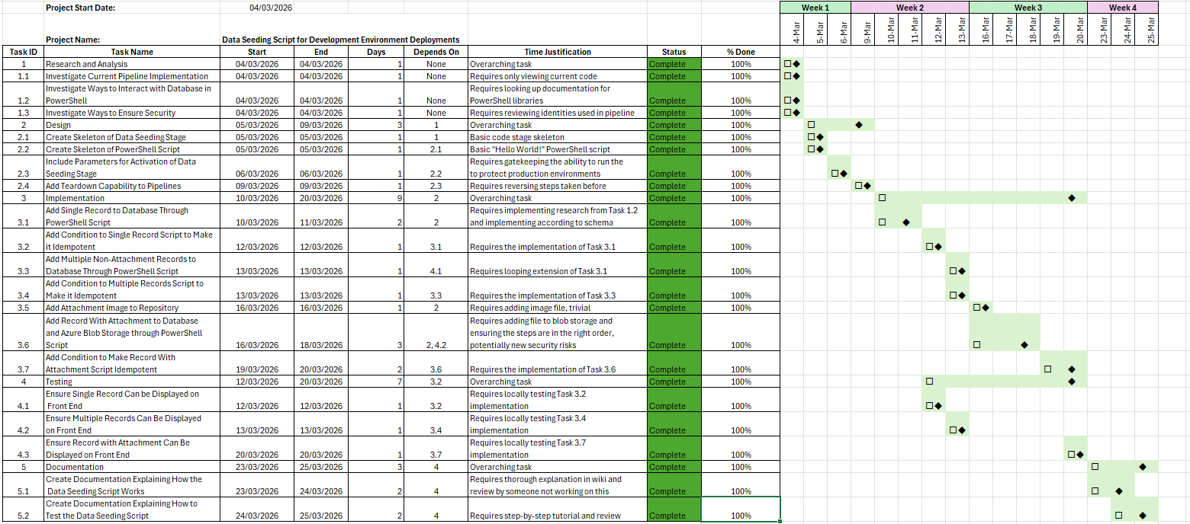
Final Gantt Chart

Slide 41
Evaluation of Success
Overall Success
Overall timeframe aligned with initial Gantt Chart, despite additional tasks being added
Records were added correctly through pipeline
Not possible to achieve pipeline runtime success criteria
Already have added JSON functionality and the seeding has been used and expanded further following the project
Notes:
Overall, the project for creating the database seeding script for the development environment deployments went well. The progression of the project was in line with the timeframe specified in the initial Gantt Chart in Appendix A Figure 12. This did not change when the Gantt Chart was amended (as can be seen in Appendix A Figure 13) as the overall timeframe for the project was not altered. The Research and Design phases of the project were completed quickly without issue, and the Implementation and Testing phases ran concurrently, as expected. The Documentation phase also was completed quickly, with only minor adjustments required that were discussed in the corresponding Pull Request for the documentation (see Figure 8).
In terms of the Success Criteria for the project (see Table 5), Success Criteria 1, 2 and 6 were all achieved, as 4 basic records were added to the database through the data seeding script, and 1 additional record that has a corresponding attachment blob in Azure blob storage was added. Evidence for this is seen in the testing done on the Errors and Omissions local frontend (see Figure 6 and Figure 7).
Success Criteria 3 was also achieved, as the deployment pipeline was able to successfully run through with the addition of the data seeding script. Success Criteria 5 was achieved, as can be seen from the completed Tasks in Figure 9, as each of these Tasks completed the full Pull Review process. Success Criteria 7 and 8 were similarly successful, with a Pull Request for documentation having been completed (see Figure 8 for evidence of amendments recommended during that Pull Request).
Unfortunately, Success Criteria 4 was not achieved. This is because of the additional time added to the pipeline as it waited for the Azure backend to propagate Role-Based Access Controls and access rules, as well as the additional time needed for the retrying of steps when this had not happened. This was specifically a problem during the implementation of the task of adding an attachment record to the database (see Section 4.3 for more details). Because of the variable lengths of time that this would extend the pipeline run by, it often exceeded an additional 10% on top of the original average time of roughly 15-16 minutes. Ultimately, because it was not possible to make any changes to this, due to not having access to Azure’s backend processes and having made every effort to otherwise reduce the time the data seeding script took, this Success Criteria was considered not possible to complete.

