Slide 1
Leave Booking System API
By Carl Gardiner

Slide 2
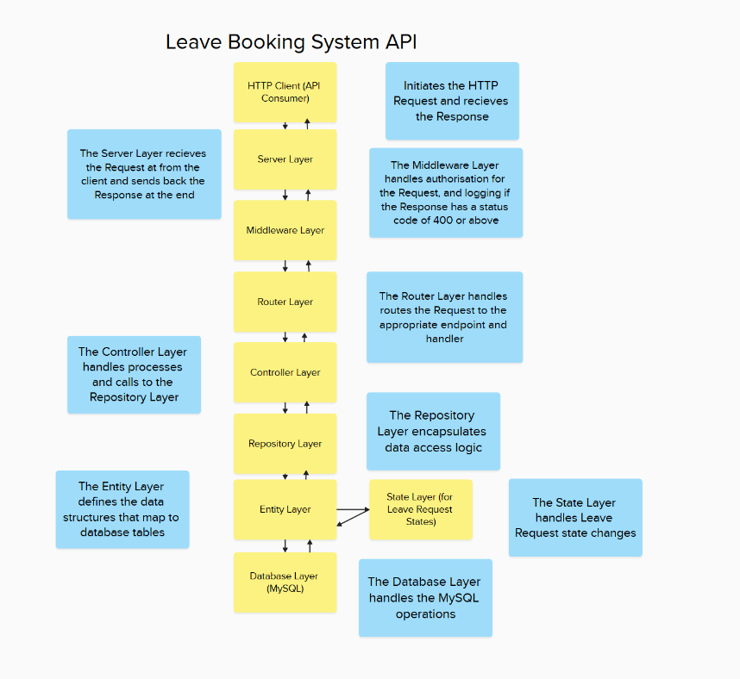
High-level Architecture

Slide 3
Security Requirements
1.Users will have to log in to view any API end points (i.e. all end points other than to login require authentication and authorisation by role)
2. JWT tokens will be used for authentication.
3. Requests will check the role of the user to establish if they are authorised to view a particular end point – a log should be kept of unauthorised access to end points
4. The system will limit the number of requests from a specific end point
5. The system will adjust its HTTP headers so that the server version is obfuscated

Slide 4
Staff Requirements
1. Request leave
2. Cancel a leave request
3. View the status of their leave requests – show all requests for a staff member including the status of those requests (Pending, Approved, Rejected)
4. View their remaining annual leave and/or days used

Slide 5
Manager Requirements
1.View outstanding requests for annual leave for their assigned members of staff
2. Approve a request for annual leave
3. Reject a request for annual leave
4. View the amount of annual leave remaining for a member of staff

Slide 6
Admin Requirements
1.Add a new member of staff
2. Amend the role or department of a member of staff
3. View all outstanding leave requests filtered by staff member, manager’s team or across the company
4. Amend the amount of annual leave assigned to a member of staff
5. Approve requests on behalf of managers and track system-wide usage.

Slide 7
Design Patterns Used
The following design patterns were used for the Leave Booking System API:
State
Factory
Dependency Injection
Chain of Responsibility
Strategy

Slide 8
State Pattern
Allow an object to alter its behaviour when its internal state changes. The object will appear to change its class.
This means that instead of conditional logic, polymorphic behaviour can be used, so the client code does not need to change
In this project, the leave requests were handled this way:

Slide 9
Leave Request States
State | approve() | reject() | cancel() | getStatus()
Pending | Approves the leave request and reduces the leave balance of the user. | Rejects the leave request. | Cancels the leave request | Returns the status ‘Pending’.
Approved | Throws an error because an already approved request cannot be reapproved. | Throws an error because an already approved request cannot be rejected. | Cancels the leave request and restores the leave balance of the user. | Returns the status ‘Approved’.
Rejected | Throws an error because an already rejected request cannot be approved. | Throws an error because an already rejected request cannot be rejected again. | Throws an error because an already rejected request cannot be cancelled. | Returns the status ‘Rejected’.
Cancelled | Throws an error because an already cancelled request cannot be approved. | Throws an error because an already cancelled request cannot be rejected. | Throws an error because an already cancelled request cannot be recancelled. | Returns the status ‘Cancelled’.

Slide 10
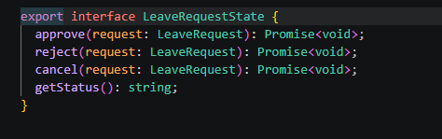
The LeaveRequestState Interface

Slide 11
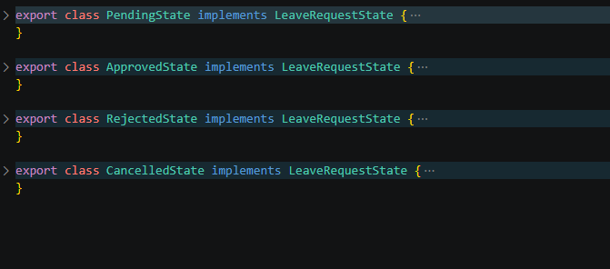
The Variations

Slide 12
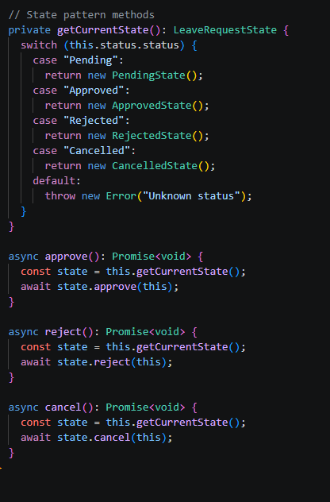
The LeaveRequest Entity Client Code

Slide 13
Factory Pattern
Defines an interface for creating a single object, but let subclasses decide which class to instantiate. Factory Method lets a class defer instantiation to subclasses.
I varied this pattern in my code, creating multiple concrete factories that each return a type, to help with Dependency Injection and to help with data-persistence and repository creation in each request

Slide 14
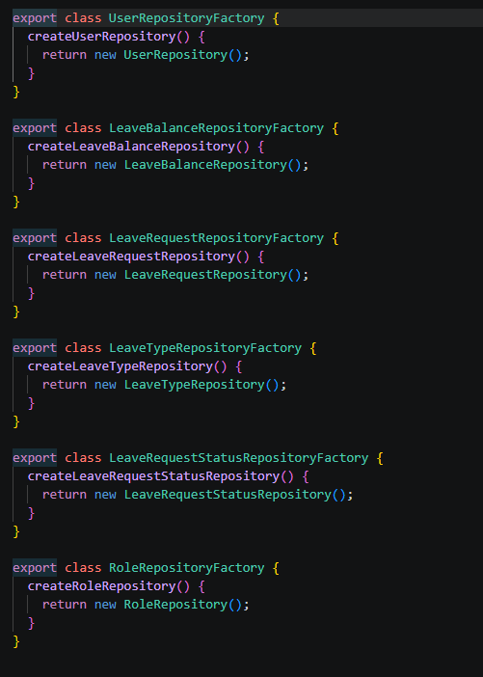
Factory Examples

Slide 15
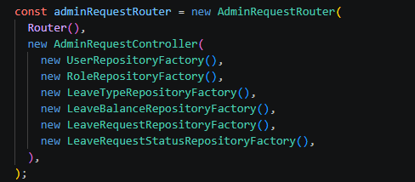
Factory Injection

Slide 16
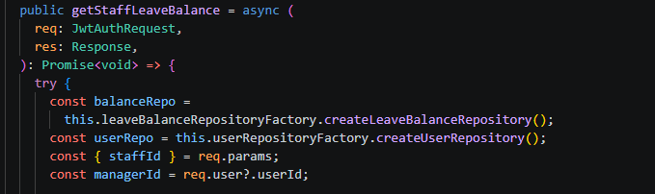
Use of Factory in a Request

Slide 17
Repository Pattern
The Repository pattern is used for data-access boundary between controllers and TypeORM.
By wrapping ORM functionality, business friendly functions can be called, meaning changes to the underlying ORM operations in the future should not affect the client code, the controller should only change when the particular business logic changes

Slide 18

Repository Pattern in Controller

Slide 19
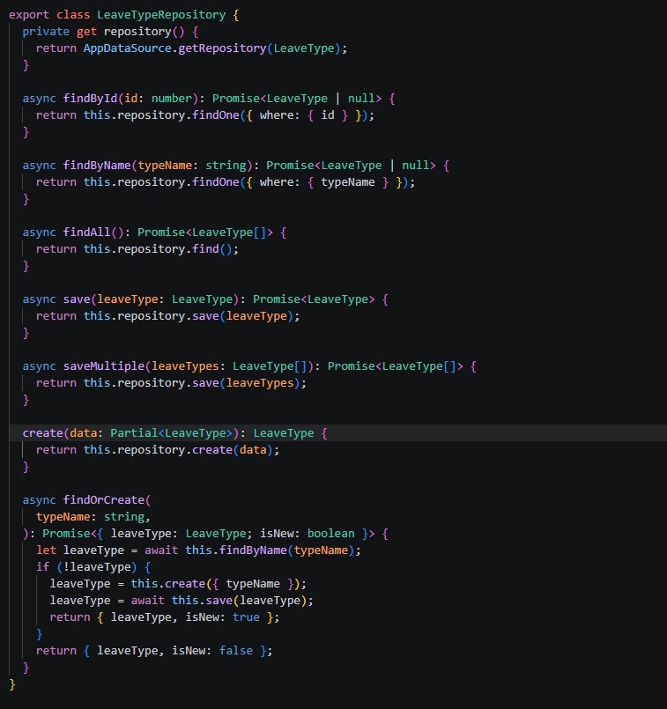
Actual Repository Code

Slide 20
Dependency Injection
Dependency Injection is where a class is injected with the objects it needs instead of creating them itself, usually through something called a composition root
This reduces coupling, allows for testability through mocking/ stubbing components, and allows polymorphism to help when dependencies may change based on environment
Allows for a more centralised Creator class, simplifying the program and reducing confusing code

Slide 21
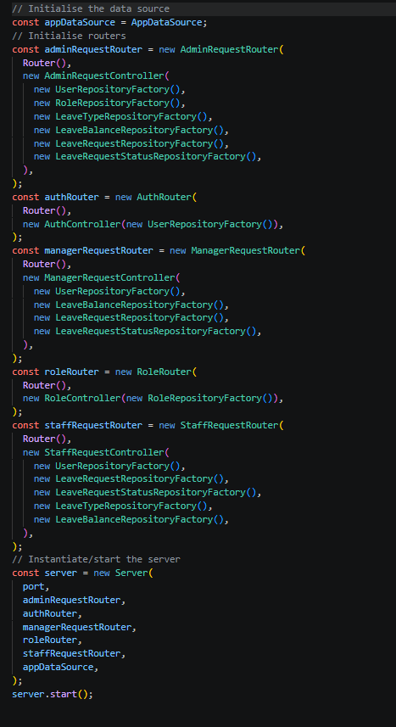
Dependency Injection in the Index

Slide 22
Chain of Responsibility Pattern
The Chain of Responsibility pattern is where a request is passed along a series of handlers, and each handler decides whether to process it or pass it on
The high-level architecture of the program handles this
Implementations details, such as the middleware chains, also handle this:

Slide 23
High-level Architecture COR

Slide 24
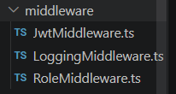
Middleware COR

Slide 25
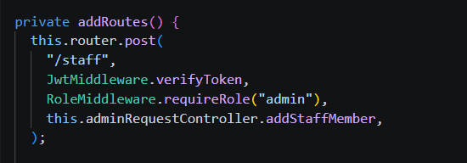
Router COR

Slide 26
Strategy Pattern
The Strategy pattern was started with the ILogger interface being used to inject a FileLogger into a responseLogger function
In the future, different types of loggers could be created, based on environment, allowing polymorphic functionality to be retained
Examples could be ConsoleLogger or RemoteLogger etc

Slide 27
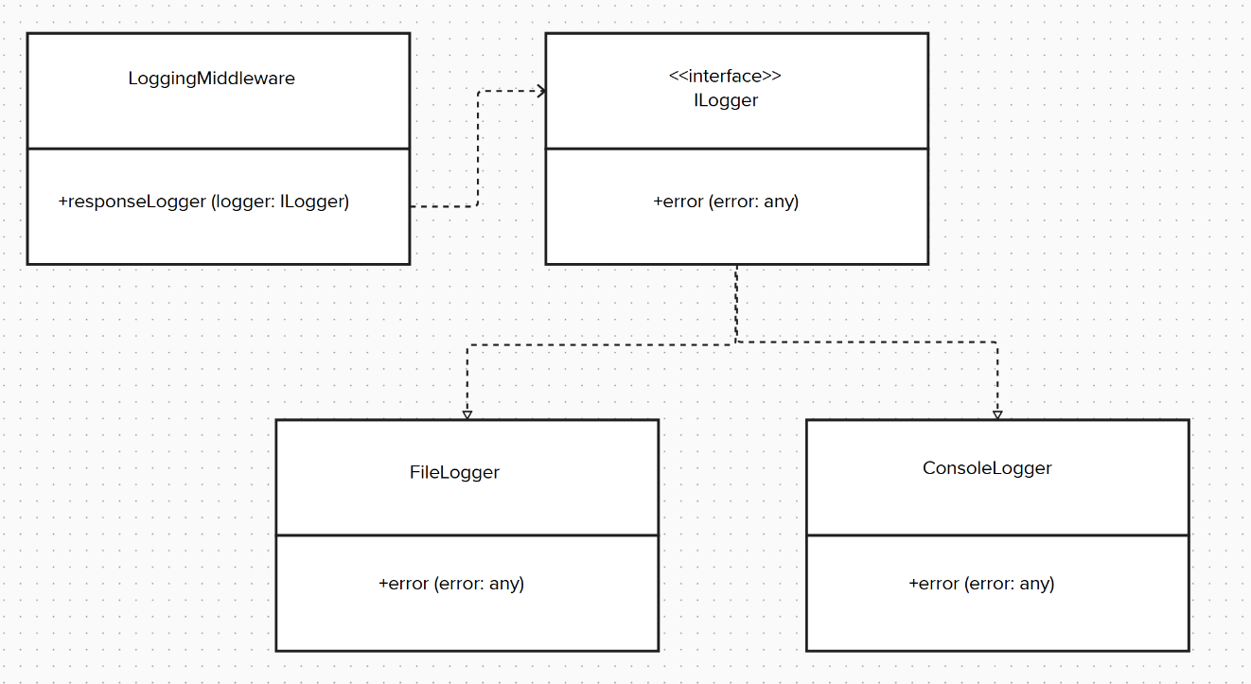
ILogger Polymorphism

Slide 28
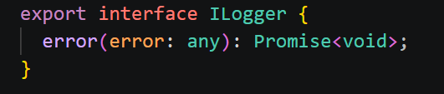
ILogger Interface

Slide 29
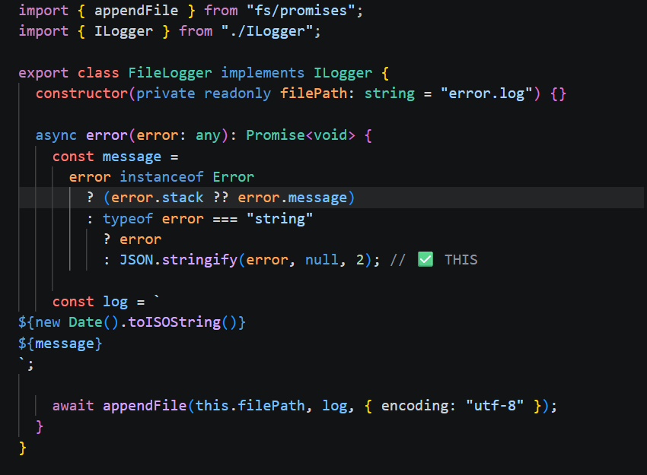
FileLogger Implementation

Slide 30

Injected FileLogger

