Slide 1
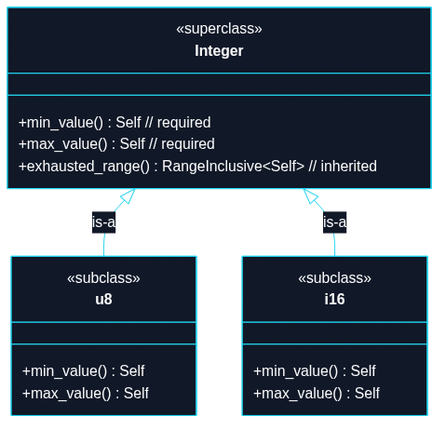
Puzzle 1
We store sets of integers, u8, i16, etc.. Every integer type must have functions like min_value. We also want all integers to inherit certain other functions such as exhausted_range.

Slide 2
use std::ops::RangeInclusive;
// Mini `range-set-blaze` Integer
// TECHNIQUE NAME: Trait Default Methods.
trait Integer: Copy + Ord {
fn min_value() -> Self;
fn max_value() -> Self;
// Default behavior inherited by implementors.
// Any impl can override this method.
/// Returns an exhausted (empty) range`.
fn exhausted_range() -> RangeInclusive<Self> {
debug_assert!(Self::min_value() < Self::max_value(), "Precondition");
Self::max_value()..=Self::min_value()
}
}
impl Integer for u8 {
fn min_value() -> Self {
u8::MIN
}
fn max_value() -> Self {
u8::MAX
}

Slide 3
}
impl Integer for i16 {
fn min_value() -> Self {
i16::MIN
}
fn max_value() -> Self {
i16::MAX
}
}
fn main() {
let r1 = u8::exhausted_range();
let r2 = i16::exhausted_range();
assert!(r1.is_empty());
assert!(r2.is_empty());
}

