Slide 1
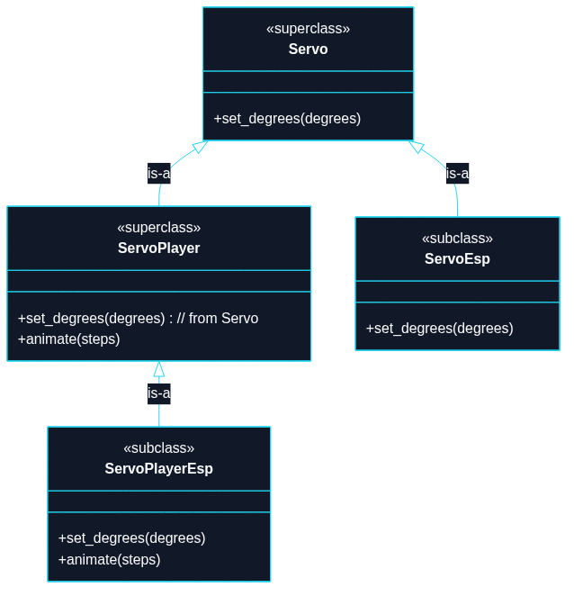
Puzzle 2
A servo is an electric motor that can move to a specified angle.

Slide 2
use std::thread;
use std::time::Duration;
// `Servo` is an abstract contract (a trait), not a concrete driver.
trait Servo {
fn set_degrees(&self, degrees: u16);
}
// `ServoPlayer` is also abstract. It extends `Servo` (supertrait), so any
// `ServoPlayer` can do everything in `Servo` plus animation.
// TECHNIQUE NAME: Supertrait Default Methods.
// (This example shows supertrait-based interface extension.)
trait ServoPlayer: Servo {
// (degrees, milliseconds to hold at that angle)
fn animate(&self, steps: &[(u16, u64)]);
}
// Concrete servo driver (similar naming to the real example): `ServoEsp`.
struct ServoEsp;
impl Servo for ServoEsp {
fn set_degrees(&self, degrees: u16) {
println!("[ServoEsp] set angle -> {degrees}°");
}
}

Slide 3
// Concrete servo player driver that can animate.
struct ServoPlayerEsp;
impl Servo for ServoPlayerEsp {
fn set_degrees(&self, degrees: u16) {
println!("[ServoPlayerEsp] set angle -> {degrees}°");
}
}
impl ServoPlayer for ServoPlayerEsp {
fn animate(&self, steps: &[(u16, u64)]) {
for (degrees, ms) in steps {
self.set_degrees(*degrees);
println!("[ServoPlayerEsp] hold for {ms}ms");
thread::sleep(Duration::from_millis(*ms));
}
}
}
// Generic program that only needs a `Servo`.
fn center_servo(servo: &impl Servo) {
servo.set_degrees(90);
}
// Generic program that needs a `ServoPlayer`.
fn run_wave(player: &impl ServoPlayer) {

Slide 4
player.animate(&[
(0, 120),
(45, 100),
(90, 100),
(135, 100),
(180, 120),
(135, 100),
(90, 100),
(45, 100),
(0, 120),
]);
}
fn main() {
let servo = ServoEsp;
let servo_player = ServoPlayerEsp;
center_servo(&servo);
// `ServoPlayer` can do everything `Servo` can!
center_servo(&servo_player);
// and more.
run_wave(&servo_player);
}

