Slide 1
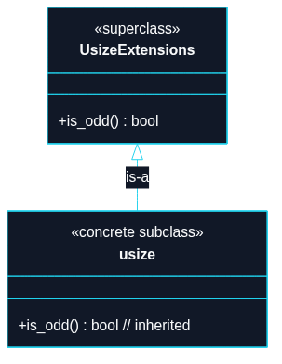
Puzzle 3
We want to add a new method is_odd() to an existing concrete type usize, even though we do not own that type.

Slide 2
trait UsizeExtensions {
fn is_odd(self) -> bool;
}
impl UsizeExtensions for usize {
fn is_odd(self) -> bool {
self & 1 != 0
}
}
// TECHNIQUE NAME: extension traits.
fn main() {
let count: usize = 7;
assert!(count.is_odd());
assert!(!12.is_odd());
}

