Slide 1
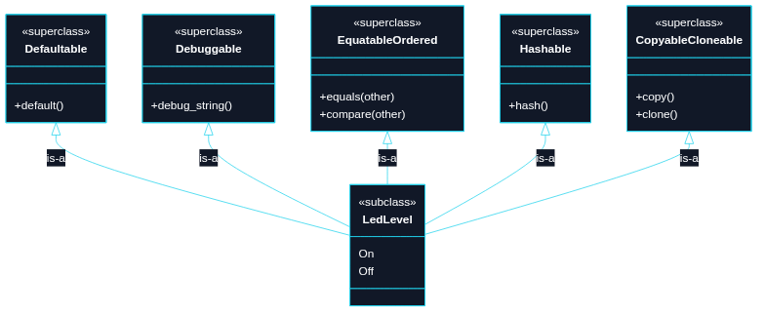
Puzzle 4
We want a small LedLevel enum type with two values (On, Off) that automatically participates in common behaviors (default value, debugging output, equality/order comparisons, hashing, copy/clone).

Slide 2
// TECHNIQUE NAME: derive-generated implementation
#[derive(Clone, Copy, Debug, Eq, Hash, Ord, PartialEq, PartialOrd, Default)]
enum LedLevel {
On,
#[default]
Off,
}
fn main() {
let default_level = LedLevel::default();
let on = LedLevel::On;
let off = LedLevel::Off;
assert_eq!(default_level, LedLevel::Off);
assert_ne!(on, off);
assert!(off > on);
// `Copy` + `Clone` come from derive too.
let copied = on;
let cloned = off.clone();
assert_eq!(copied, on);
assert_eq!(cloned, off);
}

