Slide 1
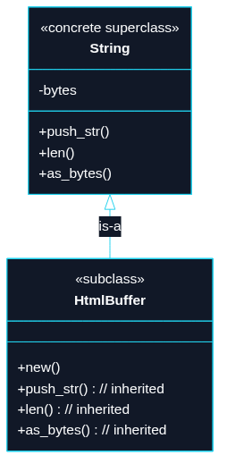
Puzzle 5
We want an HtmlBuffer to feel like a string for everyday method calls, while still being its own distinct type. Note that String is a concrete type with storage, not just an interface/trait/abstract base class.

Slide 2
use std::ops::{Deref, DerefMut};
struct HtmlBuffer(String);
impl HtmlBuffer {
fn new() -> Self {
Self(String::new())
}
}
impl Deref for HtmlBuffer {
type Target = String;
fn deref(&self) -> &Self::Target {
&self.0
}
}
impl DerefMut for HtmlBuffer {
fn deref_mut(&mut self) -> &mut Self::Target {
&mut self.0
}
}
// TECHNIQUE NAME: deref lookup.

Slide 3
fn main() {
let mut page = HtmlBuffer::new();
// `push_str` and `len` are String methods found via deref lookup.
page.push_str("<h1>Hello</h1>");
page.push_str("<p>Rust</p>");
assert_eq!(page.len(), 25);
// Borrow the thing `page` points to and compare.
assert_eq!(&*page, "<h1>Hello</h1><p>Rust</p>");
}
// Good for `Box`, `Rc`, etc., but not really good here.
// Also see AsRef, From, and Borrow traits.

