Slide 1
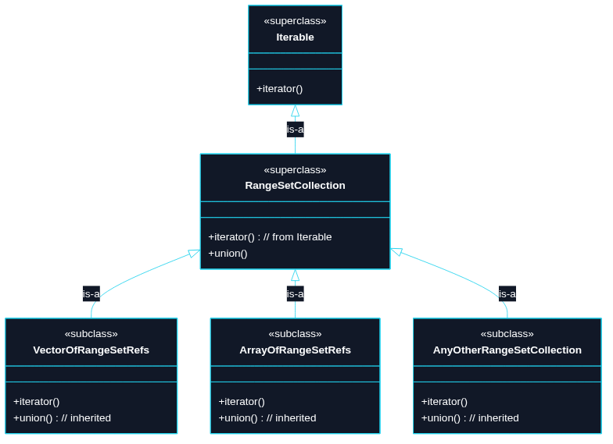
Puzzle 6
We want to union any number of sets (RangeSetBlaze<T>). In OO terms, any collection that is an iterable of RangeSetBlaze<T> references should inherit this operation.

Slide 2
use std::collections::BTreeSet;
// For this example, use u64 as our stand-in integer type.
type Integer = u64;
// Mock up RangeSetBlaze as a BTreeSet wrapper for demo purposes.
#[derive(Debug, Clone, PartialEq, Eq)]
struct RangeSetBlaze {
values: BTreeSet<Integer>,
}
impl RangeSetBlaze {
fn new() -> Self {
Self {
values: BTreeSet::new(),
}
}
// Construct from a slice of Integer values.
fn from_slice(values: &[Integer]) -> Self {
Self {
values: values.iter().copied().collect(),
}
}
// Return a new set that is the union of two borrowed sets.

Slide 3
fn union(&self, other: &Self) -> Self {
Self {
values: self.values.union(&other.values).copied().collect(),
}
}
fn is_empty(&self) -> bool {
self.values.is_empty()
}
}
// A RangeSetCollection is any type that can be turned into an iterator
// over borrowed RangeSetBlaze values.
//
// TECHNIQUE NAME: "blanket implementation".
// One impl applies to every type that matches the bound.
trait RangeSetCollection<'a>: IntoIterator<Item = &'a RangeSetBlaze> {
fn union(self) -> RangeSetBlaze
where
Self: Sized,
{
let mut result = RangeSetBlaze::new();
for set in self {
result = RangeSetBlaze::union(&result, set);
}
result

Slide 4
}
}
// Blanket implementation:
// Any type that can be turned into an iterator over &RangeSetBlaze
// automatically implements RangeSetCollection.
impl<'a, I> RangeSetCollection<'a> for I where I: IntoIterator<Item = &'a RangeSetBlaze> {}
fn main() {
let a = RangeSetBlaze::from_slice(&[1, 2, 3]);
let b = RangeSetBlaze::from_slice(&[3, 4, 5]);
let c = RangeSetBlaze::from_slice(&[5, 7, 9]);
let expected = RangeSetBlaze::from_slice(&[1, 2, 3, 4, 5, 7, 9]);
// A vector of sets can be unioned together.
assert_eq!(vec![&a, &b, &c].union(), expected);
// An array of sets can be unioned together.
assert_eq!([&a, &b, &c].union(), expected);
// A filtered option can be unioned.
assert_eq!(Some(&a).filter(|set| !set.is_empty()).union(), a);
}

