Slide 1
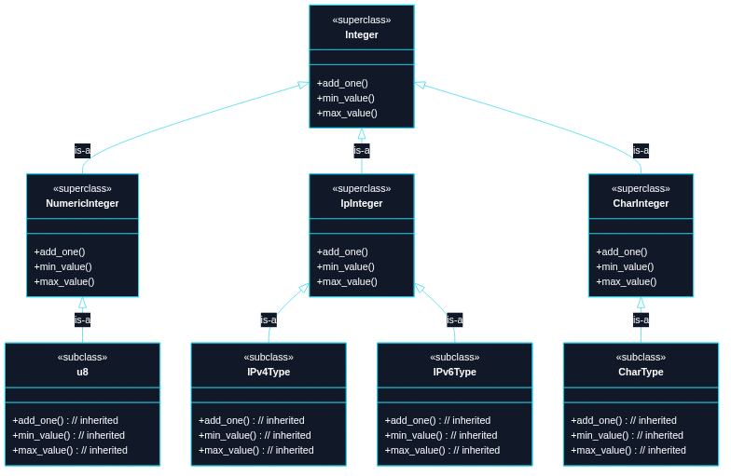
Puzzle 7
Treat 15 integer-like types uniformly: u8, ..., usize, ...i128, char, IPv4, IPv6 For example, with a min, max, and ability to add one (unchecked).

Slide 2
use std::net::{Ipv4Addr, Ipv6Addr};
trait Integer: Copy + Ord {
fn add_one(self) -> Self;
fn min_value() -> Self;
fn max_value() -> Self;
}
macro_rules! impl_integer_ops_num {
($t:ty) => {
fn add_one(self) -> Self {
self + 1
}
fn min_value() -> Self {
<$t>::MIN
}
fn max_value() -> Self {
<$t>::MAX
}
};
}
macro_rules! impl_integer_ops_ip {
($ip_type:ty, $representation_type:ty) => {

Slide 3
fn add_one(self) -> Self {
<$ip_type>::from(<$representation_type>::from(self).wrapping_add(1))
}
fn min_value() -> Self {
<$ip_type>::from(<$representation_type>::MIN)
}
fn max_value() -> Self {
<$ip_type>::from(<$representation_type>::MAX)
}
};
}
macro_rules! impl_integer_ops_char {
() => {
fn add_one(self) -> Self {
let mut num = u32::from(self) + 1;
if num == 0xD800 {
num = 0xE000;
}
char::from_u32(num).unwrap_or(char::MIN)
}
fn min_value() -> Self {
char::MIN

Slide 4
}
fn max_value() -> Self {
char::MAX
}
};
}
impl Integer for i8 { impl_integer_ops_num!(i8); }
impl Integer for u8 { impl_integer_ops_num!(u8); }
impl Integer for i16 { impl_integer_ops_num!(i16); }
impl Integer for u16 { impl_integer_ops_num!(u16); }
impl Integer for i32 { impl_integer_ops_num!(i32); }
impl Integer for u32 { impl_integer_ops_num!(u32); }
impl Integer for i64 { impl_integer_ops_num!(i64); }
impl Integer for u64 { impl_integer_ops_num!(u64); }
impl Integer for i128 { impl_integer_ops_num!(i128); }
impl Integer for u128 { impl_integer_ops_num!(u128); }
impl Integer for isize { impl_integer_ops_num!(isize); }
impl Integer for usize { impl_integer_ops_num!(usize); }
impl Integer for Ipv4Addr { impl_integer_ops_ip!(Ipv4Addr, u32); }
impl Integer for Ipv6Addr { impl_integer_ops_ip!(Ipv6Addr, u128); }
impl Integer for char { impl_integer_ops_char!(); }
// Can't use num_traits::PrimInt as a 'subclass'
// because Rust worries that 'char' etc. might

Slide 5
// be added to it later (coherence).
// TECHNIQUE NAME: macro-generated implementation.
fn main() {
let x: u8 = 254;
assert_eq!(x.add_one(), 255);
assert_eq!('a'.add_one(), 'b');
assert_eq!(char::min_value(), char::MIN);
assert_eq!(char::max_value(), char::MAX);
assert_eq!(Ipv4Addr::min_value(), Ipv4Addr::from(0u32));
assert_eq!(Ipv4Addr::max_value(), Ipv4Addr::from(u32::MAX));
}

