Slide 1
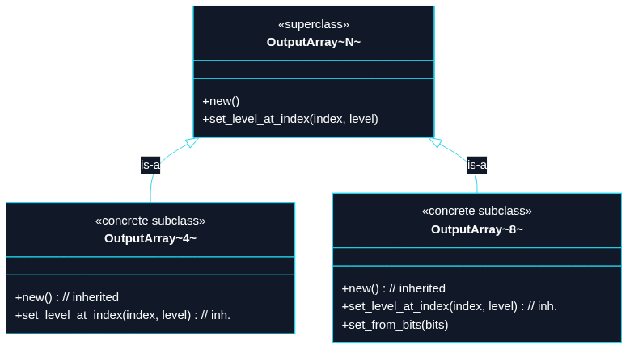
Puzzle 8
We have an OutputArray<N> superclass with two methods. For N = 8, however, we want one extra method because it maps cleanly to a u8 bitmask.

Slide 2
#[derive(Debug, Clone, Copy)]
struct OutputArray<const N: usize> {
levels: [bool; N],
}
impl<const N: usize> OutputArray<N> {
fn new() -> Self {
Self { levels: [false; N] }
}
fn set_level_at_index(&mut self, index: usize, level: bool) {
self.levels[index] = level;
}
}
// Hardcoded 8, matching the bit width expected by a u8 mask.
impl OutputArray<8> {
fn set_from_bits(&mut self, mut bits: u8) {
for slot in &mut self.levels {
*slot = (bits & 1) == 1;
bits >>= 1;
}
}
}
// TECHNIQUE NAME: constraint-gated methods.

Slide 3
// - Methods that only exist when certain constraints are met.
fn main() {
let mut any = OutputArray::<4>::new();
any.set_level_at_index(2, true);
let mut eight = OutputArray::<8>::new();
eight.set_from_bits(0b1011_0001);
assert_eq!(any.levels, [false, false, true, false]);
assert_eq!(eight.levels, [true, false, false, false, true, true, false, true]);
}

