Slide 1
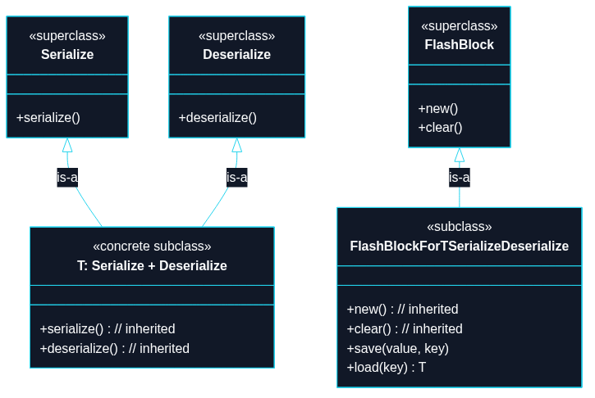
Puzzle 9
We want two levels of FlashBlock: a base level with new and clear, and a constrained level that adds save and load only when T satisfies both serialization and deserialization capabilities.

Slide 2
use std::collections::HashMap;
use serde::de::DeserializeOwned;
use serde::{Deserialize, Serialize};
#[derive(Debug, Clone, Serialize, Deserialize, PartialEq, Eq)]
struct WifiCredentials {
ssid: String,
password: String,
}
/// Key point: method-level gating.
/// - The type exists for all use-cases.
/// - Only `save/load<T>` require extra capabilities on `T`.
#[derive(Default)]
struct FlashBlock {
store: HashMap<String, Vec<u8>>,
}
impl FlashBlock {
fn new() -> Self {
Self::default()
}
fn clear(&mut self) {
self.store.clear();

Slide 3
}
fn save<T>(&mut self, key: &str, value: &T) -> Result<(), postcard::Error>
where
T: Serialize + DeserializeOwned,
{
let bytes = postcard::to_stdvec(value)?;
self.store.insert(key.to_string(), bytes);
Ok(())
}
fn load<T>(&self, key: &str) -> Option<T>
where
T: Serialize + DeserializeOwned,
{
let bytes = self.store.get(key)?;
postcard::from_bytes(bytes).ok()
}
}
// TECHNIQUE NAME: method-level gating.
fn main() -> Result<(), postcard::Error> {
let mut flash = FlashBlock::new();
let credentials = WifiCredentials {

Slide 4
ssid: "HomeWiFi".to_string(),
password: "secret".to_string(),
};
// Works: WifiCredentials satisfies Serialize + Deserialize.
flash.save("wifi", &credentials)?;
let loaded: Option<WifiCredentials> = flash.load("wifi");
let loaded = loaded.unwrap();
assert_eq!(&loaded.ssid, "HomeWiFi");
assert_eq!(&loaded.password, "secret");
flash.clear();
assert!(flash.load::<WifiCredentials>("wifi").is_none());
Ok(())
}

