Slide 1
Nine Ways to Inherit in Rust a Language without Inheritance
Carl Kadie · github.com/CarlKCarlK/rust-inherit

Slide 2
Introduction
Rust has objects, but not class inheritance
Defining “object-oriented” is controversial
Skip that debate
How do we share behavior across related types?
Credentials: C++, C#, Python*, Smalltalk
Format: 9 puzzles & Rust solutions
inspired by real code

Slide 3
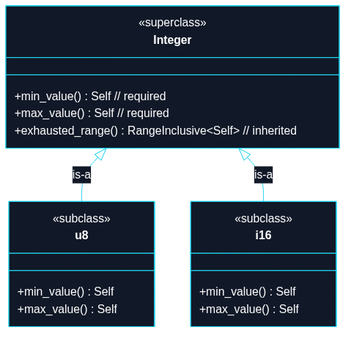
Puzzle 1
We store sets of integers, u8, i16, etc.. Every integer type must have functions like min_value. We also want all integers to inherit certain other functions such as exhausted_range.

Slide 4
use std::ops::RangeInclusive;
// Mini `range-set-blaze` Integer
// TECHNIQUE NAME: Trait Default Methods.
trait Integer: Copy + Ord {
fn min_value() -> Self;
fn max_value() -> Self;
// Default behavior inherited by implementors.
// Any impl can override this method.
/// Returns an exhausted (empty) range`.
fn exhausted_range() -> RangeInclusive<Self> {
debug_assert!(Self::min_value() < Self::max_value(), "Precondition");
Self::max_value()..=Self::min_value()
}
}
impl Integer for u8 {
fn min_value() -> Self {
u8::MIN
}
fn max_value() -> Self {
u8::MAX
}

Slide 5
}
impl Integer for i16 {
fn min_value() -> Self {
i16::MIN
}
fn max_value() -> Self {
i16::MAX
}
}
fn main() {
let r1 = u8::exhausted_range();
let r2 = i16::exhausted_range();
assert!(r1.is_empty());
assert!(r2.is_empty());
}

Slide 6
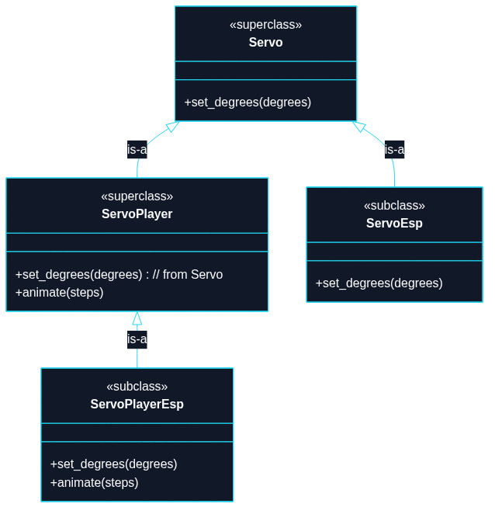
Puzzle 2
A servo is an electric motor that can move to a specified angle.

Slide 7
use std::thread;
use std::time::Duration;
// `Servo` is an abstract contract (a trait), not a concrete driver.
trait Servo {
fn set_degrees(&self, degrees: u16);
}
// `ServoPlayer` is also abstract. It extends `Servo` (supertrait), so any
// `ServoPlayer` can do everything in `Servo` plus animation.
// TECHNIQUE NAME: Supertrait Default Methods.
// (This example shows supertrait-based interface extension.)
trait ServoPlayer: Servo {
// (degrees, milliseconds to hold at that angle)
fn animate(&self, steps: &[(u16, u64)]);
}
// Concrete servo driver (similar naming to the real example): `ServoEsp`.
struct ServoEsp;
impl Servo for ServoEsp {
fn set_degrees(&self, degrees: u16) {
println!("[ServoEsp] set angle -> {degrees}°");
}
}

Slide 8
// Concrete servo player driver that can animate.
struct ServoPlayerEsp;
impl Servo for ServoPlayerEsp {
fn set_degrees(&self, degrees: u16) {
println!("[ServoPlayerEsp] set angle -> {degrees}°");
}
}
impl ServoPlayer for ServoPlayerEsp {
fn animate(&self, steps: &[(u16, u64)]) {
for (degrees, ms) in steps {
self.set_degrees(*degrees);
println!("[ServoPlayerEsp] hold for {ms}ms");
thread::sleep(Duration::from_millis(*ms));
}
}
}
// Generic program that only needs a `Servo`.
fn center_servo(servo: &impl Servo) {
servo.set_degrees(90);
}
// Generic program that needs a `ServoPlayer`.
fn run_wave(player: &impl ServoPlayer) {

Slide 9
player.animate(&[
(0, 120),
(45, 100),
(90, 100),
(135, 100),
(180, 120),
(135, 100),
(90, 100),
(45, 100),
(0, 120),
]);
}
fn main() {
let servo = ServoEsp;
let servo_player = ServoPlayerEsp;
center_servo(&servo);
// `ServoPlayer` can do everything `Servo` can!
center_servo(&servo_player);
// and more.
run_wave(&servo_player);
}

Slide 10
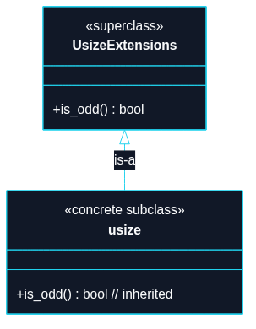
Puzzle 3
We want to add a new method is_odd() to an existing concrete type usize, even though we do not own that type.

Slide 11
trait UsizeExtensions {
fn is_odd(self) -> bool;
}
impl UsizeExtensions for usize {
fn is_odd(self) -> bool {
self & 1 != 0
}
}
// TECHNIQUE NAME: extension traits.
fn main() {
let count: usize = 7;
assert!(count.is_odd());
assert!(!12.is_odd());
}

Slide 12
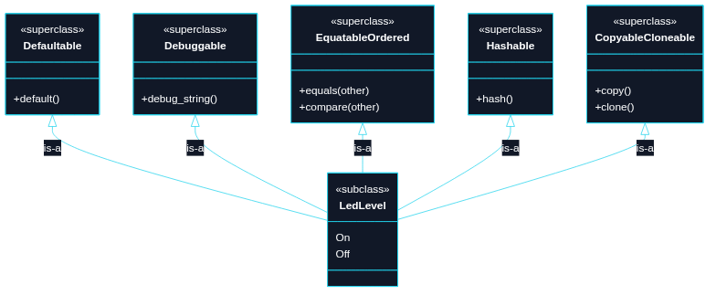
Puzzle 4
We want a small LedLevel enum type with two values (On, Off) that automatically participates in common behaviors (default value, debugging output, equality/order comparisons, hashing, copy/clone).

Slide 13
// TECHNIQUE NAME: derive-generated implementation
#[derive(Clone, Copy, Debug, Eq, Hash, Ord, PartialEq, PartialOrd, Default)]
enum LedLevel {
On,
#[default]
Off,
}
fn main() {
let default_level = LedLevel::default();
let on = LedLevel::On;
let off = LedLevel::Off;
assert_eq!(default_level, LedLevel::Off);
assert_ne!(on, off);
assert!(off > on);
// `Copy` + `Clone` come from derive too.
let copied = on;
let cloned = off.clone();
assert_eq!(copied, on);
assert_eq!(cloned, off);
}

Slide 14
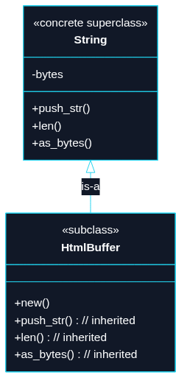
Puzzle 5
We want an HtmlBuffer to feel like a string for everyday method calls, while still being its own distinct type. Note that String is a concrete type with storage, not just an interface/trait/abstract base class.

Slide 15
use std::ops::{Deref, DerefMut};
struct HtmlBuffer(String);
impl HtmlBuffer {
fn new() -> Self {
Self(String::new())
}
}
impl Deref for HtmlBuffer {
type Target = String;
fn deref(&self) -> &Self::Target {
&self.0
}
}
impl DerefMut for HtmlBuffer {
fn deref_mut(&mut self) -> &mut Self::Target {
&mut self.0
}
}
// TECHNIQUE NAME: deref lookup.

Slide 16
fn main() {
let mut page = HtmlBuffer::new();
// `push_str` and `len` are String methods found via deref lookup.
page.push_str("<h1>Hello</h1>");
page.push_str("<p>Rust</p>");
assert_eq!(page.len(), 25);
// Borrow the thing `page` points to and compare.
assert_eq!(&*page, "<h1>Hello</h1><p>Rust</p>");
}
// Good for `Box`, `Rc`, etc., but not really good here.
// Also see AsRef, From, and Borrow traits.

Slide 17
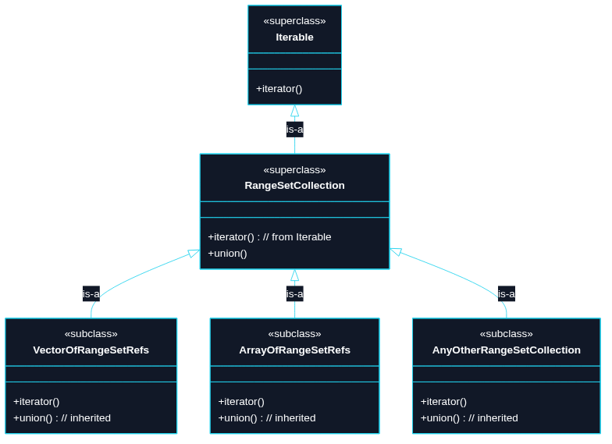
Puzzle 6
We want to union any number of sets (RangeSetBlaze<T>). In OO terms, any collection that is an iterable of RangeSetBlaze<T> references should inherit this operation.

Slide 18
use std::collections::BTreeSet;
// For this example, use u64 as our stand-in integer type.
type Integer = u64;
// Mock up RangeSetBlaze as a BTreeSet wrapper for demo purposes.
#[derive(Debug, Clone, PartialEq, Eq)]
struct RangeSetBlaze {
values: BTreeSet<Integer>,
}
impl RangeSetBlaze {
fn new() -> Self {
Self {
values: BTreeSet::new(),
}
}
// Construct from a slice of Integer values.
fn from_slice(values: &[Integer]) -> Self {
Self {
values: values.iter().copied().collect(),
}
}
// Return a new set that is the union of two borrowed sets.

Slide 19
fn union(&self, other: &Self) -> Self {
Self {
values: self.values.union(&other.values).copied().collect(),
}
}
fn is_empty(&self) -> bool {
self.values.is_empty()
}
}
// A RangeSetCollection is any type that can be turned into an iterator
// over borrowed RangeSetBlaze values.
//
// TECHNIQUE NAME: "blanket implementation".
// One impl applies to every type that matches the bound.
trait RangeSetCollection<'a>: IntoIterator<Item = &'a RangeSetBlaze> {
fn union(self) -> RangeSetBlaze
where
Self: Sized,
{
let mut result = RangeSetBlaze::new();
for set in self {
result = RangeSetBlaze::union(&result, set);
}
result

Slide 20
}
}
// Blanket implementation:
// Any type that can be turned into an iterator over &RangeSetBlaze
// automatically implements RangeSetCollection.
impl<'a, I> RangeSetCollection<'a> for I where I: IntoIterator<Item = &'a RangeSetBlaze> {}
fn main() {
let a = RangeSetBlaze::from_slice(&[1, 2, 3]);
let b = RangeSetBlaze::from_slice(&[3, 4, 5]);
let c = RangeSetBlaze::from_slice(&[5, 7, 9]);
let expected = RangeSetBlaze::from_slice(&[1, 2, 3, 4, 5, 7, 9]);
// A vector of sets can be unioned together.
assert_eq!(vec![&a, &b, &c].union(), expected);
// An array of sets can be unioned together.
assert_eq!([&a, &b, &c].union(), expected);
// A filtered option can be unioned.
assert_eq!(Some(&a).filter(|set| !set.is_empty()).union(), a);
}

Slide 21
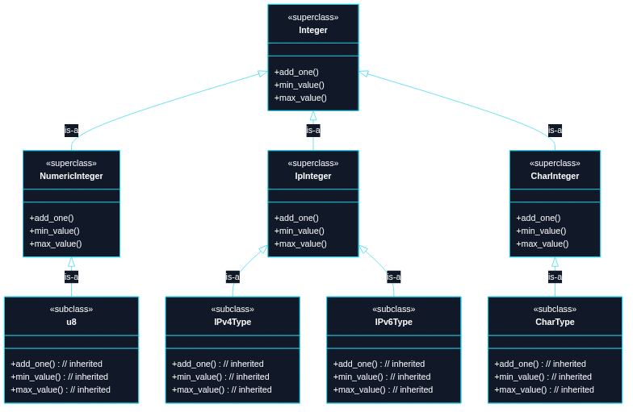
Puzzle 7
Treat 15 integer-like types uniformly: u8, ..., usize, ...i128, char, IPv4, IPv6 For example, with a min, max, and ability to add one (unchecked).

Slide 22
use std::net::{Ipv4Addr, Ipv6Addr};
trait Integer: Copy + Ord {
fn add_one(self) -> Self;
fn min_value() -> Self;
fn max_value() -> Self;
}
macro_rules! impl_integer_ops_num {
($t:ty) => {
fn add_one(self) -> Self {
self + 1
}
fn min_value() -> Self {
<$t>::MIN
}
fn max_value() -> Self {
<$t>::MAX
}
};
}
macro_rules! impl_integer_ops_ip {
($ip_type:ty, $representation_type:ty) => {

Slide 23
fn add_one(self) -> Self {
<$ip_type>::from(<$representation_type>::from(self).wrapping_add(1))
}
fn min_value() -> Self {
<$ip_type>::from(<$representation_type>::MIN)
}
fn max_value() -> Self {
<$ip_type>::from(<$representation_type>::MAX)
}
};
}
macro_rules! impl_integer_ops_char {
() => {
fn add_one(self) -> Self {
let mut num = u32::from(self) + 1;
if num == 0xD800 {
num = 0xE000;
}
char::from_u32(num).unwrap_or(char::MIN)
}
fn min_value() -> Self {
char::MIN

Slide 24
}
fn max_value() -> Self {
char::MAX
}
};
}
impl Integer for i8 { impl_integer_ops_num!(i8); }
impl Integer for u8 { impl_integer_ops_num!(u8); }
impl Integer for i16 { impl_integer_ops_num!(i16); }
impl Integer for u16 { impl_integer_ops_num!(u16); }
impl Integer for i32 { impl_integer_ops_num!(i32); }
impl Integer for u32 { impl_integer_ops_num!(u32); }
impl Integer for i64 { impl_integer_ops_num!(i64); }
impl Integer for u64 { impl_integer_ops_num!(u64); }
impl Integer for i128 { impl_integer_ops_num!(i128); }
impl Integer for u128 { impl_integer_ops_num!(u128); }
impl Integer for isize { impl_integer_ops_num!(isize); }
impl Integer for usize { impl_integer_ops_num!(usize); }
impl Integer for Ipv4Addr { impl_integer_ops_ip!(Ipv4Addr, u32); }
impl Integer for Ipv6Addr { impl_integer_ops_ip!(Ipv6Addr, u128); }
impl Integer for char { impl_integer_ops_char!(); }
// Can't use num_traits::PrimInt as a 'subclass'
// because Rust worries that 'char' etc. might

Slide 25
// be added to it later (coherence).
// TECHNIQUE NAME: macro-generated implementation.
fn main() {
let x: u8 = 254;
assert_eq!(x.add_one(), 255);
assert_eq!('a'.add_one(), 'b');
assert_eq!(char::min_value(), char::MIN);
assert_eq!(char::max_value(), char::MAX);
assert_eq!(Ipv4Addr::min_value(), Ipv4Addr::from(0u32));
assert_eq!(Ipv4Addr::max_value(), Ipv4Addr::from(u32::MAX));
}

Slide 26
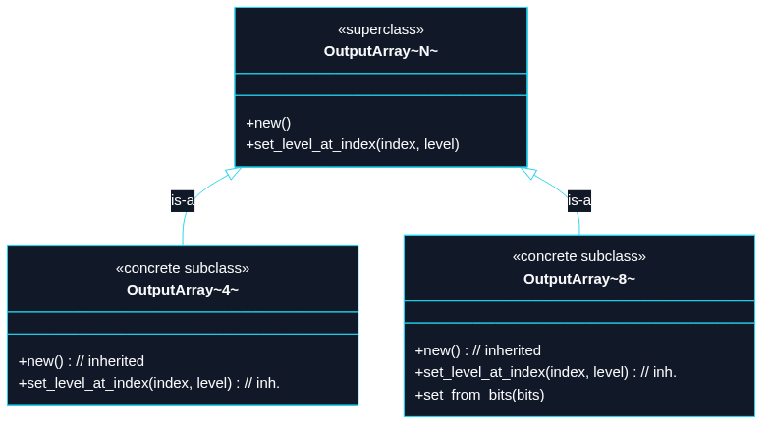
Puzzle 8
We have an OutputArray<N> superclass with two methods. For N = 8, however, we want one extra method because it maps cleanly to a u8 bitmask.

Slide 27
#[derive(Debug, Clone, Copy)]
struct OutputArray<const N: usize> {
levels: [bool; N],
}
impl<const N: usize> OutputArray<N> {
fn new() -> Self {
Self { levels: [false; N] }
}
fn set_level_at_index(&mut self, index: usize, level: bool) {
self.levels[index] = level;
}
}
// Hardcoded 8, matching the bit width expected by a u8 mask.
impl OutputArray<8> {
fn set_from_bits(&mut self, mut bits: u8) {
for slot in &mut self.levels {
*slot = (bits & 1) == 1;
bits >>= 1;
}
}
}
// TECHNIQUE NAME: constraint-gated methods.

Slide 28
// - Methods that only exist when certain constraints are met.
fn main() {
let mut any = OutputArray::<4>::new();
any.set_level_at_index(2, true);
let mut eight = OutputArray::<8>::new();
eight.set_from_bits(0b1011_0001);
assert_eq!(any.levels, [false, false, true, false]);
assert_eq!(eight.levels, [true, false, false, false, true, true, false, true]);
}

Slide 29
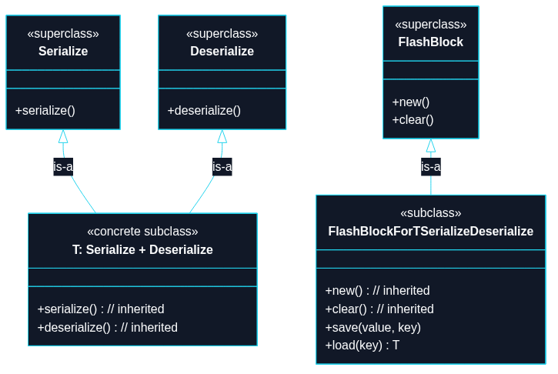
Puzzle 9
We want two levels of FlashBlock: a base level with new and clear, and a constrained level that adds save and load only when T satisfies both serialization and deserialization capabilities.

Slide 30
use std::collections::HashMap;
use serde::de::DeserializeOwned;
use serde::{Deserialize, Serialize};
#[derive(Debug, Clone, Serialize, Deserialize, PartialEq, Eq)]
struct WifiCredentials {
ssid: String,
password: String,
}
/// Key point: method-level gating.
/// - The type exists for all use-cases.
/// - Only `save/load<T>` require extra capabilities on `T`.
#[derive(Default)]
struct FlashBlock {
store: HashMap<String, Vec<u8>>,
}
impl FlashBlock {
fn new() -> Self {
Self::default()
}
fn clear(&mut self) {
self.store.clear();

Slide 31
}
fn save<T>(&mut self, key: &str, value: &T) -> Result<(), postcard::Error>
where
T: Serialize + DeserializeOwned,
{
let bytes = postcard::to_stdvec(value)?;
self.store.insert(key.to_string(), bytes);
Ok(())
}
fn load<T>(&self, key: &str) -> Option<T>
where
T: Serialize + DeserializeOwned,
{
let bytes = self.store.get(key)?;
postcard::from_bytes(bytes).ok()
}
}
// TECHNIQUE NAME: method-level gating.
fn main() -> Result<(), postcard::Error> {
let mut flash = FlashBlock::new();
let credentials = WifiCredentials {

Slide 32
ssid: "HomeWiFi".to_string(),
password: "secret".to_string(),
};
// Works: WifiCredentials satisfies Serialize + Deserialize.
flash.save("wifi", &credentials)?;
let loaded: Option<WifiCredentials> = flash.load("wifi");
let loaded = loaded.unwrap();
assert_eq!(&loaded.ssid, "HomeWiFi");
assert_eq!(&loaded.password, "secret");
flash.clear();
assert!(flash.load::<WifiCredentials>("wifi").is_none());
Ok(())
}

Slide 33
Conclusion
Trait Default Methods | “Interface” defines default implementation
Supertrait Default Methods | #1 but with more levels of traits
Extension Traits | Add methods to one or a few (foreign) types
Derive-Generated Implementations | #[derive(Clone, Debug, etc.)]
Deref Method Lookup | Add methods to concrete types like String
Blanket Implementations | Add methods to all (foreign) types that satisfy
Macro-Generated Implementations | When #2 doesn’t work because “coherence”
Constraint-Gated Methods | e.g. when const N=8, add a method
Method-Level Constraints | e.g. method defined when T: Serialize+etc

