Slide 1
Semi-Annual Review Meeting
Building the NOMA Simulation Model for MAC Layer Research
基於連續干擾消除技術之 非正交多重接取模擬平台
謝宏昀教授
SIGCOMM
中華民國103年6月27日

Slide 2
OUTLINE
STATUS QUO
KEY NEW INSIGHTS
MAIN ACHIEVEMENT
HOW IT WORKS
LIMITATION AND ASSUMPTIONS
QUANTITATIVE IMPACT
PROJECT GOALS
CONCLUSIONS

Slide 3
STATUS QUO
Related work has investigated fundamental performance gains of non-orthogonal multiple access (NOMA) over OFDMA predominantly based on the Shannon capacity model.
These theoretic models cannot capture the complexity and real performance of NOMA using practical communication techniques.
To proceed with the MAC-layer research (e.g. resource allocation and power control) based on NOMA, it is desirable to have an underlying model that can capture the practical performance trade-offs in NOMA.
The problem to solve at this stage is to build a working simulation model based on existing NOMA PHY techniques (e.g. successive interference cancellation, SIC) that can serve as the basis for future research investigation at the MAC layer.
What is the state of the art, what are its limitations, what are the problems to be solved?

Slide 4
KEY NEW INSIGHTS
Error propagation in existing NOMA PHY techniques (SIC) due to successive decoding of multiplexed signals needs to be taken into consideration in the simulation model.
The impact of modulation/coding scheme (MCS) selection as well as the power allocation factor (PAF) among NOMA users (users that share the same resource block) also needs to be taken into consideration in the simulation model.
For a two-user NOMA system, pairing of users for sharing each resource block should ensure that the bit error rates (BERs) achieved at each user are within the tolerable range when the sum rate is being maximized.
What are the key new insights?

Slide 5
MAIN ACHIEVEMENT (or OBJECTIVE)
We have built a physical-layer simulation platform for single-antenna NOMA with consideration of modulation, channel coding, and multipath channels based on SIC.
We have obtained the desired MCS/BER model for two-user NOMA in the two-stage decoding scheme for further investigation on MCS selection, power allocation, and user pairing at the MAC layer.
We have investigated a simple scheduling algorithm for pairing users in each OFDM resource block such that the BERs of all users can satisfy the desired constraint (through proper MCS selection) while achieving performance gain in the sum rate.

Slide 6
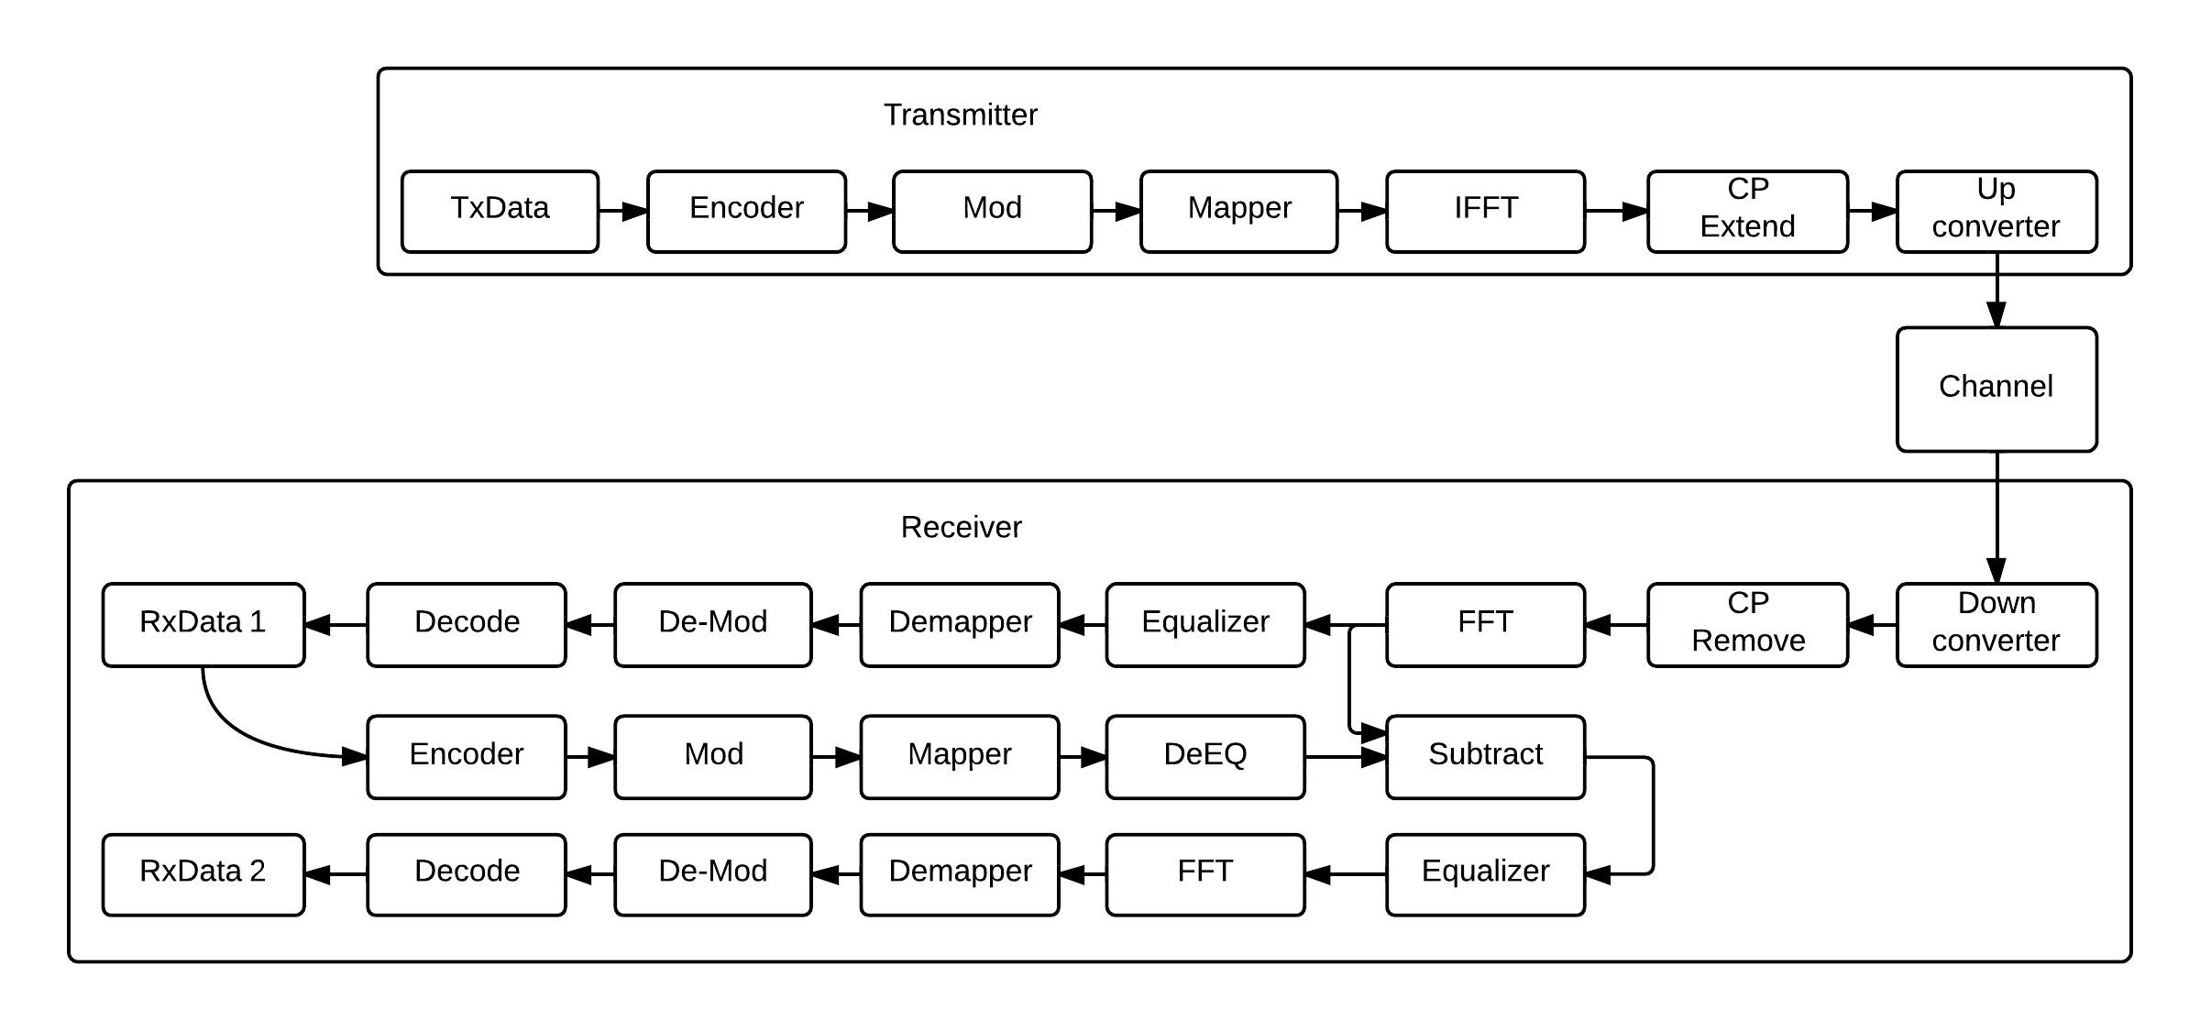
HOW IT WORKS
The physical layer simulation (programmed in C++ with library dependency on IT++, BLAS, LAPACK and FFTW) is designed that the receiver can extract two layers of multiplexed data.
At the Transmitter (BS), signals of different sources is multiplexed.

Slide 7
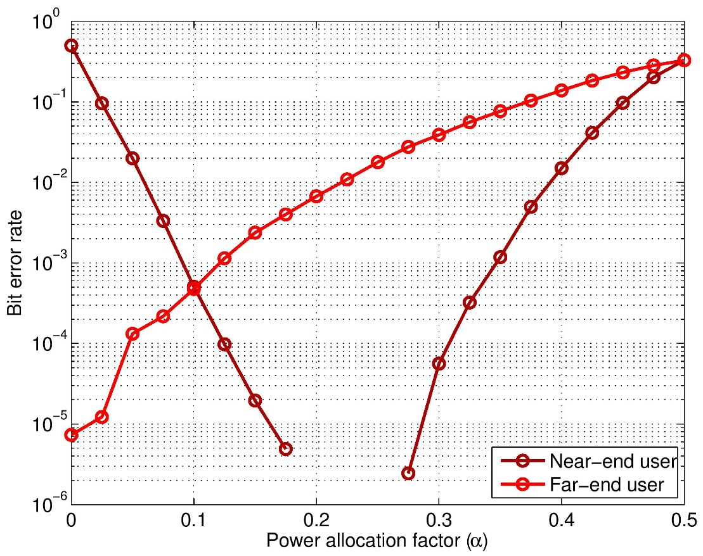
HOW IT WORKS
For each MCS, power allocation factor (alpha value) and given user position, the scenario BER is calculated. The simulation ( figure below) show the how error propagation effects the SIC decoding performance for near-end user as the power allocation factor come close to 0.5.
Practically, a BER constraint is needed so that the corresponding rate is bounded.

Slide 8
LIMITATION AND ASSUMPTIONS
The receiver is aware of number of multiplexed user data and thus no further detection is needed to identify the depth of decoding order. Transceiver can only process signals of two sources utmost.
Full channel state information is assume in the simulation, no channel estimation or receiver manufacture defect is taken into consideration.
In the theoretical model (SINR based), the range of supported rate is continuous, however supported rate for UE is limited in the simulation.
Weighted sum ratio, the objective in SIC is defined as, for example: UE1 reaches 60% of dedicated throughput (OFDM) and UE2 reaches 72%, the weighted sum ratio is 66%.

Slide 9
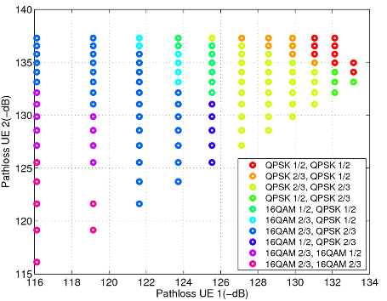
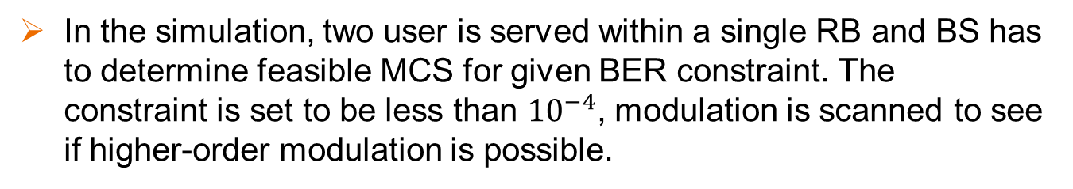
QUANTITATIVE IMPACT
In the simulation, two user is served within a single RB and BS has to determine feasible MCS for given BER constraint. The constraint is set to be less than ${10}^{−4}$, modulation is scanned to see if higher-order modulation is possible.
Because of error propagation during decoding, the feasible region is bounded by far-end user (labeled as UE2).
The greater the difference of the channel condition, the BS can operate with better MCS.
Best MCS for two-user NOMA

Slide 10
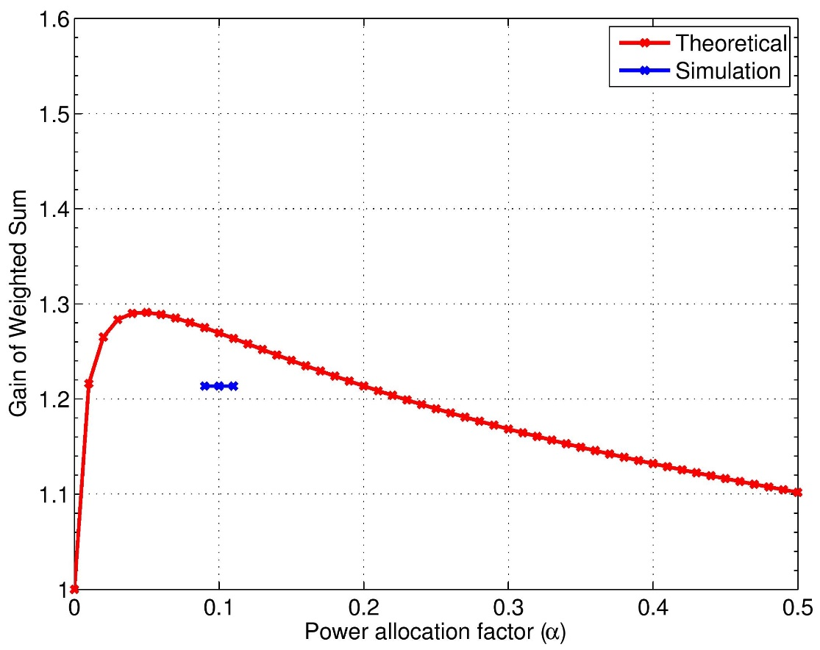
QUANTITATIVE IMPACT
We have found that a 20% performance gain in the (weighted) sum rate can be achieved when the paired users have a path-loss ratio of 22.73. The performance gain increases as the difference in the channel condition (path loss) keeps increasing.
Theoretical model optimal power allocation factor shifts compared to operable region for best MCS by the simulation results.
Notes:
We have found that given the desired BER threshold, the range of operable power allocation factor (power allocated to the near user vs. that to the far user) is small – it falls mostly in 0.25 ~ 0.05, depends on channel condition.
PL ratio: 22.73
Theo. best alpha: 0.0473
Theo. gain: 29.11%
Sim. operable alpha: 0.09 – 0.11
Sim. gain: 21.36%
MCS: UE1(16QAM – 1/2) UE2(QPSK – 1/2)
As mentioned in the [LIMITATION AND ASSUMPTIONS] the supported MCS is limited, so the Simulation sample points (gain) is not necessary to be bounded by region below the line of Theoretical result.

Slide 11
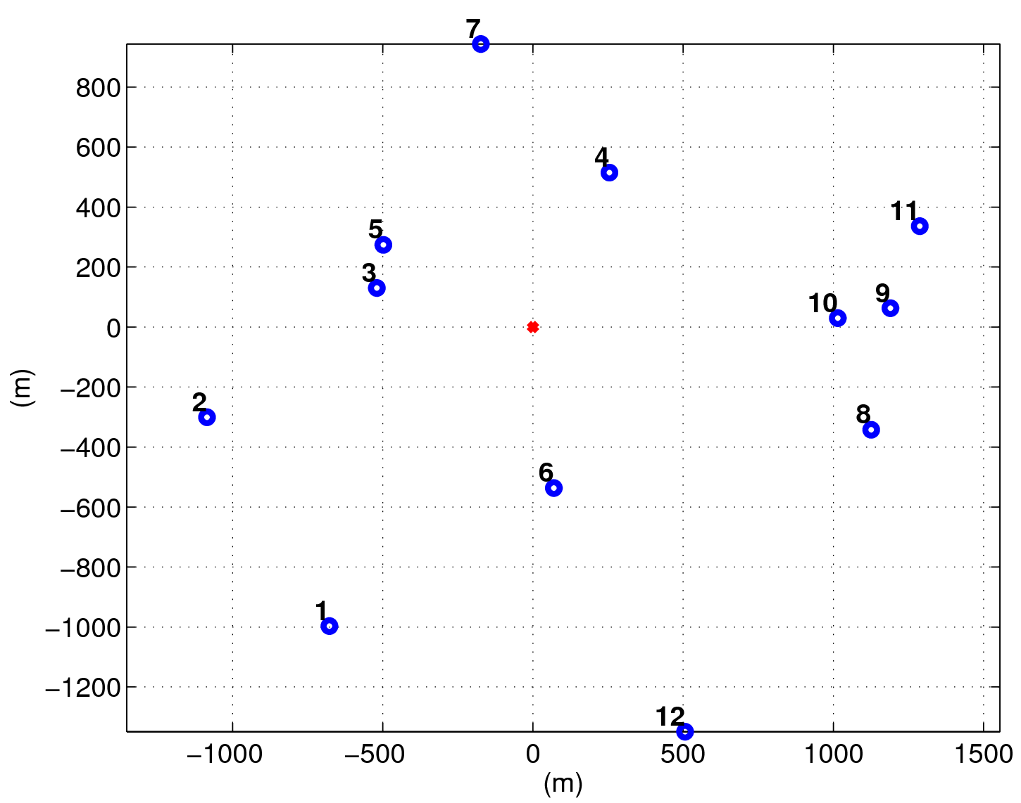
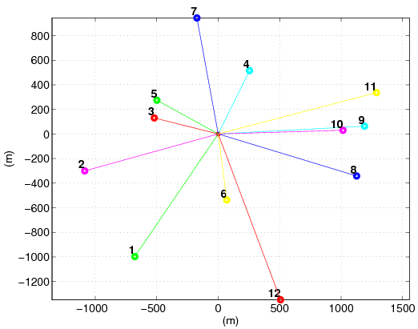
QUANTITATIVE IMPACT
Based on the obtained MCS/BER model for two-user NOMA (previous figure), the proposed scheduling algorithm can pair users with 91.67% optimality (for a 12-user downlink scenario) without incurring the complexity needed in exhaustive search.
The simulation result shows 20.19% average weighted sum gain (optimal) compared to OFDM.

Slide 12
PROJECT GOALS
Based on the NOMA simulation model and the two-user scheduling algorithm that we have completed so far, our goal in the future is to explore more generic problems and algorithms for resource allocation, scheduling, and power control at the MAC layer for optimizing the performance of NOMA under the desirable computation complexity and communication overheads.
The simulation model for single-antenna NOMA will be extended to MIMO such that clustered-based resource allocation and scheduling can be investigated in the future.

Slide 13
CONCLUSIONS
We have built a simulation model for NOMA based on SIC that takes into consideration MCS selection, error propagation, and power allocation into consideration.
The simulation model serves as the basis for our preliminary investigation at the MAC layer for two-user pairing and scheduling in each OFDM resource block.
Our preliminary results have substantiated the potentials of NOMA in the next-generation communication system and paved the ground for continuing investigation of various MAC layer research issues in the future.

