Slide 1
Investigation over NOMA with SIC in single antenna scheme
Physical Layer Simulation
Speaker : Ming-Jie Yang, Chin-Wei Hsu Advisor : Hung-Yun Hsieh

Slide 2
Outline
Introduction
NOMA with SIC (successive interference cancellation)
SIC Model
Multiuser capacity
Signal multiplexing
Performance gain metrics
Simulation
Tools (IT++)
System architecture, scenario and settings
Simulation results
Reference

Slide 3
Recap of our previous works
In the previous works, we surveyed and introduced literature on the physical and MAC layer techniques for non-orthogonal multiple access (NOMA)
Based on previous works, we investigate theoretic and simulation models for NOMA to lay a more solid ground for the resource allocation and scheduling to be studied in this project
[1] Y. Saito, Y. Kishiyama, A. Benjebbour, T. Nakamura, A. Li, and K. Higuchi, “Non-Orthogonal Multiple Access (NOMA) for Cellular Future Radio Access,” VTC Spring 2013.
[2] S. Tomida and K. Higuchi, “Non-orthogonal Access with SIC in Cellular Downlink for User Fairness Enhancement,” ISPACS), 2011.
[3] J. Umehara, Y. Kishiyama, and K. Higuchi, “Enhancing User Fairness in Non-orthogonal Access with Successive Interference Cancellation for Cellular Downlink,” ICCS 2012
[4] J. Schaepperle and A. Regg, “Enhancement of Throughput and Fairness in 4G Wireless Access Systems by Non-orthogonal Signaling,” Bell Labs Technical Journal, 2009
[5] A. Ruegg and A. Tarable, “Iterative SIC Receiver Scheme For Nonorthogonally Superimposed Signals on Top of OFDMA,” PIMRC, 2010

Slide 4
NOMA with SIC
Allocate more than one user at a single resource block, which achieves performance gain and improve user fairness.
Simulations investigate SIC in SISO in downlink cases, and the BS is capable of supporting two users.
UE2
UE4
UE1
UE3
UE5
time
[1] Y. Saito, Y. Kishiyama, A. Benjebbour, T. Nakamura, A. Li, and K. Higuchi, “Non-Orthogonal Multiple Access (NOMA) for Cellular Future Radio Access,” VTC Spring 2013.
[2] J. Schaepperle and A. Regg, “Enhancement of Throughput and Fairness in 4G Wireless Access Systems by Non-orthogonal Signaling,” Bell Labs Technical Journal, 2009

Slide 5
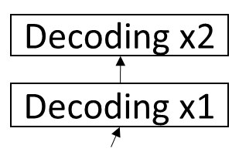
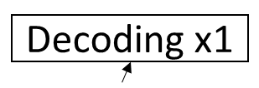
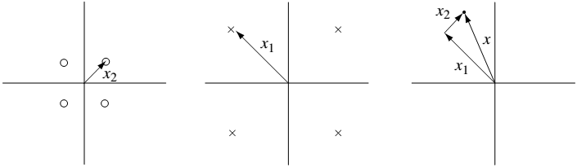


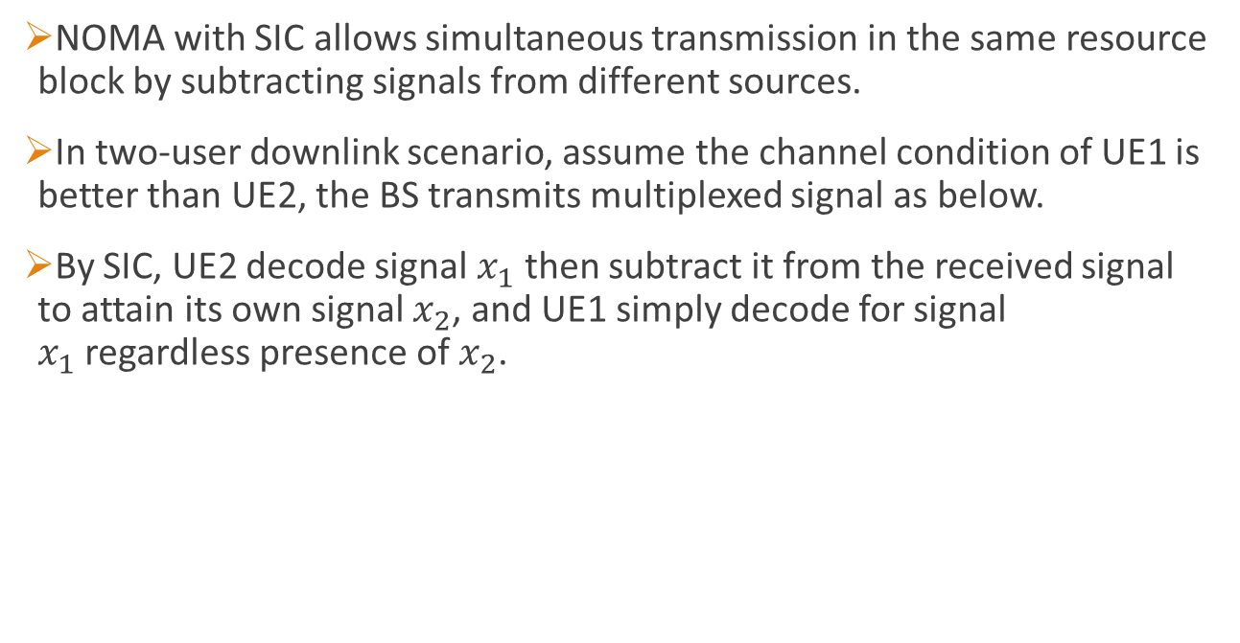
NOMA with SIC
NOMA with SIC allows simultaneous transmission in the same resource block by subtracting signals from different sources.
In two-user downlink scenario, assume the channel condition of UE1 is better than UE2, the BS transmits multiplexed signal as below.
By SIC, UE2 decode signal $x_{1}$ then subtract it from the received signal to attain its own signal $x_{2}$, and UE1 simply decode for signal $x_{1}$regardless presence of $x_{2}$.
UE2
UE1

Slide 6








Signal multiplexing
Access of two-user in uplink
Access of two-user in downlink
$$x_{1}$$
$$h_{1}$$
Rx
+
$$x_{2}$$
$$h_{2}$$
$$N_{0}$$
$$h_{1}$$
$$x_{1}+x_{2}$$
Tx
$$h_{2}$$

Slide 7
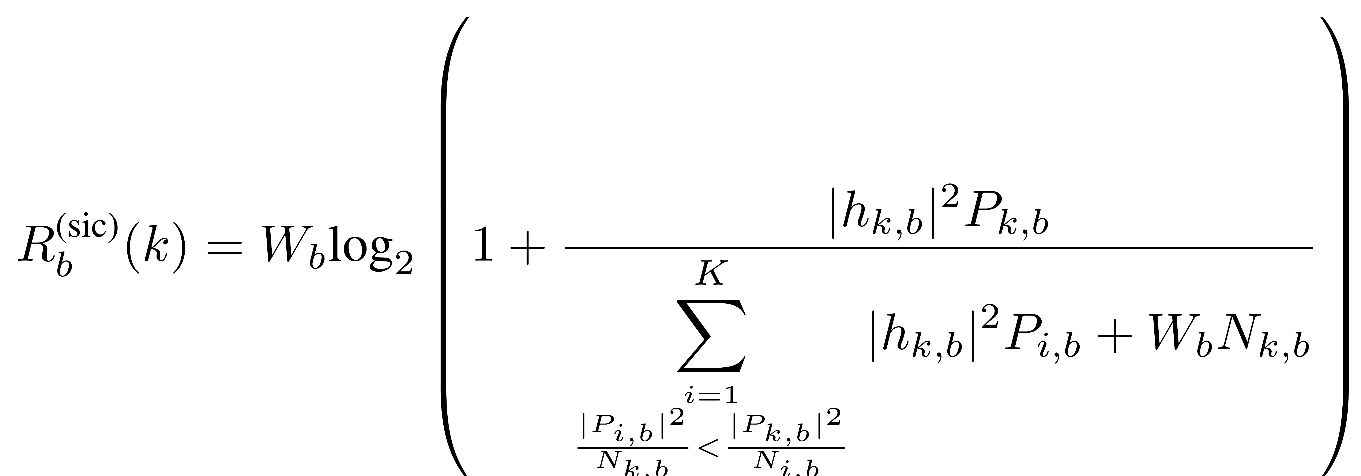
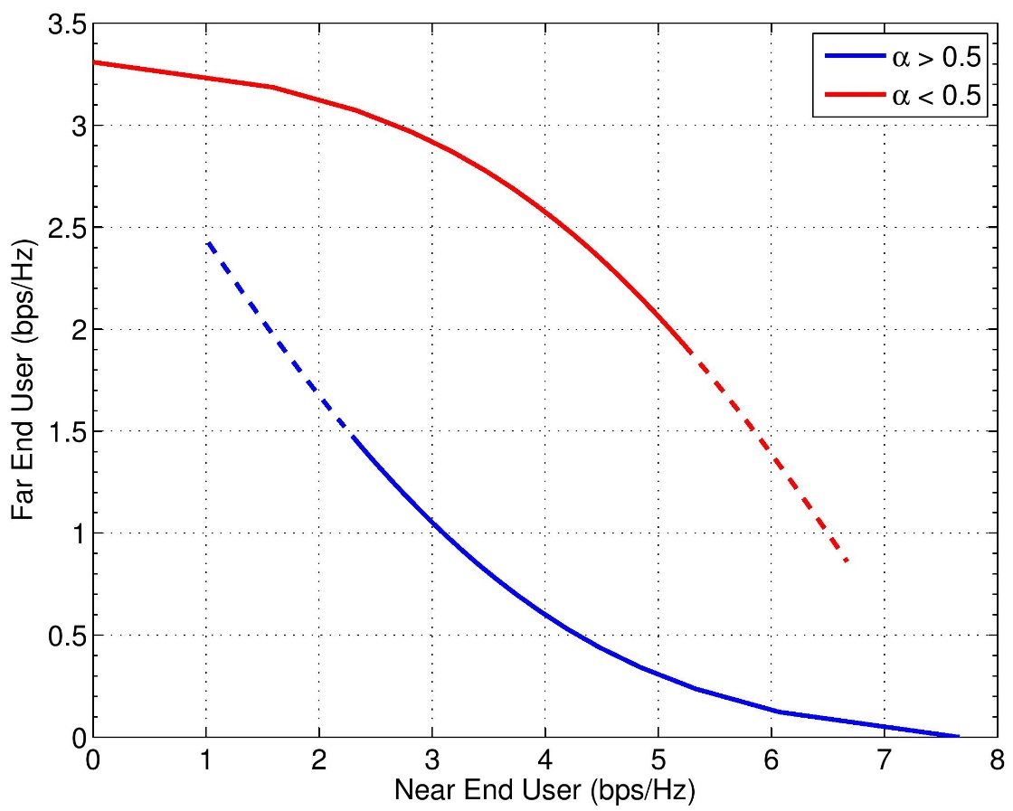

Ideal SIC model (1/2)
Assume data signals with greater power can be decoded successfully.
The sum of power allocated is constrained, i.e.
In two-user case, define $α$ as power allocation factor on near- end user.

Slide 8

Ideal SIC model (2/2)
Define performance metrics as follows,
$R_{1}=αWlog_{2}\left(1+SINR_{1}\right)$
$R_{2}=(1−α)Wlog_{2}\left(1+SINR_{2}\right)$
The grey line shows the linear combination of rates when only one of the user is in service.
Notes:
Grey line explanation

Slide 9
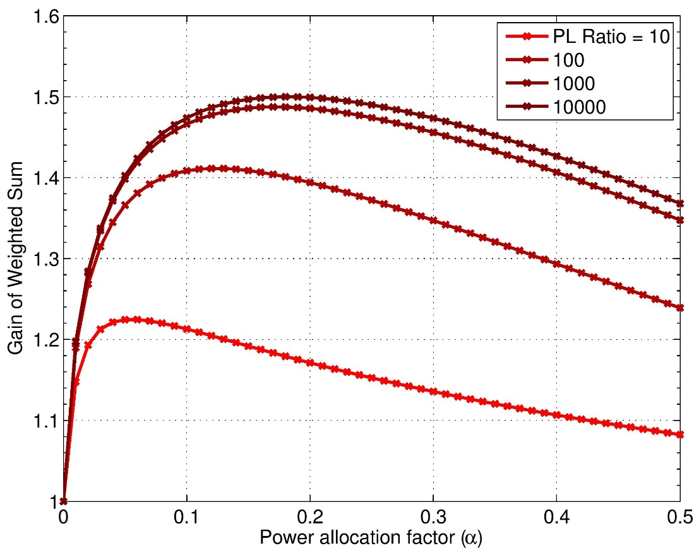
Performance Gain Metrics
As the difference of the PL ratio increase the gain in weighted sum also increases.
The maximum of Gain slowly converges as the PL Ratio increase.

Slide 10
Ideal SIC model issue
The ideal model of SIC based on Shannon capacity has several issues
Error propagation: Capacity is calculated assumes zero-error when decoding former stages before extracting users own signal, however once error occurs, SIC performance degrades.
Imperfect channel estimation: To remove effect of users’ interference, receiver has to compensate channel perfectly, otherwise residual error also cause degradation.

Slide 11

Simulation Tools
IT++ is a C++ library of mathematical, signal processing and communication classes and functions. Its main use is in simulation of communication systems and for performing research in the area of communications.
Originated from former department of Information Theory at the Chalmers University of Technology, Gothenburg, Sweden.
Supports basic mathematical operations, signal processing (e.g. filters, FFT, DFT), Communications (e.g. modulator, standard channel model), Protocol simulation (e.g. queues, packet generators).
The simulation is built base on IT++ and other external libraries (BLAS, LAPACK and FFTW libraries).
[3] IT++ project main page, http://itpp.sourceforge.net/4.3.1/

Slide 12
System Architecture
Binary Data |  | Received Signal
Encoder |  | Remove CP
 |  |  |  |  |  | Subtraction
Modulation |  | Equalizer |  | Reverse Eq.
IFFT |  | FFT |  | IFFT |  | Equalizer
Add CP |  | Demodulation |  | Modulation |  | FFT
Channel |  | Decoder |  | Encoder |  | Demodulation
 |  | signal #1 |  |  |  | Decoder
 |  |  |  |  |  | signal #2
Transmitter Receiver

Slide 13
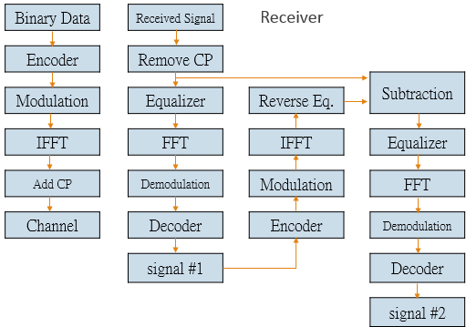
Parameters and values
Parameters | Simulation settings
FFT size | 2048
Carrier frequency | 2.6 GHz
Coding scheme | Convolutional Code
Cyclic Prefix | 144 samples
Modulation | BPSK, QPSK, 16QAM
Channel | AWGN, 3-tap multipath
BS power | 4 W
Background noise | -144 dBm
Pathloss model | Hata model, medium sized city
Equalizer | 7-tap MMSE

Slide 14






Simulation Scenario
2-user case in downlink scheme, distance of transmission are $d_{1}$ and $d_{2}$
UE2 is far-end, UE1 is near-end user. BS allocates power to UEs by power factor $α$ , i.e. $P_{1}=αP$ and $P_{2}=\left(1−α\right)P$.
$$d_{2}$$
$$BS$$
$$d_{1}$$
$$UE 2 far−end$$
$$UE 1 near−end$$

Slide 15
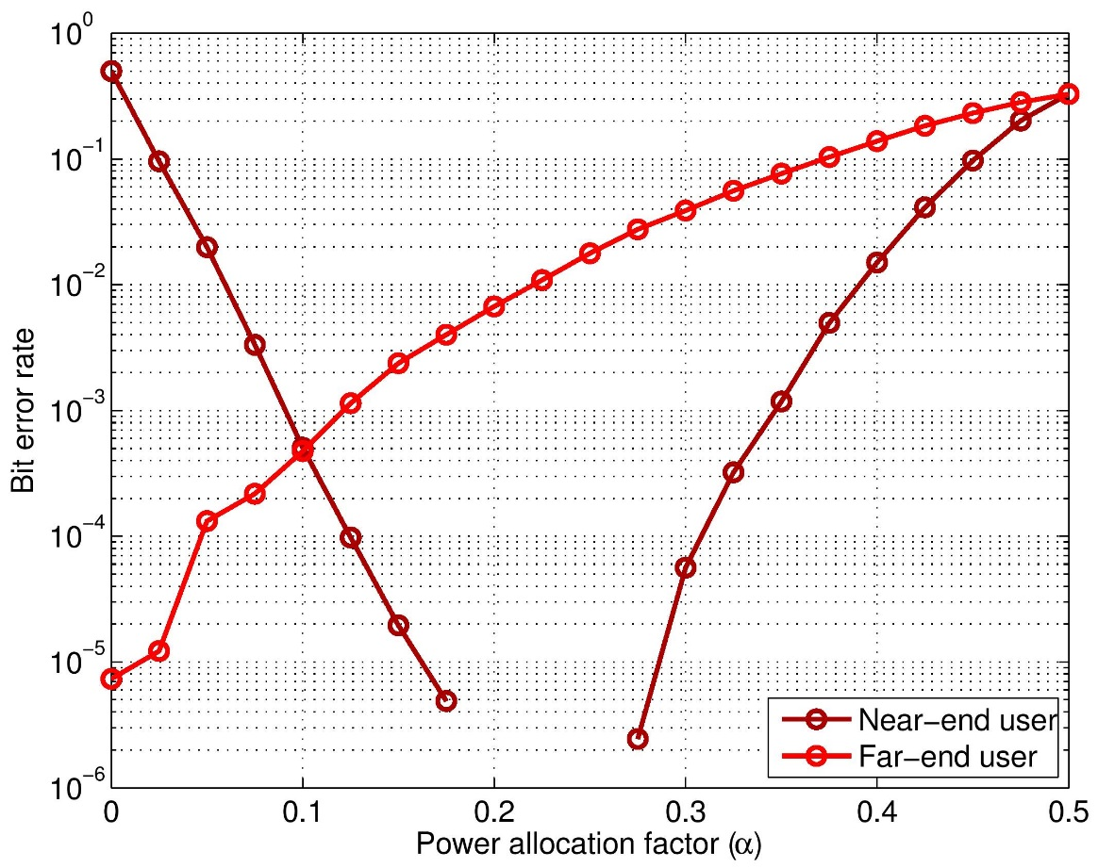
Simulation Result (1/3)
QPSK, code rate ½ is used
UE1 positions at 1km, UE2 positions at 2km BS at origin point.
Error propagation cause degradation when power allocation factor come close to 0.5 .

Slide 16
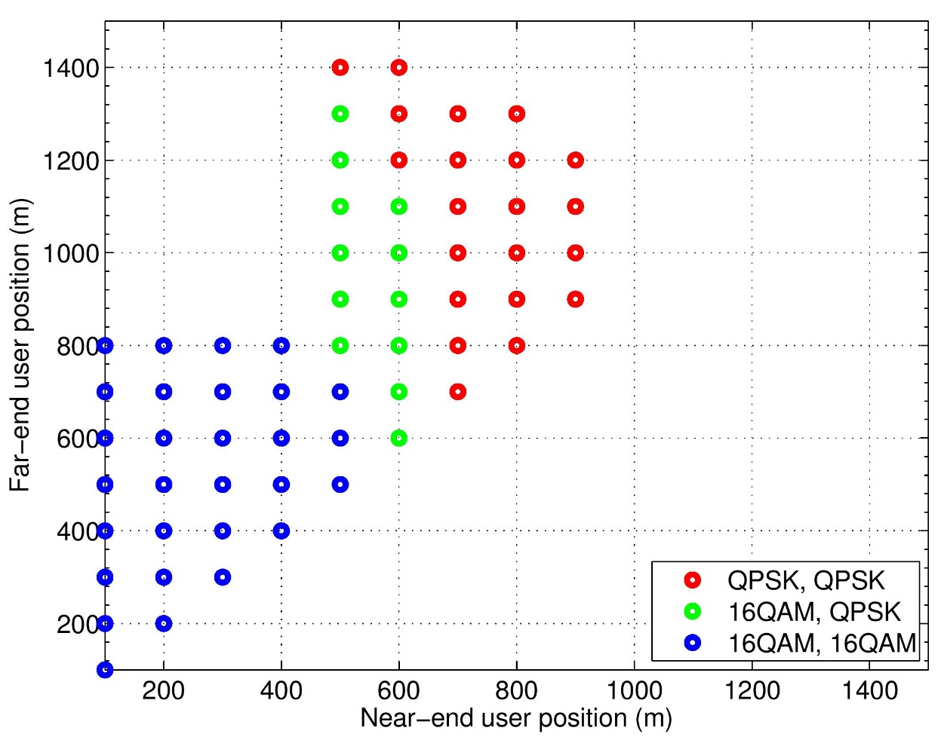

Simulation Result (2/3)
BER is constrained to be greater than ${10}^{−2}$, modulation changes if the higher order modulation is possible.
The system is limited by far-end user, for example, if UE2 (QPSK) is at 1400m, UE1 (QPSK) is limited in 600m, if UE2 is at 1200m, UE1 is feasible at 900m.

Slide 17

Simulation scenario
Consider scheduling users in a single cell, all users has to be scheduled once in given time window.
Assume there are 10 users randomly scattered in 1400 square meter plane. The objective is to maximize spectrum utilization.
$$BS$$

Slide 18
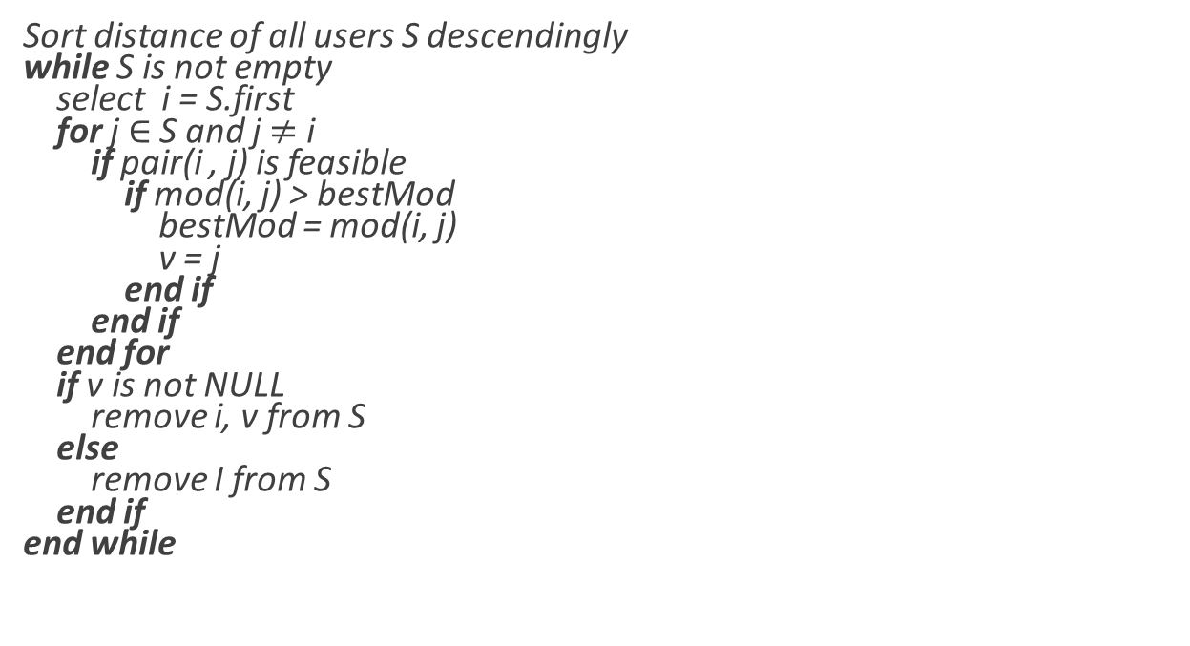
Scheduling algorithm
Sort distance of all users S descendingly while S is not empty select i = S.first for j $∈$ S and j $≠$ i if pair(i , j) is feasible if mod(i, j) > bestMod bestMod = mod(i, j) v = j end if end if end for if v is not NULL remove i, v from S else remove I from S end if end while

Slide 19
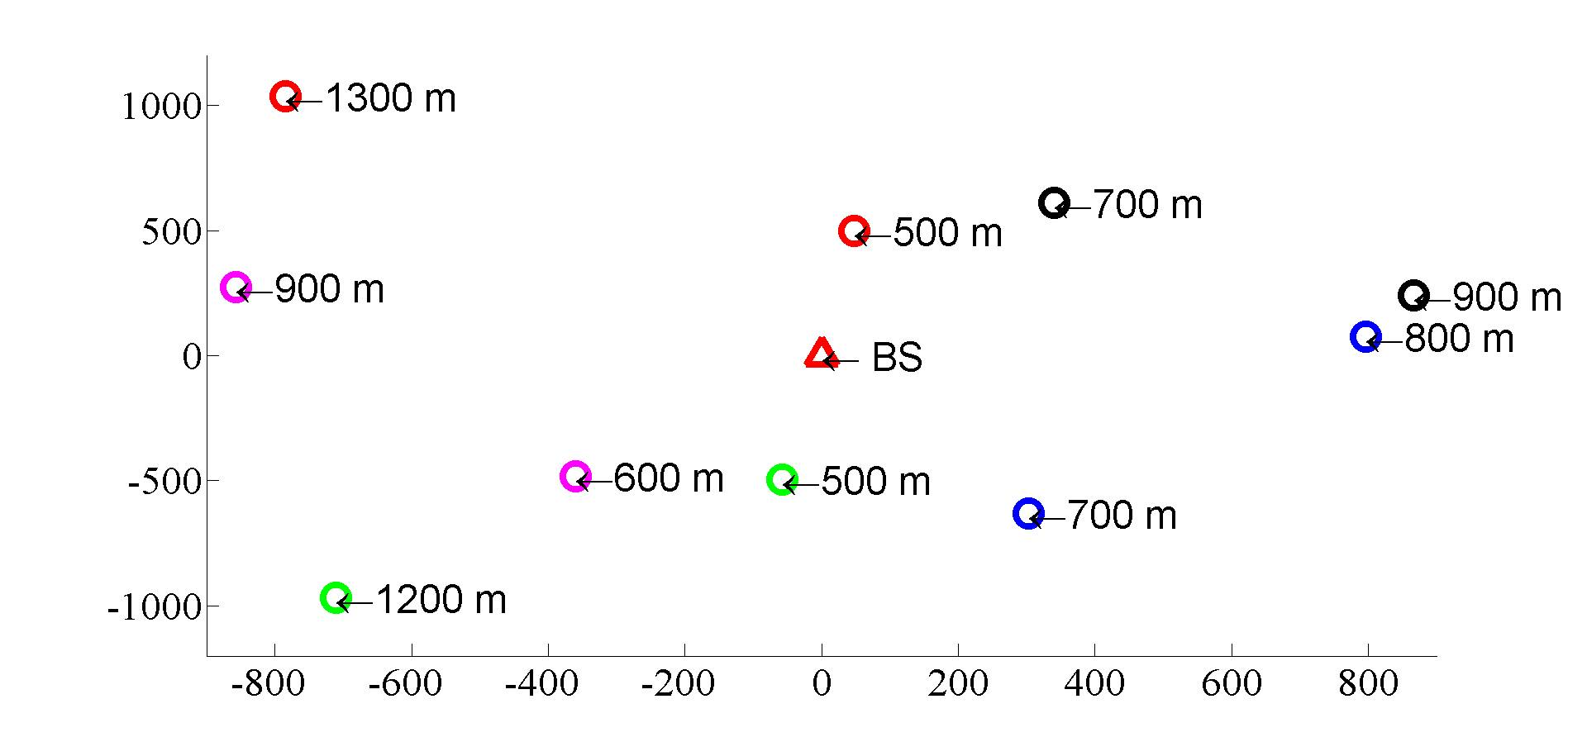
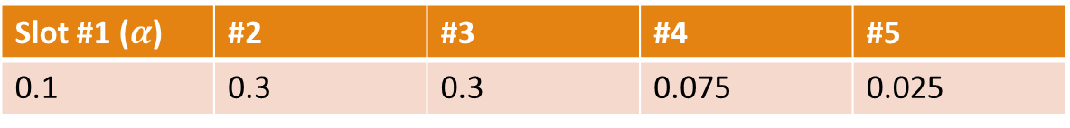
Slot #1 | #2 | #3 | #4 | #5
QPSK(1300) | QPSK(700) | QPSK(900) | QPSK(1200) | 16QAM(600)
16QAM(500) | QPSK(800) | QPSK(700) | 16QAM(500) | QPSK(900)
To schedule multiple users in a single cell, max support of simultaneous transmission is 2.
Slot #1 ($α$) | #2 | #3 | #4 | #5
0.1 | 0.3 | 0.3 | 0.075 | 0.025

Slide 20
Reference
[1] Y. Saito, Y. Kishiyama, A. Benjebbour, T. Nakamura, A. Li, and K. Higuchi, “Non-Orthogonal Multiple Access (NOMA) for Cellular Future Radio Access,” VTC Spring 2013.
[2] J. Schaepperle and A. Regg, “Enhancement of Throughput and Fairness in 4G Wireless Access Systems by Non-orthogonal Signaling,” Bell Labs Technical Journal, 2009
[3] IT++ project main page, http://itpp.sourceforge.net/4.3.1/
[4] 3GPP TS 36.104 v8.2.0, May 2008

Slide 21

Q&A
Thank you for your attention.

