Slide 1
Investigation over NOMA with SIC in single antenna scheme
Physical Layer Simulation
Speaker : Ming-Jie Yang, Chin-Wei Hsu Advisor : Hung-Yun Hsieh

Slide 2
Outline
Previous work
Introduction
Simulation result (best MCS given pair)
Scheduling Problem (single cell, 12 UEs)
Algorithm
Schedule Results

Slide 3
Recap of our previous works
In the previous works, we surveyed and introduced literature on the physical and MAC layer techniques for non-orthogonal multiple access (NOMA)
Based on the survey, we investigate theoretic and simulation models for NOMA to lay a solid ground for the resource allocation and scheduling to be studied in this project
By the simulation result ,we observe effect of error propagation: Capacity is calculated assumes zero-error when decoding former stages before extracting users own signal, however once error occurs, SIC performance degrades.

Slide 4
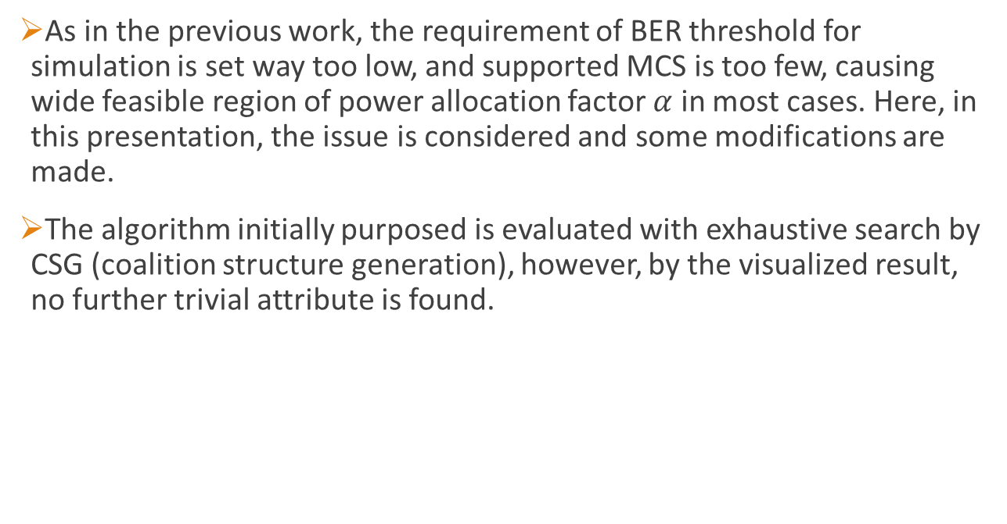
Introduction
As in the previous work, the requirement of BER threshold for simulation is set way too low, and supported MCS is too few, causing wide feasible region of power allocation factor $α$ in most cases. Here, in this presentation, the issue is considered and some modifications are made.
The algorithm initially purposed is evaluated with exhaustive search by CSG (coalition structure generation), however, by the visualized result, no further trivial attribute is found.

Slide 5
MCS adaption in SIC
The power ratio factor is determined by linear search quantumized by (0.0125).
Two user equipments are placed on position with distance multiple of 100m
Both user has BER constraint no greater than 10^-4
Parameters | Simulation settings
FFT size | 2048
Carrier frequency | 2.6 GHz
Coding scheme | Convolutional Code (punctured)
Cyclic Prefix | 144 samples
Modulation | BPSK (skipped), QPSK, 16QAM
Channel | AWGN, ITU pedestrian 3km/hr
BS power | 4 W
Background noise | -144 dBm
Pathloss model | Hata model, medium sized city
Equalizer | FDE MMSE

Slide 6
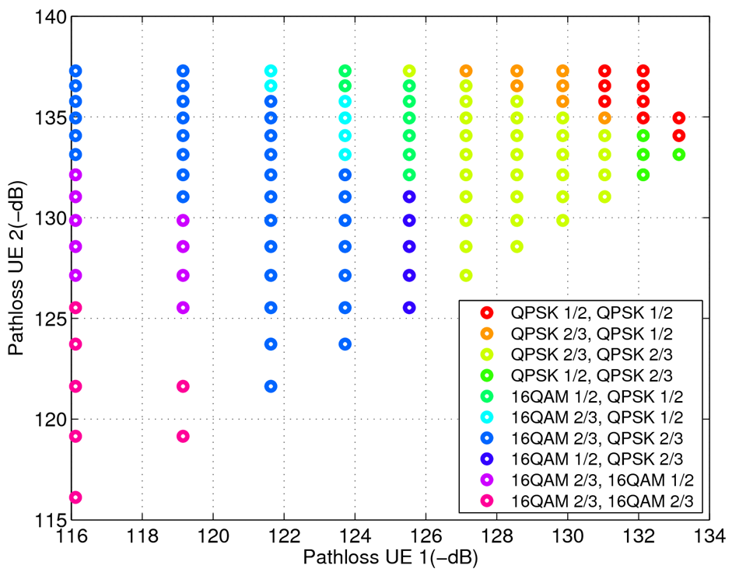
MCS adaption in SIC
The marked MCS is the best in given channel condition and BER constraint.
The overall system is bounded by far-end user (#2)

Slide 7

Scheduling problem
Consider scheduling users in a single cell, all users has to be scheduled once in given time window.
Assume there are 12 users randomly scattered in 2800 square meter plane. The objective is to maximize spectrum utilization.
$$BS$$

Slide 8
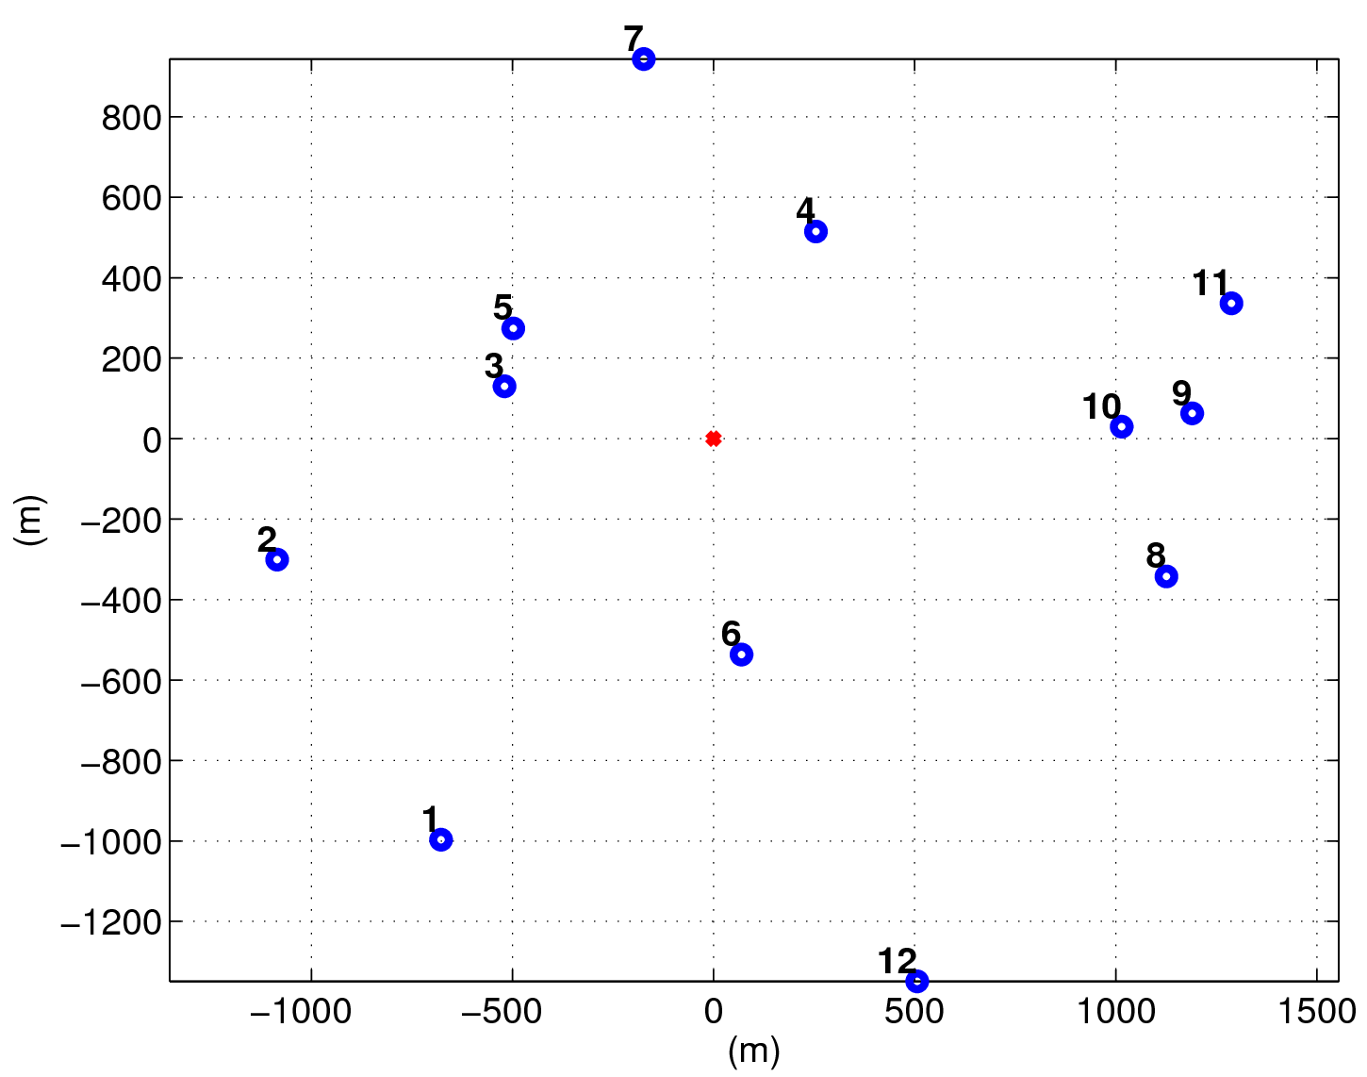
Scheduling problem - scenario
This is a sample of random topo- logy generated.
The red spot at the origin is BS

Slide 9
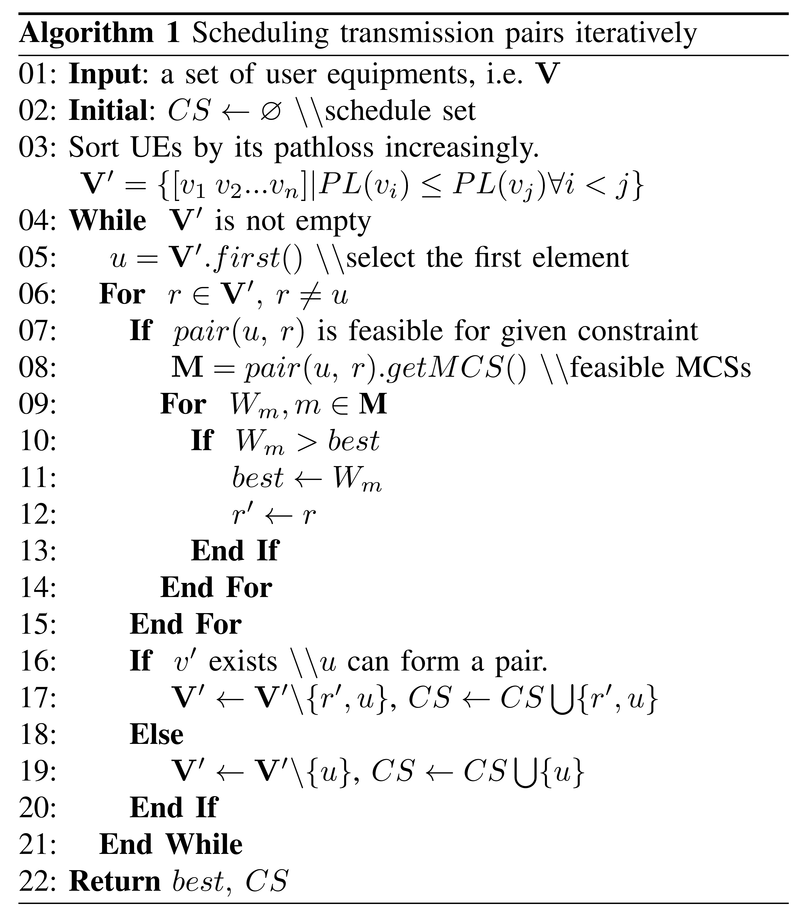
Algorithm
It is observed that scheduling pairs with great path loss difference can help achieve better system performance. Thus, the initial algorithm is designed as follows.

Slide 10
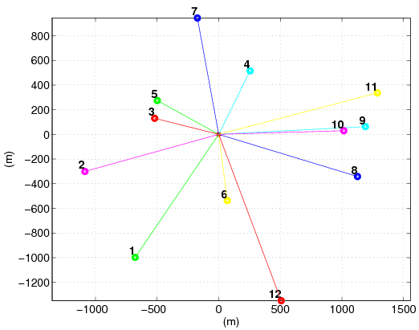
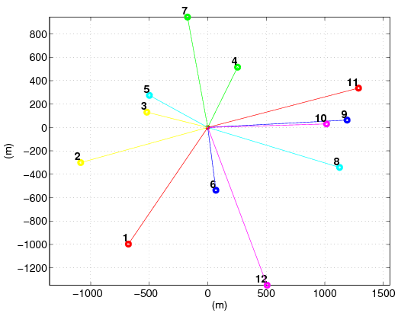
Scheduling results
Left-hand side is generated by Algorithm 1, and figure on the right is optimal solution by exhaustive search. Alg. 1 reached 91.67% optimality.

Slide 11
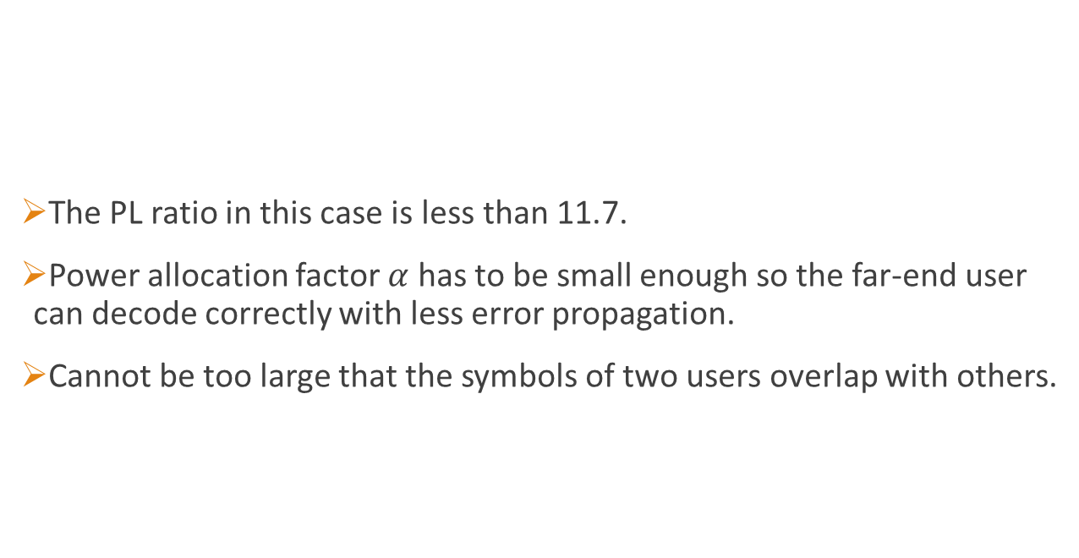
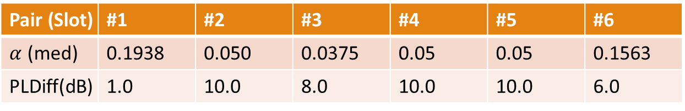
Scheduling results (optimal)
The PL ratio in this case is less than 11.7.
Power allocation factor $α$ has to be small enough so the far-end user can decode correctly with less error propagation.
Cannot be too large that the symbols of two users overlap with others.
Pair (Slot) | #1 | #2 | #3 | #4 | #5 | #6
$α$ (med) | 0.1938 | 0.050 | 0.0375 | 0.05 | 0.05 | 0.1563
PLDiff(dB) | 1.0 | 10.0 | 8.0 | 10.0 | 10.0 | 6.0

Slide 12

Q&A
Thank you for your attention.

