Slide 1
Advanced Resource Allocation and Scheduling for Non-Orthogonal Multiple Access

Slide 2
Outlines
Summary of progress
PHY layer aspects of NOMA
Ideal SIC
Considering PER and modulation
MAC layer aspects of NOMA
Two-user resource allocation
Optimization of multi-user resource allocation
Plan for the next month

Slide 3
Summary of progress
The main progress of our project in the past few months is to survey literature on the physical and MAC layer techniques for non-orthogonal multiple access (NOMA)
[1] Y. Saito, Y. Kishiyama, A. Benjebbour, T. Nakamura, A. Li, and K. Higuchi, “Non-Orthogonal Multiple Access (NOMA) for Cellular Future Radio Access,” VTC Spring 2013.
[2] S. Tomida and K. Higuchi, “Non-orthogonal Access with SIC in Cellular Downlink for User Fairness Enhancement,” ISPACS), 2011.
[3] J. Umehara, Y. Kishiyama, and K. Higuchi, “Enhancing User Fairness in Non-orthogonal Access with Successive Interference Cancellation for Cellular Downlink,” ICCS 2012
[4] J. Schaepperle and A. Regg, “Enhancement of Throughput and Fairness in 4G Wireless Access Systems by Non-orthogonal Signaling,” Bell Labs Technical Journal, 2009
[5] A. Ruegg and A. Tarable, “Iterative SIC Receiver Scheme For Nonorthogonally Superimposed Signals on Top of OFDMA,” PIMRC, 2010

Slide 4
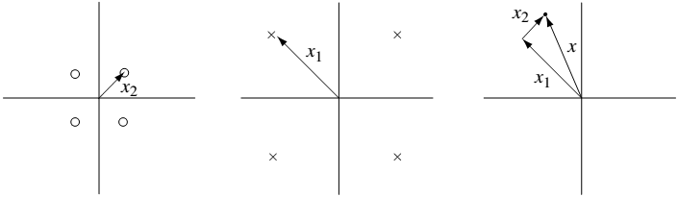





PHY Layer Aspects: Ideal SIC (1/5)
To allow NOMA, successive interference cancellation (SIC) or superposition coding has been considered in the literature [1]–[3]
To understand how SIC works, take the two-user downlink communication as an example
The following figure is the encoding example using QPSK
UE2
UE1
$$x_{2}[m]$$
$$x_{1}[m]$$
$$x_{1}\left[m\right]+x_{2}[m]$$

Slide 5
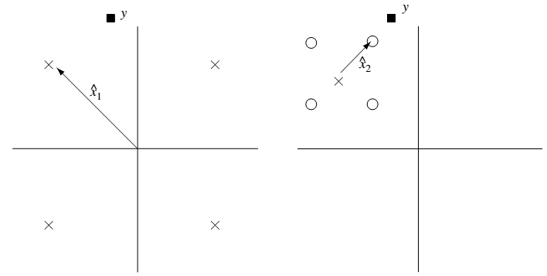
PHY Layer Aspects: Ideal SIC (2/5)
Assuming that the channel gain of UE2 is better than UE1, if UE1 can decode its signal, then UE2 must also be able to decode the UE1 signal
The transmitted constellation point of UE1 is decoded first
Decoding x1
UE2
UE1

Slide 6
PHY Layer Aspects: Ideal SIC (3/5)
The transmitted constellation point of UE1 is decoded first, followed by decoding of the constellation point of UE2
For UE1, it can simply go ahead and decode its own signal without decoding the signal for UE2 first
Decoding x2
Decoding x1
Decoding x1
UE2
UE1

Slide 7
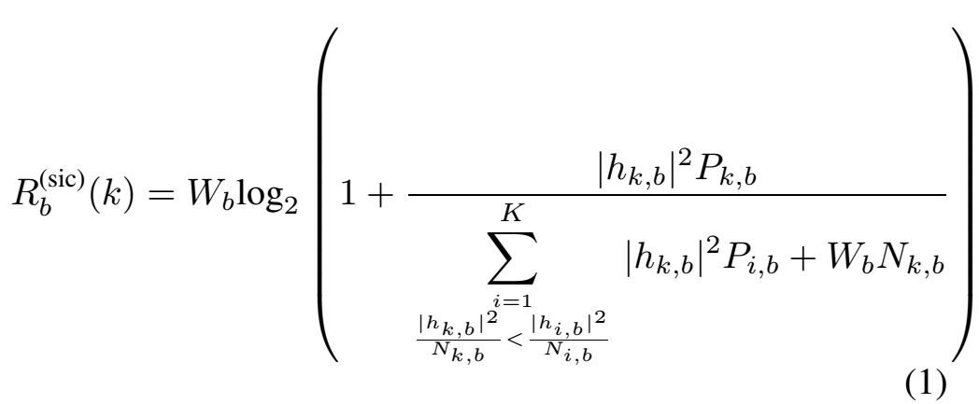
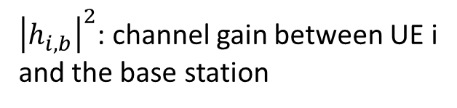

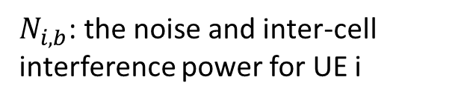
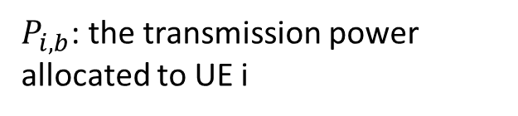

PHY Layer Aspects: Ideal SIC (4/5)
The case for SIC among K UEs can be performed similarly, and ideally for any UE the optimal decoding is to remove the signal components of UEs with worse channel gains
The achievable rate $R_{b}^{\left(sic\right)}(k)$ for UE k in resource b can be represented as follows
${\left|h_{i,b}\right|}^{2}$: channel gain between UE i and the base station
$W_{b}$: the bandwidth of resource b
$P_{i,b}$: the transmission power allocated to UE i
$N_{i,b}$: the noise and inter-cell interference power for UE i

Slide 8
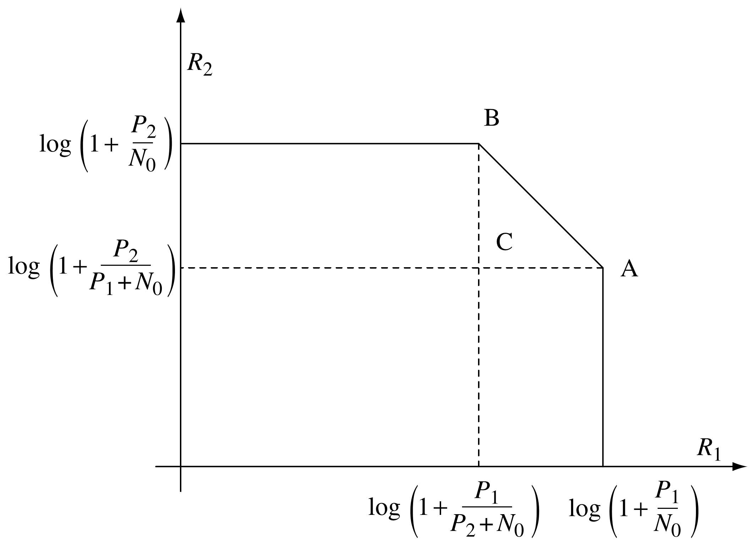
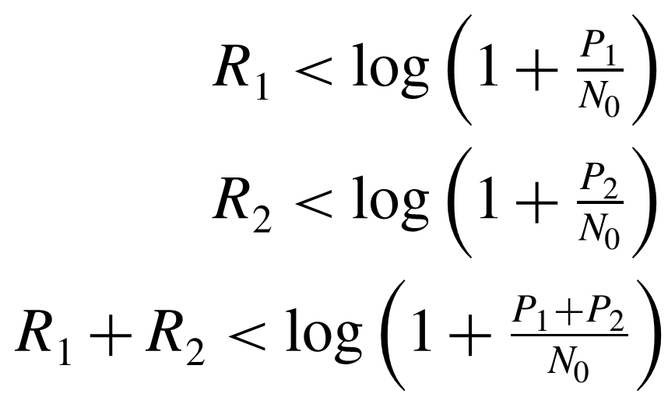
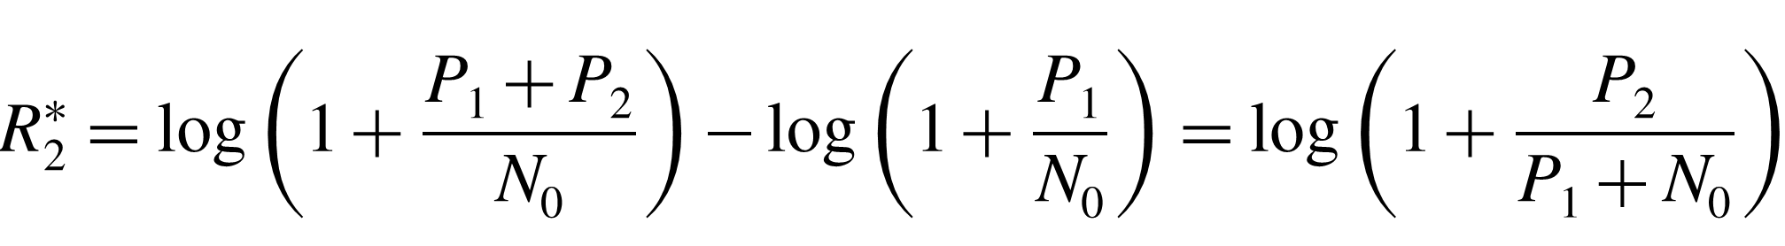
PHY Layer Aspects: Ideal SIC (5/5)
Capacity region of the two-user uplink AWGN channel is shown in the following and the red line is the optimal operation points
Set of all rates R1 and R2 satisfying the three constraints:
Optimal operation points
U1 can achieve its single-user bound while at the same time U2 can get a non-zero rate; in fact as high as its rate at point A

Slide 9
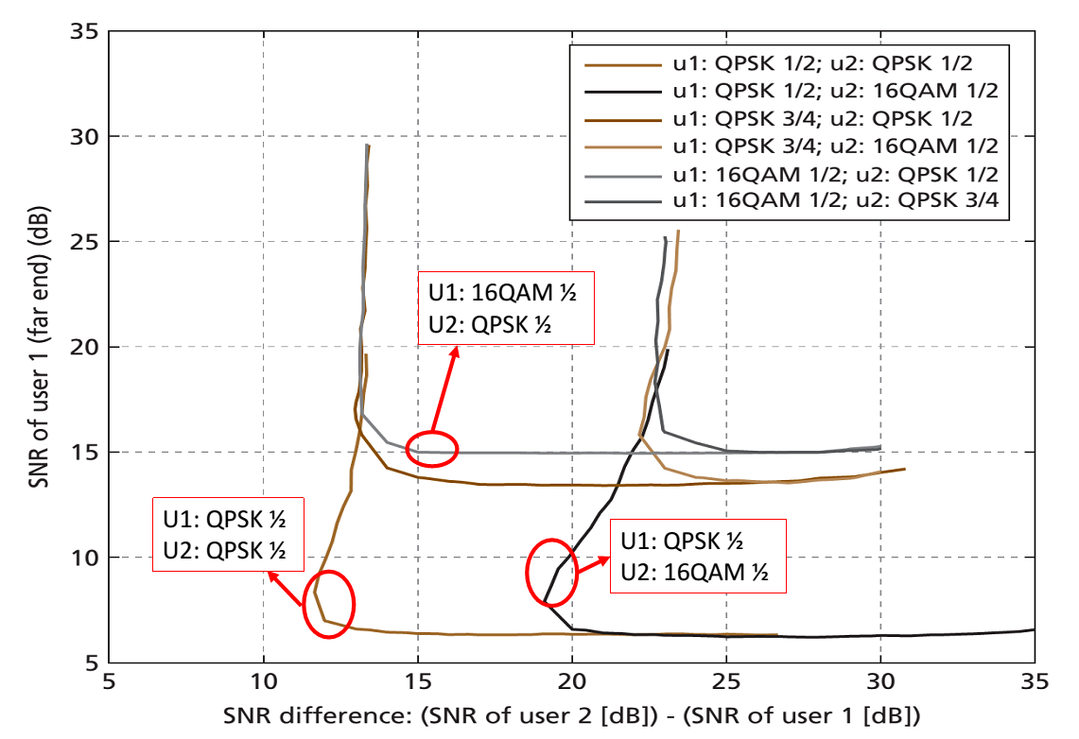

PHY Layer Aspects: PER and Modulation
The authors in [4] have shown simulation results for SIC with respect to modulation schemes and SNR difference
All points enclosed in the upper right area of each curve are in the desired operating region with $PER≤{10}^{−2}$
We can find that the simulation result does not strictly follow (1)
For example, if the SNR of U1 becomes 8 times (i.e. 9 dB) larger, the modulation of U1 can upgrade from QPSK to 16QAM, which has only 2 times larger capacity

Slide 10
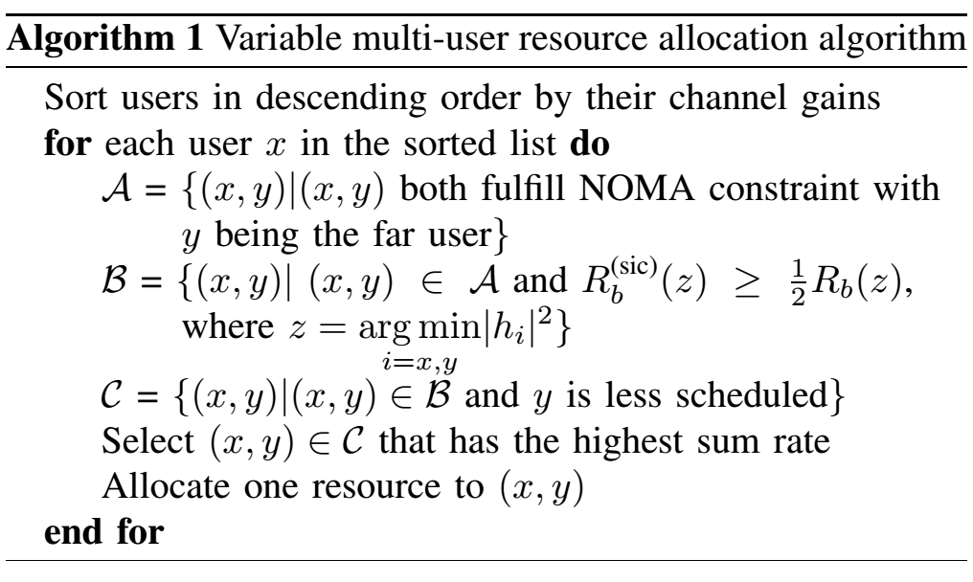
MAC Layer Aspects: Two-user Resource Allocation
The authors in [4] consider the problem of choosing the best pair of UEs for sharing each resource unit and an algorithm called variable multi-user resource allocation as shown in Algorithm 1 is proposed

Slide 11
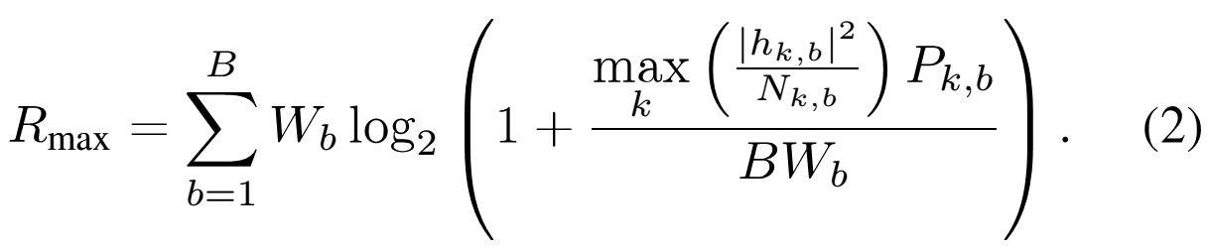
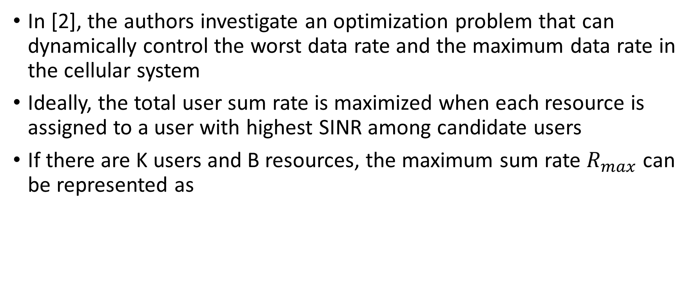
MAC Layer Aspects: Optimization of Multi-user Resource Allocation (1/4)
In [2], the authors investigate an optimization problem that can dynamically control the worst data rate and the maximum data rate in the cellular system
Ideally, the total user sum rate is maximized when each resource is assigned to a user with highest SINR among candidate users
If there are K users and B resources, the maximum sum rate $R_{max}$can be represented as

Slide 12
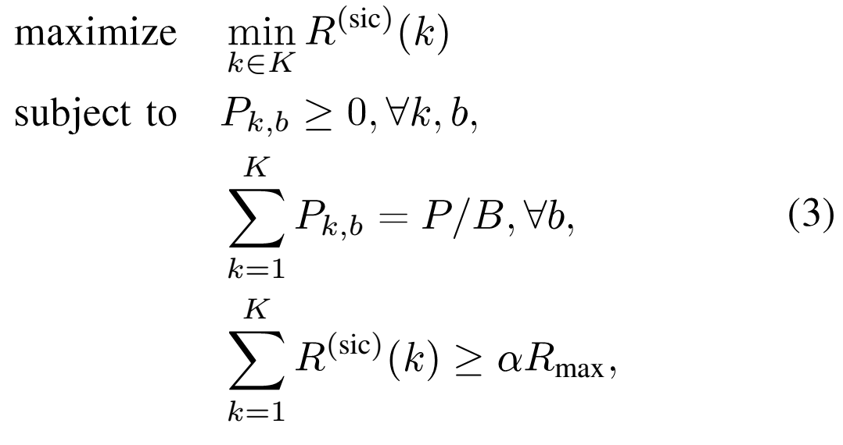

MAC Layer Aspects: Optimization of Multi-user Resource Allocation (2/4)
Based on (1)(2) and $R^{\left(sic\right)}\left(k\right)=\sum_{b=1}^{B}{R_{b}^{\left(sic\right)}(k)}$, the problem to maximize the worst user data rate with total rate constraint is written as

Slide 13
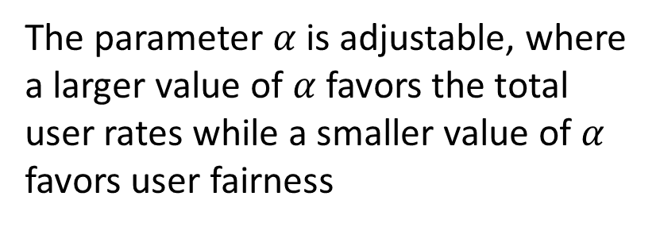
MAC Layer Aspects: Optimization of Multi-user Resource Allocation (3/4)
Based on (1)(2) and $R^{\left(sic\right)}\left(k\right)=\sum_{b=1}^{B}{R_{b}^{\left(sic\right)}(k)}$, the problem to maximize the worst user data rate with total rate constraint is written as
The parameter $α$ is adjustable, where a larger value of $α$ favors the total user rates while a smaller value of $α$ favors user fairness

Slide 14
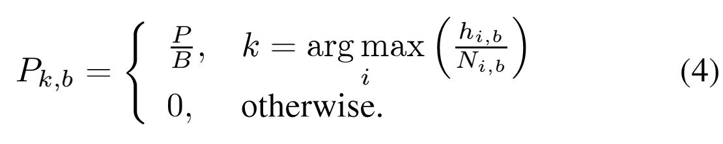
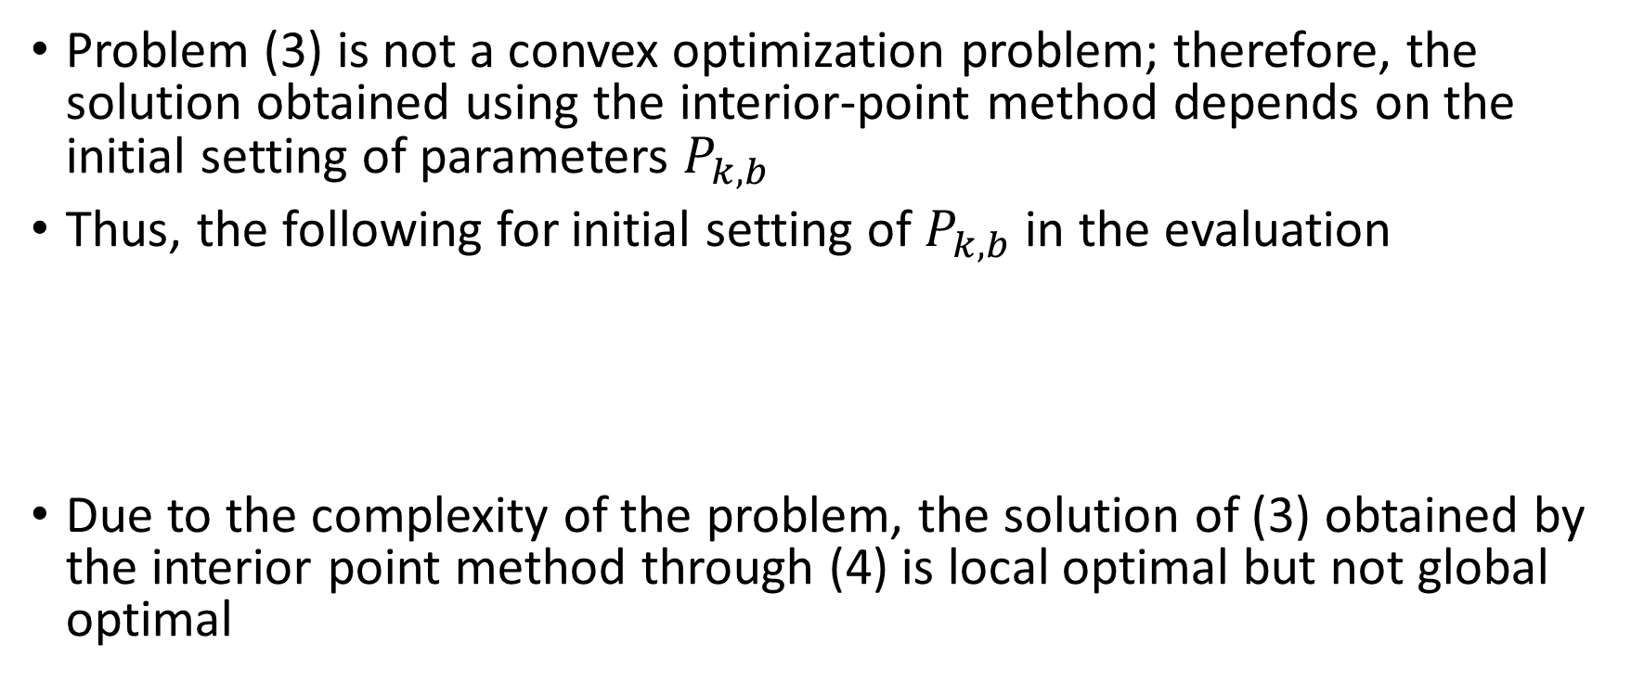
MAC Layer Aspects: Optimization of Multi-user Resource Allocation (4/4)
Problem (3) is not a convex optimization problem; therefore, the solution obtained using the interior-point method depends on the initial setting of parameters $P_{k,b}$
Thus, the following for initial setting of $P_{k,b}$ in the evaluation
Due to the complexity of the problem, the solution of (3) obtained by the interior point method through (4) is local optimal but not global optimal

Slide 15
Mac Layer Aspects: Scheduling Resource Blocks with Considerations of Fairness (1/3)
In [3], a scheduling method applying fractional frequency reuse (FFR) and weighted proportional fair (PF)-based scheduling is proposed.
FFR divides users spatially (cell-edge or cell-interior) and allocates frequency resources accordingly.
Soft FFR relax the restriction for NOMA with SIC, since SIC achieve gains when users with bad channel condition and those with good are multiplexed.

Slide 16

Mac Layer Aspects: Scheduling Resource Blocks with Considerations of Fairness (2/3)
Here $R_{b}\left(k;t\right)$ denotes the rate of user k at frequency block b and at time slot t. $T\left(k;t+1\right)$ denotes the estimated average throughput.
$f_{b}\left(S\right)$ is the scheduling metric for user set $S$ at block $b$, and $S_{b}$ are the users to be scheduled.

Slide 17

Mac Layer Aspects: Scheduling Resource Blocks with Considerations of Fairness (3/3)
In FFR scheduling metric is affected by the frequency block access policy, and coefficient $α_{b}(k)$ (no less than 0) adjust the soft priority to users that are cross-accessing (e.g. cell-edge users access inner-band).

Slide 18
Plan for the Next Month
In the next month, we plan to continue investigation of NOMA on physical and MAC layers to better equip ourselves with state-of-the-art research advances on NOMA
In addition to theoretic, ideal models for NOMA, we also plan to investigate more closely the simulation models presented in [4] to lay a more solid ground for the resource allocation and scheduling techniques to be investigated in this project.

