Slide 1
Downlink Using Proportional Fair-Based Resource Allocation

Slide 2
In non-orthogonal access with SIC

Slide 3
Scheduling Resource Blocks with Considerations of Fairness (1/3)
In [1], a scheduling method applying fractional frequency reuse (FFR) and weighted proportional fair (PF)-based scheduling is proposed.
FFR divides users spatially (cell-edge or cell-interior) and allocates frequency resources accordingly.
Soft FFR relax the restriction for NOMA with SIC, since SIC achieve gains when users with bad channel condition and those with good are multiplexed.

Slide 4

Scheduling Resource Blocks with Considerations of Fairness (2/3)
Here $R_{b}\left(k;t\right)$ denotes the rate of user k at frequency block b and at time slot t. $T\left(k;t+1\right)$ denotes the estimated average throughput.
$f_{b}\left(S\right)$ is the scheduling metric for user set $S$ at block $b$, and $S_{b}$ are the users to be scheduled.

Slide 5

Scheduling Resource Blocks with Considerations of Fairness (3/3)
In FFR scheduling metric is affected by the frequency block access policy, and coefficient $α_{b}(k)$ (no less than 0) adjust the soft priority to users that are cross-accessing (e.g. cell-edge users access inner-band).

Slide 6
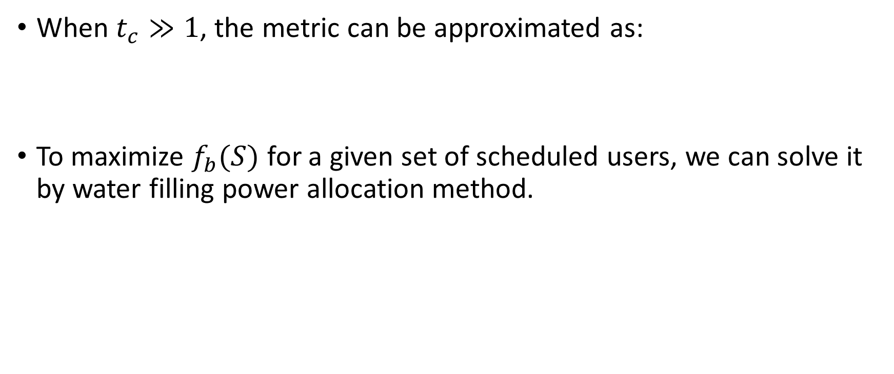
Transmission Power Allocation Sub-problem
When $t_{c}≫1$, the metric can be approximated as:
To maximize $f_{b}(S)$ for a given set of scheduled users, we can solve it by water filling power allocation method.

Slide 7
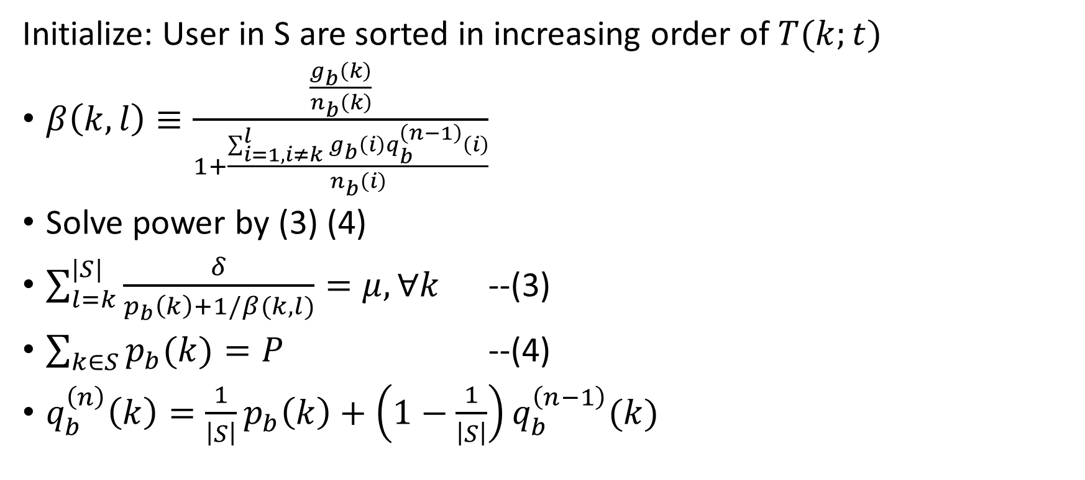
Water-Filling Power Allocation Method
Initialize: User in S are sorted in increasing order of $T(k;t)$
$β\left(k,l\right)≡\frac{\frac{g_{b}\left(k\right)}{n_{b}\left(k\right)}}{1+\frac{\sum_{i=1,i≠k}^{l}{g_{b}\left(i\right)}q_{b}^{\left(n−1\right)}\left(i\right)}{n_{b}\left(i\right)}}$
Solve power by (3) (4)
$\sum_{l=k}^{|S|}{\frac{δ}{p_{b}\left(k\right)+1/β(k,l)}}=μ, ∀k$ --(3)
$\sum_{k∈S}{p_{b}(k)}=P$ --(4)
$q_{b}^{\left(n\right)}\left(k\right)=\frac{1}{\left|S\right|}p_{b}\left(k\right)+\left(1−\frac{1}{\left|S\right|}\right)q_{b}^{\left(n−1\right)}(k)$

Slide 8
Reference
[1] Enhancing User Fairness in Non-orthogonal Access with Successive Interference Cancellation for Cellular Downlink, 2012
[2] Performance of Non-orthogonal Access with SIC in Cellular Downlink Using Proportional Fair-Based Resource Allocation, 2012

