Slide 1
Stack

Slide 2
Abstract Data Types (ADTs)
An abstract data type (ADT)
is an abstraction
of a data structure
An ADT specifies:
Data stored
Operations on the data
Error conditions
associated with operations
Example: ADT modeling
a simple stock trading system
The data stored are buy/sell orders
The operations supported are
order buy(stock, shares, price)
order sell(stock, shares, price)
void cancel(order)
Error conditions:
Buy/sell a nonexistent stock
Cancel a nonexistent order

Slide 3

The Stack ADT
The Stack ADT
stores arbitrary objects
Insertions and deletions
follow the last-in first-out scheme
Think of a
spring-loaded plate dispenser
Main stack operations:
push(object):
inserts an element
object pop():
removes and returns the last inserted element
Auxiliary stack operations:
object top():
returns the last inserted element without removing it
integer size():
returns the number of elements stored
boolean isEmpty():
indicates whether no elements are stored

Slide 4
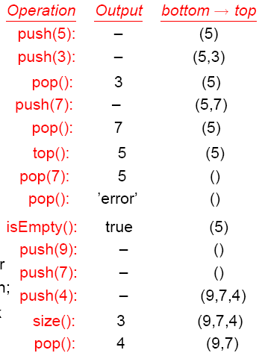
Stack: operations and their effects

Slide 5
ExampleI using built-in Stack: Reversing an Array
Refer to ArrayReverseApp project
The elements of an array can be reversed
Using the Java built-in class called Stack
Which is part of the java.util package
Number is a base class for
BigDecimal, BigInteger
Byte, Double, Float, Integer, Long and Short

Slide 6
ExampleII using built-in Stack: Reversing an Array
Refer to SecretMessageApp project
The secret message is
Encoded by having each individual word reversed
And then decoded by means of an auxiliary stack
Character are displayed in reverse order when
Popped from the auxiliary stack variable

Slide 7
Our Stack Interface
public interface Stack {
public int size();
public boolean isEmpty();
public Object top() throws StackException;
public void push(Object o) throws StackException;
public Object pop() throws StackException; }
Java interface corresponding to
our Stack ADT
Requires the definition of class StackException
Different from the built-in Java
class java.util.Stack

Slide 8
Exceptions
Attempting the execution
of an operation of ADT may
sometimes cause an error condition, called an exception
Exceptions are said to be
“thrown” by an operation that cannot be executed
In the Stack ADT, operations
pop and top cannot be
performed if the stack is empty
push cannot be
performed if the stack is full
Attempting the execution
of pop or top on an empty stack throws an StackException
of push on a full stack throws an StackException

Slide 9
Array-based Stack
A simple way of implementing the Stack ADT
uses an array
We add elements
from left to right
A variable keeps track
of the index of the top element
Algorithm size()
return t + 1
Algorithm pop()
if isEmpty() then
throw StackException
else
t ← t − 1
return S[t + 1]
…
S
0
1
2
t

Slide 10
Array-based Stack (cont.)
The array
storing the stack elements may become full
A push operation will then throw a StackException
Limitation of the array-based implementation
Not intrinsic to the Stack ADT
Algorithm push(o)
if t = S.length − 1 then
throw StackException
else
t ← t + 1
S[t] ← o
…
S
0
1
2
t

Slide 11
Example III using our Stack: Parentheses Matching
“(”, “{”, or “[” must be paired with a matching “)”,“}”, or “[”
correct: ( )(( )){([( )])}
correct: ((( )(( )){([( )])}
incorrect: )(( )){([( )])}
incorrect: ({[ ])}
incorrect: (
Refer to GroupingSymbolsApp project

Slide 12
Parentheses Matching Algorithm
Algorithm ParenMatch(X,n):
Input: An array X of n tokens, each of which is either a grouping symbol, a variable, an arithmetic operator, or a number
Output: true if and only if all the grouping symbols in X match
Let S be an empty stack
for i=0 to n-1 do
if X[i] is an opening grouping symbol then
S.push(X[i])
else if X[i] is a closing grouping symbol then
if S.isEmpty() then
return false {nothing to match with}
if S.pop() does not match the type of X[i] then
return false {wrong type}
if S.isEmpty() then
return true {every symbol matched}
else
return false {some symbols were never matched}

