Slide 1
Priority Queues

Slide 2
Priority Queue ADT
A priority queue stores a collection of entries
Each entry is a pair (key, value)
Main methods of the Priority Queue ADT
insert(k, x)
inserts an entry with key k and value x
removeMin()
removes and returns the entry with smallest key
Additional methods
min(): returns, but does not remove, an entry with smallest key
size(), isEmpty()

Slide 3
Entry and Key
An entry in a priority queue is
simply a key-value pair
Priority queues store entries to allow
for efficient insertion and removal based on keys
A key is
An object used
to identify the priority of an entry of a priority queue

Slide 4
Comparator ADT
A comparator
encapsulates the action of comparing
two objects according to a given total order relation
When the priority queue needs to compare two keys,
It can uses a user-supplied comparator
The primary method of the Comparator ADT:
compare(a, b):
Returns an integer i such that
i < 0 if a < b,
i = 0 if a = b,
i > 0 if a > b;

Slide 5
Sorting with a Priority Queue
Algorithm PriorityQueueSort(sequence S, priority Q P)
while (!S.isEmpty( )) do
e=S.removeFirst( );
P.insert(e);
while (!P.isEmpty( )) do
e=P.remove( );
S.insertLast(e);
Refer to TreeMapSorting Project

Slide 6
Java’s PriorityQueue Class
PriorityQueue
orders elements by their natural ordering.
inserts elements in priority order such that
the highest-priority element (i.e., the largest value)
will be the first element removed from the PriorityQueue.
Common PriorityQueue operations are
offer
to insert an element at the appropriate location based on priority order
poll
to remove the highest-priority element of the priority queue
peek
to get a reference to the highest-priority element of the priority queue
Refer to PriorityQueueSorting Project

Slide 7
Collection Interface and Collections Class

Slide 8
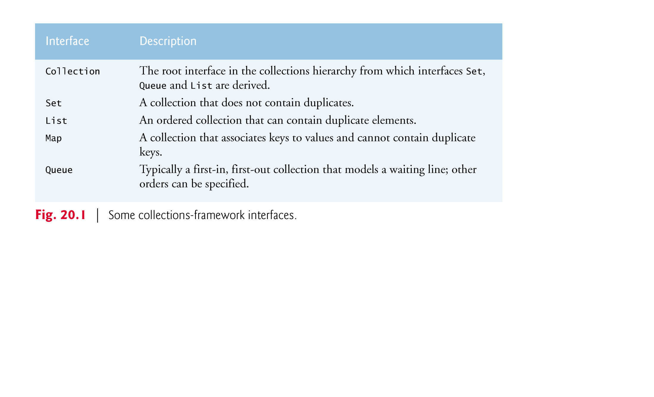
Collection interface

Slide 9
Collection interface and Collections class
Interface Collection is the root interface
from which interfaces Set, Queue and List are derived.
Interface Set defines a
collection that does not contain duplicates.
Interface Queue defines a
collection that represents a waiting line.
Class Collections provides static methods
that search, sort and perform other operations on collections.

Slide 10
Lists and LinkedList class
A List (sometimes called a sequence)
is a Collection that can contain duplicate elements.
is implemented by several classes,
including ArrayList, and LinkedList.
A LinkedList enables
efficient insertion (or removal) of elements
in the middle of a collection.

Slide 11
LinkedList methods
addAll
appends all elements of a collecton to the end of a List.
listIterator
gets A List’s bidirectional iterator.
subList obtains a portion of a List.
This is a so-called range-view method,
which enables the program to view a portion of the list.
Refer to LinkedListApp Project

Slide 12
Arrays as Lists
Class Arrays provides static method asList
to view an array as a List collection.
A List view allows you to manipulate
the array as if it were a list.
This is useful for adding the elements in an array
to a collection and for sorting array elements.
Refer to UsingToArray Project

Slide 13
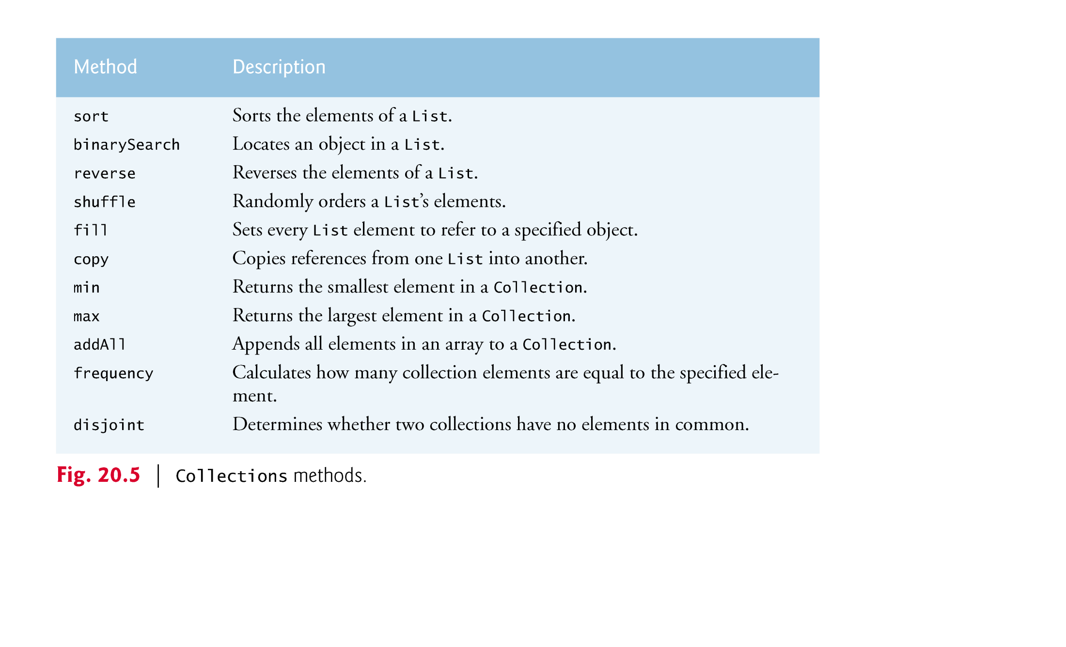
Collections Methods
Class Collections provides
several high-performance algorithms for
manipulating collection elements.
Refer to UsingCollectionsMethod Project

Slide 14
Sets
A Set is an unordered Collection
of unique elements (i.e., no duplicate elements).
The collections framework contains several
Set implementations, including HashSet and TreeSet.
HashSet stores its elements in a hash table, and
TreeSet stores its elements in a tree.

Slide 15
Sets (Cont’d)
TreeSet method
headSet gets a subset of the TreeSet in which every element
is less than the specified value.
tailSet gets a subset in which each element
is greater than or equal to the specified value.
first and last
get the smallest and largest elements of the set, respectively.
Refer to RemovingDuplicates Project

