Slide 1
Analysis of algorithms

Slide 2
What are we going to learn?
Need to say that some algorithms are
“better” than others
Criteria for evaluation
Structure of programs (simplicity, elegance, etc)
Running time
Memory space

Slide 3
Overview
Running Time
Pseudo-code
Analysis of algorithms
Asymptotic notations
Asymptotic analysis

Slide 4
Experimental studies
Run the program with various data sets
In a computer, and measure the wall clock time
In other words,
Write a program
implementing the algorithm
Run program
with inputs of varying size
Get an accurate measure
of running time and plot result

Slide 5
Limitations of experiments
Perceived limitations of experiments include
To compare algA to algB, both algorithms
must be implemented
Ideally, algA and algB are to be compared
on the same hardware and under same software environments
Experiments can be done only
on a limited set of test inputs
=> it is critical that there is sufficient number
of representative test cases (hard problem)

Slide 6
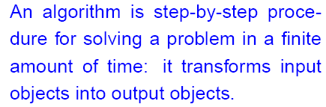
Algorithms, and inputs
n = 4
T(n)
Input
Algorithm
Output
Running time of algorithms
Typically depends on the input set, and its size (n)
We describe it using functions of n

Slide 7
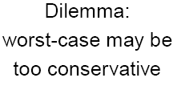
Average case vs. Worst case
The average case behavior
is harder to analyze since
You need to know a probability distribution of input
We focus on the worst case
running time
In certain apps (air traffic control,
weapon systems, etc)
Knowing the worst case time
is important

Slide 8
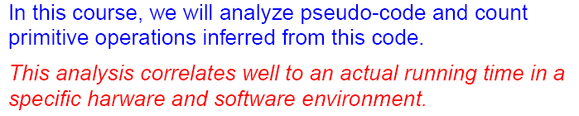
Worst case analysis
Some of the advantages include
Uses a high-level description (pseudo-code) of algorithm
Instead of an implementation
Characterizes running time as a function of input size n
Allows us to evaluate the speed of an algorithm
Independent of the hardware/software environment

Slide 9
General methodology
Independent of
implementation hardware and software environments
Actual elapsed time depends on
Hardware, software (os), compiler
Use high-level description of the algorithm
instead of one of its implementations
Worry about order of magnitude
Count steps (don’t worry about of time each steps takes)
Ignore multiplicative constants

Slide 10
Pseudo-code
Pseudo-code is a description of an algorithm
For human eyes only (mix of English and programming)
Brief and easy to read – and hopefully, understand !!
Example: finding the max element of an array
Algorithm arrayMax(A, n)
Input array A of n integers
Output maximum element of A
currentMax ← A[0]
for i ← 1 to n − 1 do
if A[i] > currentMax then
currentMax ← A[i]
return currentMax
Notes:
A pseudo code is more structured than English prose and less detailed than a program. Moreover, it hides program design issues.

Slide 11
Pseudocode Details
Control flow
if … then … [else …]
while … do …
repeat … until …
for … do …
Indentation replaces braces
Method declaration
Algorithm method (arg [, arg…])
Input …
Output …
Method call
var.method (arg [, arg…])
Return value
return expression
Expressions
Assignment (like = in Java)
Equality testing (like == in Java)
n² Superscripts and other mathematical formatting allowed

Slide 12
How to count steps
Comments, declarative statements (0)
Expressions and assignments (1)
Except for function calls
Cost for function needs to be counted separately
And then added to the cost for the calling statement

Slide 13
How to count steps: iteration
Iteration statements – for, while
Boolean expression + count
the number of times the body is executed
And then multiply by the cost of body
That is, the number of steps inside the loop
while <expression> do
<body of while>

Slide 14
How to count steps: switch or if else
Running time
of worst case statement + Boolean expression
Switch <expression>
case1: <statement1>
case2: <statement2>
….

Slide 15
Counting Primitive Operations
By inspecting the pseudocode,
we determine the maximum number of primitive operations
executed by an algorithm, as a function of the input size
Algorithm arrayMax(A, n)
# operations
currentMax ← A[0] 2
for i ← 1 to n − 1 do 2n+1
if A[i] > currentMax then 2(n − 1)
currentMax ← A[i] 2(n − 1)
{ increment counter i } 2(n − 1)
return currentMax 1
Total 8n − 2

Slide 16
Estimating Running Time
Algorithm arrayMax executes
8n − 2 primitive operations in the worst case.
Define:
a = Time taken by the fastest primitive operation
b = Time taken by the slowest primitive operation
Let T(n) be worst-case running time of arrayMax. Then a (8n − 2) ≤ T(n) ≤ b(8n − 2)
Hence, the running time T(n) is bounded
by two linear functions

Slide 17
Growth Rate of Running Time
Changing the hardware/ software environment
Affects T(n) by a constant factor, but
Does not alter the growth rate of T(n)
The linear growth rate of the running time T(n)
is an intrinsic property of algorithm arrayMax

Slide 18
Big-Oh Notation
Given functions f(n) and g(n), we say that f(n) is O(g(n)) if there are positive constants c and n₀ such that
f(n) ≤ cg(n) for n ≥ n₀
Example: 2n + 10 is O(n)
2n + 10 ≤ cn
(c − 2) n ≥ 10
n ≥ 10/(c − 2)
Pick c = 3 and n₀ = 10

Slide 19
Big-Oh Example
Example: the function n² is not O(n)
n² ≤ cn
n ≤ c
The above inequality cannot
be satisfied since c must be a
constant

Slide 20
Constant factors
The growth rate is not affected by
constant factors or
lower-order terms
Examples
102n + 105 is a linear
function
105n² + 108n is a
quadratic function

Slide 21
Seven important functions
Seven functions that often appear in algorithm analysis:
Constant ≈ 1
Logarithmic ≈ log n
Linear ≈ n
N-Log-N ≈ n log n
Quadratic ≈ n²
Cubic ≈ n³
Exponential ≈ 2^{n}
In a log-log chart,
the slope of the line
corresponds to the growth rate of the function
Notes:
Ideally, we would like data structure operations to run in times proportional to the constant or logarithm function, and we would like our algorithms to run in linear or n-log-n time. Algorithms with quadratic and cubic running times are less practical, but algorithms with exponential running times are infeasible for all but the smallest sized inputs.

Slide 22
Big-Oh rules
If f(n) is a polynomial of degree d,
then f(n) is O(n^{d}), i.e.
Drop lower-order terms
Drop constant factors
Use the smallest possible class of functions
Say “2n is O(n)” and never, ever say “2n is O(n²)”
Use the simplest expression of the class
Say “3n+5 is O(n)” instead of “3n+5 is O(3n)”

Slide 23
Big-Oh notation: mathematical proof
Given functions f(n) and g(n), we say that f(n) is O(g(n)) if there are positive constants c and n₀ such that
f(n) ≤ cg(n) for n ≥ n₀
Example: 2n + 10 is O(n)
2n + 10 ≤ cn
(c − 2) n ≥ 10
n ≥ 10/(c − 2)
Pick c = 3 and n₀ = 10

Slide 24
Big-Oh example
Example: the function n² is not O(n)
n² ≤ cn
n ≤ c
The above inequality cannot be
satisfied since c must be a
constant

Slide 25
Asymptotic algorithm analysis
The asymptotic analysis
Determines the running time in big-Oh notation.
Two basic steps to perform the asymptotic analysis
Find the worst-case number of operations
as a function of the input size
Then express this function with big-Oh notation
Example of arrayMax

Slide 26
Example of analysis
Find that algorithm executes at most 8n-2 ops
Drop constant factors and lower order terms
Say that algorithm “runs in O(n) time”
Algorithm arrayMax(A, n)
Input array A of n integers
Output maximum element of A
currentMax ← A[0]
for i ← 1 to n − 1 do
if A[i] > currentMax then
currentMax ← A[i]
return currentMax

Slide 27
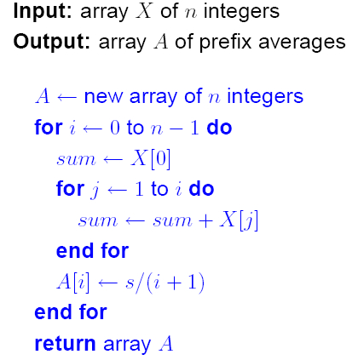
Example of analysis (cont’d)
Find statement
Executed most of the time
In this case
Statement inside inner loop
Total number of time
Inner loop is executed
=> n(n-1)/2
Running time is O(n²)

Slide 28
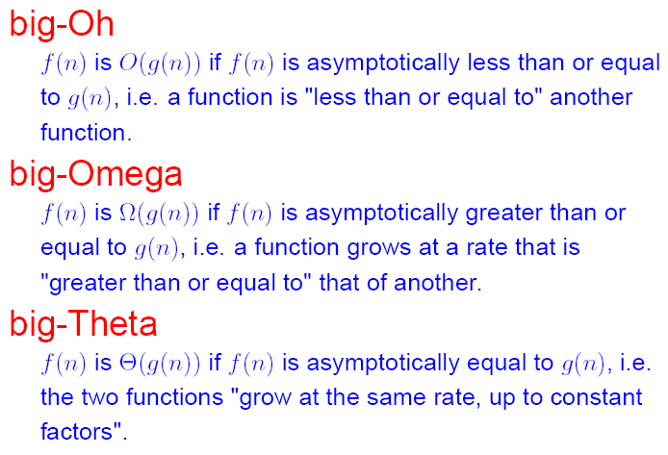
Intuition behind asymptotic notation

Slide 29

Math you need to review (Chapter 3)
Summations
Properties of logarithms and exponentials
properties of logarithms:
log_{b}(xy) = log_{b}x + log_{b}y
log_{b} (x/y) = log_{b}x - log_{b}y
log_{b}xa = alog_{b}x
log_{b}a = log_{x}a/log_{x}b
properties of exponentials:
a^{(b+c)} = a^{b}a ^{c}
a^{bc} = (a^{b})^{c}
a^{b} /a^{c} = a^{(b-c)}
b = a ^{log}_{a}^{b}
b^{c} = a ^{c*log}_{a}^{b}

