Slide 1
Generic Collections Java

Slide 2
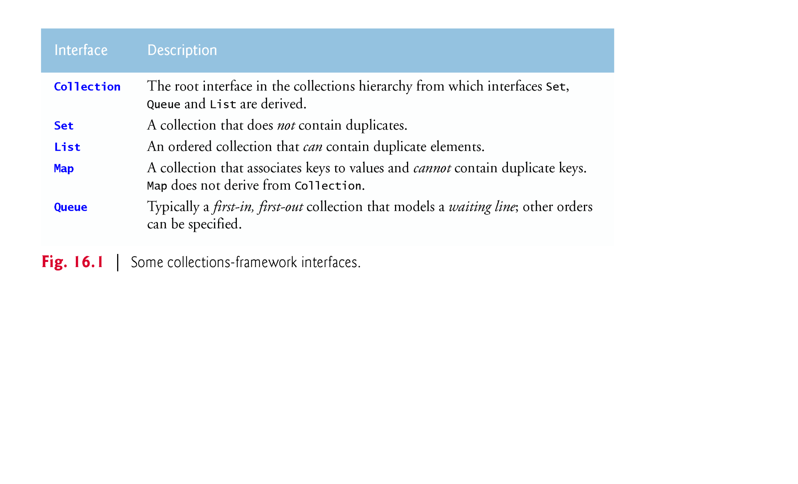
Java Collections Framework
The figure below lists some collections interfaces

Slide 3
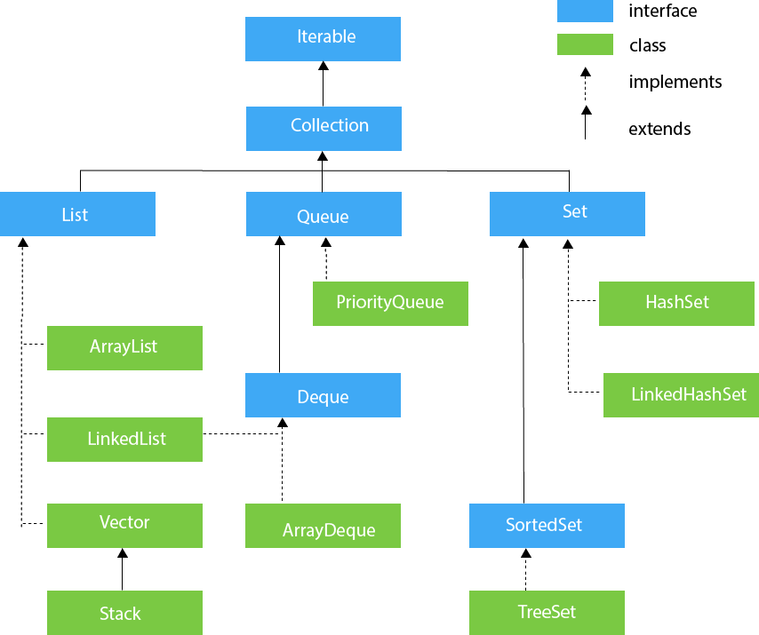
Java Collections Hierarchy

Slide 4
Difference between Collection interface and Collections class
The Collection interface
Contains operations for
adding and removing objects in a collection
The Collections class
Provides high-performance static methods for manipulating
objects created from classes implementing Collection interface

Slide 5
Lists
A List is
a collection that can contain duplicate elements
Implemented by several classes including
ArrayList and LinkedList classes
A LinkedList
Enables efficient insertion (or removal) of elements
In middle of collection
Is less efficient than ArrayList for jumping to a specific element in collection

Slide 6
Sets
A Set is
a collection of unique elements
Implemented mainly by
HashSet and TreeSet classes
HashSet
Stores its elements in a hash table and is not sorted
TreeSet
Stores its elements in a tree and is sorted
Implements SortedSet interface which is derived from Set

Slide 7
Maps
Map
associates keys to values
Where keys must be unique
is implemented by
HashMap and TreeMap
TreeMap
maintains its keys in ascending order
Implements the SortedMap interface
Which is derived from the Map interface

Slide 8
Class PriorityQueue and Interface Queue
Interface Queue
extends interface Collection
is implemented by the PriorityQueue class
PriorityQueue
Orders its elements by their natural order (i.e., ascending)
Can use new ordering rules
that are defined through the Comparator interface

Slide 9
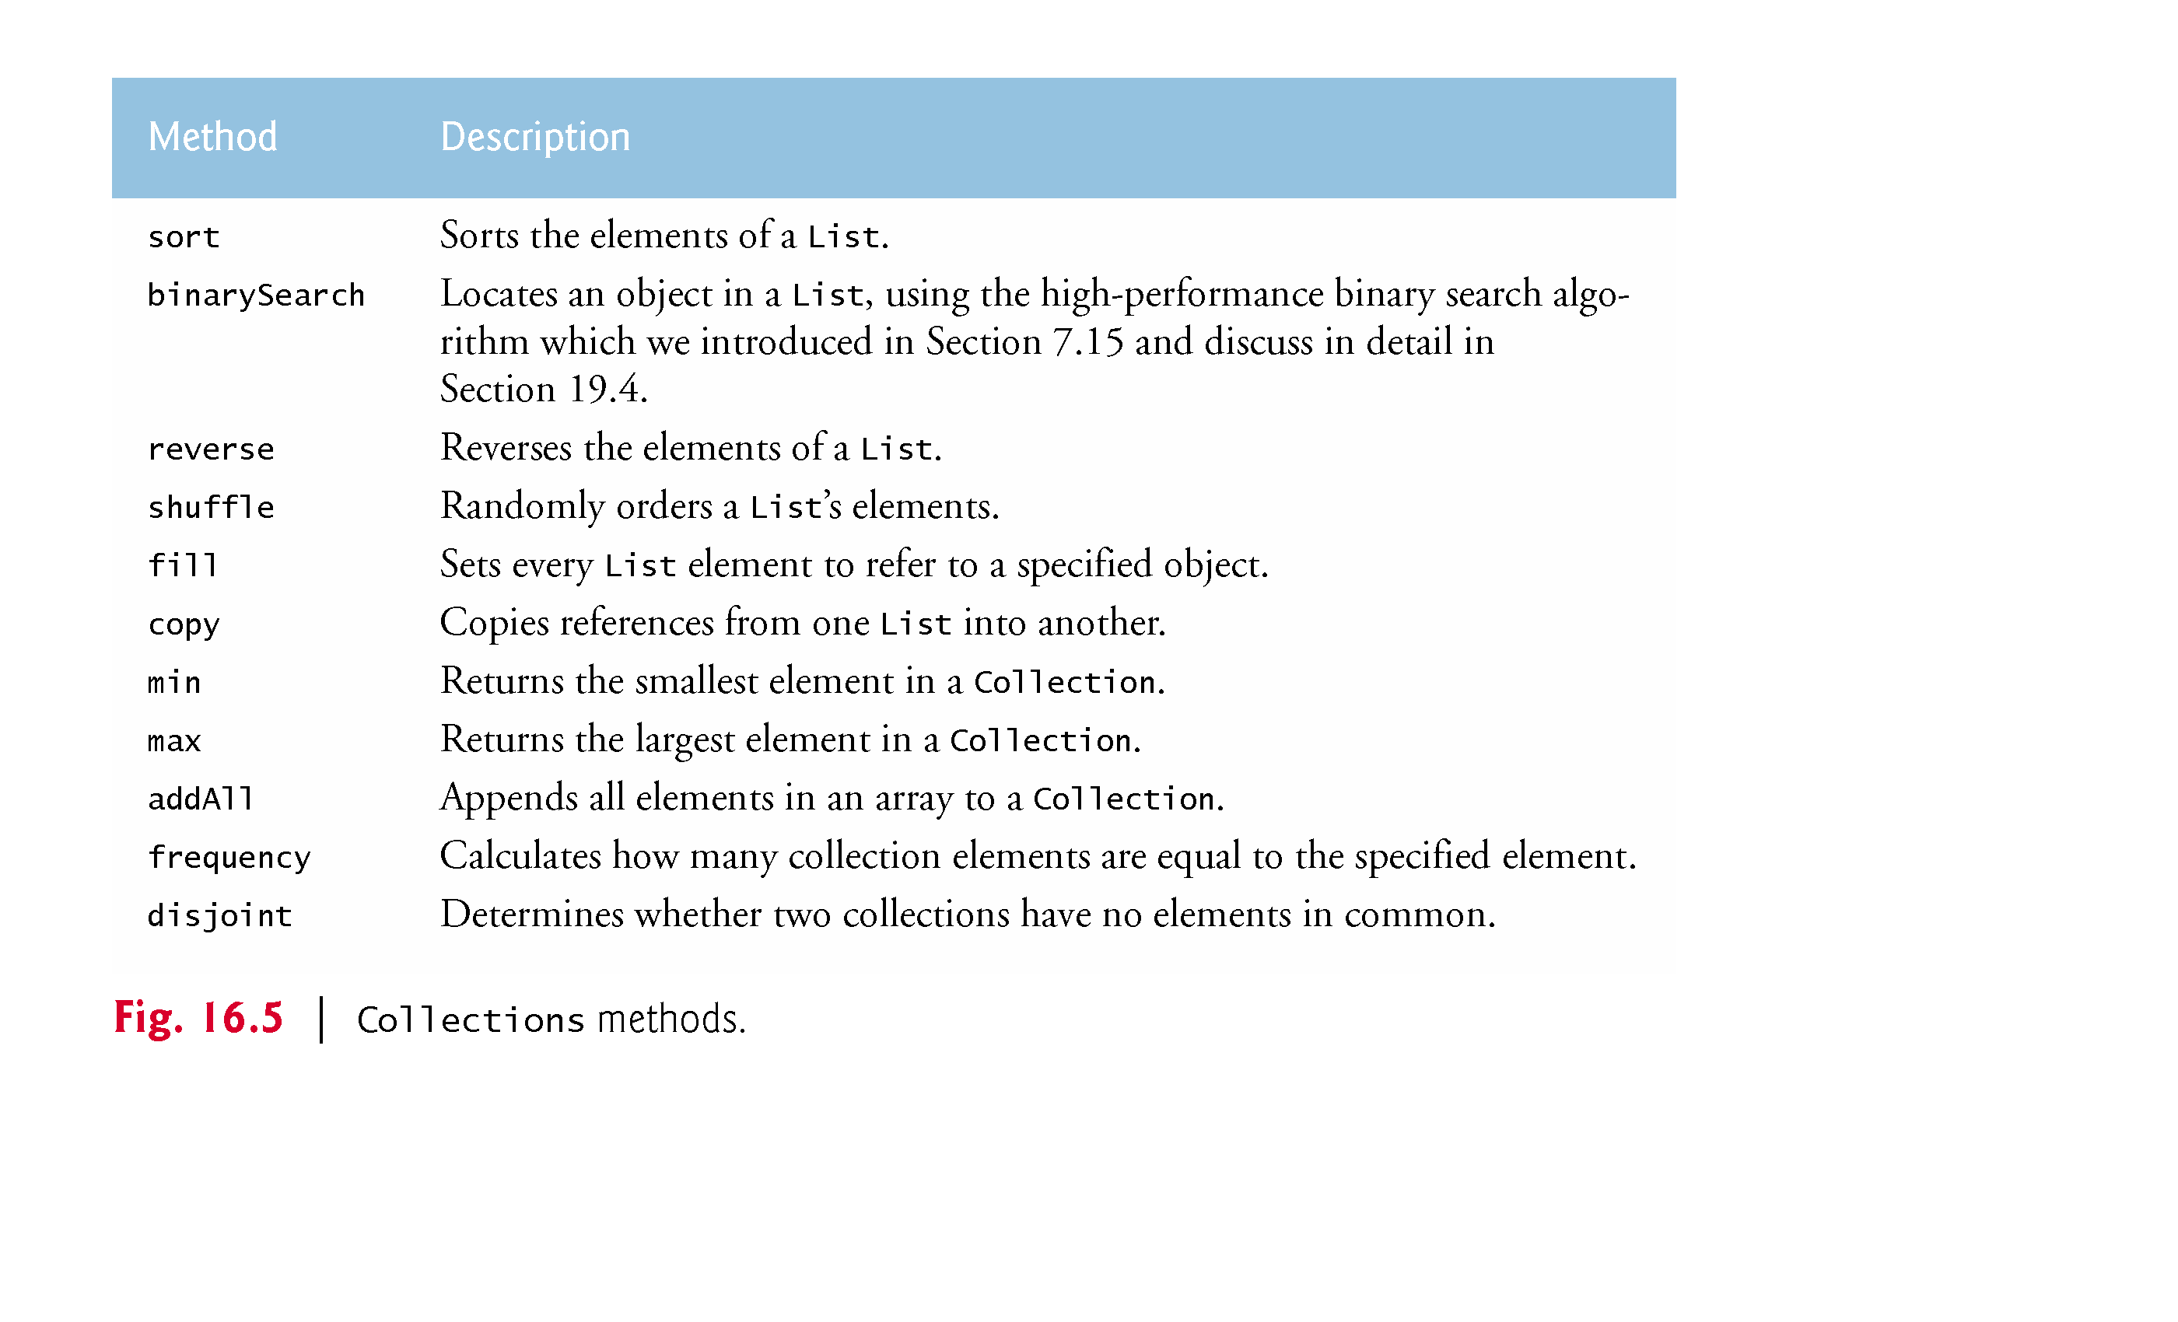
Collections class
Collections
Provides several methods for manipulating collection elements

Slide 10
Time complexity
HashSet
add: O(1)
contains: O(1)
TreeSet
add: O(log(n))
contains: O(log(n))
PriorityQueue
add or offer: O(log(n))
remove or poll: O(log(n))

Slide 11
Time complexity (Continued)
ArrayList
add: O(1)
get(int idx): O(1)
contains: O(n)
remove(0): O(n)
LinkedList
add: O(1)
get(int idx): O(n)
contains: O(n)
remove(0): O(1)

Slide 12
Time complexity (Continued)
HashMap
get: O(1)
containsKey: O(1)
TreeMap
get: O(log(n))
containsKey: O(log(n))

