Slide 1
Reinforcement Learning WS25/26 Project Air-Hockey
Carl Kueschall
University of Tuebingen
26.02.2026

Slide 2
Table of Contents
Intro
Problem Setup
Method
Training Curriculum
Self-Play and League Curation
Results
Ablations
Final Takeaways

Slide 3
DreamerV3 Hockey World-Model RL w/ recursive self-play and curated league training
Challenge:
Sparse Rewards (+10 | -10 | 0) in adversarial continuous control task
Method:
DreamerV3 with Self-Play PFSP and curated opponent league
Scratch Training
Self-Play Expansion
Final Checkpoint
League Creation
Core Message: Robustness under Opponent Diversity is the main objective

Slide 4



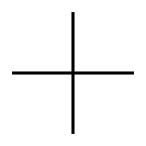

Problem Setup and Success Criteria
Observation Space: 18D
Fixed-Opponent Competence
Action Space: 4D Continuous per Player
Reward: +10 score, -10 concede, 0 otherwise
Cross-Play Robustness
Difficulty: Sparse Terminal-like signal + adversarial dynamics

Slide 5


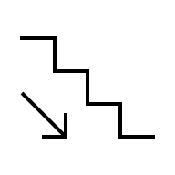
Method: DreamerV3 + Sparse Reward Adaptation
World Model (RSSM): Encoder + Dynamics + Reward/Continue Prediction
Encoder
Dynamics (RSSM)
Reward/Continue Prediction
Policy learns from imagination, not just from env gradients
Imagination Rollouts --- Actor/Critic Optimization
Goal
Stable Credit Assignment under sparse + averserial feedback
Imagination Rollouts
Actor/Critic Optimization
Two-Hot Symlog Heads
DreamSmooth Temporal Reward Smoothin
Sparse-Event Reward-Loss Weighting
PFSP Opponent Sampling

Slide 6
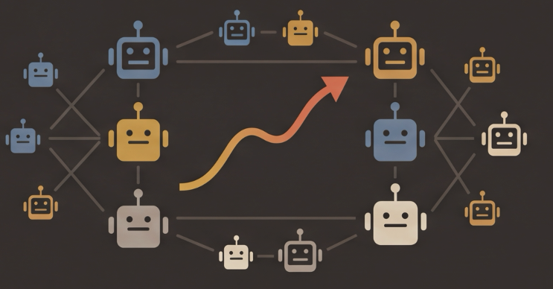


Training Curriculum
Phase C: Curated League Self-Play (~60%)
Phase B:
Self-Play (~20%)
Performance
Phase A: Anchor Competence (~20%)

Slide 7



Self-Play and League Curation Pipeline
Collect Diverse Candidate Checkpoints
Summit Matrix Evaluation
(vs. bots & checkpoints)
Score Robustness
(worst-case, etc.)
Greedy Quality + Diversity Selection
Create Weight-Map for all League Checkpoints
Output:
Curated League Pool for Final Training
Ensure
Quality
High robust cross-play against diverse opponents
Diversity
Avoid redundant policies and maximize behavioral coverage

Slide 8
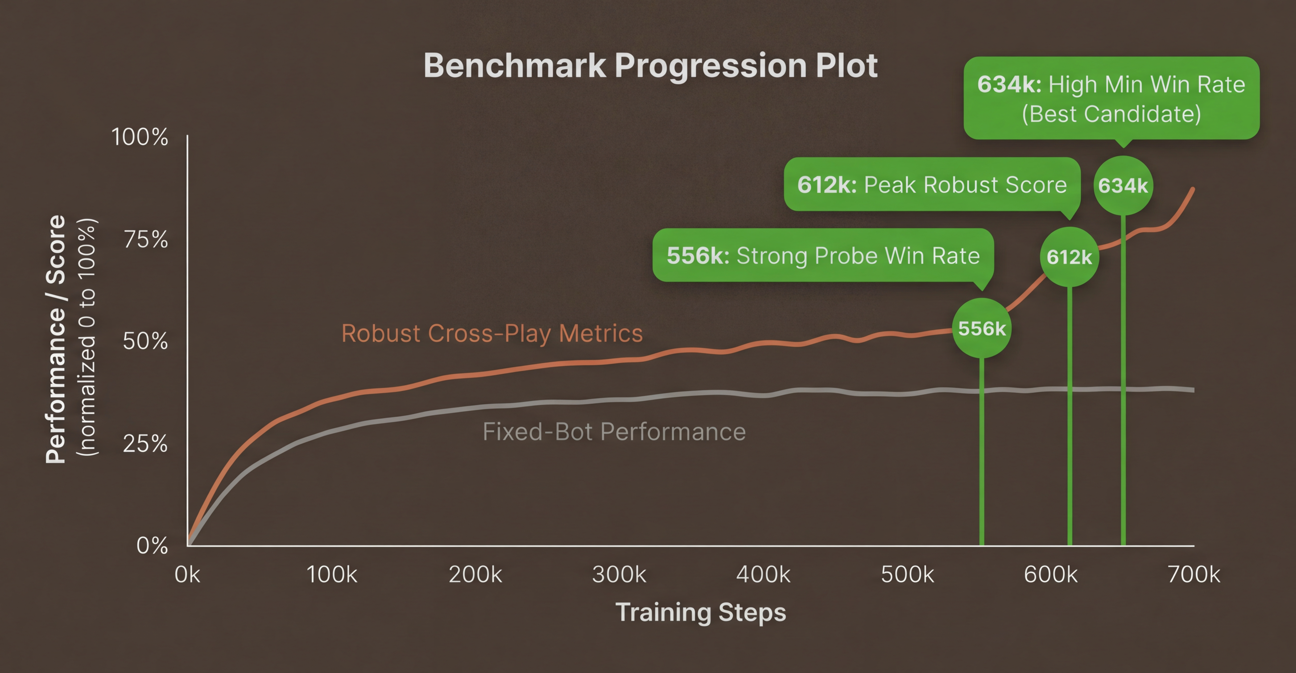
Results: Robust Selection Beats Single-Metric Picking Fixed-bot performance saturating | Cross-Play Metrics important to discriminate between checkpoints

Slide 9
Results: Robust Selection Beats Single-Metric Picking Placed 16th out of all agents in the final tournament. Placed 11th out of all teams in the final tournament.
100% Win-rate
Weak Bot
Tournament checkpoint 692k
98% Win-rate
Strong Bot

Slide 10
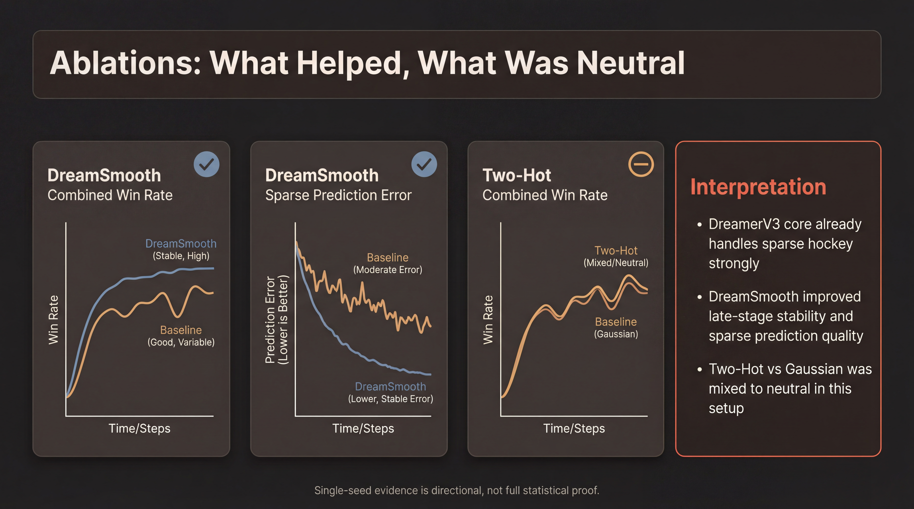

Slide 11
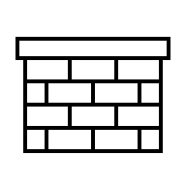
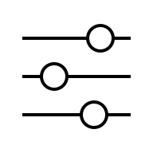

Final Takeaways
Robustness
Evaluate beyond fixed bots using cross-play worst-case and quantiles
Diversity
Curated Opponent Pools prevent overfitting to narrow behaviors
Recursion
Recursive self-play + league management continuously raises the bar
However:
League Self-Play recursion is a finnicky thing. With bad generalization and mismatched capacity of the model, we easily run into catastrophic forgetting issues.

Slide 12
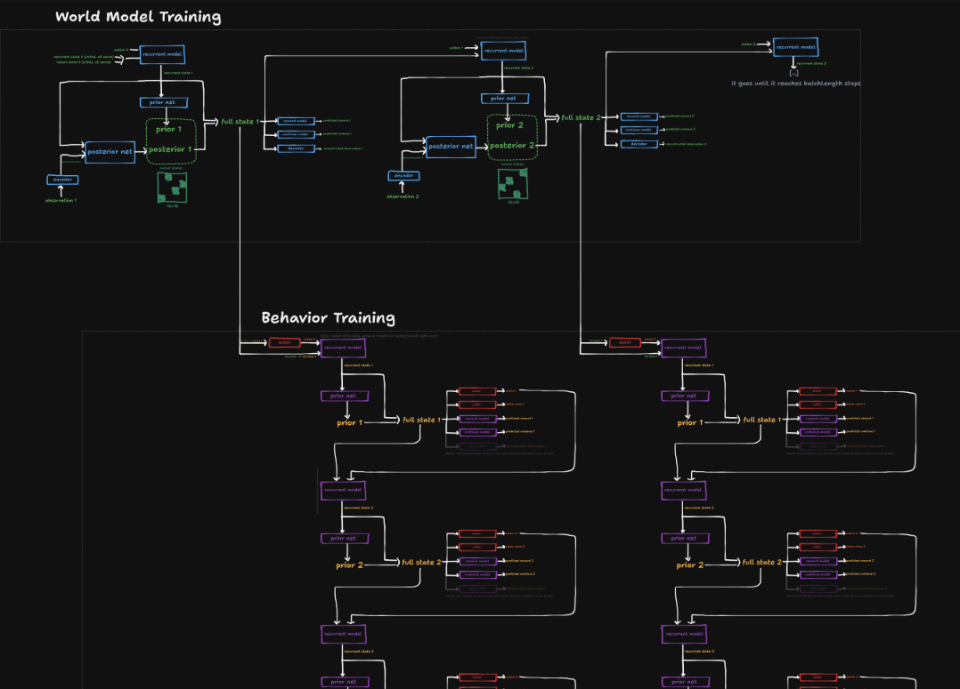
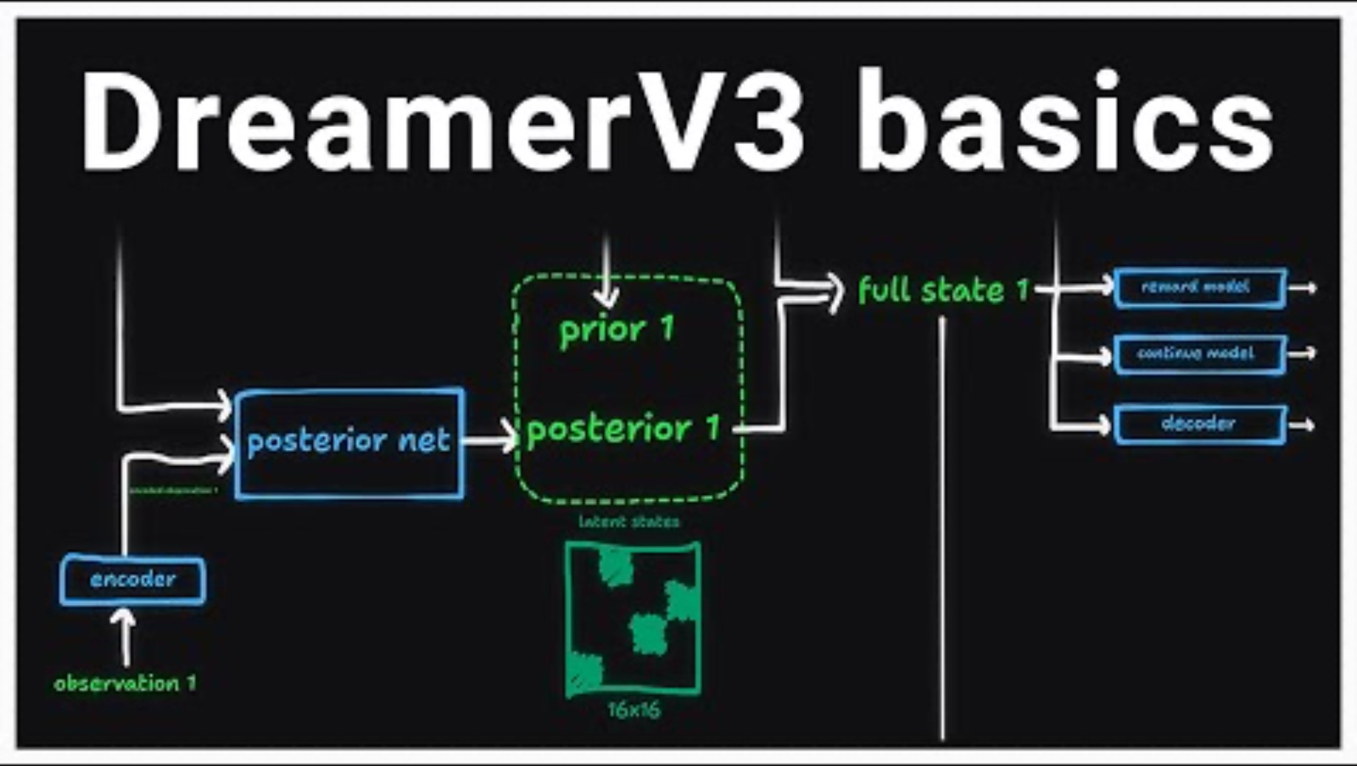
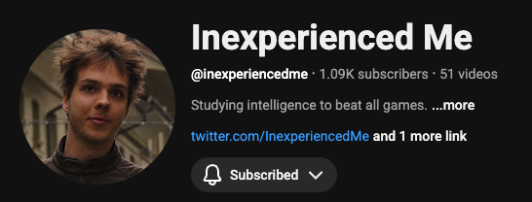
Thanks to the YouTuber “Inexperienced Me” for an incredibly valuable breakdown of the core Dreamer-V3 architecture and code, which serves as the raw basis for my implementation

Slide 13

Thank You!

