Slide 1

Risk Factors that Causes
of Road Traffic Accidents in Region IV-A Calabarzon
Clariz Mae M. Castillo
Carl Yousef A. Mabini
Christian Jay G. Ramos
Hardeep Sandhu

Slide 2


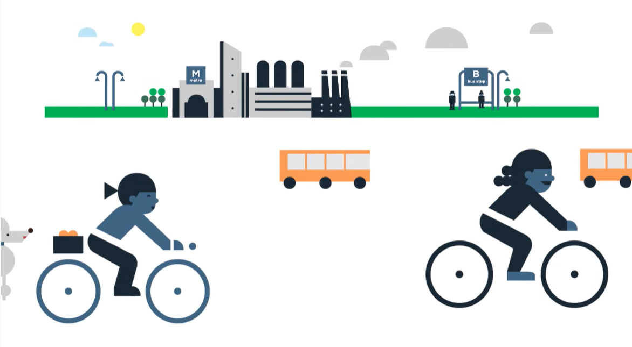

Slide 3

INTRODUCTION
Road accidents is commonly caused by collision of vehicles, in pedestrians, all object that result to fatality, disability, and damage to property. Road accidents also caused by driver’s error, mechanical defect, over speeding, drinking before driving, and damage roads. This study will discuss and analyze about risk that caused accidents in CALABARZON Philippines.

Slide 4
PROBLEM STATEMENT
Road accidents are the most dreaded thing that can happen to a driver, despite the fact that they occur frequently. The majority of road users are aware of the general guidelines and safety precautions to take while on the road, but it is the road users' own negligence that causes accidents and wrecks.

Slide 5
EXPECTED OUTPUT
This study aims to give insights about incidents happening within Cavite, Laguna, Batangas, Rizal and Quezon from the years 2016 to 2018 using analytical data.

Slide 6
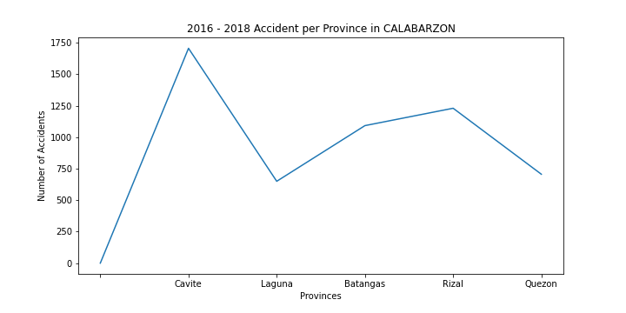


Slide 7
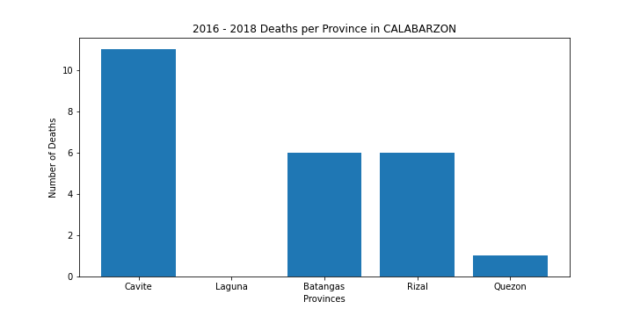

Slide 8
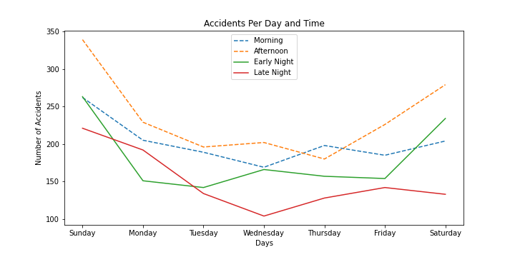

Slide 9
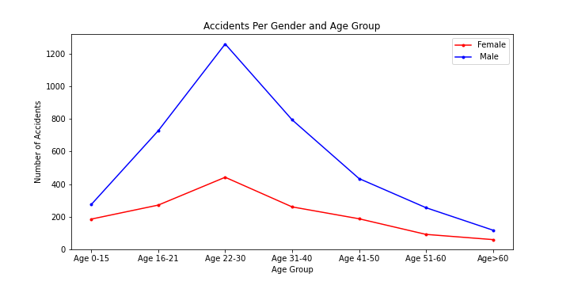

Slide 10
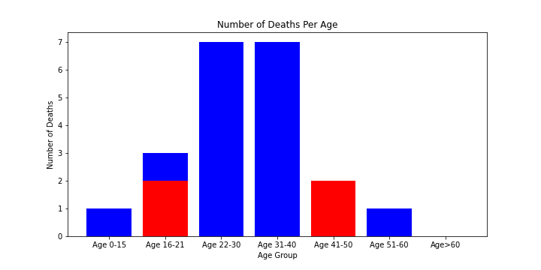

Slide 11
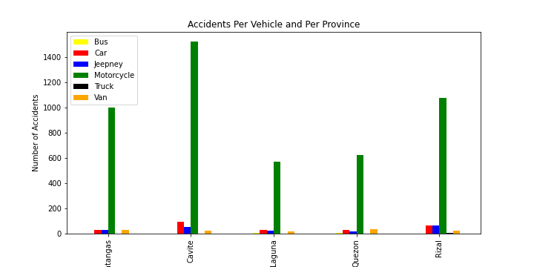

Slide 12
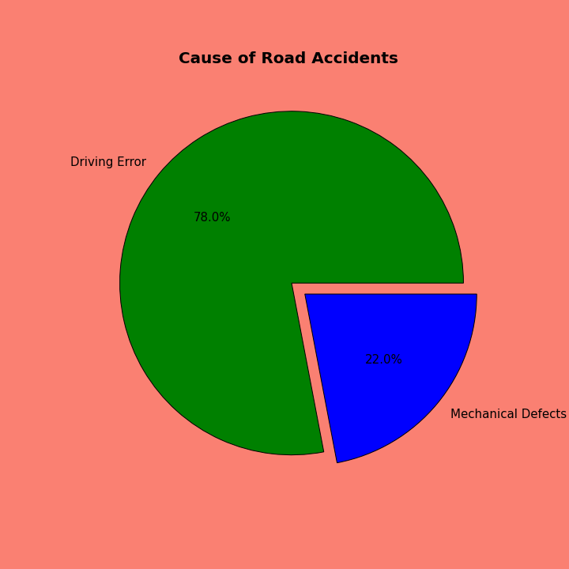
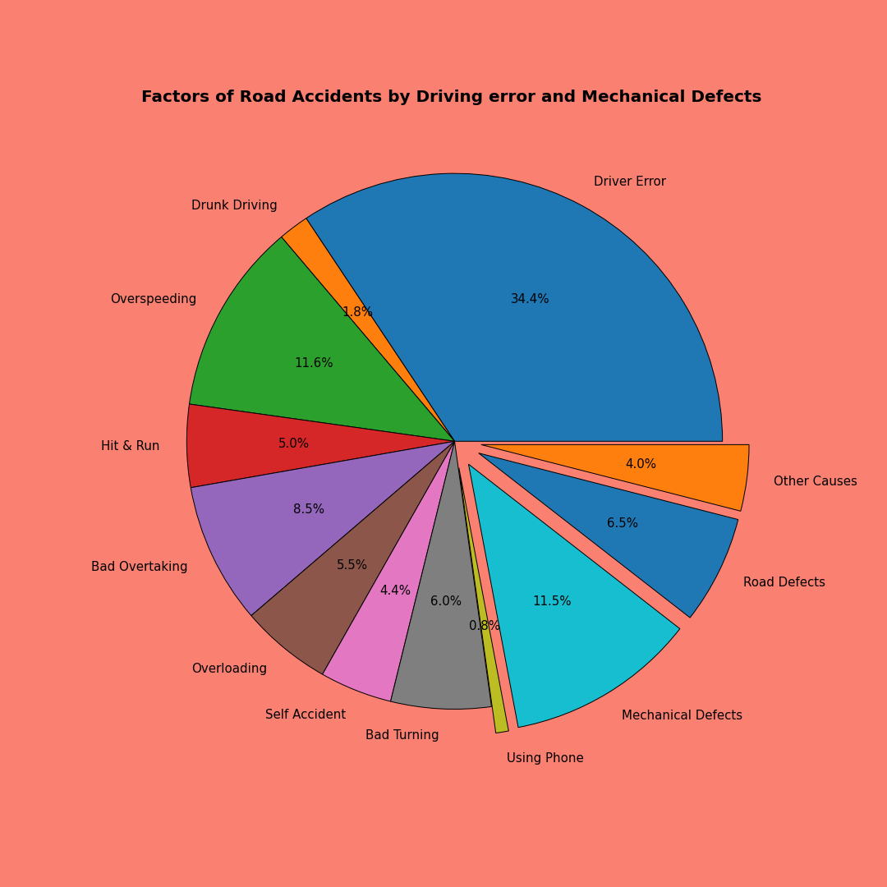

Slide 13


Slide 14
Conclusion
Significant Factors that affect the road traffic accidents are:
Driver Age
Driving Time
This analysis had verified that the criticality of the road traffic accident increased as the driver’s age increased. Driving time are indicators of road traffic accident criticality and Late night driving has the common critical accidents in CALABARZON.

Slide 15
THANKYOU!

