Slide 1
Cross Numbers
Carl Humphries
s50841050

Slide 2
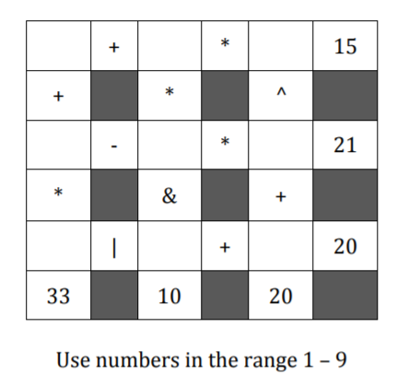
The Game
All rows and columns are equations.
Numbers need to be filled in to match row/column solutions.
A user can enter a “move” and the game will immediately say if it is a bad move.
A user can ask for a hint and the game will fill in a number that leads to a solution

Slide 3
Problem
The problem with this is that finding all the solutions takes a long time. Finding all the solutions is NP-Hard and Brute Force alone wont cut it.
Is there a way to shrink the state space.
Goals
The games needs to load reasonably quick and respond to the user as almost instantly.
All solutions need to be found either in the background or quickly.

Slide 4
Restrictions
To mitigate the state space restrictions where added.
Rows cannot have duplicates.
Only use the range 1-9.
Equally remove numbers from each row.
If the state space is large regenerate the grid?

Slide 5
Finding A Solution
Generate a grid.
For each row find all the number combinations that will lead to a valid row.
Check how big the state space would be by using these row solutions (product of lengths of the row solutions). If it is greater than 50000 go to step 1.
For all the combinations of row solutions. Check that the columns are valid. If the columns are valid store the solution.

Slide 6
Evaluation
If there is one element return that value Otherwise…
Find the operator that would resolve last. Use this as a splitting point.
Recurse on LHS and RHS then resolve LHS operator RHS.

Slide 7
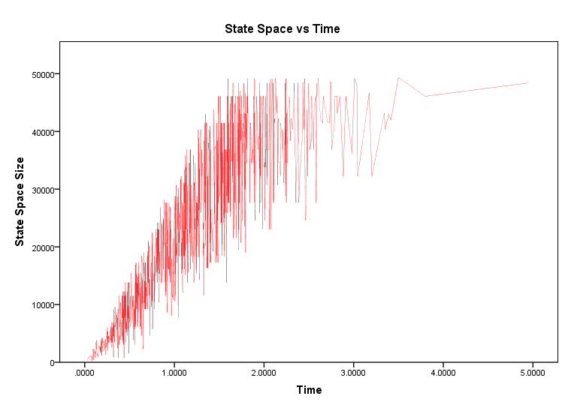
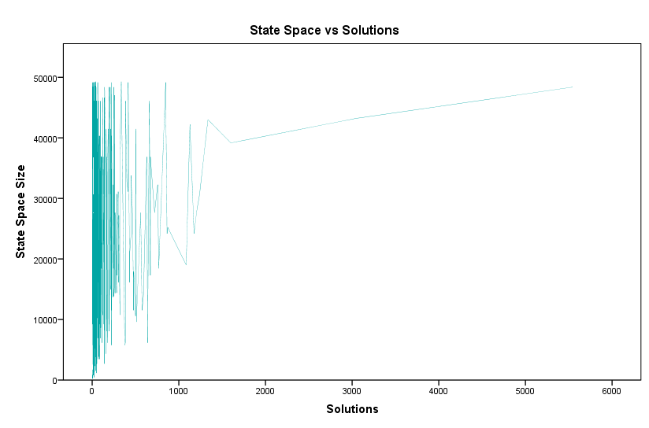
Experimental Results
It is quite clear that the state space affects the speed.
But if the state space is smaller will there be less solutions?

Slide 8
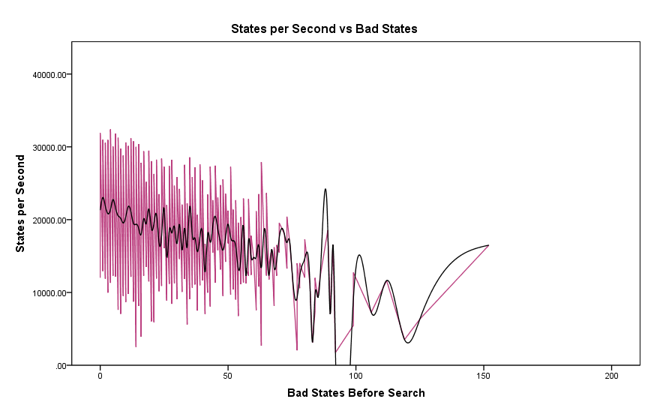
Regeneration Problems
If the algorithm takes longer to find a small state space how does this affect the time?

Slide 9
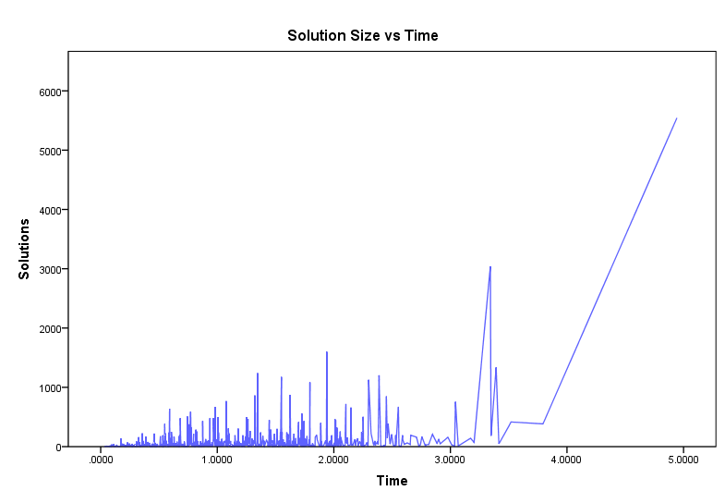
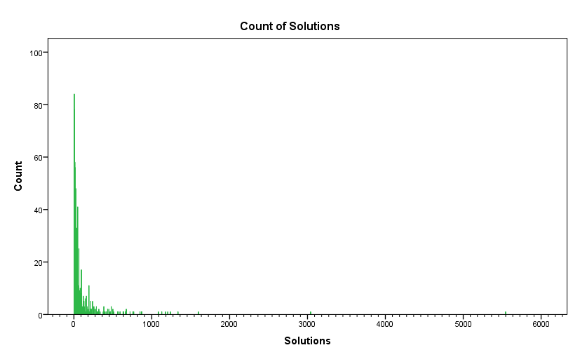
Solutions vs Time
So what about the amount of solutions?

Slide 10
Conclusion
The biggest factor for time complexity was the state space shown in experimental results. And with the implementation of restrictions to mitigate this, the results seemed promising.

