Slide 1
Linked Words
Carl Humphries
s5084150

Slide 2
Problem Description
Given a dictionary of words, build a sequence of words so that the next word’s second and third letters match the second last and third last letters of the current word.
All words can only be used once.
All words used in the sequence need to be the same length and be included in the range 4-15.

Slide 3
Algorithm Design

Slide 4
Heuristic
The Algorithm uses a heuristic to determine what is a good path.
It does this by keeping track of the amount of words that end/start in the same pair. It takes the one with the biggest value. Since we want to keep as many options open after removing the word.
Example: {“heart”, “start”, “stats”} would store a count of 2 in the slot of “.ta..” for the outs dictionary. Since any word end with “..ta.” would have 2 places to go. But it would store a count of 1 in “..ea.” (So a word ending in “..ta.” would be better than a word ending in “..ea.”)
“..at.” would store a count of 1 for the ins dictionary. Since any word ending in either of these pairs only has one spot to go. But “..ar.” would store a count of 2. (so a word starting with “.ar..” would be better than a word starting with “..at.”)

Slide 5
Three Parts
Generate possible starting words.
Build onto the front. Do this until no more words can be added onto the front.
Do the same to the back until no more words can be added. Then take the last word off and repeat to add more words. Do this until it returns to the starting point or there isn’t enough words left.

Slide 6
Starting words
Since the program builds onto the front of the sequence first, “eXAmple” would be rated the same as “.XA….” as a starting point. So the program ends up with “.(26)(26)….” max starting points. It relies more on the heuristic when adding words, so to combat the extra calculations less starting sample space was needed.

Slide 7
Adding words (Both backwards/Forwards)
The program uses a heuristic to add words to the front and back.
It does this by keeping track of the amount of in connections to a “pair”, and the amount of out connections to a “pair”. Basically the amount of words that have “XY” on the back and the amount of “XY” on the front.
From here it can determine the best child based on how many ways it can branch off (“out” for the back “in” for the front).
It adds words until there is no children with a way out. Then it takes a random child to create an “End cap”

Slide 8
Implementation

Slide 9
Data Structures
Two dictionaries with the same number of words just indexed by either front or end pair.
words_start {(string), (string){}}: Allows fast lookup for words to go next in the sequence
words_end {(string), (string){}}: Allows fast lookup for words to go in front in the sequence
Both ins/outs are used to compare what word should be next and what words should be start points.
Ins {(string), (int)}: Stores the number of words that can connect to a front pair e"xa"mple.
Outs {(string), (int)}: Stores the number of words that can connect to a end pair exam"pl"e.
word_count (int): Count of words in the data structures.
Note All these values are updated with x when pop_word(x) or add_word(x) are called.

Slide 10
Add to Front
Algorithm add_to_front(sequence[]) //Input: A any length sequence of words in a deque. first <- sequence[0] flag <- True added <- False while first[1:3] in words_end and flag: flag <- False best_child <- "" max_ins <- 0 for sub in words_end[first[1:3]]: word_ins <- ins[sub[1:3]] word_outs <- outs[sub[-3:-1]] if word_ins > max_ins: max_ins <- word_ins best_child <- sub flag <- True if flag: sequence.appendleft(pop_word(best_child)) added <- True first <- sequence[0] if first[1:3] in words_end: sequence.appendleft(pop_word(Random end cap)) added <- True return added

Slide 11
Add to End
Algorithm add_to_front(sequence[0-n-1]) //Input: A any length sequence of words in a deque. last <- sequence[n-1] flag <- True added <- False while last[-3:-1] in words_start and flag: flag <- False best_child <- "" max_outs <- 0 for sub in words_start[last[-3:-1]]: word_ins <- ins[sub[1:3]] word_outs <- outs[sub[-3:-1]] if word_outs > max_outs: max_outs <- word_outs best_child <- sub flag <- True if flag: sequence.append(pop_word(best_child)) added <- True last <- sequence[-1] if last[-3:-1] in words_start: sequence.append(pop_word(Random end cap)) added <- True return added

Slide 12
Main
longest_sequence = [] used_words = [] starting_words = get_starting_words() for word in starting_words: sequence <- [pop_word(word)] As a deque add_to_front(sequence) if len(sequence) > len(longest_sequence): longest_sequence <- sequence while add_to_end(sequence) returns that it added words: if len(sequence) > len(longest_sequence): longest_sequence <- sequence while No next words, enough words and not at the starting word: used_words.append(sequence.pop()) loop sequence length: add_word(sequence.pop()) loop used_words length: add_word(used_words.pop()) Print longest_sequence

Slide 13
Performance Analysis

Slide 14
Syntax
S = starting words
W = words in dictionary
N = words with s length
L = length of output string
B = max amount of children

Slide 15
Time Complexity (functions)
add_word() = 5 = O(1)
pop_word() = 9 = O(1)
read_in_words() = w*add_word() + splitlines() + open() + close() = O(w)
validate() = n*1 + count()*n = O(n^2)
save_results() = open() + 9 + validate() + write() + close() = O(l)
get_starting_words = n*3 = O(n)
add_to_end & add_to_front = 3 + n*(3+b*(2+3) + 2) + 2 = O(bn)
Notes:
“note splitlines is roughly O(w) website didn’t show only showed #TODO”

Slide 16
Time complexity (Main Program)
Main = 2 + read_in_words() + 6 + get_starting_words() + s*(pop_word() + add_to_front() + 3 + n*(add_to_end() + 3 + n*1) + 1 + n) + save_results()
Main = 8 + O(w)+O(n) + s*(5+O(bn)+O(n)+n*(O(bn)+3+n))+O(l) + O(n^2)
Main = O(w) + O(n) + s*(O(bn)+O(n) + n*(O(bn)+n)) + O(l) + O(n^2)
Main = O(w) + O(sbn^2) + O(l) + O(n^2) ~ O(sbn^2)
Where w>=n>=b AND w>=s

Slide 17
Space Complexity
Main = Data Structures*O(n) + O(longest sequence) + O(current sequence)
Main ~ O(n)

Slide 18
Experimental Results

Slide 19
Raw Results
Word Length | Words | Target Length | My Length | Difference | Difference % | Target Time | My Time | My Time Scaled | Difference % | Target Found Time | My found Time
4 | 3862 | 92 | 92 | 0 | 0.00 | 0.51 | 0.20 | 0.21 | 41.31 | 0.12 | 0.14
5 | 8548 | 3131 | 3101 | 30 | 0.96 | 146.7 | 42.08 | 43.65 | 29.75 | 55.88 | 40.89
6 | 14383 | 5456 | 5494 | -38 | -0.70 | 339.88 | 127.78 | 132.55 | 39.00 | 330.61 | 107.84
7 | 21730 | 8401 | 8567 | -166 | -1.98 | 629.41 | 469.13 | 486.63 | 77.31 | 362.03 | 307.56
8 | 26447 | 10330 | 10386 | -56 | -0.54 | 828.28 | 643.59 | 667.61 | 80.60 | 353.05 | 322.62
9 | 18844 | 5234 | 5260 | -26 | -0.50 | 394.73 | 263.08 | 272.89 | 69.13 | 394.36 | 129.38
10 | 12308 | 2409 | 2388 | 21 | 0.87 | 167.08 | 100.77 | 104.53 | 62.56 | 98.98 | 29.47
11 | 7850 | 1579 | 1595 | -16 | -1.01 | 72.22 | 34.44 | 35.72 | 49.46 | 56.55 | 17.34
12 | 5194 | 919 | 926 | -7 | -0.76 | 31.03 | 11.70 | 12.14 | 39.12 | 30.44 | 5.58
13 | 3275 | 505 | 499 | 6 | 1.19 | 11.16 | 3.02 | 3.13 | 28.03 | 2.66 | 0.45
14 | 1775 | 246 | 232 | 14 | 5.69 | 3.18 | 1.16 | 1.20 | 37.72 | 0.56 | 0.89
15 | 954 | 98 | 81 | 17 | 17.35 | 0.66 | 0.27 | 0.28 | 41.75 | 0.15 | 0.16
Sums |  | 38400 | 38621 | -221 | -0.58 | 2624.84 | 1697.20 | 1760.52 | 67.07

Slide 20
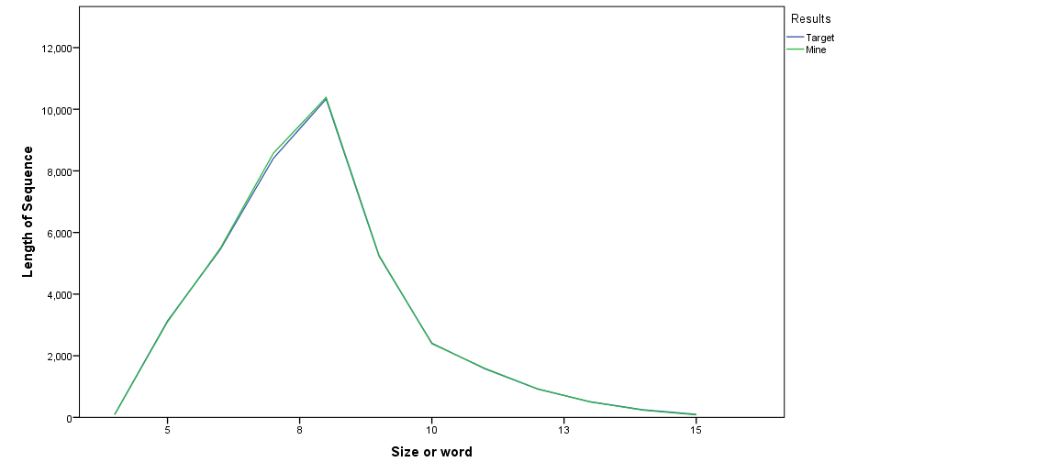
Word Length Comparison
Difference in the sums of all the sequences is -221

Slide 21
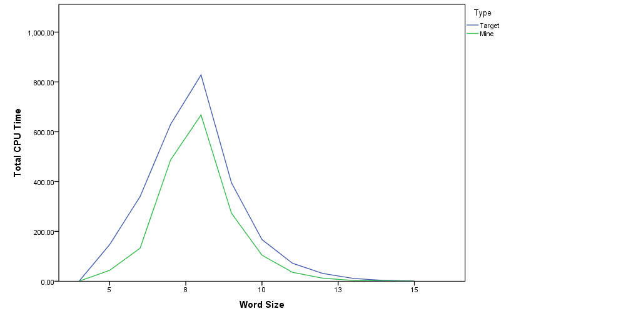
Time Comparison
Overall was 67.07% of the target time.

Slide 22
Analysis
The Algorithm implemented almost cut the time in half. But it did perform no so well on smaller sample sizes. This was due to the heuristic not performing as well when dealing with less places to go. On large word list sizes it found better results most of the time.
While the results are from the best sequences the algorithm found. There still could be better due to the randomness of sets and how it chooses starting points.
Taking the sum of all the sequence lengths it was 0.58% better than the target.

Slide 23
Conclusion
In conclusion from the results in most cases the new algorithm was better at getting a bigger sequence.
But the large draw back to this algorithm was the time it took going through all the starting points. If it used every word as a starting point times would have been a lot larger with results only to increase by small amounts.

