Slide 1
Nordkap Friluft
March 2026 status · April 2026 · Inbound CPH

Slide 2
Agenda
Headline & wins
Tents
Organic traffic
Email
Competitive picture
Paid
Actions for April

Slide 3
Headline
Tent PDP rework moved CVR to 0.96% (target 1.0%).
Non-branded organic up to 13.3k per week, +20% across the quarter.
Email open rate down to 19.5%. Three months of decline.
Hav & Fjeld now ranks ahead on packs as well as tents.
Blended ROAS softened to 3.2x. CAC held at 418 DKK.

Slide 4
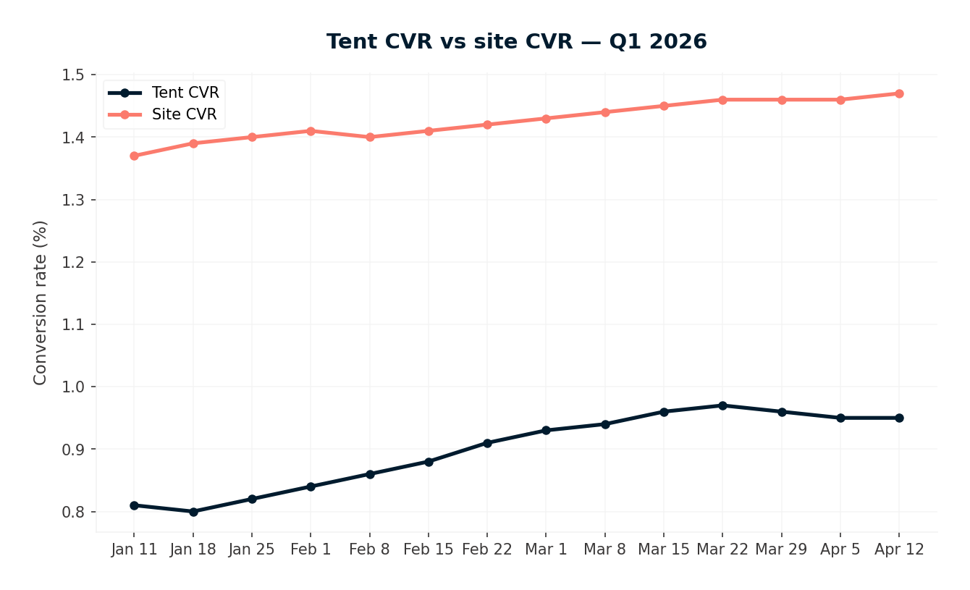
Tents — PDP rework working
Tent CVR: 0.82% → 0.89% → 0.96% (Jan baseline → Feb → Mar). On track for the 1.0% Q2 target.
Site-wide CVR sat at 1.45% across the same period — flat. The tent lift is category-specific.
Category page flip went live April 1. Eight days of post-launch data, too early to read.
We treat the PDP work as proven, not finished.

Slide 5
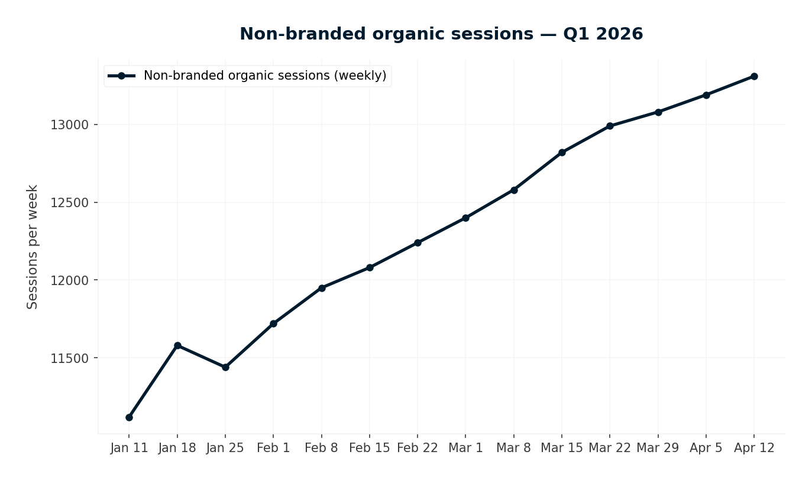
Organic traffic — holding
Non-branded organic sessions: 11.1k → 13.3k per week across the quarter.
Trend is steady, not spiky. SEO foundation is doing what it should.
Worth flagging: this is the floor under the next slide. Competitive pressure rises easier when the foundation is weak.

Slide 6
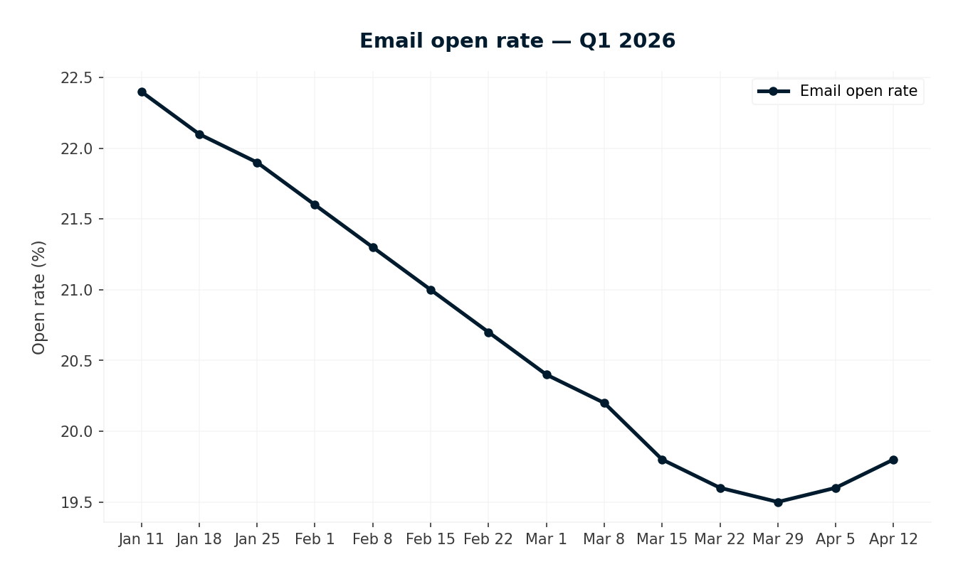
Email — still sliding
Open rate: 22.4% → 19.5% over the quarter. Target 28%.
Decline is three months running. List quality, not subject-line variance.
The re-permissioning campaign was proposed in February and again in March. It has not shipped.
This is the single clearest 'we owe you action' item in the deck.

Slide 7
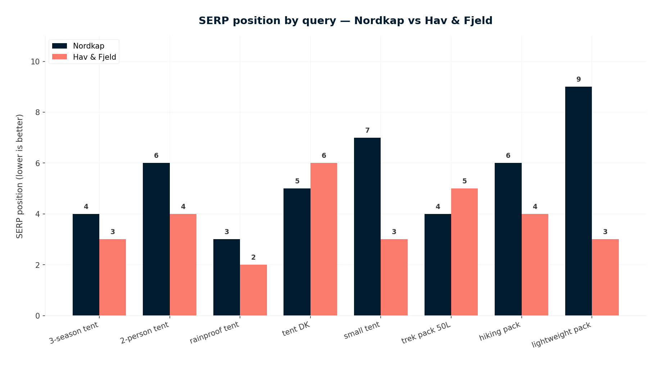
Competitive — Hav & Fjeld now on packs
Hav & Fjeld leads Nordkap on 6 of 8 tracked queries.
New this month: they rank ahead on all three pack queries (trekking rygsaek 50l, rygsaek vandretur, letvaegts rygsaek).
Tent pressure has plateaued; pack pressure has opened.
Recommend: contest packs. Defending tents is cheaper to maintain than to rebuild. See actions.

Slide 8
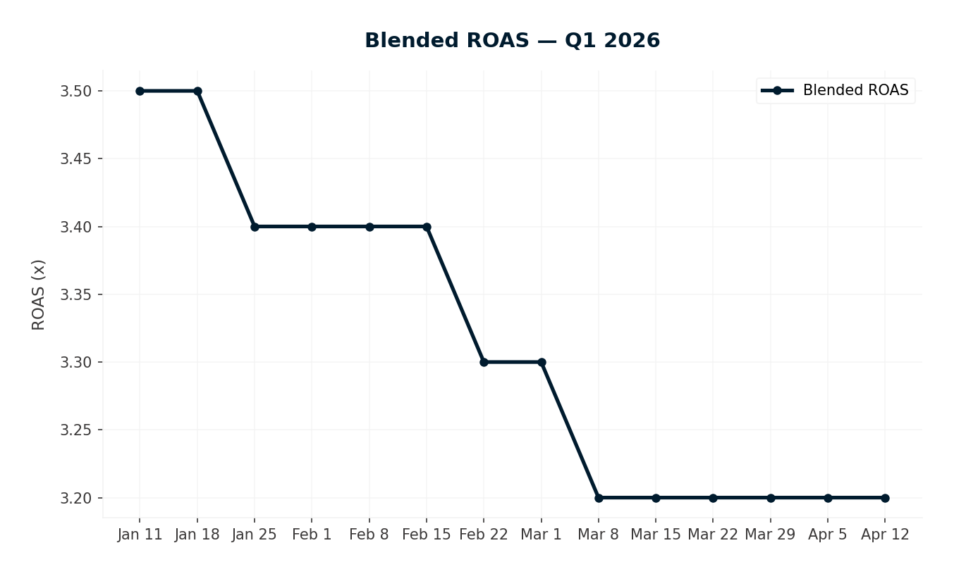
Paid — ROAS soft, CAC held
Blended ROAS: 3.5x → 3.2x across the quarter. Target 3.5x.
The drop is Meta-side. Google Ads is stable.
New customer CAC sat at 418 DKK, inside the 420 DKK ceiling.
We are watching, not changing course. Internal review of Meta creative rotation underway.

Slide 9
Actions for April
Email re-permissioning
Defend pack SEO
Hold tent gains
Watch Meta-side ROAS
High priority. Was promised April 15. We draft segmentation, suppression rules, and copy this week.
Add Hav & Fjeld pack queries to weekly tracking. Scope a content + on-page response before May.
Keep the new PDPs as-is. Let category-page-flip data accumulate through April for next month's read.
Internal Inbound work: review Meta creative rotation. No client ask this month.

Slide 10
Thanks
Questions next.
Next meeting: first Wed in May.

