Slide 1
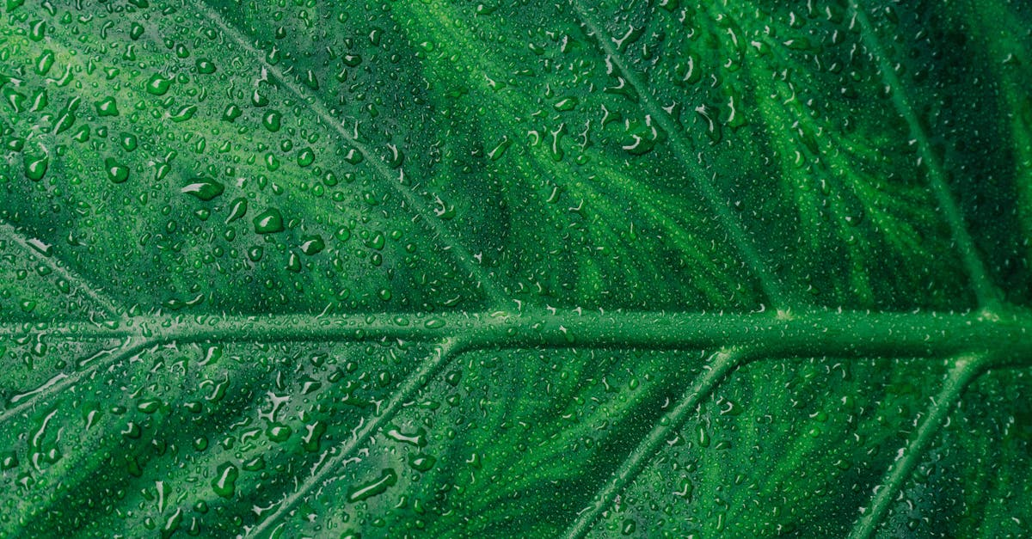
Photosynthesis:
*process of converting light energy into chemical energy
Notes:
Photosynthesis is the process of converting light energy obtained from the sun into chemical energy in the form of glucose. The process occurs in the chloroplasts of plant cells and involves the capture of sunlight by pigment molecules, which includes chlorophyll. This light energy is converted into chemical energy through a series of complex reactions, which result in the formation of glucose. The overall reaction for photosynthesis is as follows:
6 CO2 + 6 H2O + light energy → C6H12O6 + 6 O2
Photosynthesis can be divided into two main stages: the light-dependent reactions and the light-independent reactions. The light-dependent reactions involve the splitting of water molecules into oxygen, protons, and electrons. The oxygen is released into the atmosphere, while the protons and electrons are used in the light-independent reactions. The light-independent reactions, also known as the Calvin Cycle, involve the fixation of carbon dioxide into organic compounds such as glucose.
Photosynthesis is essential for life on Earth, as it provides the primary source of organic compounds for the food chain. Plants, algae, and some bacteria are capable of photosynthesis, while other organisms, including animals, rely on these organisms for nourishment. The process of photosynthesis also plays a crucial role in regulating the Earth's atmosphere by removing carbon dioxide and releasing oxygen.
Photosynthesis occurs most efficiently under certain conditions, including optimal light intensity and temperature. The rate of photosynthesis can be affected by external factors such as sunlight intensity, carbon dioxide concentration, and water availability. Additionally, photosynthesis can be restricted by environmental factors such as pollution and climate change.
Photosynthesis research has a significant impact on many areas, including agriculture, biotechnology, and environmental science. Improvements in photosynthesis technology can lead to the development of new crops with increased yields and nutritional content, as well as the production of biofuels from plant-based resources. Scientists continue to investigate methods for enhancing the efficiency of photosynthesis, such as genetic engineering and the development of new pigment molecules.

Slide 2

*plants use this process to create food for themselves
Notes:
Photosynthesis is a process that plants use to create food for themselves. It is a complex process that involves the conversion of light energy, water, and carbon dioxide into glucose, oxygen, and water. In other words, photosynthesis enables plants to make their own food.
Photosynthesis consists of two main stages: the light-dependent reactions and the light-independent reactions. The light-dependent reactions occur in the thylakoid membranes of the chloroplasts and involve the absorption of light energy by pigments such as chlorophyll. This light energy is then used to create ATP and NADPH, which are energy-rich molecules. The ATP is used to power the light-independent reactions, while the NADPH is used as a source of reducing power.
The light-independent reactions, also known as the Calvin cycle, occur in the stroma of the chloroplasts. These reactions involve the use of the ATP and NADPH generated in the light-dependent reactions to convert carbon dioxide into glucose. Carbon dioxide is first bonded to a molecule called ribulose bisphosphate (RuBP) to form an unstable compound, which is then converted into two molecules of 3-phosphoglycerate (3-PGA). These molecules can then be converted into two molecules of glyceraldehyde-3-phosphate (G3P), which can then be used to synthesize glucose.
Overall, photosynthesis is an essential process that enables plants to produce their own food. It is necessary for the survival of plants and for the entire food chain, as it provides the primary source of energy and carbon for both plants and animals. Through photosynthesis, plants are able to convert light energy into chemical energy, creating a sustainable source of food for themselves and for all living organisms.

Slide 3
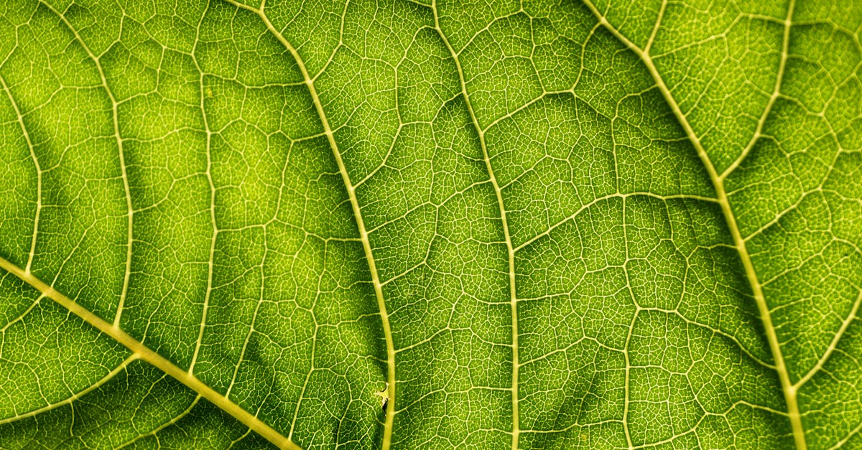
*chloroplasts in plant cells contain chlorophyll, which absorbs light energy
Notes:
Chloroplasts are specialized organelles found in plant cells that contain the pigment chlorophyll. This green pigment absorbs light energy from the sun and uses it to convert carbon dioxide and water into glucose and oxygen through a process called photosynthesis.
Chlorophyll is made up of a porphyrin ring, which is similar to heme, and long hydrocarbon chains. It has a characteristic blue-green absorbance spectrum that is best suited for capturing light energy from the sun's blue and red wavelengths, which are most abundant. Chlorophyll captures light energy at approximately 430 and 640 nanometers, which are in the blue and red parts of the visible spectrum.
The chloroplasts are organized into a specialized organelle called the chloroplast membrane, which is typically 2 to 3 nanometers thick. The membrane contains lipids that provide buoyancy and phospholipids that regulate ion flow into and out of the organelle. The membrane is surrounded by fluid, which provides a continuous interface for the exchange of materials with the cytoplasm.
Once chlorophyll has absorbed light energy, it is used to excite electrons within the pigment molecule. This process is known as light-dependent reactions, which occur in the thylakoid membrane of the chloroplasts. The excited electrons are transferred through a series of protein complexes to a molecule called ATP synthase, which uses the energy to create ATP molecules. ATP is used as the energy currency of the cell and is important for powering many cellular processes.
In addition to light-dependent reactions, the chloroplasts also contain an enzyme called rubisco, which catalyzes the light-independent reactions of photosynthesis. These reactions use ATP and NADPH produced in the light-dependent reactions to drive the conversion of carbon dioxide into glucose, a process called calcination. The glucose produced is used by the plant for energy or stored as starch for later use.
Overall, the chloroplasts in plant cells are key organelles for photosynthesis. They contain chlorophyll, which absorbs light energy, and they are organized in a specialized architecture

Slide 4

*requires water, carbon dioxide, and sunlight
Notes:
Photosynthesis is the process through which plants, algae, and some bacteria convert carbon dioxide and water into oxygen and organic compounds using solar energy. The process requires water, carbon dioxide, and sunlight. water is necessary for photosynthesis because it is used as a reactant in the process, and is essential for the functioning of the chloroplasts, the organelles where photosynthesis occurs. Carbon dioxide is also necessary for photosynthesis as it is used as a source of carbon for the production of glucose, one of the primary products of photosynthesis. Sunlight is the energy source for photosynthesis, it is absorbed by the pigments in the chloroplasts, primarily chlorophyll, which then use this energy to drive the chemical reactions that produce oxygen and organic compounds.
Photosynthesis is an essential process for life on Earth, as it produces the oxygen that we breathe and the food that we eat. However, the process is limited by the availability of the necessary ingredients. Water, carbon dioxide and sunlight are all essential for photosynthesis to occur, and any changes in the availability of these ingredients can have a significant impact on the ability of plants to carry out the process. For example, a lack of water can limit the ability of plants to photosynthesize and may cause growth and development problems. Similarly, an excess of carbon dioxide can lead to increased photosynthetic activity and an increase in the production of glucose, but can also lead to other negative effects such as increased oxygen levels and decreased carbon storage in soils and in the ocean.
In summary, photosynthesis is a vital process that requires water, carbon dioxide, and sunlight. The process produces oxygen and organic compounds, which are essential for life on Earth. The availability of these ingredients can have a significant impact on the ability of plants to carry out the process, and any changes in their availability can lead to negative effects on the planet's ecosystems. It's important to maintain a balance in the availability of these ingredients in order to ensure the continued existence of life on Earth.

Slide 5
Add improvements!
Notes:
I hope the video was helpful. we generated some recommendations for improvements, if you are interested: simply press the button below that matches your expectations for a remade video. Thanks for watching and I hope to see you again soon on our site

