Slide 1
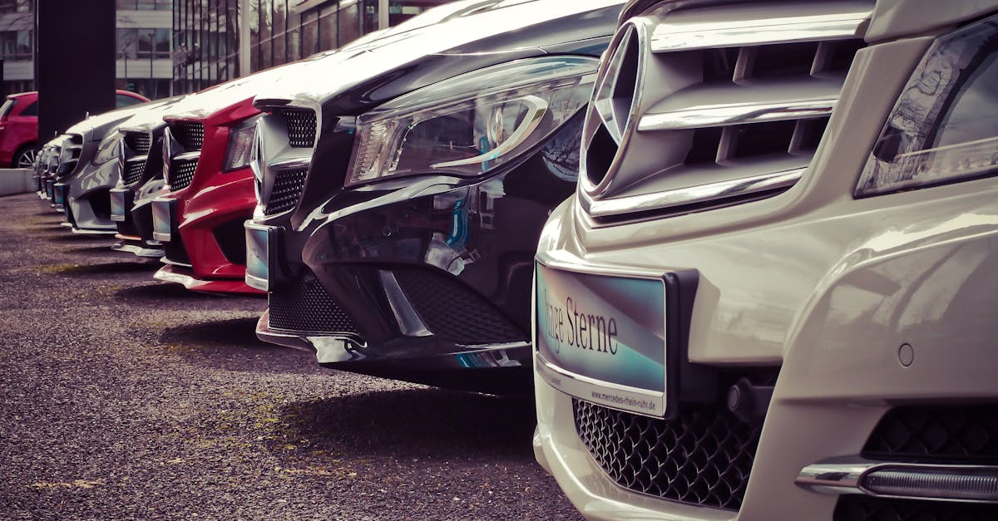
Fast, shiny, loud
Notes:
Fast, shiny, loud is the mantra of Lightning McQueen, the star of the Pixar animated movie Cars. Lightning is a race car who dreams of becoming a Roadster champion, and he takes every challenge he faces head-on, determined to achieve his goals. He may not be the most popular racing car in the world, but he has a unique style that sets him apart from the rest. His bright red paint job, sleek metal body, and lightning-fast speed make him a force to be reckoned with on the track. And while others may scoff at him, Lightning knows that it's not the outside that matters, but what's on the inside.

Slide 2
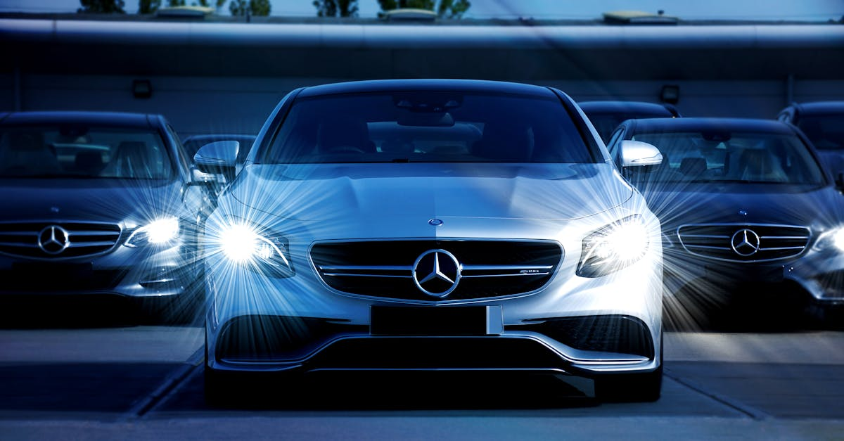
Wheels, engine, gasoline
Notes:
Wheels, engine, and gasoline are the key components that make cars functional. Wheels provide mobility and allow cars to move on different surfaces. Engines are responsible for propelling the wheels, and gasoline is used as fuel to power the engine. The efficiency of these components plays a significant role in the performance and longevity of a car. Regular maintenance and upkeep are essential to ensure that these components operate optimally and safely. Cars must also comply with safety regulations and standards set by government agencies.

Slide 3
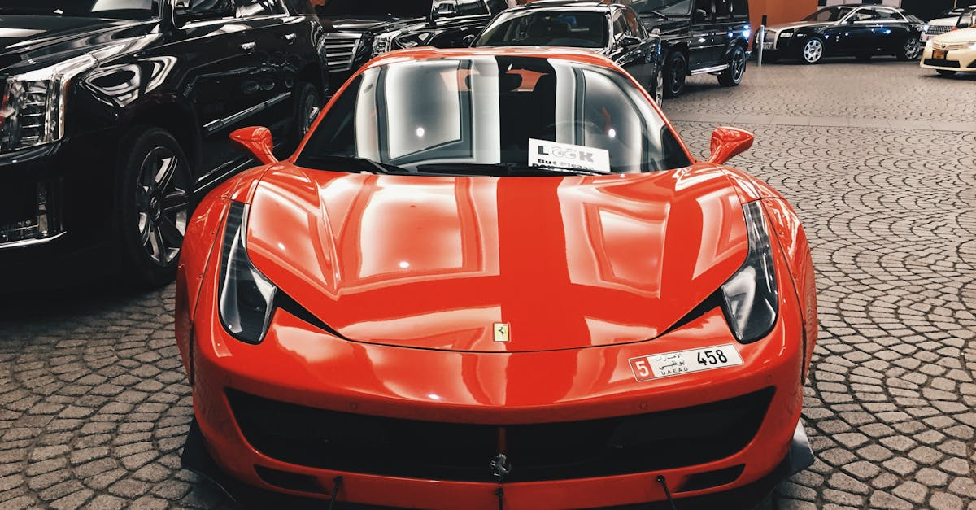
Military, utility, comfort
Notes:
Cars are versatile machines that serve various purposes depending on their intended use. Military cars are designed to withstand harsh conditions and are used for transportation, surveillance, and combat mission support. Utility cars are versatile vehicles that can carry a variety of equipment and passengers over different terrains. Comfort cars prioritize passenger comfort and are designed to provide a smooth and luxurious driving experience. In summary, cars come in various forms, each serving a specific purpose, and the choice of vehicle depends on the individual's needs.

Slide 4

Design, safety, innovation
Notes:
Design, safety, and innovation play vital roles in the car industry. The design of cars should prioritize both aesthetics and functionality to make them appealing to consumers. Safety features, such as airbags, anti-lock brakes, and electronic stability control, are crucial to protect drivers and passengers in case of accidents. Innovation is key to making cars more efficient, eco-friendly, and connected to technology. The integration of electric and autonomous driving systems is pushing the industry towards a more sustainable and safer future. The balance between these three factors is essential to create cars that are both appealing and safe for everyone on the road.

Slide 5
Add improvements!
Notes:
I hope the video was helpful. we generated some recommendations for improvements, if you are interested: simply press the button below that matches your expectations for a remade video. Thanks for watching and I hope to see you again soon on our site

