Slide 1
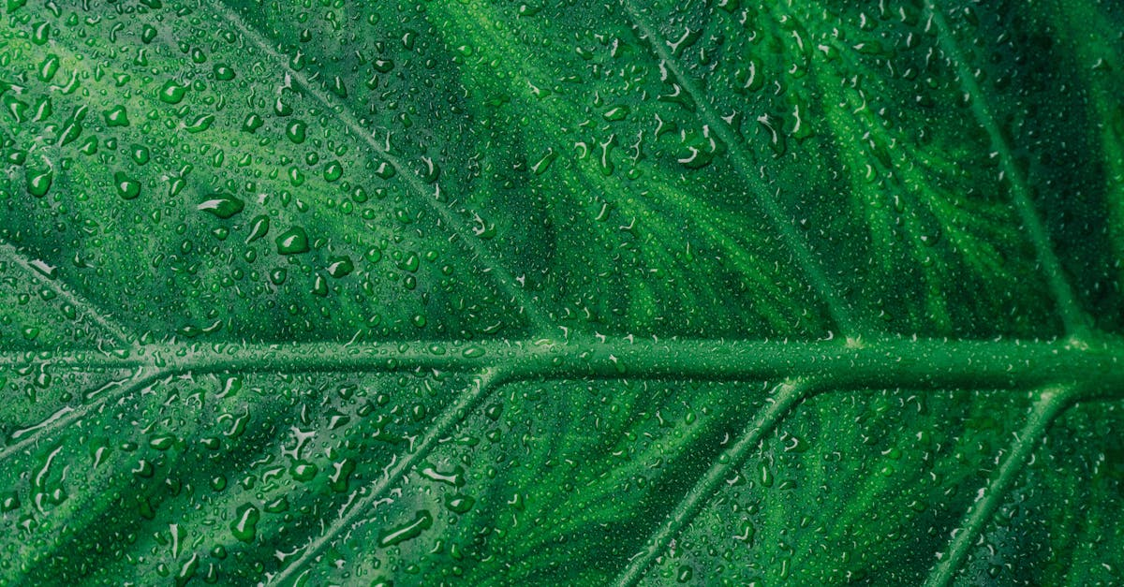
Plants absorb light energy
Notes:
Die Photosynthese wird deutlich beschrieben als den Vorgang bei dem Pflanzen ihre Lichtenergie in chemische Energie verwandeln, was sehr wichtig ist für ihre Ernährung. Dieser Vorgang wird in zwei größereTypen geteilt, die beide verschiedene und besondere Rollen spielen.

Slide 2
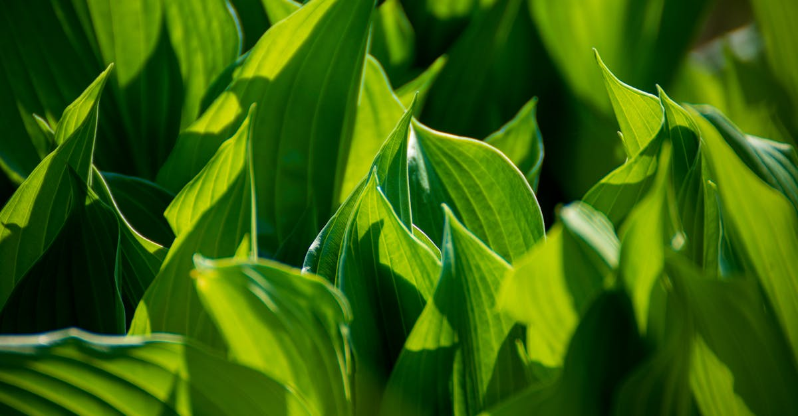
Water and carbon dioxide react to form glucose
Notes:
Photosynthesis is the process by which plants convert water and carbon dioxide into glucose, oxygen, and other byproducts. The process involves two stages: the light-dependent reactions, which take place in the thylakoid membranes of chloroplasts, and the light-independent reactions, which occur in the stroma of chloroplasts. The light-dependent reactions use light energy to generate ATP and NADPH, which are used in the light-independent reactions to power the synthesis of glucose via the Calvin cycle. This process is essential for the production of oxygen and the support of life on Earth.

Slide 3
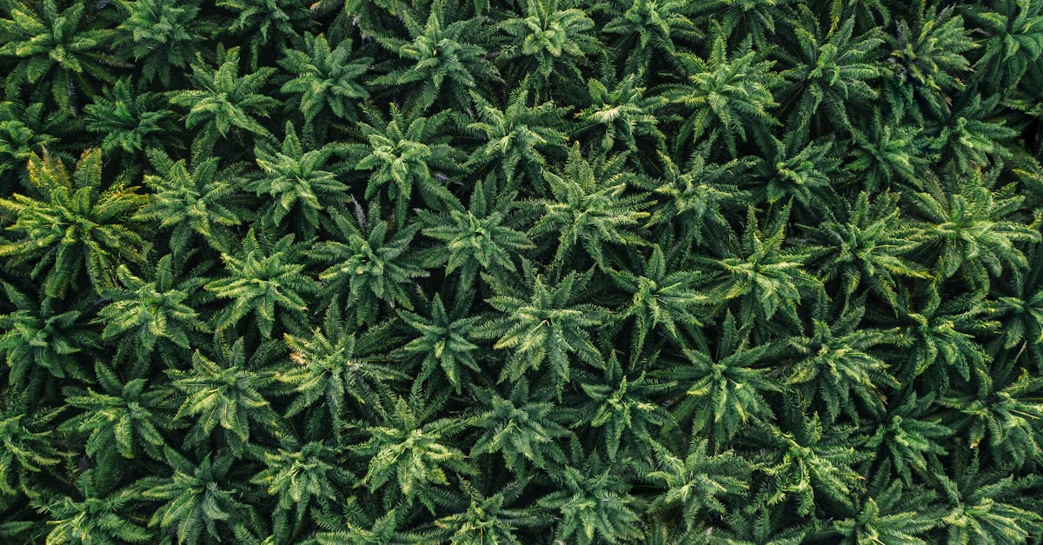
Process sustains life on earth
Notes:
Photosynthesis is a process that sustains life on earth. It involves the conversion of sunlight, water, and carbon dioxide into glucose, oxygen, and water. This process is vital for all living organisms, as it provides the energy and nutrients necessary for growth and reproduction. The byproducts of photosynthesis, oxygen and water, are also essential for the survival of many other organisms. Without photosynthesis, life on earth would not be sustainable.

Slide 4
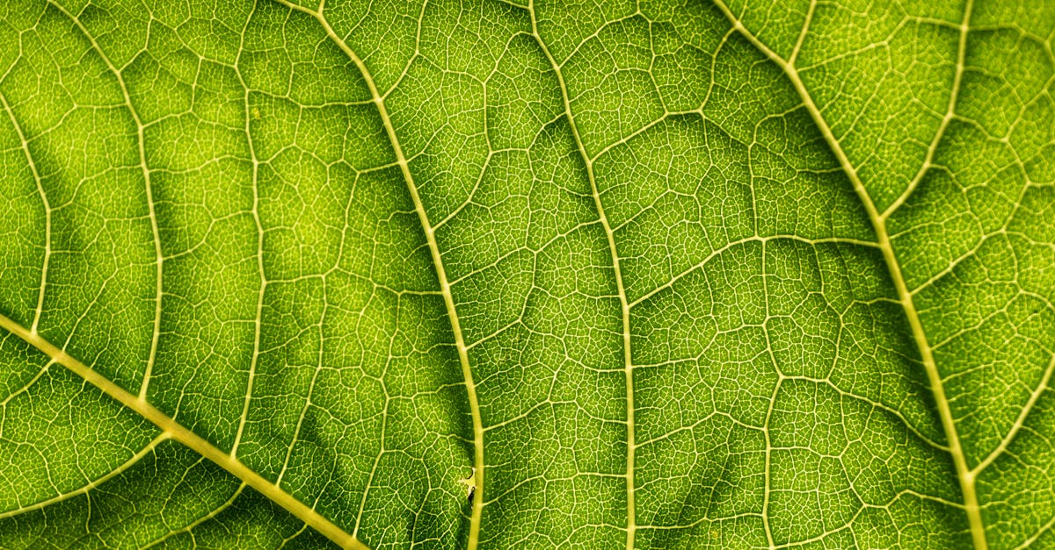
Oxygen released as a byproduct
Notes:
During photosynthesis, plants release oxygen as a byproduct of converting carbon dioxide and water into glucose through the process of photosynthesis. The plant absorbs light energy, which excites electrons in the chlorophyll molecules. This causes water molecules to split, releasing oxygen gas as a byproduct. The oxygen is then exhaled by the plant, making it available for other organisms to breathe. The process of photosynthesis is essential for providing oxygen to the Earth's atmosphere and sustaining life.

Slide 5
Ecercises
What is the byproduct that is produced during photosynthesis?
Notes:
Here is a quick question for you to strenghten youre knowledge: What is the byproduct that is produced during photosynthesis?

Slide 6
Add improvements!
Notes:
I hope the video was helpful. we generated some recommendations for improvements, if you are interested: simply press the button below that matches your expectations for a remade video. Thanks for watching and I hope to see you again soon on our site

