Slide 1
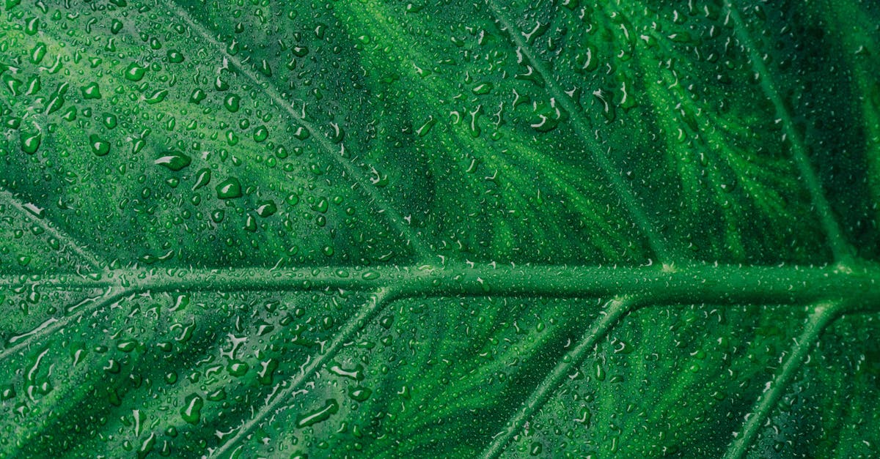
Plants harness sunlight
Notes:
Photosynthesis is the process by which plants convert sunlight into chemical energy in the form of glucose. This process occurs in the chloroplasts of plant cells, where the chlorophyll molecules capture photons of sunlight and use them to drive the chemical reaction that produces glucose. The process is limited by the amount of sunlight that can be absorbed by the plant's leaves and the efficiency of the chlorophyll molecules in using this energy to drive the reaction. Additionally, other environmental factors such as temperature, water availability and soil nutrients can also affect the rate of photosynthesis in plants.

Slide 2
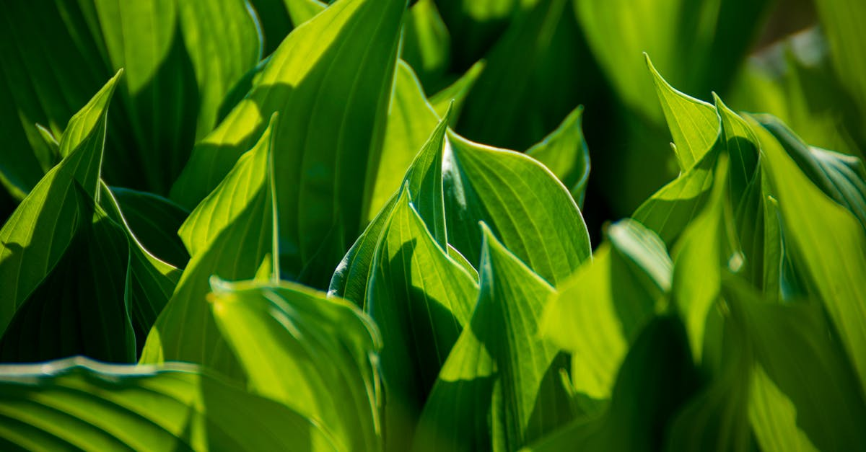
Water, carbon dioxide
Notes:
During photosynthesis, water molecules are used to produce carbon dioxide. The process involves splitting water molecules into oxygen and hydrogen ions. The carbon dioxide produced is then used to create organic molecules, while the oxygen is released into the atmosphere. Photosynthesis is the process by which plants convert light energy into chemical energy, and is a vital source of food and oxygen for the world. The water molecule plays a critical role in this process, as it provides the necessary chemical components for the creation of carbon dioxide. However, excess water can lead to decreased photosynthesis and decreased oxygen production.

Slide 3
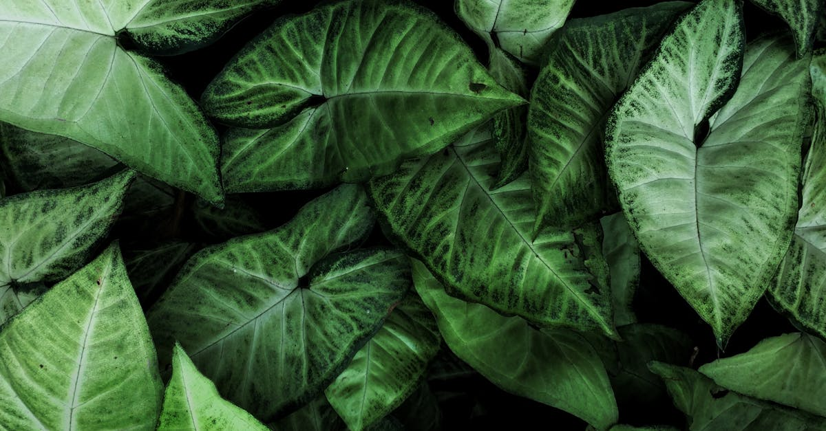
Food chlorophyll absorbs light
Notes:
Chlorophyll is a pigment that absorbs light during photosynthesis. The light is used to power the chemical process that converts carbon dioxide and water into glucose and oxygen. The absorptive spectrum of chlorophyll is centered around blue and red light, with only a narrow range of green light being transmitted. This allows plants to selectively absorb light from the sun and use it to carry out photosynthesis. The efficiency of chlorophyll at absorbing light is important to the entire photosynthetic process and ultimately to the growth and development of the plant.

Slide 4
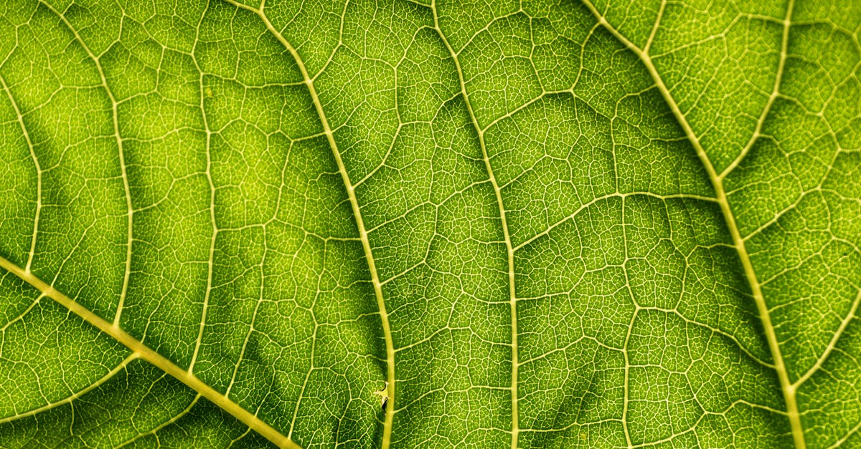
Energy stored in atp
Notes:
Photosynthesis is the process by which plants, algae, and certain bacteria convert sunlight, water, and carbon dioxide into glucose, oxygen, and energy. The chemical energy in ATP (adenosine triphosphate) is released during this process. During photosynthesis, light energy is converted into chemical energy by the use of pigments and the electron transport chain. The ATP is produced during the electron transport chain, and it is stored in the chloroplasts of the plant cells. The limit of energy stored in ATP is usually around 38,000 kJ/mol, which is not a large amount of energy but it is enough for the operation of the plant.

Slide 5

Oxygen released light drives chemical reaction
Notes:
In photosynthesis, light energy is absorbed by pigments to create ATP and NADPH. This energy then drives the chemical conversion of water molecules into oxygen and hydrogen ions. The oxygen is released into the air as a byproduct, while the hydrogen ions can be used to produce energy-rich molecules for cellular metabolism. Oxygen released during photosynthesis is necessary for the survival of all aerobic organisms on Earth.

Slide 6

Production of carbohydrates
Notes:
Photosynthesis is the process by which green plants use sunlight, carbon dioxide, and water to produce carbohydrates. In the presence of sunlight, chlorophyll captures photons of light and uses them to generate ATP and NADPH, the energy currency of the cell. These energy-rich molecules are then used to drive the production of glucose, the primary carbohydrate, through a series of enzyme-catalyzed reactions in the high-energy region of the chloroplasts. The glucose produced is used for energy and building material for the plant. Although the process of photosynthesis can occur in the presence of oxygen, it is not a direct source of oxygen since the plants take in oxygen from the air during the process of respiration.

Slide 7

Photosynthesis! phytoplankton selfreplicating
Notes:
Photosynthesis is the process by which plants, algae, and some bacteria convert sunlight, water, and carbon dioxide into glucose and oxygen. One of the key organisms involved in photosynthesis are phytoplankton, which are single-celled plants that are responsible for producing half of the world's oxygen. These microorganisms self-replicate, meaning that they can reproduce asexually in large numbers. This makes phytoplankton an important part of the food chain, as they provide the base of the food web. Additionally, phytoplankton play a major role in carbon sequestration, as they remove carbon dioxide from the atmosphere and store it in their cells. Overall, phytoplankton are an essential component of photosynthesis and contribute to the balance of life and the earth's atmosphere.

Slide 8

Form basis of food chain
Notes:
Photosynthesis is the process by which plants use sunlight to convert carbon dioxide and water into glucose, releasing oxygen as a byproduct. This process forms the base of the food chain, as plants produce glucose that is used by other organisms as a source of energy. The oxygen produced during photosynthesis is also required by many organisms, including animals, for respiration. In this way, photosynthesis plays a critical role in sustaining life on Earth.

Slide 9
Add improvements!
Notes:
I hope the video was helpful. we generated some recommendations for improvements, if you are interested: simply press the button below that matches your expectations for a remade video. Thanks for watching and I hope to see you again soon on our site

