Slide 1
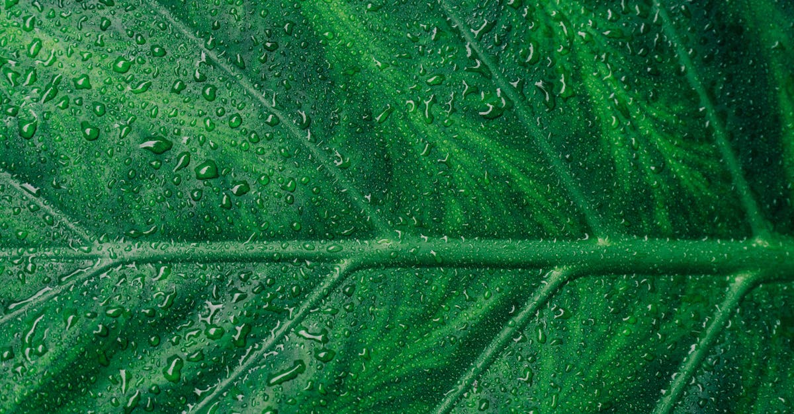
Photosynthesis
Notes:
.
Photosynthesis, a fundamental process for life on Earth, is the biochemical pathway by which green plants, algae, and some bacteria convert carbon dioxide into organic compounds, while concurrently releasing oxygen as a waste product. This process is crucial for maintaining the Earth's atmosphere and supporting all aerobic organisms, including humans.
The process of photosynthesis can be divided into two main phases: the light-dependent reactions and the light-independent reactions, also known as the Calvin cycle. The light-dependent reactions occur in the thylakoid membrane of the chloroplast, where energy from sunlight is captured and converted into chemical energy.
The first step in the light-dependent reactions is the absorption of photons by pigments, primarily chlorophyll, located within the thylakoid membrane. These pigments absorb light energy and transfer it to a reaction center, initiating a series of redox reactions. The initial electron donor is water (H2O), which is split into protons (H+), electrons (e-), and molecular oxygen (O2). The protons are used to create an electrochemical gradient across the thylakoid membrane, driving the synthesis of ATP (adenosine triphosphate) via ATP synthase. The electrons, meanwhile, travel through a series of proteins called electron transport chains, ultimately reducing NADP+ (nicotinamide adenine dinucleotide phosphate) to NADPH (reduced nicotinamide adenine dinucleotide phosphate).
The ATP and NADPH produced during the light-dependent reactions serve as energy carriers for the light-independent reactions, which take place in the stroma of the chloroplast. In this phase, carbon dioxide is fixed into organic molecules, primarily glucose (C6H12O6). This process occurs in three stages: carbon fixation, reduction, and regeneration.
During carbon fixation, a five-carbon sugar called ribulose bisphosphate (RuBP) reacts with carbon dioxide to form two molecules of 3-phosphoglycerate. In the reduction stage, these intermediates are converted into 2-phosphoglycerate, which is then phosphorylated to form one molecule each of glyceraldehyde 3-phosphate (G3P) and 3-phosphoglycerate. Finally, in the regeneration stage, G3P is converted back into RuBP, allowing the process to repeat.
The overall equation for photosynthesis can be represented as follows:
6 CO2 + 6 H2O + light energy → C6H12O6 + 6 O2 + 6 H2O
This equation illustrates that for every six molecules of carbon dioxide absorbed, six molecules of glucose are produced, along with six molecules of water and six molecules of oxygen. The oxygen is released as a waste product, while the glucose serves as food for the plant,

Slide 2
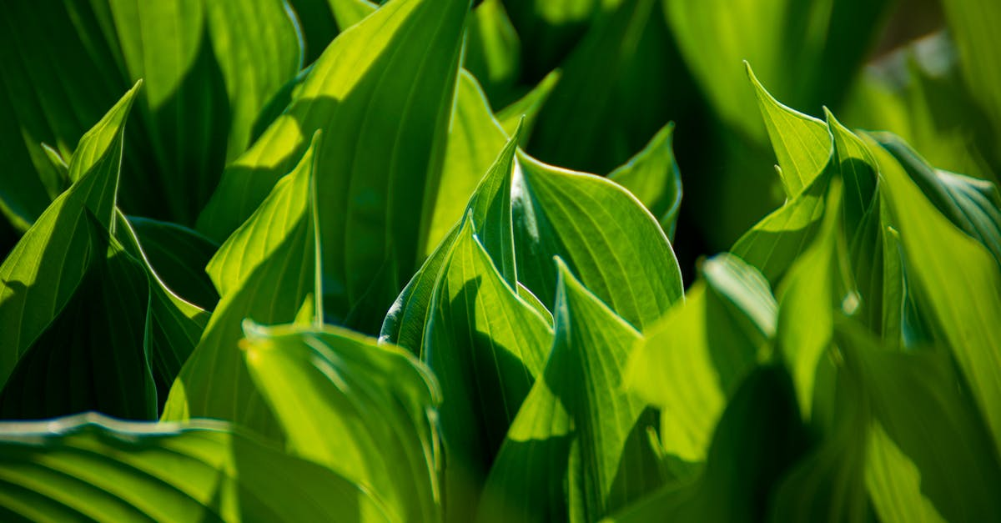
Chloroplasts
Notes:
:
Chloroplasts are the powerhouses of the plant kingdom, playing a pivotal role in photosynthesis. These organelles are found within the eukaryotic cells of green plants, algae, and some bacteria, and they are responsible for converting light energy into chemical energy through a process known as photophosphorylation.
The structure of chloroplasts is intricate and complex, designed to facilitate the process of photosynthesis. The chloroplast contains a double membrane, with an intermembrane space between them. Within this double membrane lies the stroma, a fluid-like matrix that serves as the site for various metabolic reactions. The inner boundary of the double membrane houses the thylakoid membrane, which contains pigments such as chlorophyll, carotenoids, and phycobilins that absorb light energy.
The thylakoid membrane is folded into sacs called thylakoids, which form a network of interconnected tubes. The lumen, or space within the thylakoids, is where the photosynthetic electron transport chain is located. This chain facilitates the transfer of electrons from water molecules to carbon dioxide, generating ATP (adenosine triphosphate) and NADPH (nicotinamide adenine dinucleotide phosphate), two crucial energy-carrying molecules.
The light-dependent reactions occur within the thylakoid membrane. During these reactions, sunlight is absorbed by chlorophyll, triggering a series of events that result in the production of ATP and NADPH. The light-independent reactions, also known as the Calvin cycle, take place in the stroma. Here, carbon dioxide is fixed into organic compounds using the energy stored in ATP and NADPH.
The chloroplast also contains several other important components. For instance, the ribosomes, which are essential for protein synthesis, are found on the outer surface of the chloroplast. Additionally, the chloroplast genome, located within the chloroplast, encodes genes necessary for the synthesis of proteins involved in photosynthesis.
The efficiency of photosynthesis depends on various factors, including the amount of sunlight, temperature, and the availability of carbon dioxide. Chloroplasts have evolved mechanisms to adapt to these changing conditions. For example, they can adjust the number of thylakoids, change the orientation of their chlorophyll molecules, and regulate the opening and closing of stomata, small pores on the plant's leaves that allow for gas exchange.
In conclusion, chloroplasts play a vital role in photosynthesis, the process by which plants convert light energy into chemical energy. They contain a complex structure that facilitates both light-dependent and light-independent reactions, and they possess mechanisms to adapt to varying environmental conditions. Understanding the role and structure of chloroplasts provides valuable insights into the workings of photosynthesis and the overall health of plants.

Slide 3
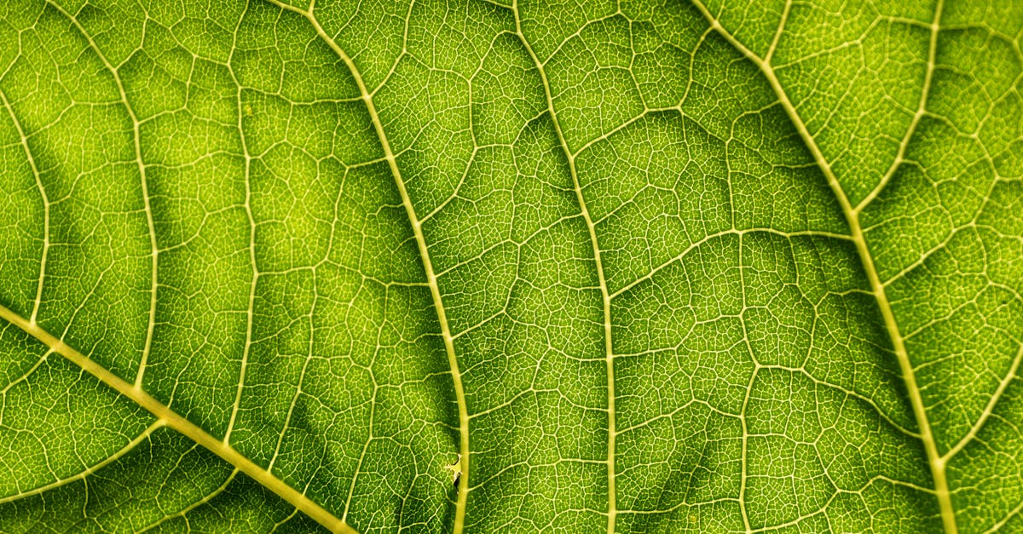
Carbon dioxide
Notes:
Carbon Dioxide (CO2) plays a pivotal role in the process of photosynthesis, a fundamental biological process that converts carbon dioxide and water into glucose and oxygen. This cyclical process is essential for life on Earth, as it provides organisms with energy and maintains the planet's oxygen levels.
In photosynthesis, CO2 serves as the primary source of carbon for the organic compounds that plants, algae, and certain bacteria produce. The carbon atom within CO2 is incorporated into complex molecules such as glucose, cellulose, and other carbohydrates through a series of reactions catalyzed by enzymes.
The process begins when sunlight strikes the leaves of plants. Chlorophyll, a green pigment found in chloroplasts, absorbs light energy, which is then used to split water molecules into hydrogen and oxygen. The oxygen is released as a waste product, while the hydrogen is used in subsequent reactions.
The hydrogen, along with CO2, undergoes a series of reactions known as the Calvin cycle or carbon fixation. During this process, an enzyme called rubisco (ribulose bisphosphate carboxylase/oxygenase) facilitates the conversion of CO2 into an organic compound called 3-phosphoglycerate. This compound is then further converted into glucose and other carbohydrates.
It is important to note that the CO2 uptake by plants is not infinite. Factors such as the concentration of CO2 in the air, light intensity, and temperature can influence the rate of photosynthesis. For instance, an increase in CO2 concentration can lead to an enhancement of photosynthetic efficiency due to the higher availability of CO2 for the Calvin cycle.
However, excessively high levels of CO2 can have negative effects on plant growth and development. High CO2 levels can interfere with the regulation of stomata, the tiny pores on the undersides of leaves that control gas exchange. When CO2 levels are high, plants may close their stomata to conserve water, but this also limits the influx of CO2 needed for photosynthesis. As a result, photosynthesis may be inhibited, leading to reduced growth and yield.
Moreover, the increased CO2 concentration in the atmosphere is a significant contributor to global warming and climate change. This is because CO2 is one of the major greenhouse gases that trap heat in the Earth's atmosphere, causing the average global temperature to rise.
In conclusion, Carbon Dioxide is an integral component of photosynthesis, playing a crucial role in the production of organic compounds and the maintenance of oxygen levels in the atmosphere. However, while increases in CO2 can enhance photosynthetic efficiency under certain conditions, excessive levels can have detrimental effects on plant growth and contribute to global warming. Therefore, understanding the role of CO2 in photosynthesis is essential for developing strategies to mitigate climate change and ensure sustainable agriculture.

Slide 4
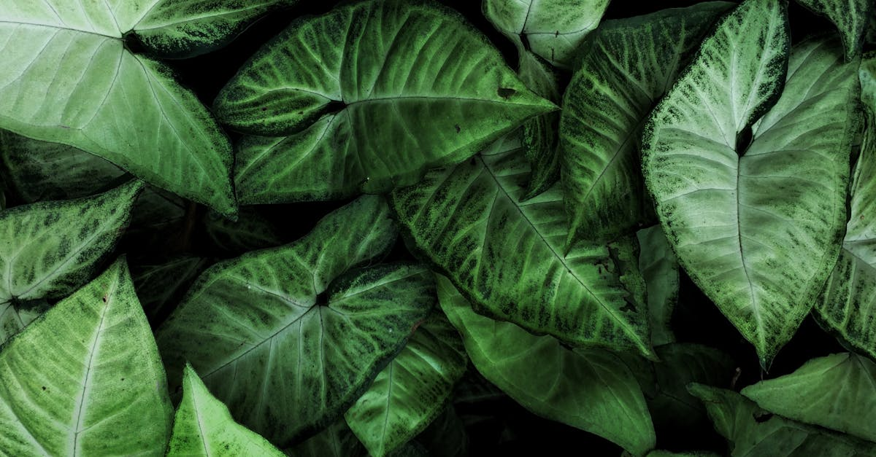
Sunlight
Notes:
Sunlight plays a pivotal role in the process of photosynthesis, which is the fundamental life-sustaining process for most organisms on Earth. This intricate biochemical reaction converts carbon dioxide and water into glucose (or other sugars) and releases oxygen as a byproduct. The primary source of energy for this transformation is sunlight.
Photosynthesis can be divided into two main stages: the light-dependent reactions and the light-independent reactions, both of which are reliant on sunlight.
During the light-dependent reactions, which occur in the thylakoid membrane of chloroplasts, sunlight is absorbed by pigments such as chlorophyll, carotenoids, and phycobilins. This absorption of light energy triggers a series of events that lead to the creation of ATP (adenosine triphosphate) and NADPH (nicotinamide adenine dinucleotide phosphate). These molecules serve as high-energy currency and reducing agents, respectively, providing the necessary energy and electrons for the subsequent light-independent reactions.
The light-independent reactions, also known as the Calvin cycle or carbon fixation, take place in the stroma of the chloroplasts. Here, carbon dioxide molecules are fixed into organic compounds through a series of enzymatic reactions. The initial step involves the conversion of ribulose bisphosphate (RuBP) into two molecules of 3-phosphoglycerate (3PG), using the energy from ATP and the electrons from NADPH. The 3PG then undergoes further transformations to eventually form glucose or other sugars.
It is essential to note that not all sunlight energy is efficiently utilized during photosynthesis. Some of the energy is lost as heat, while some is emitted as fluorescent light. Moreover, the efficiency of photosynthesis can be influenced by various factors such as temperature, light intensity, and the concentration of carbon dioxide. For instance, an increase in temperature beyond optimal levels can decrease the rate of photosynthesis, while a decrease in carbon dioxide concentration can hinder the fixation of carbon dioxide into organic compounds.
In conclusion, sunlight is indispensable for photosynthesis, serving as the primary source of energy. Through the light-dependent and light-independent reactions, carbon dioxide and water are converted into glucose, releasing oxygen as a byproduct. However, the efficiency of photosynthesis can be affected by environmental factors, making it crucial for organisms to adapt to their specific conditions to optimize this vital process. Understanding the intricacies of photosynthesis and its dependence on sunlight provides valuable insights into the workings of ecosystems and the potential impacts of climate change on these processes.

Slide 5
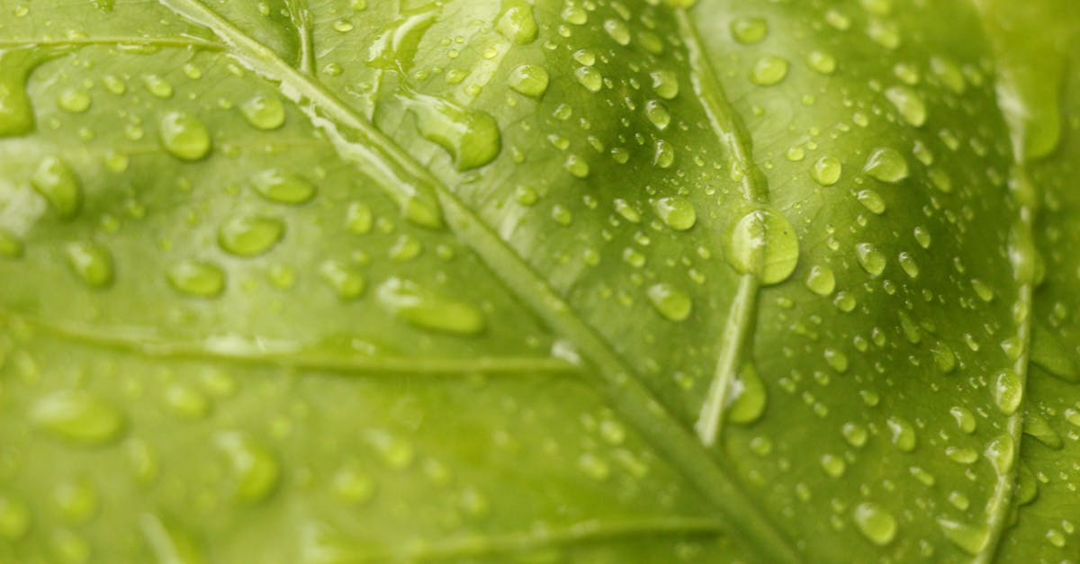
Glucose
Notes:
Glucose, a simple sugar with the chemical formula C6H12O6, plays a crucial role in the process of photosynthesis. This essential biomolecule serves as a primary energy storage and transport molecule within plant cells. The process of photosynthesis, carried out by green plants, algae, and some bacteria, converts carbon dioxide, water, and light energy into glucose and oxygen.
The process of photosynthesis can be divided into two main stages: the light-dependent reactions and the light-independent reactions, also known as the Calvin cycle. In the first stage, light energy is captured by pigments such as chlorophyll and carotenoids, located in the thylakoid membranes of chloroplasts. This energy is used to produce ATP (adenosine triphosphate) and NADPH (nicotinamide adenine dinucleotide phosphate), which are vital for the next phase of photosynthesis.
ATP and NADPH are then utilized in the Calvin cycle, the second stage of photosynthesis, to convert carbon dioxide into glucose. The Calvin cycle takes place in the stroma of the chloroplasts. During this cycle, carbon dioxide is fixed into an organic compound called a five-carbon sugar, or RuBP (ribulose bisphosphate). This reaction requires energy from ATP and an electron donor from NADPH.
The five-carbon sugar then splits into two three-carbon sugars, 3-phosphoglycerate. These intermediates are further processed through a series of reactions, resulting in the production of glucose-6-phosphate. This compound is then converted into glucose, ready for use by the plant or for storage.
It is important to note that not all of the glucose produced in photosynthesis is stored within the plant. Some glucose is immediately used for energy needs, while excess glucose may be converted into other carbohydrates such as starch or cellulose for long-term storage.
In addition to its role in photosynthesis, glucose is also involved in other metabolic pathways within the plant. For example, it can be broken down through glycolysis to produce ATP, providing energy for various cellular processes. Glucose can also be used in the synthesis of more complex compounds, such as polysaccharides, proteins, and lipids.
In conclusion, glucose is a fundamental molecule in the process of photosynthesis, playing a key role in the conversion of carbon dioxide and light energy into glucose and oxygen. Its production and utilization within the plant are integral to the survival and growth of these organisms. Furthermore, glucose is involved in various metabolic pathways, serving as a versatile energy source and building block for many cellular components.

Slide 6
Ecercises
What role does glucose play in photosynthesis?
Notes:
Here is a quick question for you to strenghten youre knowledge: What role does glucose play in photosynthesis?

Slide 7
Add improvements!
Notes:
I hope the video was helpful. we generated some recommendations for improvements, if you are interested: simply press the button below that matches your expectations for a remade video. Thanks for watching and I hope to see you again soon on our site

