Slide 1
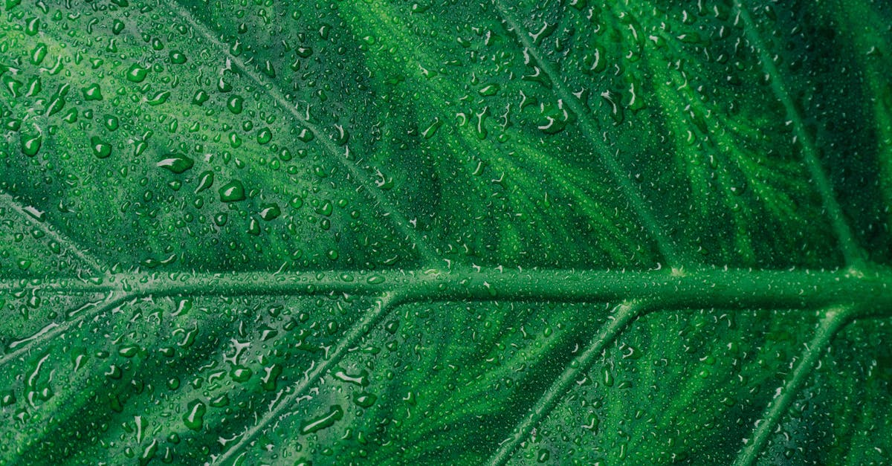
Photosynthesis
Notes:
Photosynthesis, a fundamental process essential for life on Earth, is the means by which green plants, algae, and cyanobacteria convert light energy into chemical energy. This biochemical process primarily takes place within organelles called chloroplasts, which are found in the cells of these organisms. The process of photosynthesis can be divided into two main stages: the light-dependent reactions and the light-independent reactions, also known as the Calvin cycle.
In the first stage, the light-dependent reactions, the plant absorbs sunlight, primarily in the visible spectrum, through its leaves. This light energy is used to split water molecules into hydrogen, oxygen, and electrons. The hydrogen and oxygen are stored separately within the plant, with the oxygen being released into the atmosphere. The electrons, along with carbon dioxide from the air and nutrients from the soil, are passed through a series of electron transport chains and enzymes to produce ATP (adenosine triphosphate) and NADPH (nicotinamide adenine dinucleotide phosphate). These molecules serve as the primary source of energy for the second stage of photosynthesis.
The light-independent reactions, or Calvin cycle, take place within stroma of the chloroplasts. Here, the ATP and NADPH produced during the light-dependent reactions are utilized to convert carbon dioxide into glucose, a simple sugar that serves as the primary form of energy storage for plants. This process involves three main phases: fixation, reduction, and regeneration.
During the fixation phase, an enzyme called Rubisco (ribulose bisphosphate carboxylase/oxygenase) combines carbon dioxide with a five-carbon compound called ribulose bisphosphate to form two three-carbon compounds. In the reduction phase, the three-carbon compounds undergo a series of reactions involving NADPH and ATP, resulting in the formation of a six-carbon compound called glyceraldehyde 3-phosphate. Finally, in the regeneration phase, the ribulose bisphosphate used in the fixation phase is reformed, allowing the Calvin cycle to continue.
The glucose formed during the Calvin cycle can be used immediately for energy or stored for later use. If it's not needed right away, the glucose molecule can be converted into other carbohydrates, such as cellulose for structural support, or starch for long-term energy storage. In addition, some of the glucose may be used to create more complex molecules, such as proteins, fats, and nucleic acids, which are essential for growth and reproduction.
Photosynthesis plays a crucial role in maintaining the balance of oxygen and carbon dioxide in the Earth's atmosphere. By converting carbon dioxide into organic matter, photosynthesis effectively removes carbon dioxide from the atmosphere, helping to reduce its levels and mitigate climate change. Conversely, the release of oxygen during photosynthesis contributes to the Earth

Slide 2
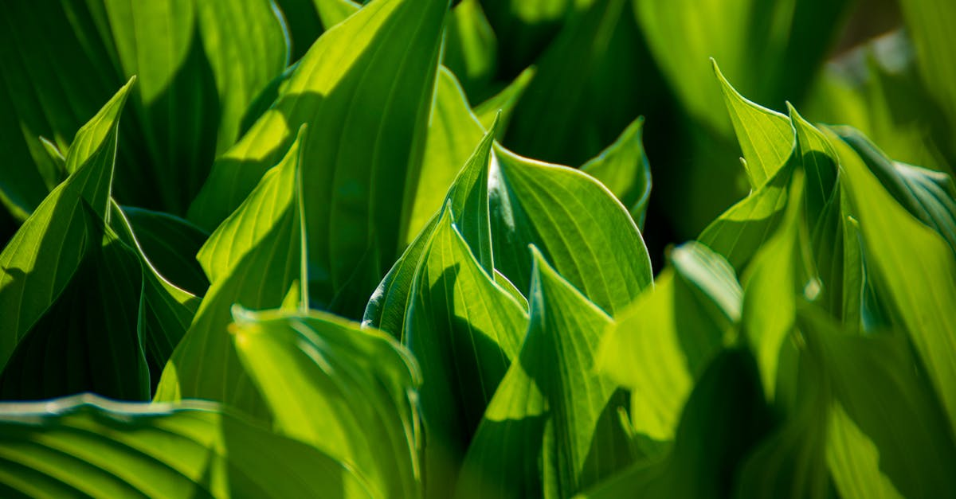
Carbon dioxide and water
Notes:
Carbon Dioxide (CO2) and Water (H2O) play essential roles in the process of photosynthesis, a fundamental biological activity carried out by green plants, algae, and certain bacteria. This process converts carbon dioxide and water, with the help of sunlight, into glucose (a type of sugar), oxygen, and other products.
During photosynthesis, carbon dioxide acts as a primary source of carbon for the plant. It enters the plant through tiny openings on the leaves called stomata. Inside the plant cells, the carbon dioxide molecules are captured and utilized within the chloroplasts, the organelles responsible for carrying out photosynthesis.
Within the chloroplasts, an enzyme called Rubisco (Ribulose-1,5-bisphosphate carboxylase/oxygenase) catalyzes the first significant step of photosynthesis. Rubisco combines carbon dioxide with a five-carbon compound called ribulose bisphosphate to form two molecules of a three-carbon compound called phosphoglycerate.
Phosphoglycerate then undergoes further reactions, ultimately resulting in the production of glucose, which serves as a vital energy source for the plant. In addition to providing energy, glucose also serves as a building block for various other organic compounds that the plant needs for growth and development.
Meanwhile, water acts as both a reactant and a solvent during photosynthesis. The water molecules are split into hydrogen ions (protons) and electrons within the chloroplasts. The protons are used to create ATP (adenosine triphosphate), another crucial energy carrier for the plant. The electrons, along with the energy from sunlight, are used to power the electron transport chain, a series of reactions that generate a flow of electrons and produce ATP.
The oxygen produced during photosynthesis is a byproduct of the water splitting reaction. Oxygen gas diffuses out of the plant through the same stomata through which carbon dioxide entered. This oxygen is vital for aerobic organisms, including humans, as it is essential for cellular respiration, a process that provides energy for most life forms on Earth.
In summary, Carbon Dioxide and Water are integral components of photosynthesis. Carbon Dioxide provides the carbon needed for the plant to synthesize glucose and other organic compounds, while Water splits to produce ATP and oxygen. Photosynthesis not only supplies plants with the energy they need but also plays a critical role in the global carbon cycle and the production of oxygen in our atmosphere.

Slide 3
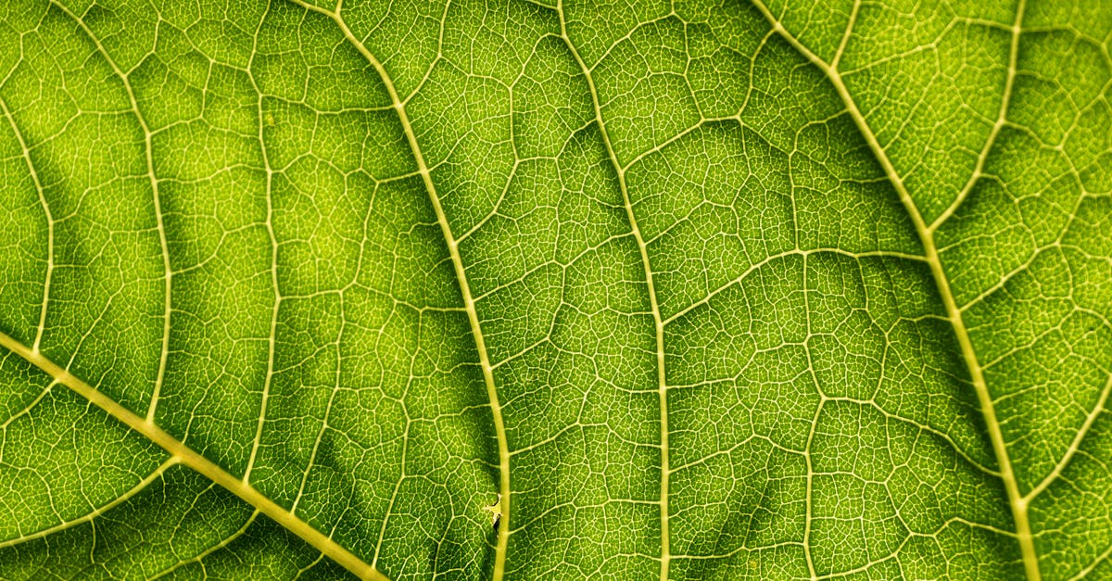
Chlorophyll absorption
Notes:
Chlorophyll, a green pigment found in plants and algae, plays a crucial role in the process of photosynthesis. This complex molecule is responsible for absorbing light energy, converting it into chemical energy, and utilizing it to produce glucose and oxygen. The specific wavelengths of light that chlorophyll can absorb are determined by its molecular structure.
Chlorophyll molecules have a porphyrin ring structure at their core, which contains magnesium. This central structure is surrounded by various side chains, some of which contain nitrogen atoms. The arrangement of these side chains and the presence of nitrogen atoms create a unique electronic structure in the chlorophyll molecule.
The electronic structure of chlorophyll allows it to absorb light most efficiently at wavelengths around 430 nanometers (violet-blue light) and 660 nanometers (red light). This is known as the absorption spectrum of chlorophyll. The reason for this specific absorption pattern lies in the arrangement of electrons within the chlorophyll molecule. When violet-blue or red light hits the chlorophyll, it excites the electrons in the molecule, causing them to move to a higher energy level.
Once excited, the electrons quickly return to their ground state, releasing the excess energy as heat. However, some of this energy is used to power the synthesis of ATP (adenosine triphosphate), a high-energy molecule that provides the energy required for other cellular processes. In addition, the energy is also used to convert carbon dioxide and water into glucose during the light-dependent reactions of photosynthesis.
Interestingly, chlorophyll does not absorb light in the yellow and green regions of the spectrum very well. This is because the energy of yellow and green light is not sufficient to excite the electrons in the chlorophyll molecule to a higher energy level. As a result, these wavelengths of light are reflected back from the leaves, giving them their green color.
The ability of chlorophyll to absorb specific wavelengths of light is not only important for photosynthesis but also has implications for the environment. For example, the absorption of red and blue light by chlorophyll can affect the distribution of light in aquatic environments. In terrestrial ecosystems, the reflection of green light by leaves can influence the growth of understory plants and the overall structure of the forest.
In conclusion, chlorophyll absorption plays a vital role in the process of photosynthesis. By absorbing light energy at specific wavelengths, chlorophyll powers the conversion of carbon dioxide and water into glucose and oxygen, providing the energy needed for life on Earth. Understanding the absorption properties of chlorophyll can help us better understand the functioning of ecosystems and the distribution of energy in both terrestrial and aquatic environments.

Slide 4
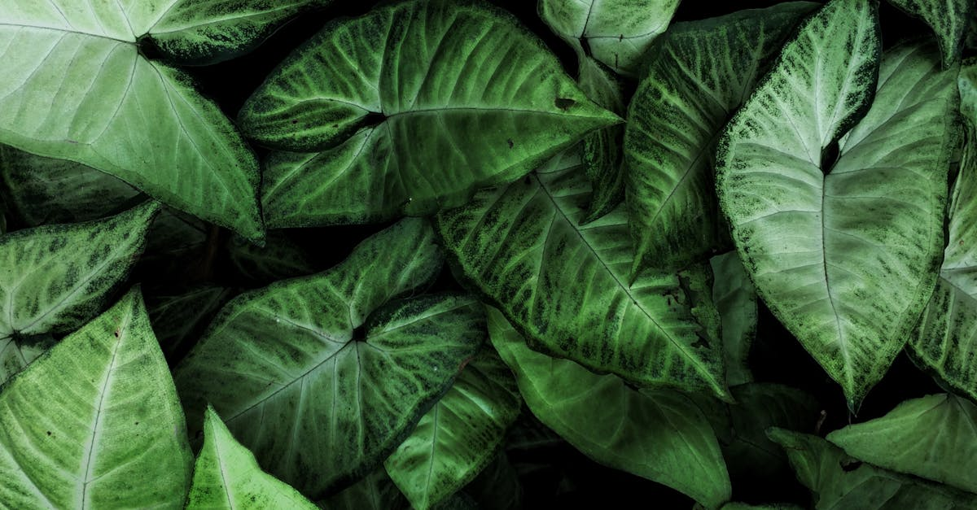
Glucose production.
(car
Notes:
)
In the intricate dance of life, glucose plays a pivotal role as the primary energy currency for all living organisms. The production of this essential molecule is primarily achieved through photosynthesis in plants, algae, and some bacteria, while animals rely on glucose uptake from their diet or the conversion of other nutrients within their bodies.
The process of photosynthesis, carried out in the chloroplasts of plant cells, is an elegant combination of light-dependent and light-independent reactions. During the light-dependent reactions, photons are absorbed by chlorophyll and carotenoid pigments, initiating a series of events that ultimately lead to the generation of ATP (adenosine triphosphate) and NADPH (nicotinamide adenine dinucleotide phosphate). These high-energy compounds are crucial for driving the subsequent light-independent reactions, also known as the Calvin cycle.
In the Calvin cycle, carbon dioxide (CO2) is fixed into organic molecules, primarily in the form of three-carbon sugar, glyceraldehyde 3-phosphate (G3P). This fixation occurs in the stroma of the chloroplasts, where enzymes such as Rubisco (ribulose bisphosphate carboxylase/oxygenase) catalyze the reaction between CO2 and a five-carbon compound, ribulose 1,5-bisphosphate (RuBP), forming two molecules of G3P.
After the initial fixation, the G3P molecules undergo a series of transformations, resulting in the net synthesis of one molecule of triose phosphate per two original molecules of RuBP. The remaining two phosphate groups are recycled back to regenerate more RuBP, allowing the cycle to continue.
The newly formed triose phosphates can then be converted into glucose or other sugars via various metabolic pathways, such as the pentose phosphate pathway, glycolysis, and the Calvin-Bassham cycle. These processes involve a complex interplay of enzymatic reactions, substrate transport, and energy coupling, ensuring that the necessary precursors for glucose synthesis are always available.
It is worth noting that not all photosynthesized glucose remains within the plant cell. In fact, a significant portion is exported to other parts of the plant via the phloem, providing energy for growth and development. Additionally, glucose can be stored as starch within the chloroplasts or converted into sucrose and translocated to vacuoles for later use or storage.
Plants can also adjust their glucose production rates based on environmental factors such as light intensity, temperature, and CO2 concentration. For example, during periods of low light, the rate of photosynthesis slows down, leading to a reduction in glucose production. Conversely, during periods of high light, plants may increase their rate of photosynthesis, thereby increasing glucose production.
In conclusion, the production of

Slide 5
Ecercises
!What is the specific wavelength range that chlorophyll absorbs most efficiently during photosynthesis?
Notes:
Here is a quick question for you to strenghten youre knowledge: !What is the specific wavelength range that chlorophyll absorbs most efficiently during photosynthesis?

Slide 6
Add improvements!
Notes:
I hope the video was helpful. we generated some recommendations for improvements, if you are interested: simply press the button below that matches your expectations for a remade video. Thanks for watching and I hope to see you again soon on our site

