Slide 1
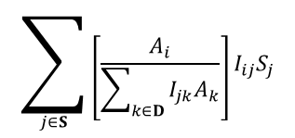



$$A_{i}γ$$
$$A_{i}γe^{−ηQ}$$
Supply
$$\sum_{j∈S}{I_{ij}S_{j}}$$
$$\sum_{j∈S}{\left[\frac{A_{i}}{\sum_{k∈D}{I_{jk}A_{k}}}\right]I_{ij}S_{j}}$$
or
Marginal Utility (U_{i})
Depending on if rival or not
ECOSYSTEM SERVICE VALUE
Demand
Quantity of Ecosystem Service (Q)

