Slide 1
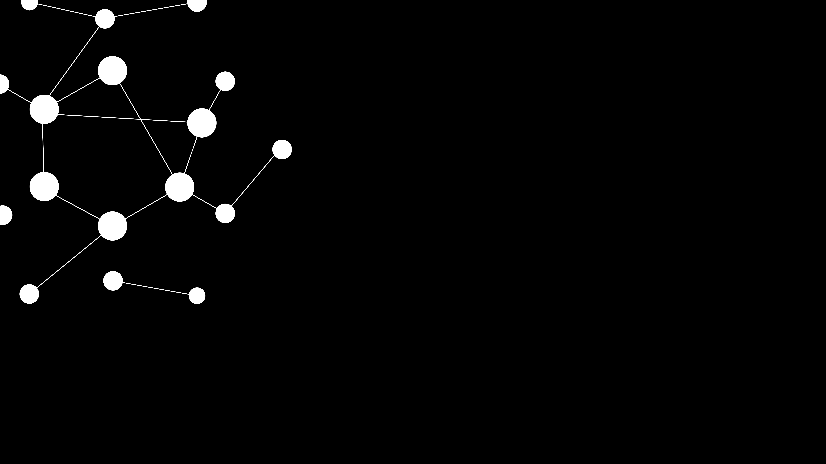

Carla Sauvant, Rémi Koumakpayi, Fabio Sala
24 / 01 / 2023
TUM School of Engineering and Design
Chair of Architectural Informatics
Critical Modeling 3.0

Slide 2

FRAMING THE PROBLEM
on-demand urban data → daily puzzle to find data
awkward data sharing process
heterogenous data from different departments
few digitalized tools for citizens

Slide 3

THE GOALS OF SYNC:UP
making urban data easily accessible for the relevant stakeholders
showing the connections between seemingly unrelated data streams
checking availability of data
facilitating data accessibility
finding the right contact person
Spontanous data discoveries that lead to new trains of thought

Slide 4
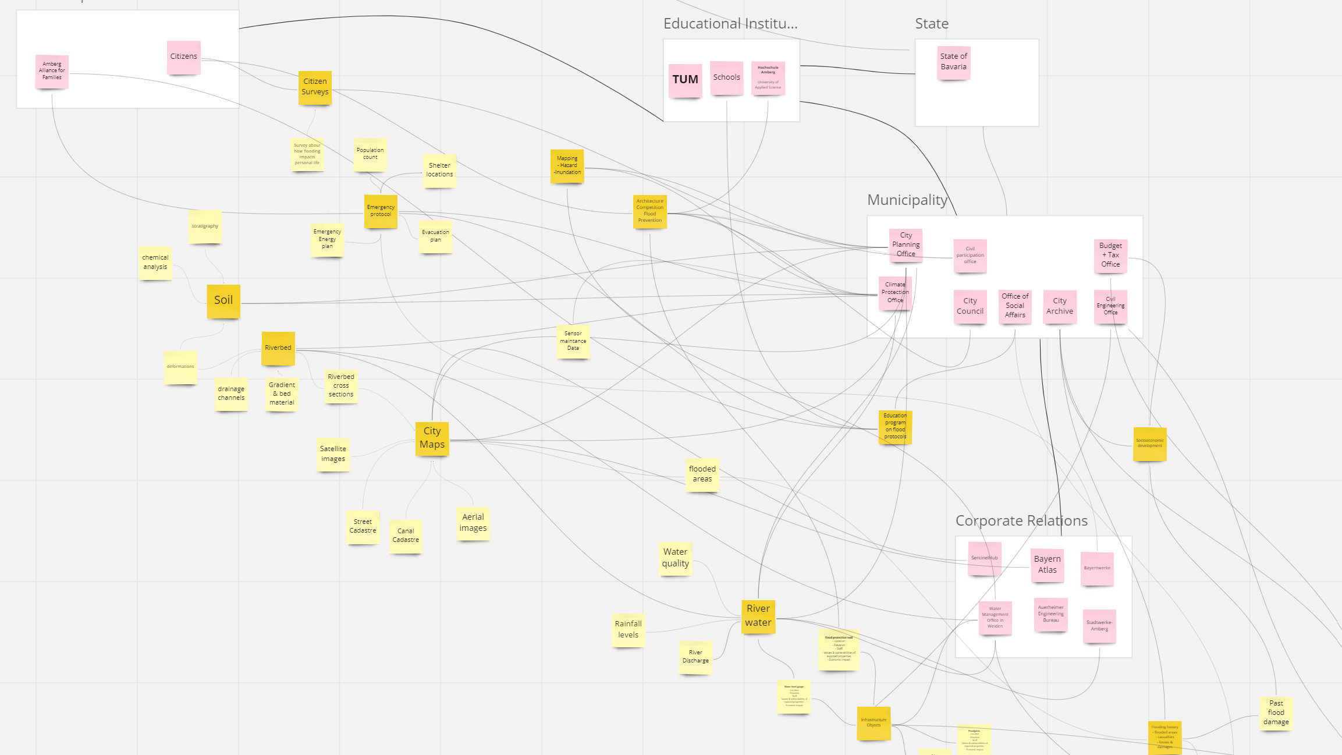

Slide 5
PROJECT WORKFLOW
Building a database
with SQL
Visualizing the database as an interactive network graph
!
Transferring SQL database to a JavaScript file
Building the graph structure in JavaScript
Layout Design in Adobe XD
Integrating the interactive graph into a web page with HTML

Slide 6
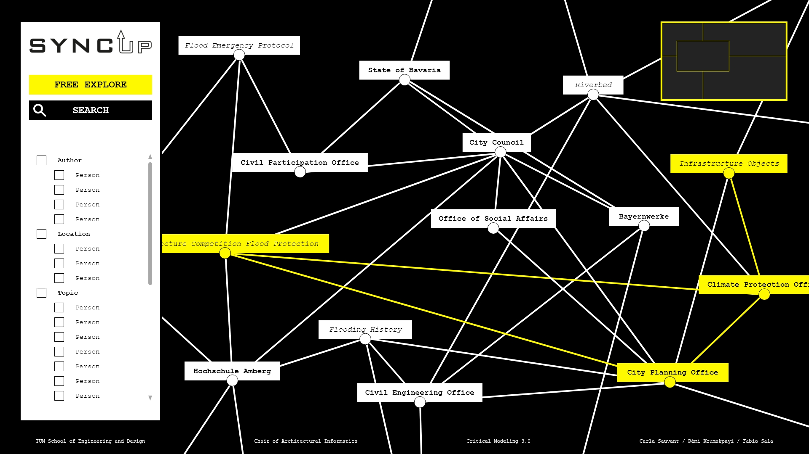
JAVASCRIPT & HTML
making urban data easily accessible for the relevant stakeholders
showing the connections between seemingly unrelated data streams
checking availability of data
facilitating data accessibility
finding the right contact person

Slide 7
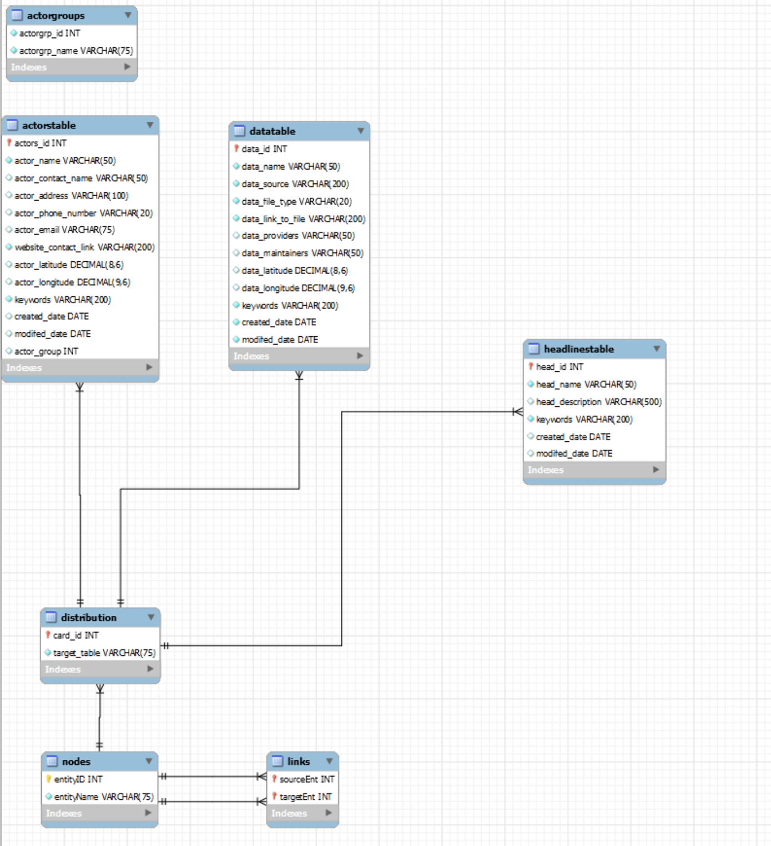

BUILDING A DATABASE
entity cards
network graph

Slide 8
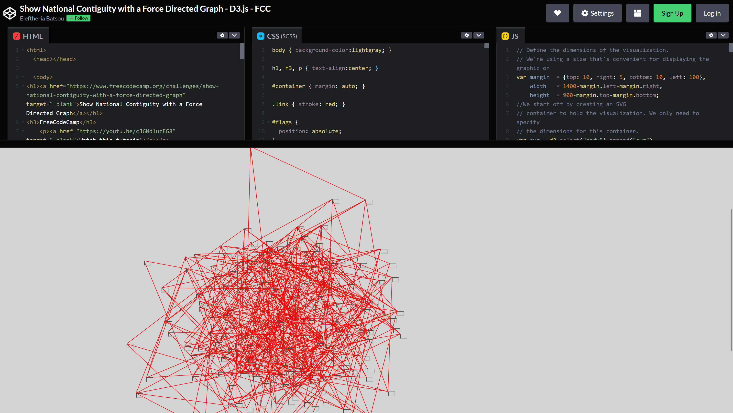
VISUALISING THE DATABASE
Integrating JavaScript with a D3.js library and CSS into an HTML web page
https://codepen.io/EleftheriaBatsou/pen/xYjgmE

Slide 9
JAVASCRIPT & CSS

Slide 10
HTML WEBSITE

Slide 11
„How can we efficiently bring our database from SQL to JavaScript and visualise it as a network graph?“
„How about the functionality of our web layout?“

