Slide 1
In Space Assembly Panel Discussion
Steve Ulrich
Spacecraft Robotics and Control Laboratory
Carleton University
Ottawa, Canada

Slide 2

Abstract
Prof. Ulrich, drawing on his 15 years of experience in spacecraft robotics, will share his perspective on some challenges in flying a robotic ISA missions.
Then, he will present some key technologies developed at Carleton University’s Spacecraft Robotics and Control Lab to make such space missions more viable.
Spacecraft GN&C Research Engineer, NGC Aerospace Ltd (2006-2008)
PhD, Aerospace Engineering, Carleton University (2012)
Postdoc Associate, MIT Space Systems Lab (2013)
Associate Professor, Carleton University (2013-current)
Member – AIAA GNC Technical Committee
Technical Area Chair (Space Robotics) – AIAA GNC Conference
Associate Editor – The Journal of the Astronautical Sciences

Slide 3

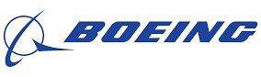



Space Robotics for OOS/ISA
Past OOS/ISA Technology Demonstration Missions
1997 – Engineering Test Satellite VII (ETS-VII)
2007 – Orbital Express (OE)
Contemporary R&D efforts towards robotic ISA
2005 – Front-end Robotics Enabling Near-term Demonstration (FREND)
2009 – Low Impact Inspection Vehicle (LIIVe)
2016 – Robotic Servicing of Geosynchronous Satellites (RSGS)
2011 – Robotic Refueling Mission 1, 2, and 3
2020 – On-orbit Servicing, Assembly, and Manufacturing 1 (OSAM-1)
2012 – Deutsche Orbital Servicing Mission (DEOS)

Slide 4
Space Robotics for OOS/ISA
These ideas have been around for a long time (Space Tugs)
OMV 1980

Slide 5
Space Robotics for OOS/ISA
Takeaway
Over the past 60 years, only two OOS free-flyers were flown, as demonstration missions
Why?
Programs such as OSAM-1 and RSGS are quite expensive (> $500 M)
Business case makes sense, but the opportunity cost is too high
Investors can get better return on investment (ROI) elsewhere, at lower risk
Looking Ahead
ISA of simple structures (space telescopes) is likely to happen
Currently no real incentives for commercial ventures, unless…
We propose technologies that are lighter, and cheaper to build, fly, and operate.
MSFC 1970
OMV 1980
Notes:
Specifically, we'll be too massive. The cheapest access to space will target much smaller spacecraft. 1 kg—100 kg range.
We'll also require too much $$$ for ground ops. As the cost of launch and S/C fab drop, ground operations costs will start to dominate

Slide 6
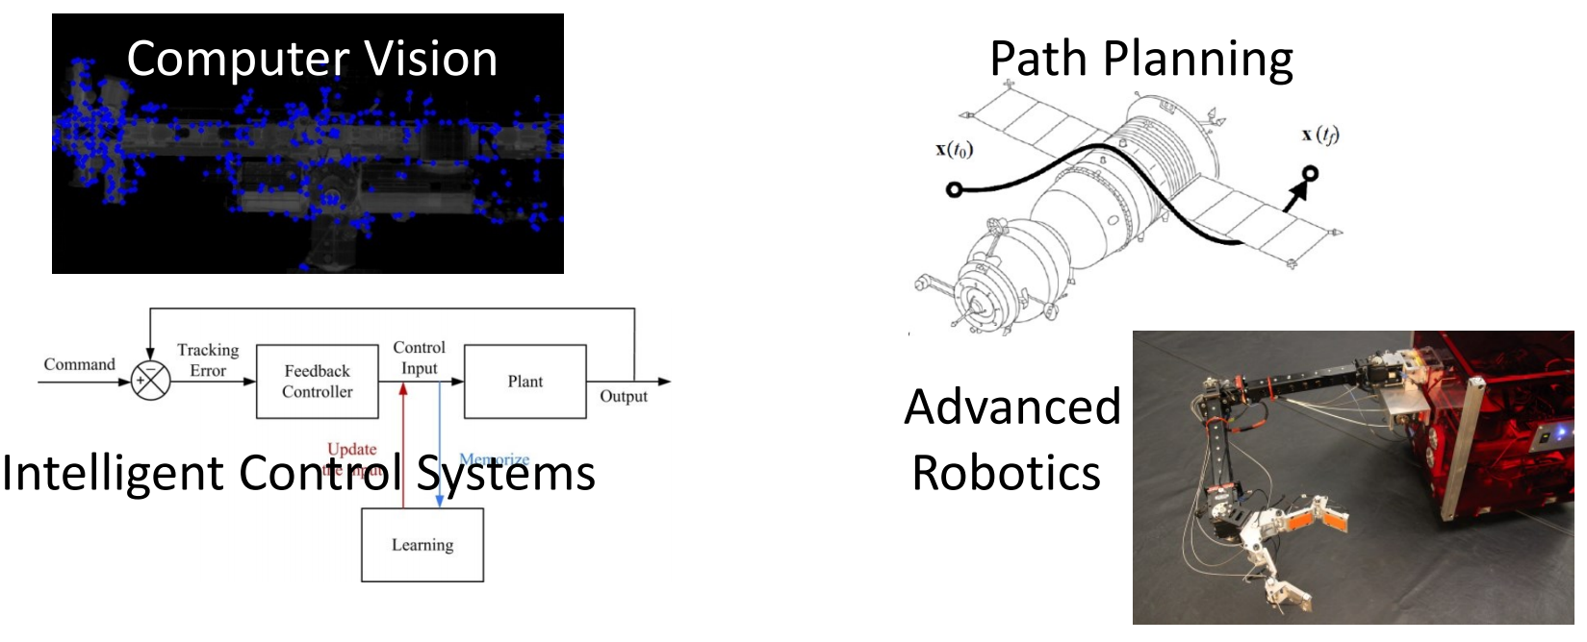
Space Robotics for OOS/ISA
Technological Solutions
Smaller, less expensive, out–of–the–box robotic arms/mechanisms
Less expensive flight computers, with tailored computer vision algorithms
More reliable yet simpler robot controls, particularly robotic manipulation techniques
More reliable yet simpler prox ops G&C, particularly motion path planning and intelligent control (e.g., AI- and RL-based).
Carleton’s Spacecraft
Robotics and Control Lab
MSFC 1970
OMV 1980

Slide 7
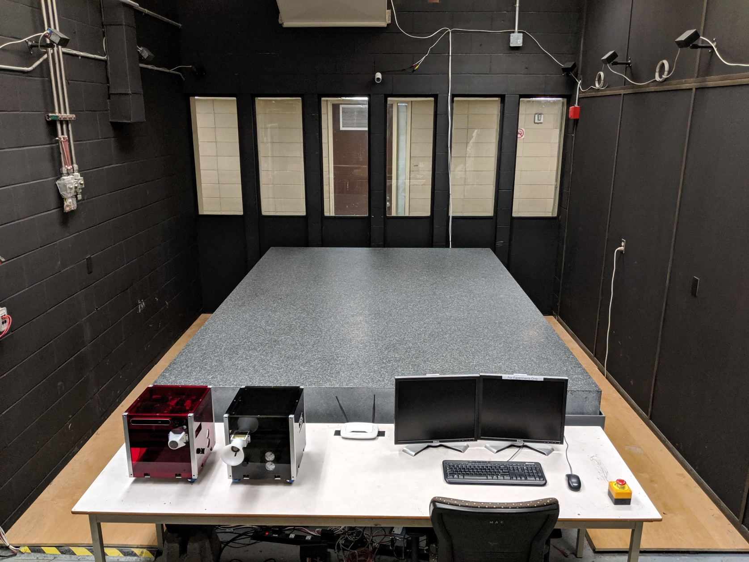
Spacecraft Proximity Operations Testbed
Spacecraft Proximity Operations Testbed

Slide 8
Spacecraft Proximity Operations Testbed
Pothen, A. A., and Ulrich, S., “Pose Tracking Control for Spacecraft Proximity Operations Using the Udwadia-Kalaba Framework,” AIAA Guidance, Navigation, and Control Conference, Orlando, FL, 6-10 Jan, 2020.
Pothen, A. A., and Ulrich, S., “Close-Range Rendezvous of Multiple Chasers with a Moving Target using Udwadia-Kalaba Equation,” American Control Conference, Philadelphia, PA, 10-12 Jul, 2019.

Slide 9
Spacecraft Proximity Operations Testbed
Machine Learning for Prox. Ops. Path-Planning
Hovell, K., and Ulrich, S., “Deep Reinforcement Learning for Spacecraft Proximity Operations Guidance,” AIAA Journal of Spacecraft and Rockets. accepted

Slide 10
Spacecraft Proximity Operations Testbed
Nonlinear Optimization of Free-Floating Space Robots
Crain, A., and Ulrich, S., “Experimental Validation of Pseudospectral-based Optimal Trajectory Planning for Free-Floating Robots,” AIAA Journal of Guidance, Control, and Dynamics, Vol. 42, No. 8, 2019, pp. 1726-1742.

Slide 11
Spacecraft Proximity Operations Testbed
Computer Vision for Pose Estimation
Shi, J.-F., Ulrich, S., and Ruel, S., “Uncooperative Spacecraft Pose Estimation using Monocular Monochromatic Images,” AIAA Journal of Spacecraft and Rockets. accepted

