Slide 1
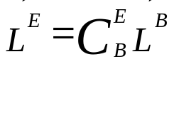
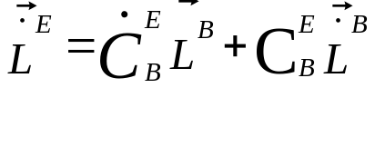










Lever Arm Equations
0
SMALL ~ a/Re
P = Platform frame (local level tangent frame) computed
FRB 10-2011 / 5-2013

