Slide 1
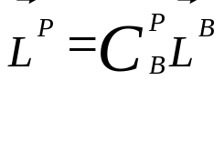
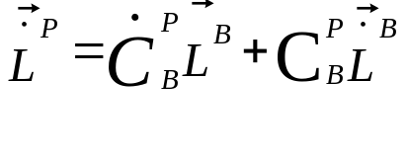









Lever Arm Equations in Platform Frame
Lever Arm Equations in Platform Frame
0
P = Platform frame (local level tangent frame) computed
FRB 10-2011 / 5-2013

