Slide 1
CAT(Carl Auto Test tool)
Author: Chen Liguo
EXT: 579-26187
Date: 2016-02-25

Slide 2
Summary
CAT Introduction
Login
Preview
Menubar details
Toolbar details
Other options
Write script
Debug/Run
Future

Slide 3
CAT introduction
CAT是基于android平臺，通過解析手機界面
控件屬性，發送用戶觸屏事件，來實現自動
化測試的工具。
適用于Android4.0以上的手機。
打開方式：雙擊執行CAT.bat即可
前提：已添加java及android adb命令到電腦
環境變量

Slide 4
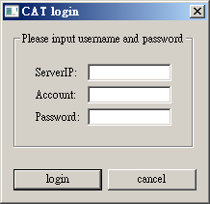
Login
Input username and password to login

Slide 5
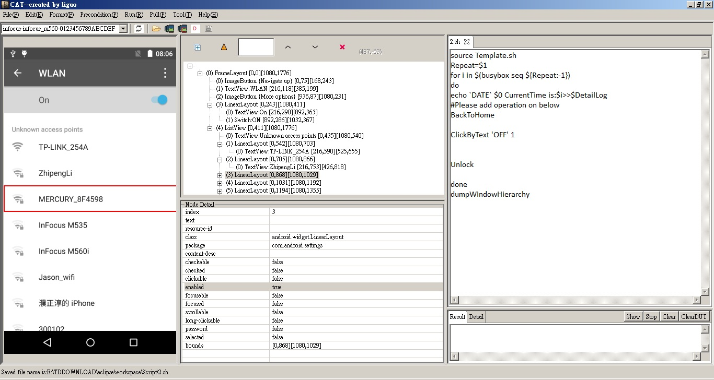
Preview
菜單欄
工具欄
屬性樹
手機截屏
腳本編輯區
控件詳情
結果顯示
狀態欄

Slide 6
Menubar details
File
Edit
Format
Precondition
Run
Pull
Tool
Help

Slide 7
File
New – It will new one script,
shortcut: Ctrl+N
Open – Open one script from my computre
shortcut: Ctrl+O
Save – Save the editing script
shortcut: Ctrl+S
Exit – Close CAT
shortcut: Alt+F4

Slide 8
Edit
Copy – Copy the choosed text during editing
Cut – Cut the choosed text during editing
Paste – Paste the words during editing
Find – It will show find dialog
Select All – Choose all text during editing script

Slide 9
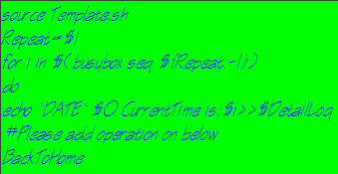
Format
Set font – Modify the text font of edit script
Set backgroundcolor – Modify the text backgroundcolor
Set forecolor – Modify the text forecolor
So, you can modify edit area like this:

Slide 10
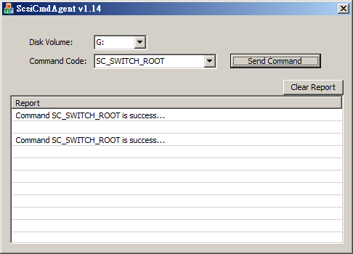
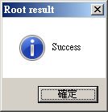
Precondition
Root > Scsi – Open the scsi tool
> adb root – Run adb root at background and show root result dialog

Slide 11
Install busybox/procrank – Install linux command tool:busybox, procrank(procrank need root permission) to test device
Push Template – Push the template.sh to DUT(/data/local/tmp)

Slide 12
Run
Run – Run the editing script
Shortcut: F5
Debug – Run the command user choosed
Shortcut: F6
Stop – Stop the running command or script
Shortcut: F7

Slide 13
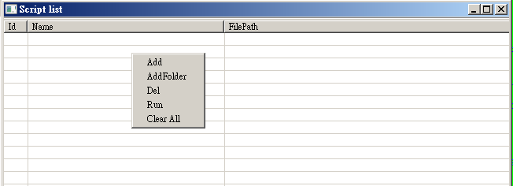
RunMulti – Show a table window
RunBD – Run the editing script at background

Slide 14
Pull
MTKLog
Start: pull mtklogs and show the log folder automatically
Stop: If user want to stop during pulling, click the
ShellResult – Pull test result to PC
Database
Contacts: pull contact database
Music: pull media database Messaging/Settings are same

Slide 15
Tools
Version Compare – Compare all apk files between previous version and current version by MD5 value, get apk version, package name, code path of all apks
Get current version
Push old version and compare
Pull result
Monkey Analyse – Analyse monkey test result and pull result automatically.

Slide 16
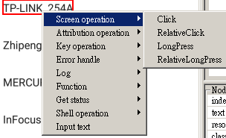
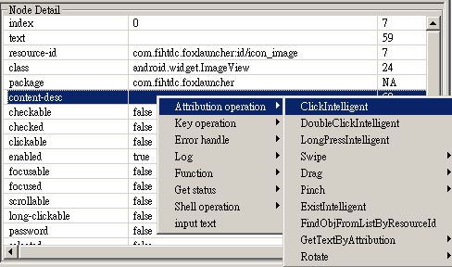
Other options
Right Click on screenshot:
Right Click on attribution details:

Slide 17
ToolBar details
– Connected devices list, user can switch it if more than one device connected. The command will be sent to the selected device.
Refresh – Refresh connected devices list if user remove one device and connect another one.
– Get attribution from test device via the command: uiautomator dump

Slide 18
– Get attribution from test device via the command: dumpWindowHierarchy
– Save attribution and screenshot to computer
– Open the attribution and screenshot file that saved by

Slide 19
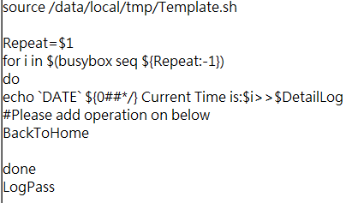
Write script
Set up precondition
Enable root permission
Install busybox/procrank
Push template
New one script, default content like this image, user need edit script between “BackToHome” and “done”.
More details please refer to “Help.xlsx”

Slide 20
Debug/Run
Debug one/multi command:
Choose the commands that you want to debug
Click Debug menu or press F6 on keyboard
Run one script – Click Run menu or press F5
Run one script at background – Click RunBD menu or press F9, can run auto test without USB cable

Slide 21
Run multi script – Click Run menu or press F8, then right click on the pop up window
Add: Add one or multi scripts to this window
Add Folder: Add one folder and show all script(include subfolder) to this window

Slide 22
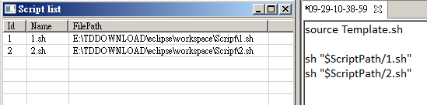
Delete: Remove the selected script
Run:
Push all scripts showed on table window to DUT
New one script on edit area automatically, like this:
Press F5, all scripts will run on your test device one by one, if F9 pressed, it will run on background

Slide 23
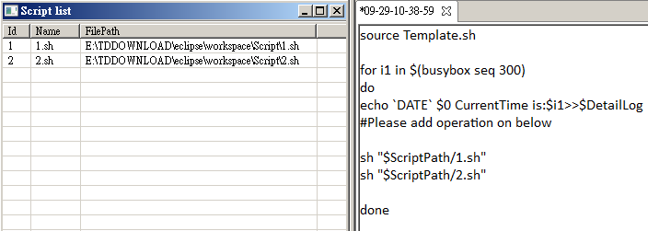
If you want to run multi scripts with cycle, please add for command, like this:
Clear All: Remove all scripts

Slide 24
Future
More function in future:
Improve find function
Add redo/undo function
Can upload error info automatically
Upgrade online
…

