Slide 1
Willson Financial Case Study
Course
CSD310-340A Database Development and Use
Group Members
Mitchel Cotton
Carli McAvoy
Johnathan Smith
Christopher Villarreal

Slide 2

Willson Financial Case Study Overview
Willson Financial is an SEC-registered financial advising firm, recently opened in a small New Mexico town. Their firm serves ranchers, farmers, and retirees.
Our database was designed to answer questions such as:
How many clients have been added in each of the last six months?
What is the average asset amount across all clients?
Which clients have more than 10 transactions per month?

Slide 3
Business Rules & Assumptions
Business Rules
One client can have one asset
One client can have many transactions
Assumptions
Each client has a single asset record that represents the client’s total combined asset value.
Each transaction is associated with one client
Each client has their own unique identifier

Slide 4
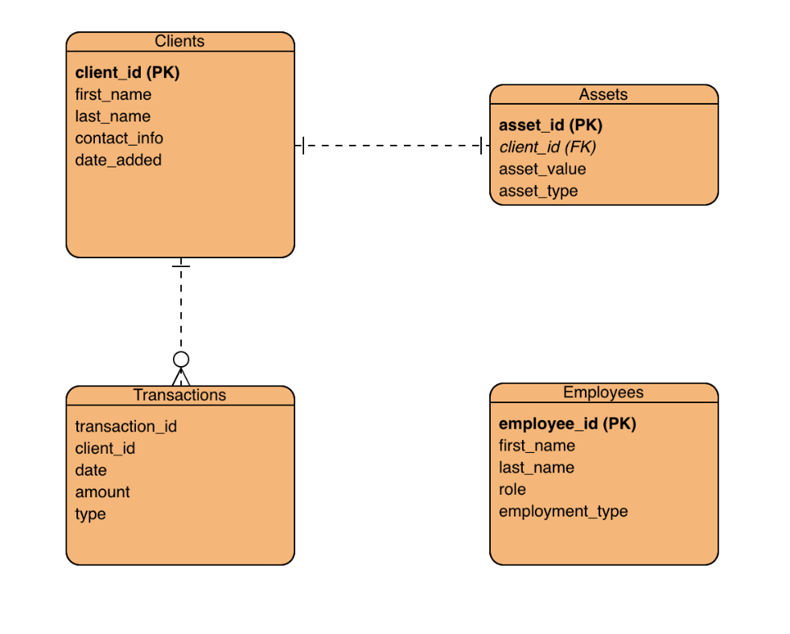
ER Diagram

Slide 5
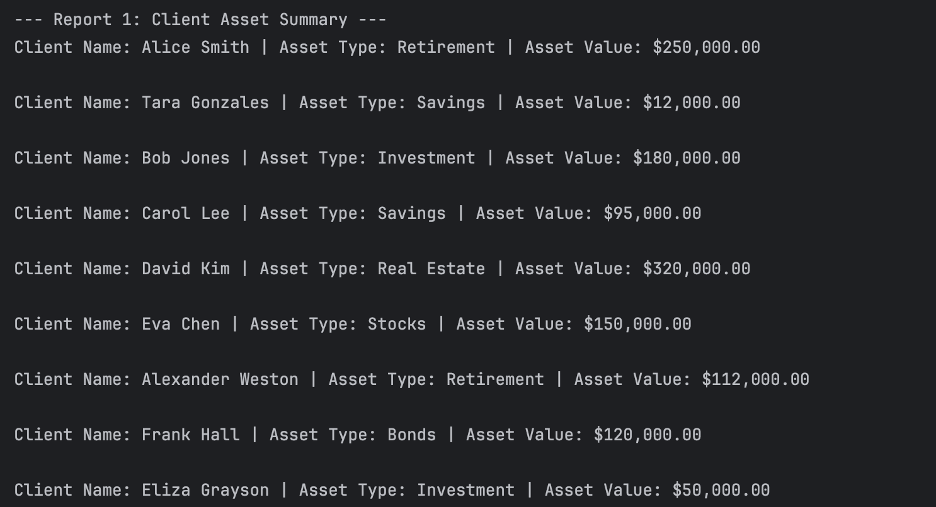
Report #1
Displays each client with their asset type and total asset value.

Slide 6
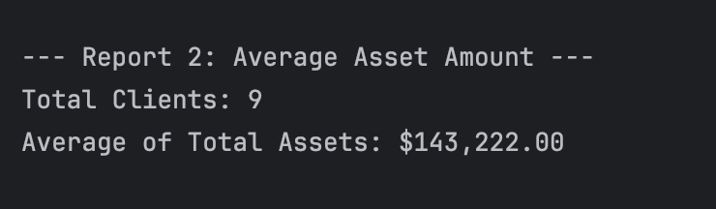
Report #2
Calculates the average asset value across all clients.

Slide 7
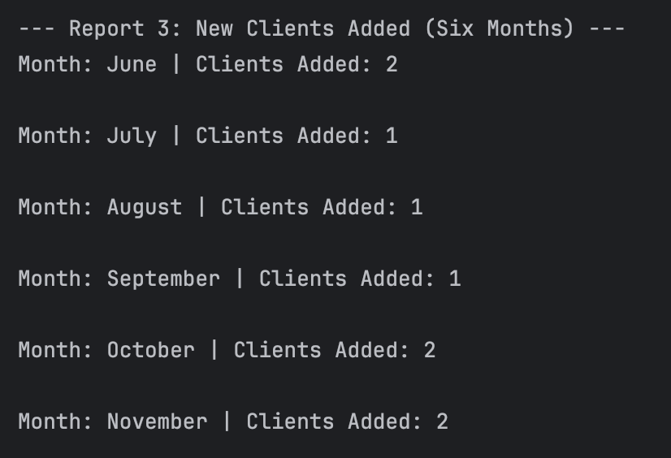
Report #3
Shows how many new clients were added per month over the last six months.

Slide 8
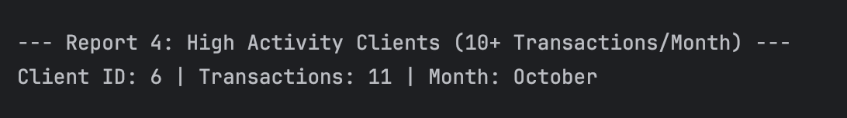
Report #4
Identifies which client(s) contain more than 10 transactions in a single month

