Slide 1
The Technology Value Stream
Carli McAvoy
Module 1.2
6/6/2026

Slide 2
What is the Value Stream?
In the world of software development, the value stream is defined as the steps required to convert a business hypothesis into a technology-enabled service or feature that delivers value to the customer.
This is initiated by a business objective or concept and begins when it is accepted into development.

Slide 3
Value Stream Stages
Ideation
Requirements, planning
Development
Coding, testing
Testing
Integration and performance
Deployment
Operations
Build, package, deploy, monitor
Support, maintenance

Slide 4
Lead Time vs. Processing Time
Lead time is a performance measurement that begins when a request is made and ends when the request is fulfilled.
Processing time starts when the team begins actively working on the project.

Slide 5
Lead Times Requiring Months
In many cases, it can take months to process and fulfill a customer request.
This can be due to monolithic systems, long test and production times, lack of automation, or long approval processes. These setbacks often contribute to poor customer outcomes.

Slide 6
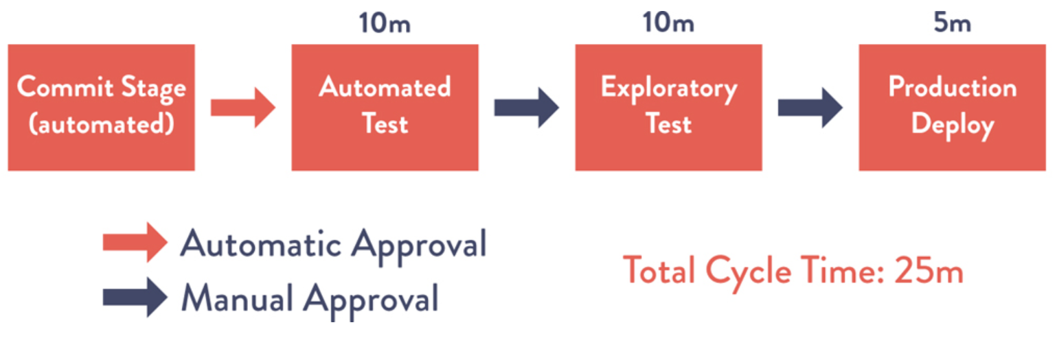
Lead Times in Minutes
Short lead times can be achieved by implementing an effective architecture, prioritizing team autonomy and automated testing with fast feedback.
Kim, G., Humble, J., Debois, P., Willis, J., & Forsgren, N. (2021).
The DevOps handbook: How to create world-class agility, reliability,
and security in technology organizations (2nd ed.). IT Revolution.

Slide 7
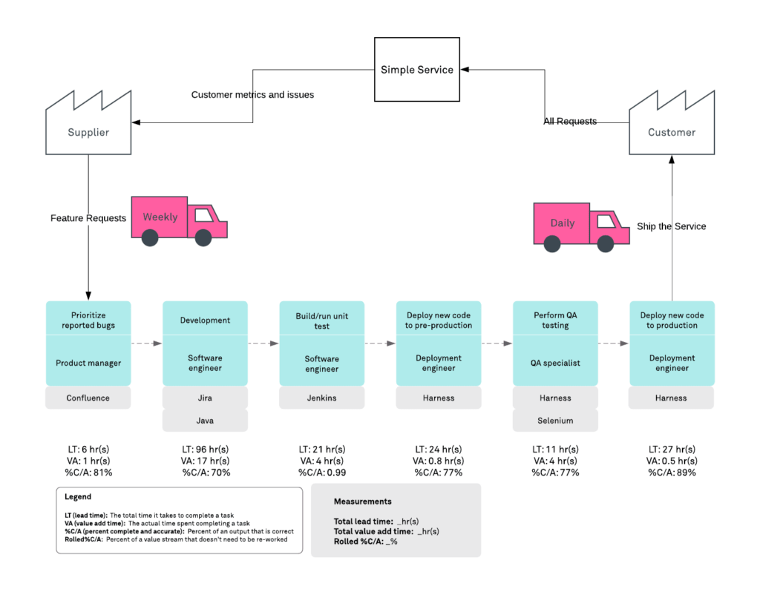
Value Stream Mapping
VS mapping is charting the path of information and resources to create a clear visualization of the sequence of activities needed to deliver a product.

Slide 8
Common Value Stream Management Implementation Challenges
Tool Fragmentation
Solution: Implement integration platforms
Metrics Complexity
Solution: Begin with manual measurement, then gradually shift to automated collection
Local vs Overall Optimization
Solution: Cross-functional teams and shared goals
Change Resistance
Solution: Demonstrate value, celebrate wins, and involve teams in designing solutions

Slide 9
References
Kim, G., Humble, J., Debois, P., Willis, J., & Forsgren, N. (2021).
The DevOps handbook: How to create world-class agility, reliability,
and security in technology organizations (2nd ed.). IT Revolution.
Quiroz-Vazquez, C. (n.d.). What is value stream management? IBM. https://www.ibm.com/think/topics/value-stream-management
Betsol. (2025, February 8). An Introduction to Value Stream Management for DevOps Leaders. https://www.betsol.com/blog/introduction-to-value-stream-management/

