Slide 1



DATA FUSION AND MACHINE LEARNING II:
^{Multi-layer Perceptrons}
DÉBORA CORRÊA AND AYHAM ZAITOUNY
^{30 OCT 2018}

Slide 2
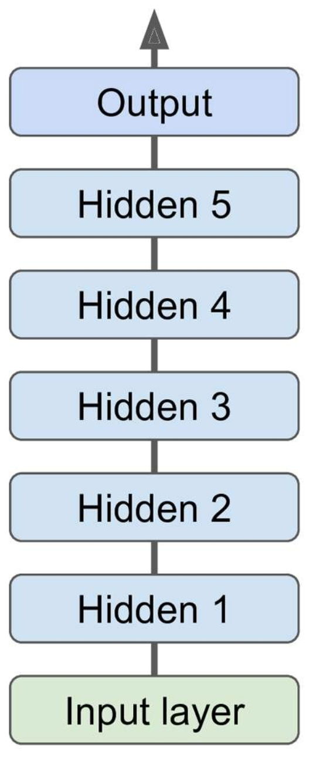
^{MULTI-LAYER PERCEPTONS}
One output layer
*Deep neural network (DNN), when an ANN has two or more hidden layers
One or more hidden layers
One input layer

Slide 3
^{MLPs HYPERPARAMETERS}
Scientists struggle training a MLPs as there are many hyperparameters to tune:

Slide 4
^{MLPs HYPERPARAMETERS}
Scientists struggle training a MLPs as there are many hyperparameters to tune:
Number of hidden layers: for many problems, one or two hidden layers are sufficient. For more complex problems, we can gradually increase the number of hidden layers until we start overfitting the training set. Very complex problems (large image classification or speech recognition), require dozens of layers and they need huge amount of training set. (Hierarchical Structure)

Slide 5
^{MLPs HYPERPARAMETERS}
Scientists struggle training a MLPs as there are many hyperparameters to tune:
Number of hidden layers: for many problems, one or two hidden layers are sufficient. For more complex problems, we can gradually increase the number of hidden layers until we start overfitting the training set. Very complex problems (large image classification or speech recognition), require dozens of layers and they need huge amount of training set. (Hierarchical Structure)
Number of neurons per hidden layer: number of neurons in the input and output layers is determined by your task. A common practice is to size the number of neurons in hidden layers to form a funnel (fewer and fewer neurons at each higher layer). A simpler approach is to pick a model with more layers and neurons than actually need, then use regularization (e.g. dropout) to prevent overfitting.

Slide 6
^{MLPs HYPERPARAMETERS}
Scientists struggle training a MLPs as there are many hyperparameters to tune:
Number of hidden layers: for many problems, one or two hidden layers are sufficient. For more complex problems, we can gradually increase the number of hidden layers until we start overfitting the training set. Very complex problems (large image classification or speech recognition), require dozens of layers and they need huge amount of training set. (Hierarchical Structure)
Number of neurons per hidden layer: number of neurons in the input and output layers is determined by your task. A common practice is to size the number of neurons in hidden layers to form a funnel (fewer and fewer neurons at each higher layer). A simpler approach is to pick a model with more layers and neurons than actually need, then use regularization (e.g. dropout) to prevent overfitting.
Activation functions: ReLU in hidden layers is a bit faster to compute than other activation functions, and Gradient Descent does not get stuck as much on local minima. For output layer: Softmax is generally a good choice for classification, for regression you can use no activation function at all.

Slide 7
^{MLPs HYPERPARAMETERS}
Scientists struggle training a MLPs as there are many hyperparameters to tune:
Number of hidden layers: for many problems, one or two hidden layers are sufficient. For more complex problems, we can gradually increase the number of hidden layers until we start overfitting the training set. Very complex problems (large image classification or speech recognition), require dozens of layers and they need huge amount of training set. (Hierarchical Structure)
Number of neurons per hidden layer: number of neurons in the input and output layers is determined by your task. A common practice is to size the number of neurons in hidden layers to form a funnel (fewer and fewer neurons at each higher layer). A simpler approach is to pick a model with more layers and neurons than actually need, then use regularization (e.g. dropout) to prevent overfitting.
Activation functions: ReLU in hidden layers is a bit faster to compute than other activation functions, and Gradient Descent does not get stuck as much on local minima. For output layer: Softmax is generally a good choice for classification, for regression you can use no activation function at all.
Weight initialization logic

Slide 8
^{MLPs HYPERPARAMETERS}
Scientists struggle training a MLPs as there are many hyperparameters to tune:
Number of hidden layers: for many problems, one or two hidden layers are sufficient. For more complex problems, we can gradually increase the number of hidden layers until we start overfitting the training set. Very complex problems (large image classification or speech recognition), require dozens of layers and they need huge amount of training set. (Hierarchical Structure)
Number of neurons per hidden layer: number of neurons in the input and output layers is determined by your task. A common practice is to size the number of neurons in hidden layers to form a funnel (fewer and fewer neurons at each higher layer). A simpler approach is to pick a model with more layers and neurons than actually need, then use regularization (e.g. dropout) to prevent overfitting.
Activation functions: ReLU in hidden layers is a bit faster to compute than other activation functions, and Gradient Descent does not get stuck as much on local minima. For output layer: Softmax is generally a good choice for classification, for regression you can use no activation function at all.
Weight initialization logic
* In theory, we could use cross-validation but it costs a lot of time and computations

Slide 9
BACK PROPAGATION TRAINING ALGORITHM

Slide 10
BACK PROPAGATION TRAINING ALGORITHM
For each instance fed to the network, the backpropagation algorithm first makes a prediction (forward pass)

Slide 11
BACK PROPAGATION TRAINING ALGORITHM
For each instance fed to the network, the backpropagation algorithm first makes a prediction (forward pass)
Then measures the error and goes through each layer in reverse to measure the contribution from each neuron (backward pass)

Slide 12
BACK PROPAGATION TRAINING ALGORITHM
For each instance fed to the network, the backpropagation algorithm first makes a prediction (forward pass)
Then measures the error and goes through each layer in reverse to measure the contribution from each neuron (backward pass)
Finally, the algorithm tunes the neuron weights to reduce the error (gradient descent step)

Slide 13
TOOLS AND STRATEGIES FOR TRAINING MLPs/DNN
Problems faced through training a DNN:
Vanishing gradients problem (or the related, exploding gradients problem) that makes lower layers very hard to train: backpropagation works by going from the output layer to the input layer. The gets smaller and smaller as the algorithm progresses down, as a result the gradient descent update leaves the lower layer connection weights unchanged and training never converges to a good solution.

Slide 14
TOOLS AND STRATEGIES FOR TRAINING MLPs/DNN
Problems faced through training a DNN:
Vanishing gradients problem (or the related, exploding gradients problem) that makes lower layers very hard to train: backpropagation works by going from the output layer to the input layer. The gets smaller and smaller as the algorithm progresses down, as a result the gradient descent update leaves the lower layer connection weights unchanged and training never converges to a good solution.
Training DNNs would be very slow with large networks

Slide 15
TOOLS AND STRATEGIES FOR TRAINING MLPs/DNN
Problems faced through training a DNN:
Vanishing gradients problem (or the related, exploding gradients problem) that makes lower layers very hard to train: backpropagation works by going from the output layer to the input layer. The gets smaller and smaller as the algorithm progresses down, as a result the gradient descent update leaves the lower layer connection weights unchanged and training never converges to a good solution.
Training DNNs would be very slow with large networks
A DNN with many parameters would severely risk overfitting the training set

Slide 16
TOOLS AND STRATEGIES FOR TRAINING MLPs/DNN
Problems faced through training a DNN:
Vanishing gradients problem (or the related, exploding gradients problem) that makes lower layers very hard to train: backpropagation works by going from the output layer to the input layer. The gets smaller and smaller as the algorithm progresses down, as a result the gradient descent update leaves the lower layer connection weights unchanged and training never converges to a good solution.
Popular strategies to solve vanishing/exploding gradients problem
Training DNNs would be very slow with large networks
A DNN with many parameters would severely risk overfitting the training set

Slide 17
TOOLS AND STRATEGIES FOR TRAINING MLPs/DNN
Problems faced through training a DNN:
Vanishing gradients problem (or the related, exploding gradients problem) that makes lower layers very hard to train: backpropagation works by going from the output layer to the input layer. The gets smaller and smaller as the algorithm progresses down, as a result the gradient descent update leaves the lower layer connection weights unchanged and training never converges to a good solution.
Popular strategies to solve vanishing/exploding gradients problem
Training DNNs would be very slow with large networks
Faster optimizers that can speed up the training
A DNN with many parameters would severely risk overfitting the training set

Slide 18
TOOLS AND STRATEGIES FOR TRAINING MLPs/DNN
Problems faced through training a DNN:
Vanishing gradients problem (or the related, exploding gradients problem) that makes lower layers very hard to train: backpropagation works by going from the output layer to the input layer. The gets smaller and smaller as the algorithm progresses down, as a result the gradient descent update leaves the lower layer connection weights unchanged and training never converges to a good solution.
Popular strategies to solve vanishing/exploding gradients problem
Training DNNs would be very slow with large networks
Faster optimizers that can speed up the training
A DNN with many parameters would severely risk overfitting the training set
Popular regularization techniques to avoid overfitting

Slide 19
TOOLS AND STRATEGIES FOR TRAINING MLPs/DNN
Strategies to solve vanishing/exploding gradients problems:

Slide 20
TOOLS AND STRATEGIES FOR TRAINING MLPs/DNN
Strategies to solve vanishing/exploding gradients problems:
Input normalization (zero mean and unit std)

Slide 21
TOOLS AND STRATEGIES FOR TRAINING MLPs/DNN
Strategies to solve vanishing/exploding gradients problems:
Input normalization (zero mean and unit std)
Xavier/Glorot weight initialization

Slide 22
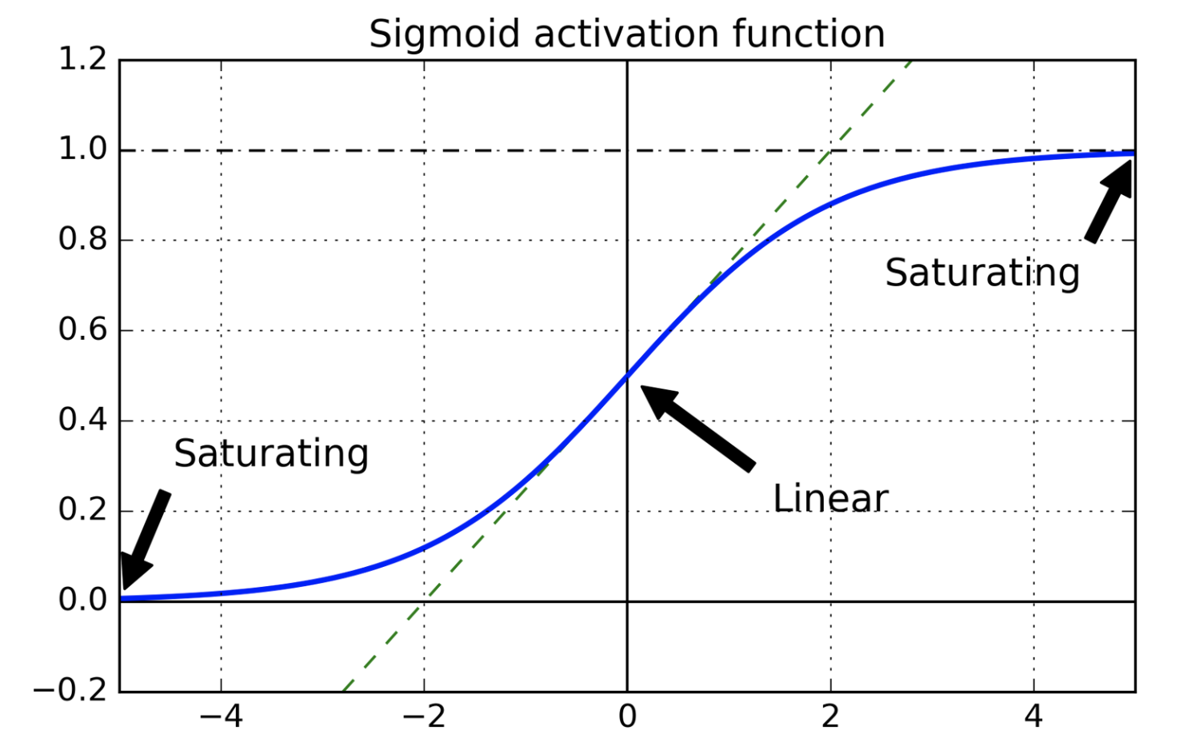
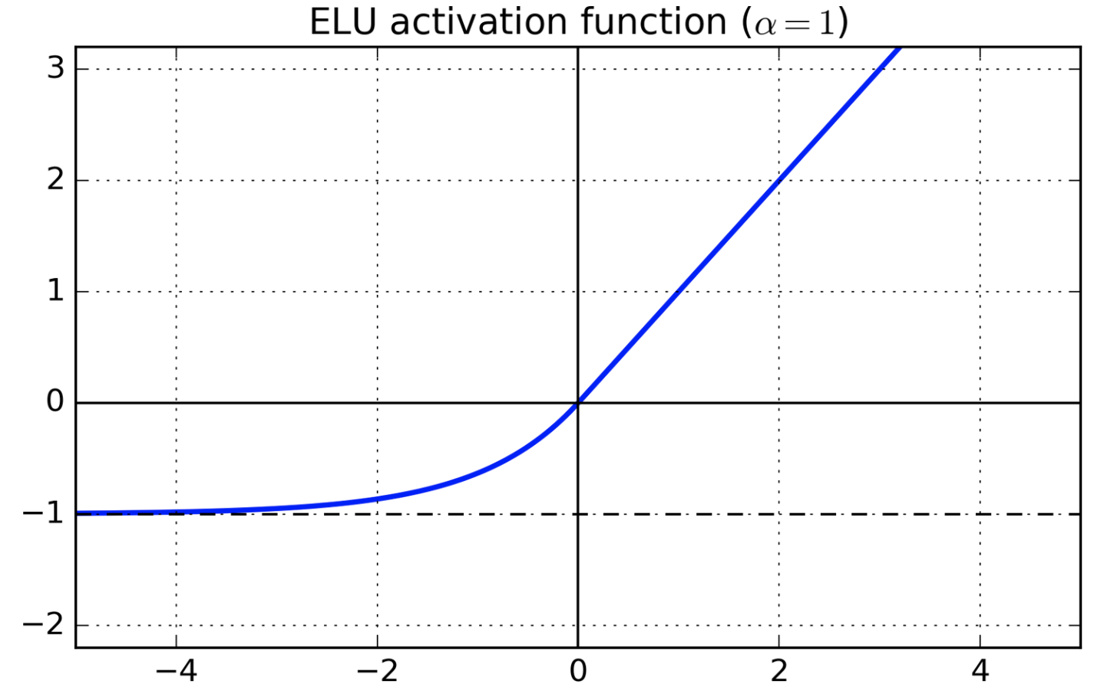
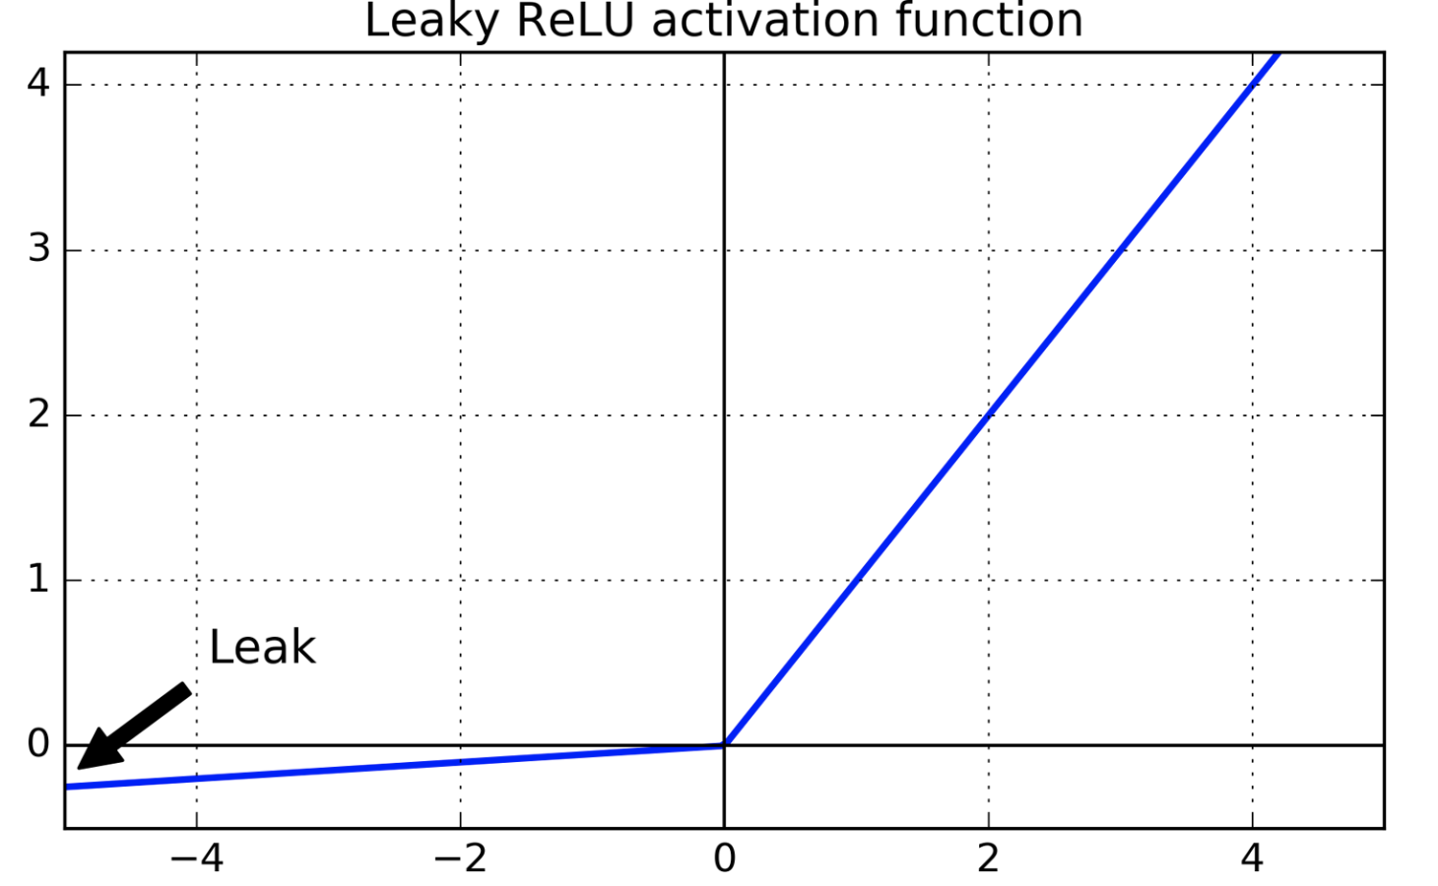
TOOLS AND STRATEGIES FOR TRAINING MLPs/DNN
Strategies to solve vanishing/exploding gradients problems:
Input normalization (zero mean and unit std)
Xavier/Glorot weight initialization
Nonsaturating activation functions: Exponential Linear Unit (ELU) Leaky ReLU

Slide 23
TOOLS AND STRATEGIES FOR TRAINING MLPs/DNN
Strategies to solve vanishing/exploding gradients problems:
Input normalization (zero mean and unit std)
Xavier/Glorot weight initialization
Nonsaturating activation functions: Exponential Linear Unit (ELU) Leaky ReLU
Batch Normalization:
Zero-centre and normalization of the inputs in each layer before activation function is computed

Slide 24
TOOLS AND STRATEGIES FOR TRAINING MLPs/DNN
Strategies to solve vanishing/exploding gradients problems:
Input normalization (zero mean and unit std)
Xavier/Glorot weight initialization
Nonsaturating activation functions: Exponential Linear Unit (ELU) Leaky ReLU
Batch Normalization:
Zero-centre and normalization of the inputs in each layer before activation function is computed
Gradient clipping:
Used for exploding gradients
Rescale gradients to prevent they exceed a maximum threshold

Slide 25
TOOLS AND STRATEGIES FOR TRAINING MLPs/DNN
Faster optimizers:
Momentum optimization
Nesterov Accelerated Gradient
AdaGrad
RMSProp
Adam Optimization
Learning Rate Scheduling

Slide 26
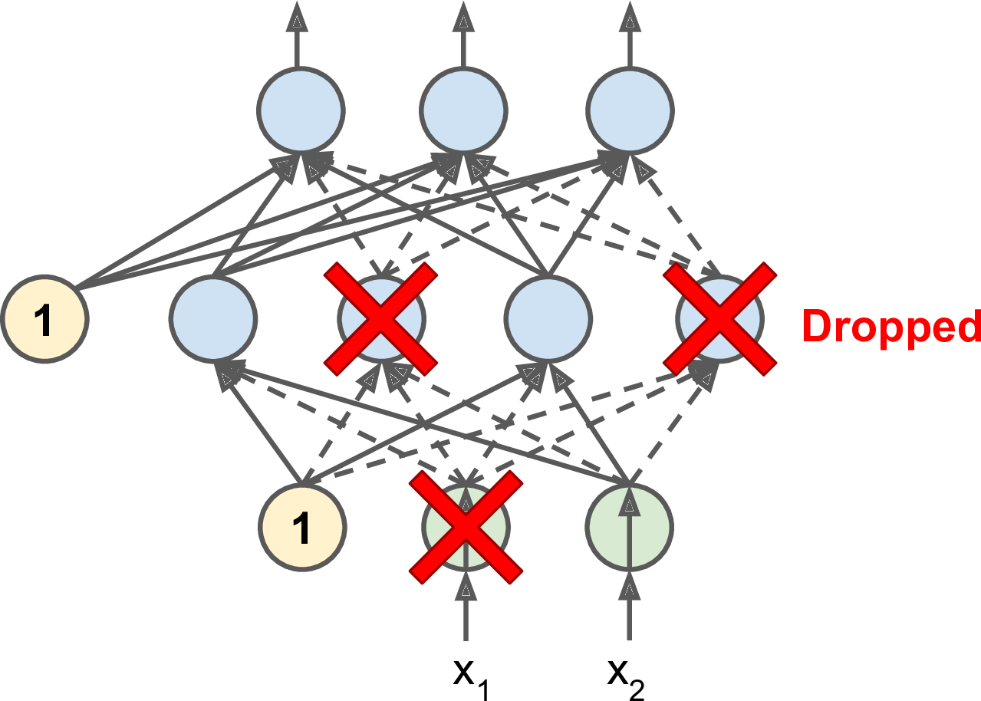
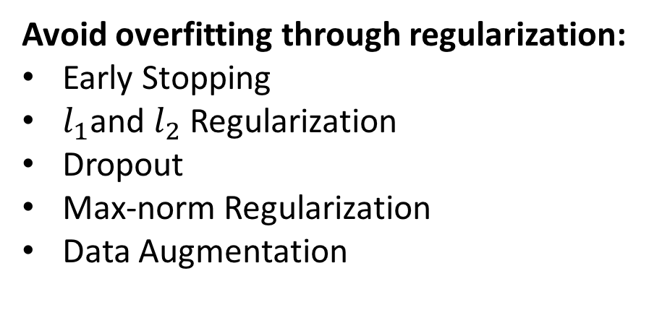
TOOLS AND STRATEGIES FOR TRAINING MLPs/DNN
Avoid overfitting through regularization:
Early Stopping
$l_{1}$and $l_{2}$ Regularization
Dropout
Max-norm Regularization
Data Augmentation

Slide 27
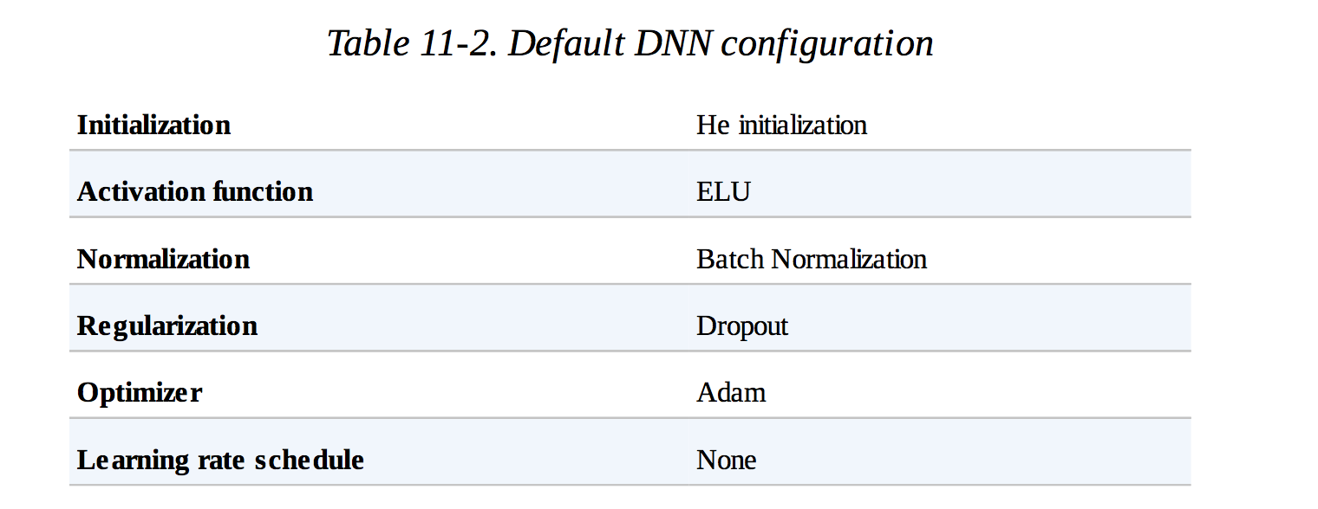
TOOLS AND STRATEGIES FOR TRAINING MLPs/DNN
Avoid overfitting through regularization:
Early Stopping
$l_{1}$and $l_{2}$ Regularization
Dropout
Max-norm Regularization
Data Augmentation
Default DNN configuration

