Slide 1
PYTHON PROGRAMMING
101
Peter Goodin
Lead Data Science Instructor, GA Melbourne
Research Fellow, Neurorehabilitation, Royal Melbourne Hospital
Honorary Research Fellow, Florey Institute of Neuroscience & Mental Health

Slide 2
PYTHON PROGRAMMING 101
LEARNING OBJECTIVES
Discuss the history of Python & how it’s used in different industries
Define how Python compares to other programming languages
Describe the benefits of a Python workflow when looking at data
Demonstrate basic Python programming fundamentals to solve a real world problem
Create a custom learning plan to build your Python skills after this workshop!
Notes:
Learning objectives will frame the class and give students reference points

Slide 3

PYTHON PROGRAMMING 101
PRE-WORK

Slide 4
PRE-WORK REVIEW
Bring a laptop with Anaconda installed. Scroll to your operating system version and click on the install button for Anaconda with Python 2.7.
We will be using Jupyter Notebooks as the main IDE for the workshop. If you have installed Anaconda, then you are ready to go!

Slide 5

PYTHON PROGRAMMING 101
OPENING

Slide 6


WHO AM I?
Peter Goodin
What I do: Lead Instructor – Data Science GA Melbourne,
Neuroscience of Stroke / brain damage
What have I done: Ph.D Cognitive Neuroscience –
Psychoneuroimmunology of Major Depressive Disorder,
Consumer Neuroscience, Condom analysis.
What I’m interested in: Tech & data science for rehabilitation after
brain damage.
petergoodin
@peter_goodin

Slide 7
ABOUT YOU!
‣
Before we dive in, let’s talk a bit about you!
‣
Name
What brings you to GA?
‣
‣
Current activities
‣
Your Goals
‣
Fun fact about yourself!

Slide 8
THE BIG PICTURE
What we’ll cover:
  Why Python?
  What can Python do for me?
  Implementing Python into your workflow
  Python Libraries
  Programming (pseudocode and Python)
  Dive into data with Python

Slide 9
THE BIG PICTURE
Why this topic matters:
  Programming is a sought-after skill
  Python has been gaining popularity (why? We'll find out!)
Why this topic rocks:
Python opens up a door to a variety of opportunities, from data science to research

Slide 10
PYTHON PROGRAMMING 101
WHAT IS PYTHON?
Created by Guido Van Rossum in 1991
Emphasises productivity and code readability
  The language is easy to pick up and learn
  This gentle learning curve brings makes it easier for many to contribute to production level code
  Readable code means that almost anyone can pick up a piece of code and understand what it is doing

Slide 11
THE ZEN OF PYTHON
Beautiful is better than ugly.
Explicit is better than implicit.
Simple is better than complex.
Complex is better than complicated.
Flat is better than nested.
Sparse is better than dense.
Readability counts.
Special cases aren't special enough to break the rules,
Although practicality beats purity.
Errors should never pass silently,
Unless explicitly silenced.
In the face of ambiguity, refuse the temptation to guess.
There should be one-- and preferably only one --obvious way to do it,
Although that way may not be obvious at first unless you're Dutch.
Now is better than never.
Although never is often better than *right* now.
If the implementation is hard to explain, it's a bad idea.
If the implementation is easy to explain, it may be a good idea.
Namespaces are one honking great idea -- let's do more of those!

Slide 12

SOME CHARACTERISTICS OF PYTHON
Interpreted language: Code implementations execute instructions without having to translate them into machine-language instruction.
In contrast, compiled code is executed by the computer's CPU (hardware)
Interpreted code may run less quickly, but can be executed on multiple platforms without modification

Slide 13
SOME CHARACTERISTICS OF PYTHON
Object-oriented (OO): Instead of concentrating on isolated "actions", object-orientation enables us to focus on "objects" that contain data & attributes.
Objects have specific procedures, known as methods (code) that can access and modify the attributes of the object.
OO makes it easier to reuse code in other programs

Slide 14
SOME CHARACTERISTICS OF PYTHON
High-level programming: This refers to the use of language similar to natural language makes it easy to use and automate.
Related to the code readability mentioned earlier.

Slide 15
SOME CHARACTERISTICS OF PYTHON
Dynamic Typing: Variables are assigned their type by Python contextually.
No need to pre-specify what kind of data a particular variable will have.
Variable can be re-used (both good and bad), quick to make changes, generally faster to work with.

Slide 16
WHY PYTHON?
Python is:
Great for rapid prototyping and full-stack commercial applications.
A modern, elegant, object-oriented language.
Highly expressive, i.e., you can be more productive.
Well documented and has an established and growing community.
Comes with "batteries included" - in other words, Python has libraries that will help you do a ton of different tasks!

Slide 17
WHY PYTHON?
Extremely fun to develop in :)
Basically everything can be done with Python.
If something can't be done, you can probably create an extension for it.
Things can be done quickly!
  For example a program that takes you weeks in C++, might take you a day in Python.

Slide 18
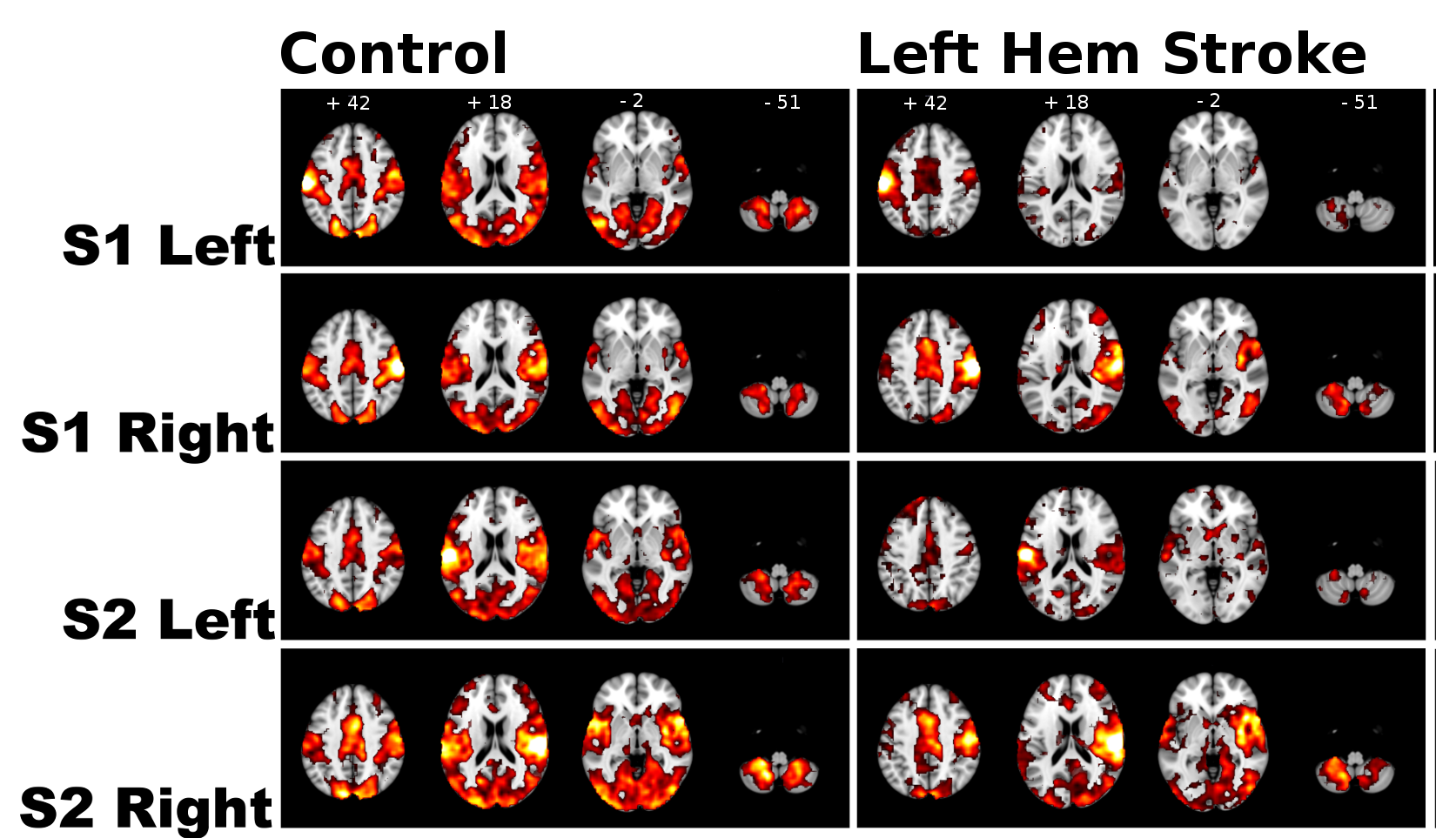
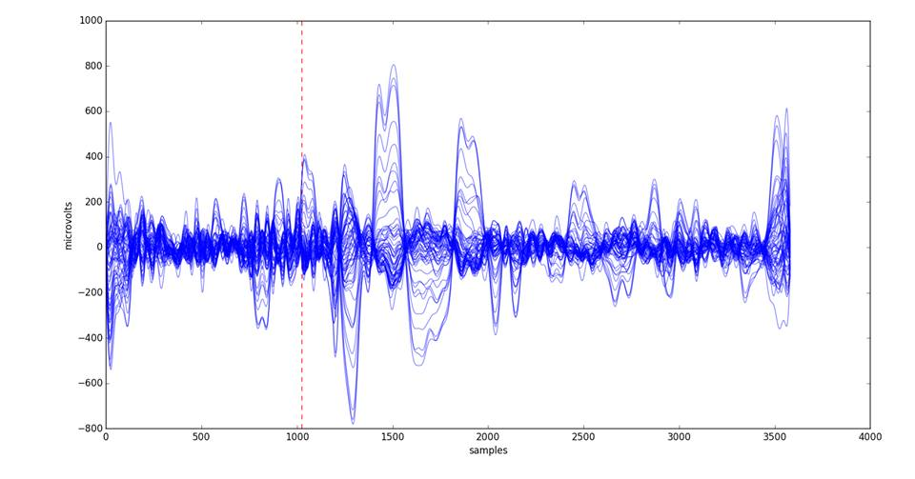

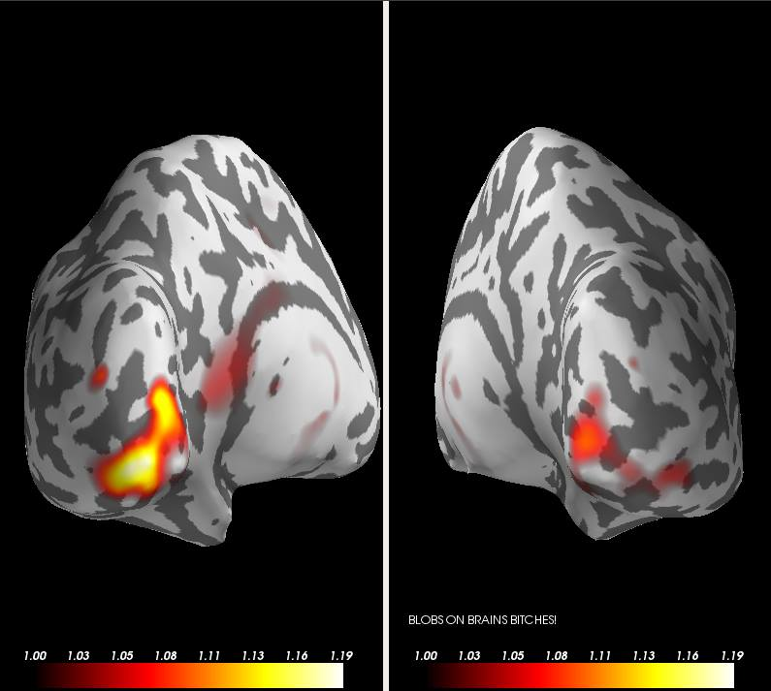
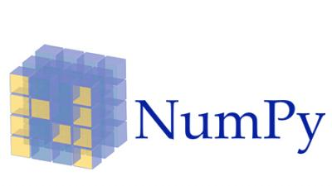
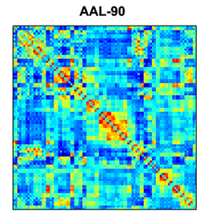


HOW DO I USE PYTHON?
Notes:
Instructor Note: KNOWLEDGE CHECK
Provide an example of your day-to-day work with Python.
Ask students how they manage their data work and whether they have had any experience with Python (or any other programming languages).
Ask students to generate answers - why are these things good? Why does this matter?

Slide 19
PYTHON PROGRAMMING 101
IMPLEMENTING
A PYTHON
WORKFLOW

Slide 20

WHERE IS PYTHON USED?
Industry & Academia
Art Middleware – Tools and Plugins
Research
Web Development and Web Applications
Game Development
Windows Applications
You name it!

Slide 21

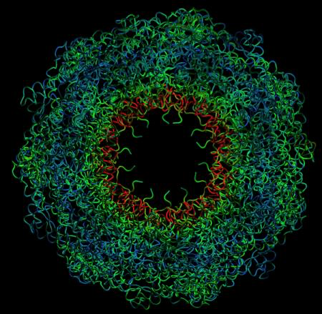

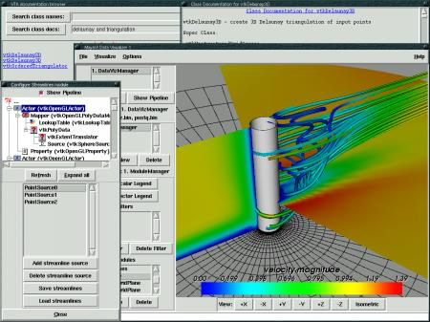
EXAMPLES
• Industry
◦ Drug discovery
◦ Financial services
◦ Films and special effects
• Academia
◦ Gravitational waves
◦ Scientific visualisation
◦ Biomolecule simulation
Notes:
Instructor Note: Examples to be presented can be drawn from your own experience with the language. If you need inspiration, there are plenty of examples in this page:
https://www.python.org/about/success/

Slide 22
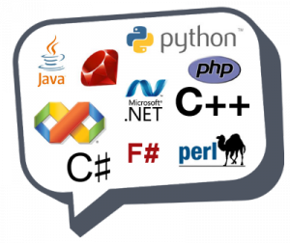
PYTHON Vs OTHER LANGUAGES
Python is often compared to other interpreted languages, such as:
  Java,
  JavaScript,
  Perl,
  Tcl, or
  Smalltalk.
Comparisons to C++, Common Lisp and Scheme can also be enlightening.

Slide 23
PYTHON PROGRAMMING
Let us what a Python program looks like.
Starting with the typical "Hello World!" program:
  In essence, we are writing code to print the message "Hello World!" in the screen.

Slide 24
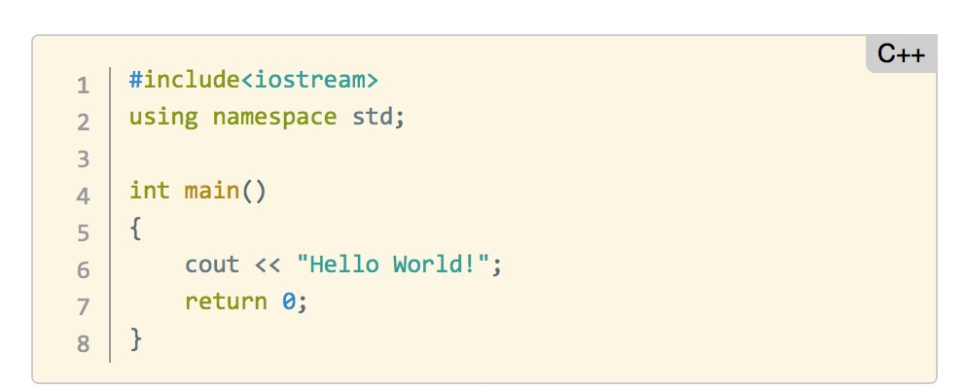
PYTHON PROGRAMMING
Let’s see the C++ version:
What do the components of the code do?
Notes:
Instructor Note:
Here we need to define a main function; however, we have to be careful with the use of punctuation (notice the semicolons at the end of some of the lines) and “cout” is not very understandable in lay terms.
Return 0 – Returns nothing from the function.

Slide 25
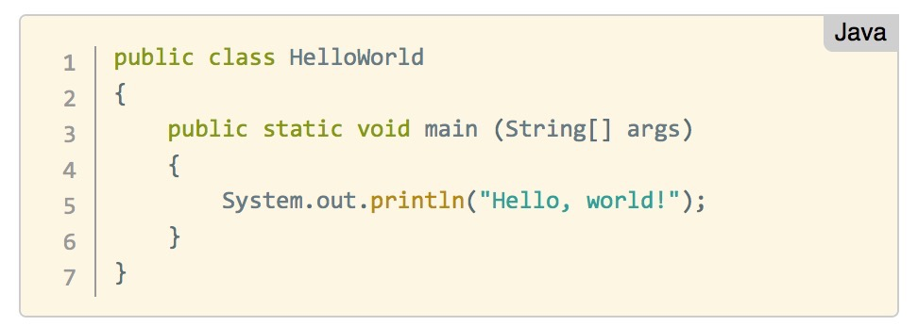
PYTHON PROGRAMMING
What about Java?
Once again, it does exactly the same at the C++ version – Prints Hello, world! to the screen
Notes:
Instructor Note:
Notice that in the Java version, we define the code inside the context of a “class”.
You are encouraged to use other specific examples of an element python does particularly well, using a simple statement or function. This depends on your familiarity with other programming languages, as well with the abilities of the students in your class.

Slide 26
PYTHON PROGRAMMING
And in Python?
And in Python?

Slide 27
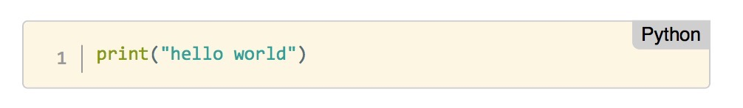
PYTHON PROGRAMMING
And in Python?
And in Python?
Notes:
Show how to print hello world n times
Print('Hello World') * n

Slide 28

PYTHON: INTERACTIVE SHELLS Vs. SCRIPTS
In our “Hello World!” python program, we are assuming that we are using an interactive shell,
In other words, we are writing code that is executed immediately by the Python interpreter.
We are able to "interact" with the results of the commands we pass. We can do this using a:
  Python shell
  iPython shell
  Jupyter notebook

Slide 29
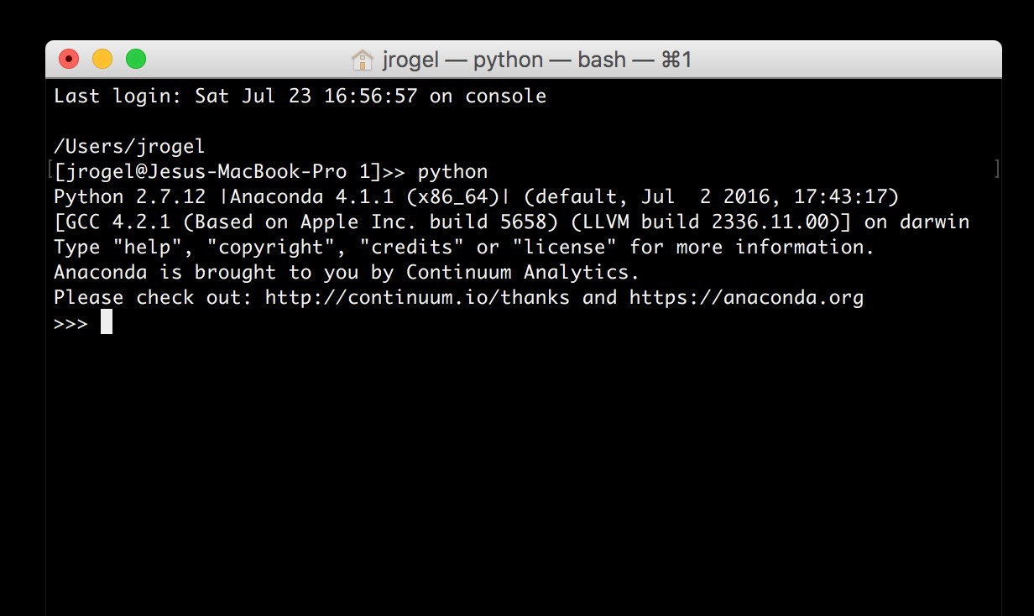
PYTHON SHELL
A python shell is similar to a Command Line Terminal and it can be launched by typing:
“python”

Slide 30
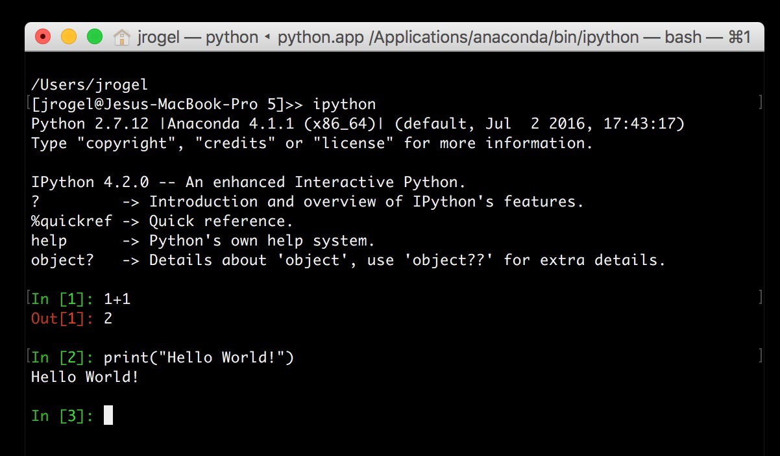
iPYTHON SHELL
A python shell is more interesting than a plain terminal, providing syntax colouring and shortcuts to interact with our code. It can be launched with:
“ipython"

Slide 31
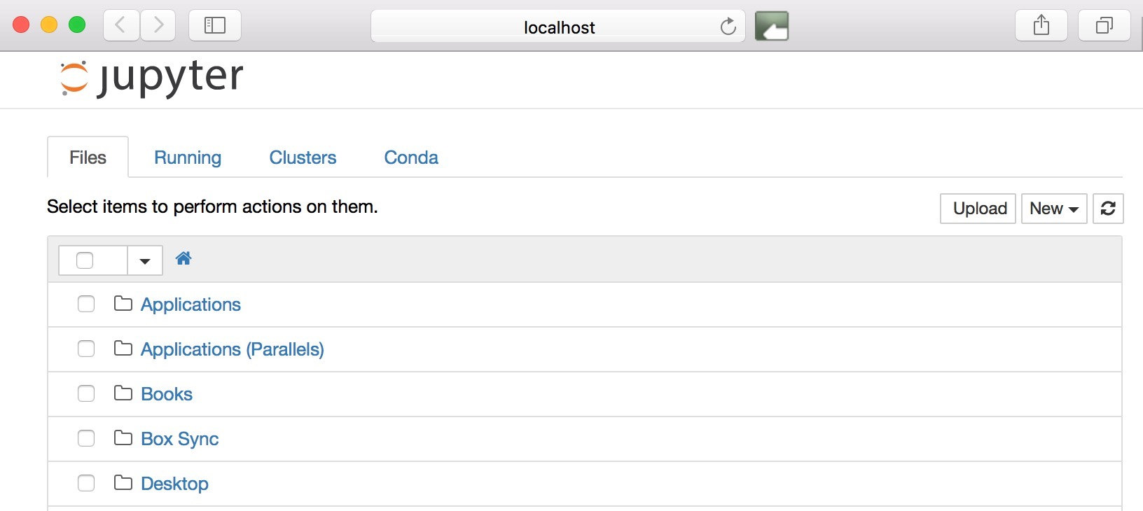
JUPYTER NOTEBOOK
A Jupyter notebook is a web interface that let’s us use formatting along side our code. It is the extremely common and very useful! You can launch it by typing:
“jupyter notebook”

Slide 32

PYTHON: INTERACTIVE SHELLS Vs. SCRIPTS
Sometimes we do not need to interact with our Python code.
Instead, we may want to execute a program and simply get results.
In those cases, we need to create a Python script.
To do so, we can use a text editor of our choice and save the code in a file with extension “.py”.

Slide 33
SCRIPT EDITORS AND IDE
Some common plain text editors include:
  Atom
  NotePad (Win), NotePad++ (Win)
  TextEdit (Mac), TextWrangler (Mac).
  Nano, Gedit (Linux, Mac)

Slide 34
SCRIPT EDITORS AND IDE
Integrated development environments (IDEs) provide comprehensive facilities for computer programmers involved in software development.
  PyCharm
  Eclipse with PyDev
  Atom
  Spyder (included in Anaconda)

Slide 35
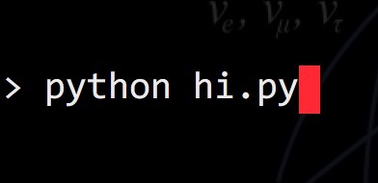
SIMPLE PYTHON SCRIPT
A barebones script for the "Hello World!" program (saved to a file called `hi.py`) looks like this:
To run the script by passing it as a command to the Python interpreter we need to write:

Slide 36
Demo
VISUALISING
DATA
Is it important?
When is it needed?
What does it add?
What tools do you use?
Notes:
The notebook has been changed from the original plotly implementation to give a whistlestop tour of the python plotting eco-system: matplotlib, seaborn and Bokeh for interactive plots.

Slide 37
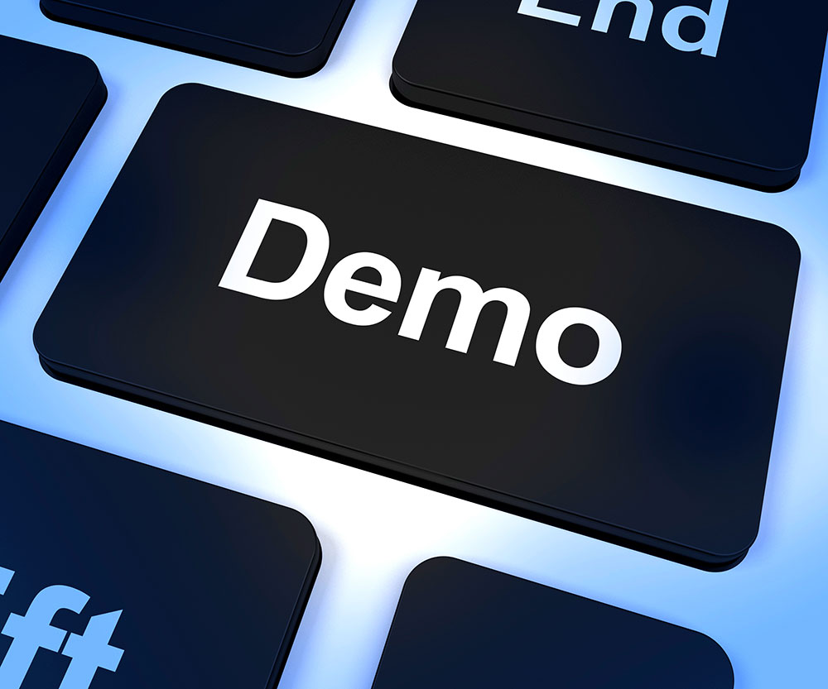
INSTRUCTIONS
We recommend using a Jupyter notebook for this demo.
Save the file called Python_101_Demo_Plotly.ipynb in a known location in your file system
Open Jupyter: in a terminal type: `jupyter notebook`
Navigate to the folder where you saved your file in step 1.
Click on the name of the file
Voilà, you are ready to follow the demo

Slide 38
Guided Practise
COMMON PYTHON PACKAGES & DATA TYPES

Slide 39
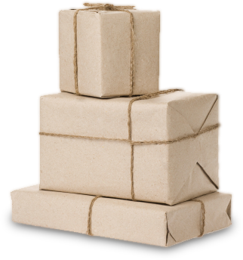
PACKAGES
Libraries of code written to solve particular set of problems
Can be installed with: pip install <package name>
or conda install <package name>
Ever used Excel? How do yo fancy working with data structured in a similar way, but better graphics and less hassle? Try pandas
Does your application require the use of advanced mathematical or numerical operations using arrays, vectors or matrices? Try SciPy (scientific python) and NumPy (numerical python)

Slide 40
PACKAGES
Libraries of code written to solve particular set of problems
Can be installed with: pip install <package name>
or conda install <package name>
Does your application require the use of advanced mathematical or numerical operations using arrays, vectors or matrices? Try SciPy (scientific python) and NumPy (numerical python)

Slide 41
PACKAGES
Are you interested in using python in a data science workflow to exploit machine learning in your applications? Look no further than Scikit-learn
Are you tired of boring-looking charts? Are you frustrated looking for the right menu to move a label in your plot? Take a look at the visuals offered by matplotlib

Slide 42
PACKAGES
Is your boss asking about significance testing and confidence intervals? Are you interested in descriptive statistics, statistical tests, or plotting functions? Well statsmodels offers you that and more.
All the data you require is available freely on the web but there is no download button and you need to scrape the website? You can extract data from HTML using Beautiful Soup and automate web browsing using Selenium!

Slide 43
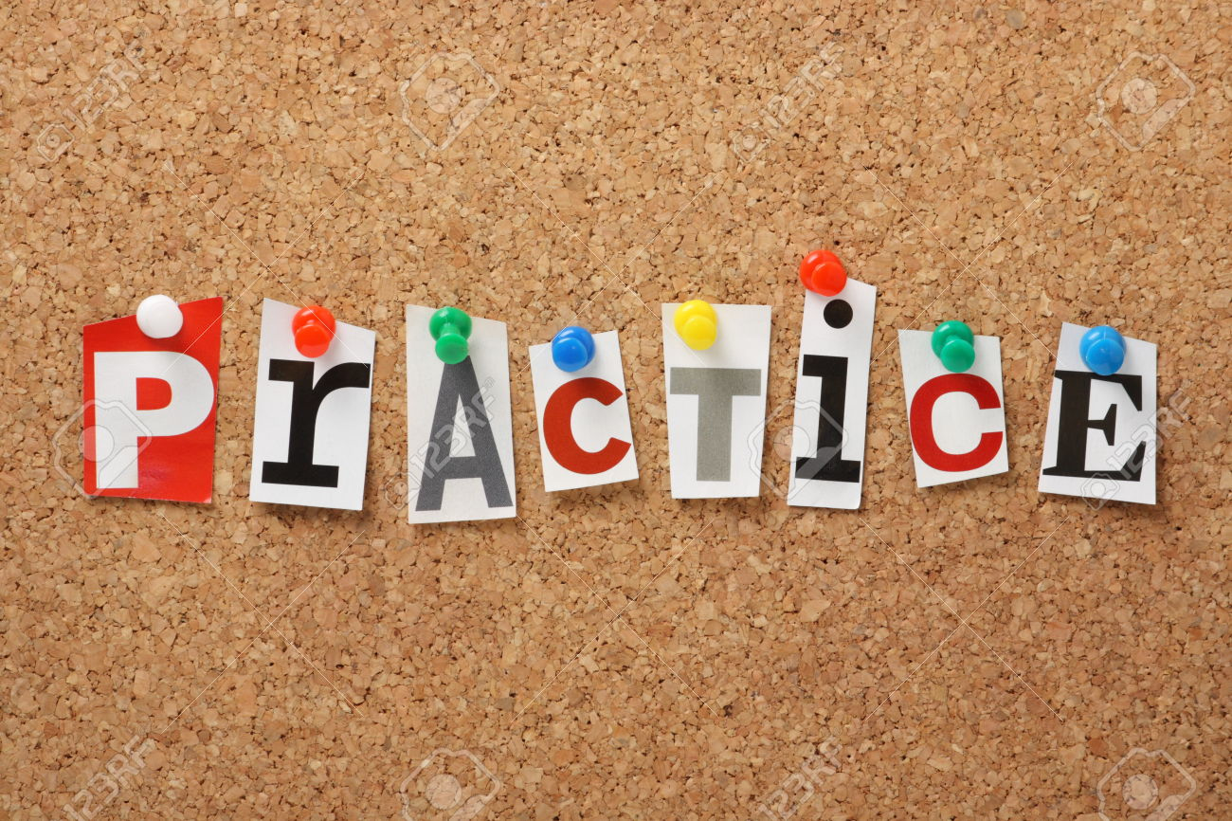
INSTRUCTIONS
We recommend using a Jupyter notebook for this practice.
Open Jupyter: in a terminal type: `jupyter notebook`
Navigate to an appropriate folder where your work will be saved
On the top-right-hand-side click in the button called "New" and select "Python 2” or “Root” (depending on your installation of Python)
Voilà, you are ready to type the commands we will cover
Notes:
This is to get the class working in an interactive environment and get comfortable with data types.

Slide 44
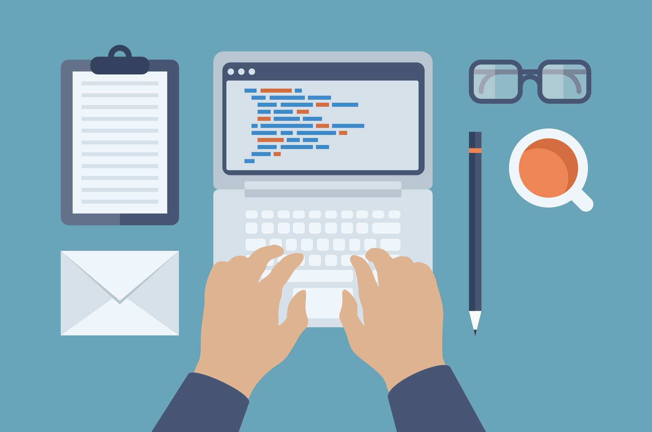
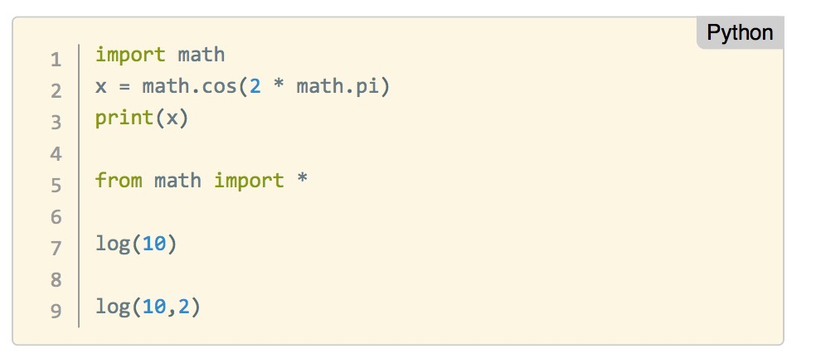
IMPORTING A MODULE
We need to import the functionality of packages and modules before we can use them
Here we import the “math” module to use mathematical functions:

Slide 45
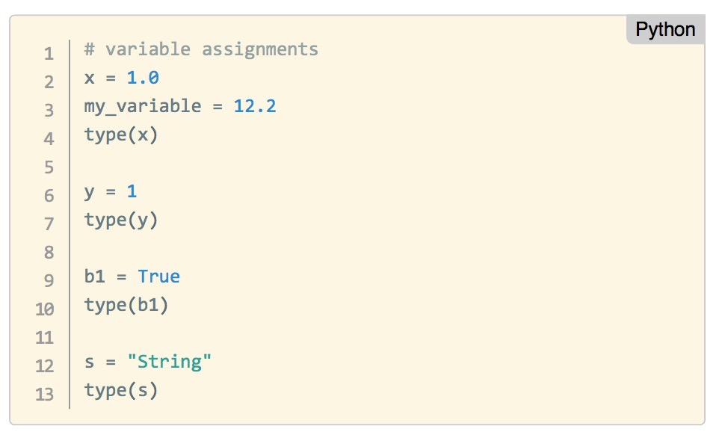
TYPES, VARIABLES, ASSIGNMENT
Like any other programming language, we need to use types and variables and be able to assign values to them

Slide 46
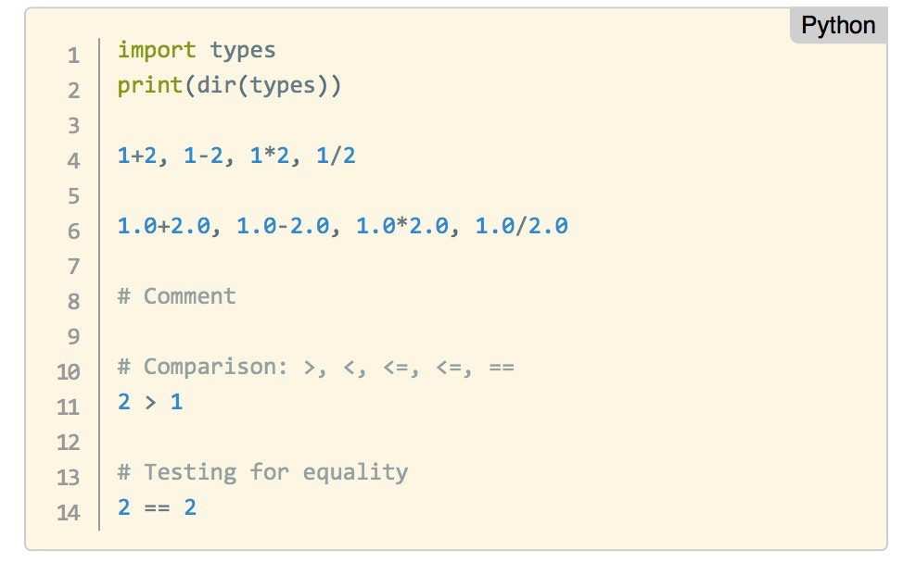
YOUR TURN
Try the following in your Jupyter Notebook:
Notes:
Have a play with the following commands and see if you can explain what they do!
Note: See if someone can find an issue with ints & tuples (the division).

Slide 47
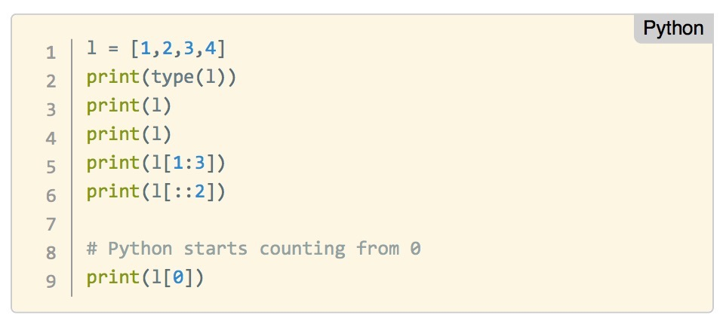
LISTS
Lists are collections of objects
They can be changed

Slide 48
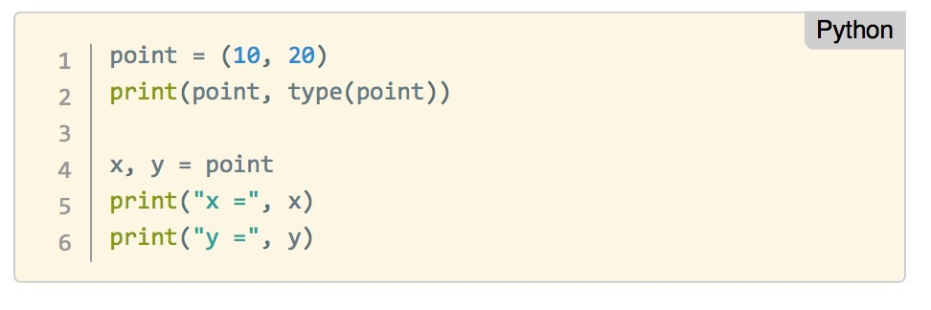
TUPLES
Tuples are very similar to lists, but
they cannot be changed

Slide 49
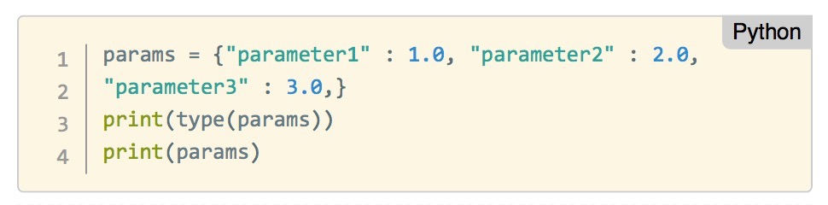
DICTIONARIES
Dictionaries combine keys with values in pairs
Like in a dictionary, you can search the keys to obtain their corresponding value

Slide 50
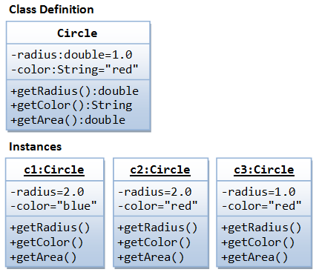
CLASS
In Object Oriented Programming, a class is a template definition of the methods and variables in a particular kind of object.
In other words, an object is a specific instance of a class
The object contains actual values instead of variables.

Slide 51
INDEPENDENT PRACTICE
THIS IS GOING TO BUILD TO SOMETHING

Slide 52
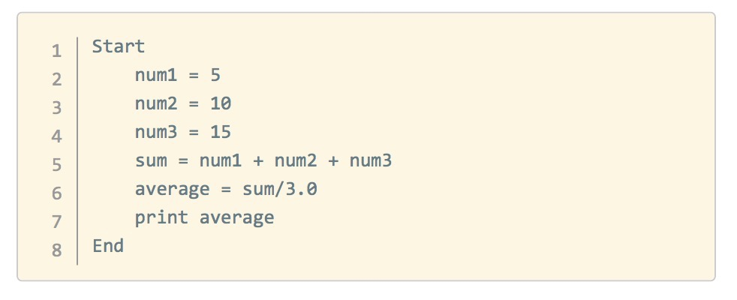
PSEUDOCODE
Pseudocode allows us to represent a program concisely.
The only thing you need is a statement to show where you are starting and where you are ending a program.
Calculate and print the average of three numbers: 5, 10, and 15.
Notes:
Instructor Note:
Run through the following example with the students. Then ask them to tackle problems similar to the ones proposed below.

Slide 53

ACTIVITY: WRITE YOUR OWN (PSEUDO)CODE
DIRECTIONS
Create some pseudocode for the following tasks
  Create a short script that will calculate the area circle with radius r.
  Calculate and print the square of a number. If the number is larger than 10 also calculate the cube.
  List the letters in the sentence "Python is awesome"
DELIVERABLE
Pseudocode explaining the necessary steps to achieve one of the tasks above
Notes:
Remember, they shouldn’t know what they’re going to design yet, since you can’t know what the solution is before you know the problem.
Share out (15m)
ASK: What are some topics people are interested in?
Instructor will facilitate a discussion around topics, may want to write them on the whiteboard.
Note: This is a great opportunity to nudge students away from some topics that may be too broad in scope, or too unsubstantial a topic.

Slide 54
INTRODUCTION
PYTHON PROGRAMMING FUNDAMENTALS
Notes:
Instructor Note: This demo is intended to show the students some of the visualization capabilities of Python.
The code in the file Python101Demo_Plotly.ipynb may be more intricate than you may want the students to grasp on their own. We suggest giving the students a copy of the complete notebook above and run through the code with them in class.
Make sure the students understand that this is a demo and that some of the instructions in the demo will become clearer as the lesson progresses. It will also give them an opportunity to continue their learning process.
DISCUSSION
Start by asking the students about the importance of visualizing data: when is it needed? what does it add? what tools do they tend to use in their daily work (if any)?
Instructor Note: Start a Jupyter notebook and remind the students how to use it.

Slide 55
INSTRUCTIONS
We recommend using a Jupyter notebook for this practice.
Open Jupyter: in a terminal type: `jupyter notebook`
Navigate to an appropriate folder where your work will be saved
On the top-right-hand-side click in the button called "New" and select "Python 2” or “Root” (depending on your installation of Python)
Voilà, you are ready to type the commands we will cover
Notes:
Instructor Note: Remind the students about the concepts learnt in the first part of the workshop. Review the first Python code introduced and the types you have covered.
DISCUSSION
1. Start by surveying what students already know or don't know
2. Then state which fundamentals you are going to cover
3. Give a high level overview of what these fundamentals do (e.g. allow programs to store and remember information, etc)
Instructor Note: Start a Jupyter notebook and remind the students how to use it.

Slide 56
PYTHON PROGRAMMING FUNDAMENTALS
Understanding core programming concepts and why they are used is just as important as knowing how to write code.
Before we start,we’ll review some basic programming concepts:
Variables: A symbolic name that stores a value (some specific piece of information). Variables have different types.
For example: r = 3

Slide 57
PYTHON PROGRAMMING FUNDAMENTALS
Control Structures: A block of programming that analyses variables and chooses a direction in which to go based on given parameters.
The term flow control details the direction the program takes (which way program control “flows”). It determines how a computer will respond when given certain conditions and parameters. Some typical structures include:
  If statement
  For loop
  Functions
Notes:
> Instructor Note: Remind the students about the concepts learnt in the first part of the workshop. Review the first Python code introduced and the types you have covered.
DISCUSSION
1. Start by surveying what students already know or don't know
2. Then state which fundamentals you are going to cover
3. Give a high level overview of what these fundamentals do (e.g. allow programs to store and remember information, etc)
Instructor Note: Start a Jupyter notebook and remind the students how to use it.

Slide 58
PYTHON PROGRAMMING FUNDAMENTALS
Data Structures: Data structure is a particular way of storing and organising data in a computer so that it can be used efficiently. Some examples include:
  Lists ← Native
  Tuples ← Native
  Dictionaries ← Native
  Arrays ← Numpy
  Matrices ← Numpy
  Dataframes ← Pandas
Notes:
> Instructor Note: Remind the students about the concepts learnt in the first part of the workshop. Review the first Python code introduced and the types you have covered.
DISCUSSION
1. Start by surveying what students already know or don't know
2. Then state which fundamentals you are going to cover
3. Give a high level overview of what these fundamentals do (e.g. allow programs to store and remember information, etc)
Instructor Note: Start a Jupyter notebook and remind the students how to use it.

Slide 59
PYTHON PROGRAMMING FUNDAMENTALS
Syntax: The syntax of a programming language is the set of rules that define the combinations of symbols that are considered to be correctly structured programs in that language
The interrelationship of all of these elements make it possible for us to write programs to implement algorithms and solve problems
Notes:
> Instructor Note: Remind the students about the concepts learnt in the first part of the workshop. Review the first Python code introduced and the types you have covered.
DISCUSSION
1. Start by surveying what students already know or don't know
2. Then state which fundamentals you are going to cover
3. Give a high level overview of what these fundamentals do (e.g. allow programs to store and remember information, etc)
Instructor Note: Start a Jupyter notebook and remind the students how to use it.

Slide 60
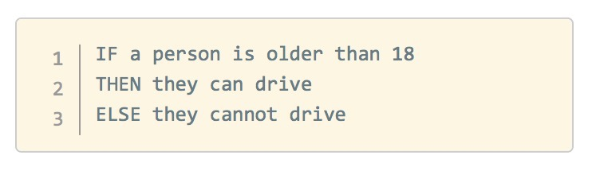
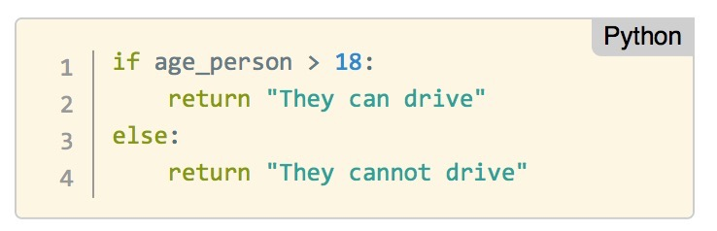
IF
An `if` statement is a conditional structure that, if proved true, performs a function or displays information.
Think of this as a decision that moves the flow of your program depending on the answer to a TRUE-FALSE question.
In pseudocode:
In Python we can write:
Notes:
> Instructor Note: Remind the students about the concepts learnt in the first part of the workshop. Review the first Python code introduced and the types you have covered.
DISCUSSION
1. Start by surveying what students already know or don't know
2. Then state which fundamentals you are going to cover
3. Give a high level overview of what these fundamentals do (e.g. allow programs to store and remember information, etc)
Instructor Note: Start a Jupyter notebook and remind the students how to use it.

Slide 61
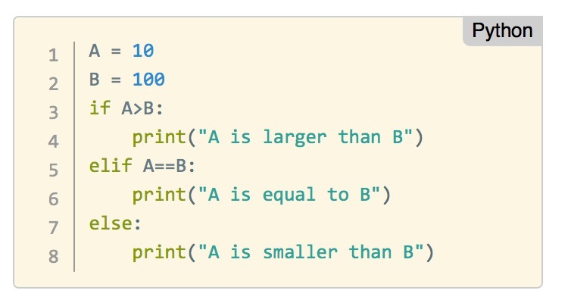
IF
Another example:
Notes:
> Instructor Note: Remind the students about the concepts learnt in the first part of the workshop. Review the first Python code introduced and the types you have covered.
DISCUSSION
1. Start by surveying what students already know or don't know
2. Then state which fundamentals you are going to cover
3. Give a high level overview of what these fundamentals do (e.g. allow programs to store and remember information, etc)
Instructor Note: Start a Jupyter notebook and remind the students how to use it.

Slide 62
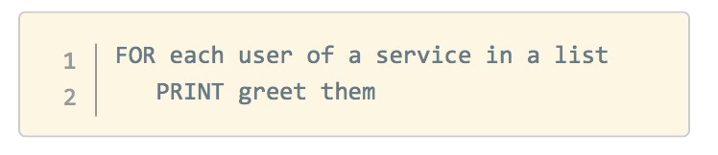
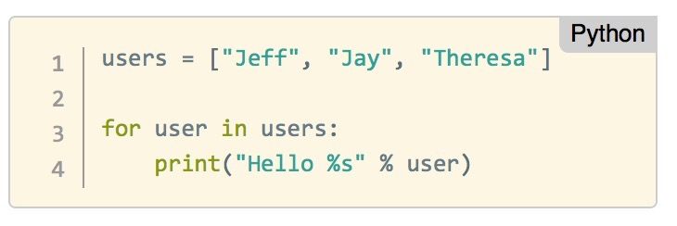
FOR LOOP
A loop statement in programming performs a predefined set of instructions or tasks while or until a predetermined condition is met.
Think of this as a repetitive action that has to be performed until further notice.
In pseudocode:
In Python we can write:
Notes:
> Instructor Note: Remind the students about the concepts learnt in the first part of the workshop. Review the first Python code introduced and the types you have covered.
DISCUSSION
1. Start by surveying what students already know or don't know
2. Then state which fundamentals you are going to cover
3. Give a high level overview of what these fundamentals do (e.g. allow programs to store and remember information, etc)
Instructor Note: Start a Jupyter notebook and remind the students how to use it.

Slide 63
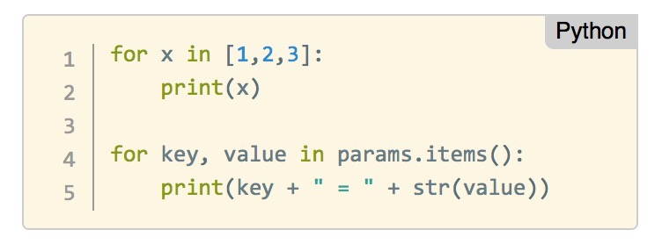
FOR LOOP
Tip: When creating a for loop, make sure it's condition will always be met to help prevent an endless loop!
Let us see other examples. Can you explain what the program is doing?
Notes:
> Instructor Note: Remind the students about the concepts learnt in the first part of the workshop. Review the first Python code introduced and the types you have covered.
DISCUSSION
1. Start by surveying what students already know or don't know
2. Then state which fundamentals you are going to cover
3. Give a high level overview of what these fundamentals do (e.g. allow programs to store and remember information, etc)
Instructor Note: Start a Jupyter notebook and remind the students how to use it.

Slide 64
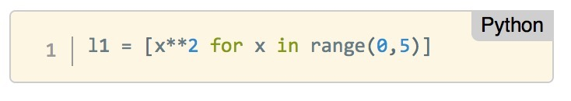
LIST COMPREHENSION
List comprehension is an elegant way to define and create list in Python. It uses a for loop inside the definition of the list itself.
Let’s take a look at one, and see if you can figure out what is happening:
Notes:
> Instructor Note: Remind the students about the concepts learnt in the first part of the workshop. Review the first Python code introduced and the types you have covered.
DISCUSSION
1. Start by surveying what students already know or don't know
2. Then state which fundamentals you are going to cover
3. Give a high level overview of what these fundamentals do (e.g. allow programs to store and remember information, etc)
Instructor Note: Start a Jupyter notebook and remind the students how to use it.

Slide 65
FUNCTIONS
A function is a group of instructions used by programming languages to return a single result or a set of results.
Functions are a convenient way to divide our code into useful blocks, providing us with order, making the code more readable and reusable.
Notes:
> Instructor Note: Remind the students about the concepts learnt in the first part of the workshop. Review the first Python code introduced and the types you have covered.
DISCUSSION
1. Start by surveying what students already know or don't know
2. Then state which fundamentals you are going to cover
3. Give a high level overview of what these fundamentals do (e.g. allow programs to store and remember information, etc)
Instructor Note: Start a Jupyter notebook and remind the students how to use it.

Slide 66
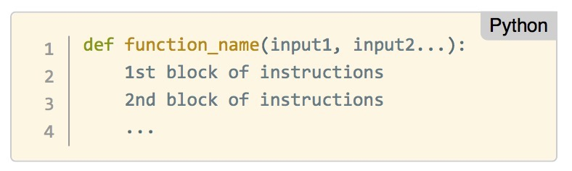
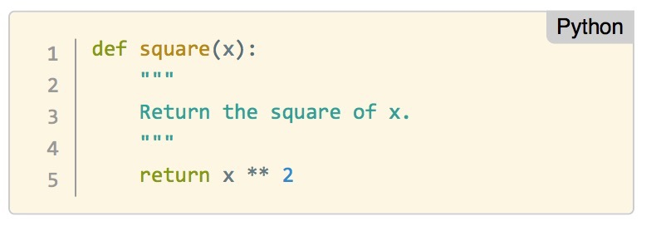
FUNCTIONS
Here is how you define a function in Python:
Let’s define a function that returns the square of the input value:
Notes:
> Instructor Note: Remind the students about the concepts learnt in the first part of the workshop. Review the first Python code introduced and the types you have covered.
DISCUSSION
1. Start by surveying what students already know or don't know
2. Then state which fundamentals you are going to cover
3. Give a high level overview of what these fundamentals do (e.g. allow programs to store and remember information, etc)
Instructor Note: Start a Jupyter notebook and remind the students how to use it.

Slide 67
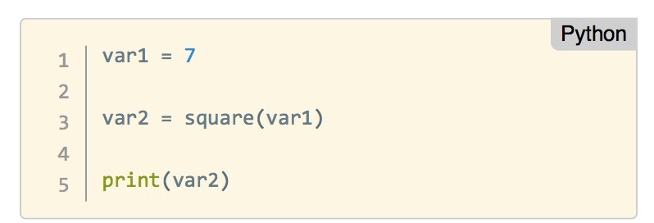
FUNCTIONS
We can call this function as follows:
Notes:
> Instructor Note: Remind the students about the concepts learnt in the first part of the workshop. Review the first Python code introduced and the types you have covered.
DISCUSSION
1. Start by surveying what students already know or don't know
2. Then state which fundamentals you are going to cover
3. Give a high level overview of what these fundamentals do (e.g. allow programs to store and remember information, etc)
Instructor Note: Start a Jupyter notebook and remind the students how to use it.

Slide 68
DEMO
WRITING PROGRAMS IN PYTHON
Notes:
Instructor Note: This demo is intended to show the students some of the visualization capabilities of Python.
The code in the file Python101Demo_Plotly.ipynb may be more intricate than you may want the students to grasp on their own. We suggest giving the students a copy of the complete notebook above and run through the code with them in class.
Make sure the students understand that this is a demo and that some of the instructions in the demo will become clearer as the lesson progresses. It will also give them an opportunity to continue their learning process.
DISCUSSION
Start by asking the students about the importance of visualizing data: when is it needed? what does it add? what tools do they tend to use in their daily work (if any)?
Instructor Note: Start a Jupyter notebook and remind the students how to use it.

Slide 69
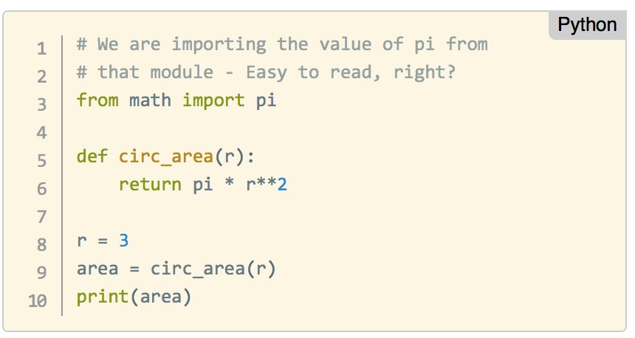
WRITING PROGRAMS IN PYTHON
Python is an interpreted language, which means you can run the program as soon as you make changes to the file.
This makes iterating, revising, and troubleshooting programs is much quicker than many other languages.
Let us create a complete program that will calculate the area circle with radius r.
Notes:
Instructor Note: Show the students how to put together a program in Python.
Instructor Note: Walk the students through translating the first pseudocode problem from Part 1 - Independent Practice. Then encourage the students to write Python code for the other two exercises from Part 1 - Independent Practice.

Slide 70
ACTIVITY: WRITE YOUR OWN CODE!
DIRECTIONS
Translate the your pseudocode into Python code!
  Create a short script that will calculate the area circle with radius r.
  Calculate and print the square of a number. If the number is larger than 10 also calculate the cube.
  List the letters in the sentence "Python is awesome"
DELIVERABLE
Python code that executes the tasks above
Notes:
Ask them to write out pseudocode to attempt to answer these problems.
Share out (15m)
ASK: What are some topics people are interested in?
Instructor will facilitate a discussion around topics, may want to write them on the whiteboard.
Note: This is a great opportunity to nudge students away from some topics that may be too broad in scope, or too unsubstantial a topic.

Slide 71
GUIDED PRACTISE
LET'S EXPLORE SOME DATA
Notes:
Introduction to Pandas – a powerful package for data manipulation and analysis.

Slide 72
INSTRUCTIONS
Let’s open a new Jupyter notebook for this practice.
We will work in pairs.
Save the file called Python101_Part2_GuidedPractice.ipynb in a known location in your file system
Start Jupyter (you know how now) and navigate to the location where you saved the file
Open the file by clicking on the name
Voilà, you can start the Guided Practice
Notes:
Instructor Note:
Use the Jupyter notebook: Python101Part2GuidedPractice.ipynb
IDE suggestion
We encourage you to use a Jupyter notebook. It makes it easier to keep the class together as students will be using a common IDE.
Activity
We suggest making the code below available to the students and get them to work in pairs going through the code in the notebook

Slide 73
INDEPENDENT PRACTISE
YOUR TURN!

Slide 74
OPTION 1
Let’s open a Jupyter notebook for this practice.
Save the file called Python101_Part2_IndPractice.ipynb in a known location in your file system
Start Jupyter (you know how now) and navigate to the location where you saved the file
Open the file by clicking on the name
Voilà, you can start the Independent Practice
Notes:
In option 1, you can use the Iris Dataset notebook included in the materials to follow up the introduction to pandas in the previous section. N
Note that the notebook makes reference to the Iris Dataset included here.
This activity lets the students to see the practical applications of python.

Slide 75
PYTHON PROGRAMMING 101
CONCLUSION
Notes:
Instructor Note: This demo is intended to show the students some of the visualization capabilities of Python.
The code in the file Python101Demo_Plotly.ipynb may be more intricate than you may want the students to grasp on their own. We suggest giving the students a copy of the complete notebook above and run through the code with them in class.
Make sure the students understand that this is a demo and that some of the instructions in the demo will become clearer as the lesson progresses. It will also give them an opportunity to continue their learning process.
DISCUSSION
Start by asking the students about the importance of visualizing data: when is it needed? what does it add? what tools do they tend to use in their daily work (if any)?
Instructor Note: Start a Jupyter notebook and remind the students how to use it.

Slide 76
REVIEW & RECAP
In this workshop, we've covered the following topics:
  Python as a popular, flexible programming language
  Python has applications in many different areas
  Python is particularly great for data manipulation
  Python programming basics include: types, variables, functions, and more!
Notes:
Instructor Note: Review Topics Covered
Gather some thoughts from the class answering the question above. After a quick discussion, restate learning objectives and describe how we met them.

Slide 77
TAKEAWAYS
LEARNING PLAN
Evaluate your python programming skills! How confident are you with:
    Python Syntax
    Programming Fundamentals
    Data Analysis

Slide 78
TAKEAWAYS
WHAT SHOULD YOU DO NEXT?
For beginner programmers:
Familiarise yourself with the language with an Introduction to Python
Go through Learn Python the hard way
And Automate the boring stuff
►
►
►

Slide 79
TAKEAWAYS
WHAT SHOULD YOU DO NEXT?
For existing programmers who are new to Python, try these:
    Read the information in Moving to Python from other languages
    Python for Java Developers
    Python for MATLAB users

Slide 80
TAKEAWAYS
WANT MORE?
General Assembly offers courses that use Python!
Check out our:
    Part-time Data Science Course
    Data Science Immersive Course

Slide 81
PYTHON PROGRAMMING 101
Q&A
Notes:
Instructor Note: This demo is intended to show the students some of the visualization capabilities of Python.
The code in the file Python101Demo_Plotly.ipynb may be more intricate than you may want the students to grasp on their own. We suggest giving the students a copy of the complete notebook above and run through the code with them in class.
Make sure the students understand that this is a demo and that some of the instructions in the demo will become clearer as the lesson progresses. It will also give them an opportunity to continue their learning process.
DISCUSSION
Start by asking the students about the importance of visualizing data: when is it needed? what does it add? what tools do they tend to use in their daily work (if any)?
Instructor Note: Start a Jupyter notebook and remind the students how to use it.

Slide 82
PYTHON PROGRAMMING 101
EXIT TICKETS
DON’T FORGET TO FILL OUT YOUR EXIT TICKET
Notes:
Instructor Note: This demo is intended to show the students some of the visualization capabilities of Python.
The code in the file Python101Demo_Plotly.ipynb may be more intricate than you may want the students to grasp on their own. We suggest giving the students a copy of the complete notebook above and run through the code with them in class.
Make sure the students understand that this is a demo and that some of the instructions in the demo will become clearer as the lesson progresses. It will also give them an opportunity to continue their learning process.
DISCUSSION
Start by asking the students about the importance of visualizing data: when is it needed? what does it add? what tools do they tend to use in their daily work (if any)?
Instructor Note: Start a Jupyter notebook and remind the students how to use it.

