Slide 1




IMPACTREPORTER
CAToolbox
RapidPDSA
DATARequestor

Slide 2



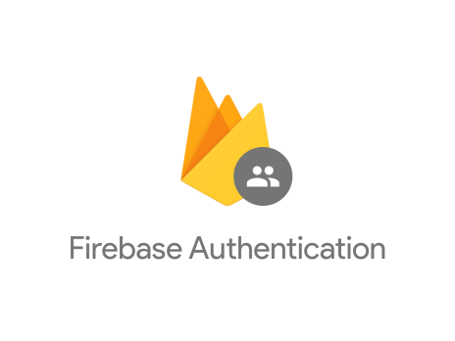
App Services
Cloud Services
Data Sources

Slide 4



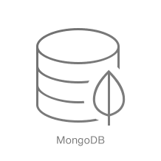




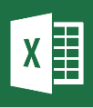




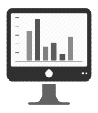


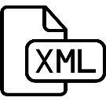

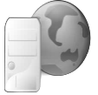

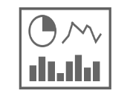



Deliver
Organize and Analyze
Acquire
Cloud Storage
Database
Blob Storage
Raw Data
(for use in other tools)
Other Internal Flat Files
Applications
Data Wrangling
& Cleaning
External Public Data
Tableau Dashboards
Tableau Server
External Partner Data
Tableau Desktop
Tableau Web Connector

