Slide 1
Artificial Intelligence for Health Metricians, Week 6: Extended Linear Models
Abraham D Flaxman
Feb 9, 2015

Slide 2
Any questions?

Slide 3

Special Room again today – WRF eSci

Slide 4
Implementations: Real ML Schemes
We’ve got some more fun stuff this week, extended linear models:
Lasso,
Ridge,
Elastic-Nets,
Support Vector Machines.
Notes:
Starting with decision trees. DM focuses on pruning methods, while ISL focuses on ensembles of trees. I’m saving ensembles for later, so the focus here is on trees, greedy construction, and pruning

Slide 5
Before, during, and after this week
Before this week: Read DM 6.4, ISL 9, do 10+10
During classes: Work with SVMs and other extended linear models, learn the “kernel trick”. Workshop ideas for class projects.
Outside of classes:
Catch up on reading, finish Extended Linear Model exercise, do data prep for class project.

Slide 6
Data Prep for Class Project
Identify and obtain the dataset(s) necessary to your 10+10-selected research question
Clean the data
Shape it into the appropriate format for machine learning (i.e. features vectors and labels for a supervised learning project).
The results will be an annotated IPython notebook describing data and prep process.

Slide 7
Lecture 6 Outline
Homework solutions
Extended Linear Models
Exercise 6: SVMs and Friends

Slide 8
Any (more) questions?

Slide 9
Lecture 6 Outline
Homework solutions
Extended Linear Models
Exercise 6: SVMs and Friends

Slide 10
Lecture 6 Outline
Homework solutions
Extended Linear Models
Exercise 6: SVMs and Friends

Slide 11
Extended Linear Models
Three things I want you to know:
Penalty functions
Loss functions
The Kernel Trick

Slide 12
Extended Linear Models
Three things I want you to know:
Penalty functions
Loss functions
The Kernel Trick

Slide 13
Linear Regression

Slide 14
Ridge Regression

Slide 15
Lasso Regression

Slide 16
Elastic Nets

Slide 17
Extended Linear Models
Three things I want you to know:
Penalty functions
Loss functions
The Kernel Trick

Slide 18
What loss function Have we been using?

Slide 19
0-1 Loss Function

Slide 20
Logistic Regression Loss Function

Slide 21
Hinge Loss Function

Slide 22
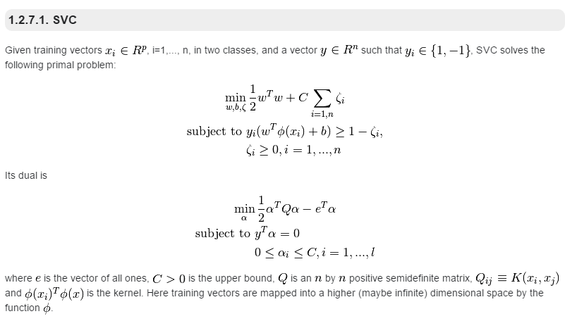
Support Vector Machines
Notes:
http://scikit-learn.org/stable/modules/svm.html#mathematical-formulation

Slide 23
Extended Linear Models
Three things I want you to know:
Penalty functions
Loss functions
The Kernel Trick

Slide 24
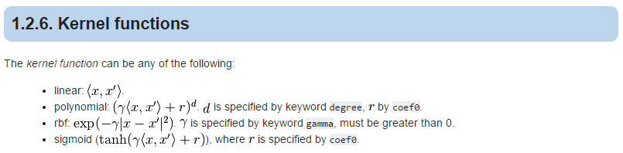
The Kernel Trick

Slide 25
Lecture 6 Outline
Homework solutions
Extended Linear Models
Exercise 6: SVMs and Friends

