Slide 1
Artificial Intelligence for Health Metricians, Week 7: Review and Projects
Abraham D Flaxman
Feb 18, 2015

Slide 2
Any questions?

Slide 3
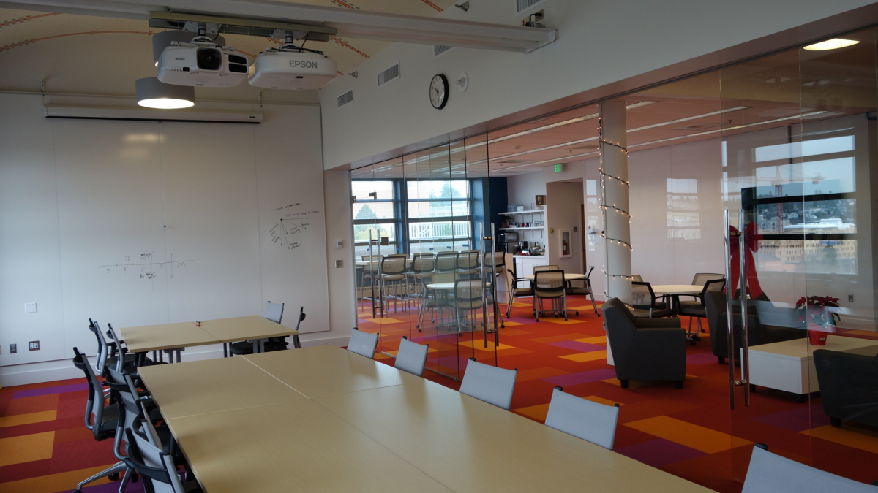
Special Room again Monday – WRF eSci

Slide 4
Projects
Data prepped?
Notes:
Starting with decision trees. DM focuses on pruning methods, while ISL focuses on ensembles of trees. I’m saving ensembles for later, so the focus here is on trees, greedy construction, and pruning

Slide 5
Data Prep for Class Project
Identify and obtain the dataset(s) necessary to your 10+10-selected research question
Clean the data
Shape it into the appropriate format for machine learning (i.e. features vectors and labels for a supervised learning project).
The results will be an annotated IPython notebook describing data and prep process.

Slide 6
Before, during, and after this week
Before this week: Catch up on reading, “complete” data prep
During class: Think through a prediction challenge designed to incorporate a few pitfalls, and also to reward application of sophisticated techniques.
Outside of classes:
Read (DM 6.8, ISL 10), finish Feature Engineering exercise, implement and evaluate baseline model for class project.

Slide 7
Lecture 7 Outline
Homework solutions
Review / Project / Baseline Model / Feature Engineering
Exercise 7: Feature Engineering I

Slide 8
Any (more) questions?

Slide 9
Lecture 7 Outline
Homework solutions
Review / Project / Baseline Model / Feature Engineering
Exercise 7: Feature Engineering I

Slide 10
Lecture 7 Outline
Homework solutions
Review / Project / Baseline Model / Feature Engineering
Exercise 7: Feature Engineering I

Slide 11
A Few Useful Things to Know
“At the end of the day, some machine learning projects succeed and some fail. What makes the difference? Easily the most important factor is the features used.”
---Pedro Domingos
(From “A Few Useful Things to Know about Machine Learning”, http://homes.cs.washington.edu/~pedrod/papers/cacm12.pdf )

Slide 12
Lecture 7 Outline
Homework solutions
Review / Project / Baseline Model / Feature Engineering
Exercise 7: Feature Engineering I

